Slide 1
Democracy Bootcamp at the PDTCA
Session 1: Facilitating Effective Discussions
8:45 to 9:25

Slide 2
Introducing PoliTalks
PoliTalks supports educators in building discussion-friendly classrooms.
It provides resources and activities designed to build the knowledge, attitudes, and skills students need to engage in constructive discussion
...

Slide 3
Here to Support Teachers
Bringing an intentional and structured approach to classroom discussion
Some new ideas, and some new ways of presenting familiar ones
Here to make classroom discussions easier!

Slide 4
Resources
Suite of resources on the learning themes (lesson plans, slide decks, videos, activities)
Learning Themes
Pluralism and Perspectives
People and Biases
Platforms and the Attention Economy
Political Discourse
Online Engagement
politalks.ca

Slide 5
Defining Terms
What is a constructive discussion?
Prioritizes understanding over resolution - we don’t have to agree
Not a debate - take “winning” off the table
Learning about others’ perspectives and gaining a deeper understanding of an issue

Slide 6
Politics in the Classroom
There’s lots happening in the world that students want to discuss, but it’s not always easy to know how to address controversial issues
Teachers can feel apprehensive about discussing politics in the classroom
Real benefits to bringing political issues into the classroom and providing an opportunity for students to develop discussion skills

Slide 7
How comfortable do you think teachers are discussing politics in the classroom?
ⓘ Start presenting to display the poll results on this slide.

Slide 8
Benefits of Classroom Discussion
Students who participate in discussions of controversial political issues in classes:
Are more engaged in the class
Become more confident in their ability to participate in discussions
Demonstrate increased political knowledge
Express more interest in politics
Follow the news more regularly
Are more likely to engage in political discussions with those who have different ideologies
Are more interested in listening to different opinions

Slide 9
Embracing Structure
Takes the guesswork out of discussion
Facilitates inclusive participation
De-centres the teacher and gives students more agency
Supports the development of skills that can be applied in more spontaneous discussions

Slide 10
Discussion Guide
Guiding Principles
Creating a Discussion-Friendly Classroom: Norms of Agreement
Preparing for Discussion
Framework for Constructive Disagreement (PLANS)
Troubleshooting
Appendix: Activities and Handouts
Table of Contents image here
Cover image TK

Slide 11
Norms of Agreement for Classroom Discussion
Co-created norms for behaviour related to discussion
Allows students voices heard, to feel invested in processes
Provides agreed-on reference for handling problems when they arise
Should be reviewed regularly and updated as needed

Slide 12
Possible Norms
Respond with curiosity instead of judgement.
Criticize ideas, not individuals.
Give everyone the opportunity to speak.
Avoid making assumptions or generalizations about others.
If you don’t understand something, ask a question.
If someone shares an idea or opinion that helps your own learning, show appreciation.
Everyone has a right to pass.
If you say something that offends someone, apologize, even if the offence was not intended.

Slide 13
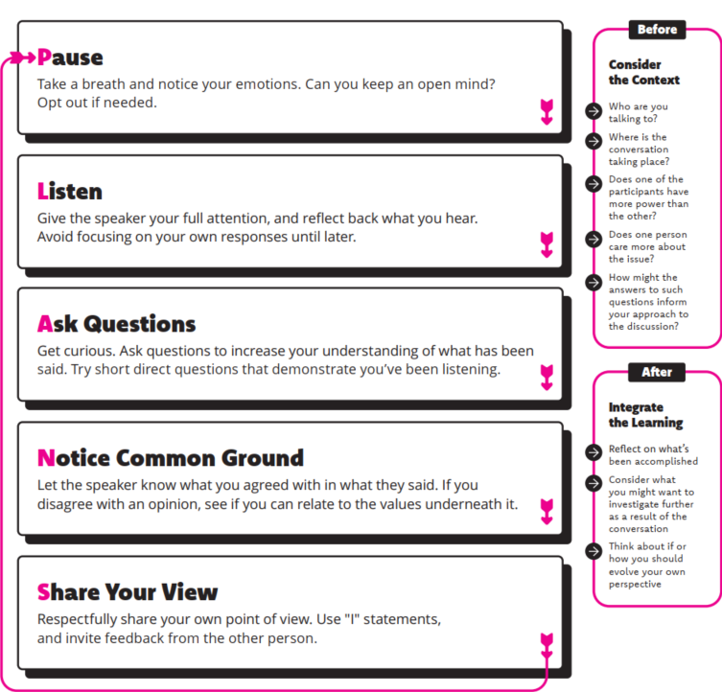
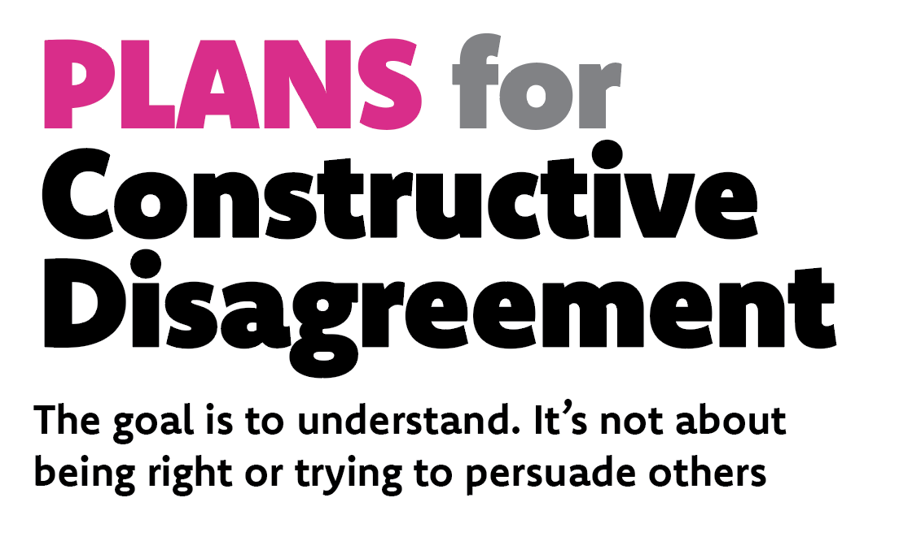

Slide 14
Rank-Order Protocol: Attributes of Classroom Discussion

Slide 15
Rank Order Protocol: Discussion Attributes
Rank the following 5 attributes of classroom discussion from most to least important. Make some short notes to explain your thinking.
Everyone Participates: All students participate actively in the discussion (this can include active listening).
Diversity of Opinions: Multiple viewpoints on a given issue are expressed and defended.
Appropriate Use of Evidence: Students support their opinions with evidence that is relevant and accurate.
Minimal Teacher Involvement: Students lead and direct the vast majority of the discussion, and the instructor only intervenes to facilitate or mediate when necessary.
Respectful Environment: Students follow the rules of classroom etiquette and treat each other with respect at all times.

Slide 16
Rank Order Protocol Activity
Rank discussion attributes from most important (1) to least important (5). Jot down some notes if needed. (4 minutes)
Divide the table into two groups of four.
Assign a timekeeper (person who has been a teacher the longest).
Take turns sharing order and reasoning. Person with the most recent birthday goes first. (2 minutes each — 8 min total)
Discuss and compare — What differences do you notice? What accounts for these differences? Does anyone want to change the order they started with? (3 minutes)

Slide 17
Coming out of your discussion, how did you rank your discussion attributes?
ⓘ Start presenting to display the poll results on this slide.

Slide 18
Debrief
Rank order activities are a great way to get students thinking about complex issues in a low-stakes way
Constructive Discussions contains additional discussion protocols that have been developed by researchers and practitioners

