Slide 1
Democracy Bootcamp at the PDTCA
Session 2: Perspectives & Biases
9:30 to 10:10

Slide 2
Perspectives and Biases
Having constructive discussions requires:
Understanding where your beliefs come from
Taking others’ perspective and getting curious about why they believe what they believe
An openness to new ideas and receptiveness to new information
Recognizing that we’re all prone to making mistakes

Slide 3
Resource Overview: Perspectives
Lesson Themes
Identities and Pluralism
Perspectives and Opinions
Political Ideologies
Underlying Values
...

Slide 4
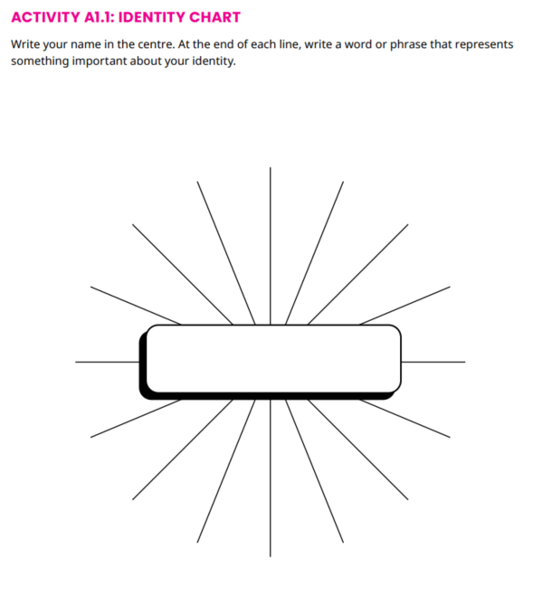
Identities and Pluralism
Analyze the key factors that shape students’ identities
Evaluate the importance of pluralism
Activity: Identity chart and discussion

Slide 5
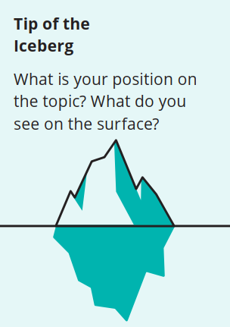
Perspectives and Opinions
Understand how different perspectives can lead to different ways of seeing the world
Get curious about the views of classmates
Iceberg Activity: What Makes Up Your Perspective?
Think-Pair-Share: Comparing Perspectives

Slide 6
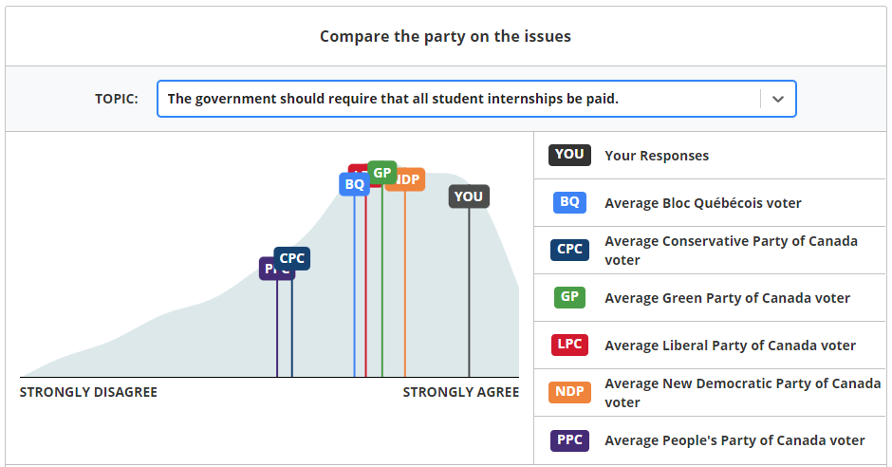
Political Ideologies
Describe different ideologies on the political spectrum
Analyze their current placement on the political spectrum
Activity: Youth Vote Compass
Discussion: Political Perspectives

Slide 7
Underlying Values
Analyze how the values you prioritize influence your views
Take the perspective of someone who prioritizes different values
Reflect on the social values they find most important
Activity and Discussion
Value Cards

Slide 8
Freedom
Equality
Prompt: Uniforms should be mandatory in schools.
Security
Financial Liberty
Sample response - disagree
People should have the freedom to choose to wear what they want
Some traditions encourage people to wear different clothes, especially during celebrations
Security isn’t really important here, so I’ll skip it
Respecting Others
Tradition

Slide 9
Activity: Value Cards
Deal three cards to each player, face up, one on top of the other. The topmost is the most important, middle second most, bottom third most. Read out your cards and definitions.
Read the prompt on screen. Consider: how would someone who prioritized those values respond to the prompt? Each partner takes a turn in explaining their response.
Now deal three new cards. How did your response change based on your new values?
Prompt: 5 minutes
“The government needs to do more to reduce the gap between rich and poor.”

Slide 10
Take a look through all the value cards. Which do you think play the biggest role in shaping your own perspectives?
ⓘ Start presenting to display the poll results on this slide.

Slide 11
Accessing Resources - politalks.ca

Slide 12
Upcoming Resource Overview: Cognitive Biases
Lesson Themes
Biased Thinking
Confirmation Bias
In-Group/Out-Group Bias
...

Slide 13
Biased Thinking
Understand the role of cognitive biases in shaping how we receive and process information
Recognize that we all have biases, and don’t have the objectively correct view on everything
Recognize that it’s easier to see biases in others than it is to see in ourselves
Activity: Bias Blind Spot
Come on in, the water’s fine!

Slide 14
Confirmation Bias
Confirmation Bias: Our tendency to seek out and interpret information in a way that confirms what we already believe
Analyze the impact of confirmation bias on information- seeking behaviour
Reflect on ways to mitigate the effects of confirmation bias

Slide 15
In-Group Bias
In-Group Bias: Our tendency to give preferential treatment to those who are members of our groups.
Understand in-group bias, and identify instances where it occurs
Recognize how in-group bias can create divisions and polarization

Slide 16
Activity: Biased Searches
The terms you use to search for information impacts which results you see
Our searches can be influenced by confirmation bias - we look for information in ways that confirm what we already believe
Search: “Video games are bad for you”
Search: “Video games are good for you”

Slide 17
Activity: Biased Searches
Get into pairs. One person will be positive, the other negative.
Search for your terms and compare results. What did you find?
Both do a neutral search. How were the results different?
Round | Positive | Negative | Neutral
1 | TikTok good for mental health | TikTok bad for mental health | TikTok mental health
2 | Justin Trudeau achievements | Justin Trudeau failures | Justin Trudeau policies
3 | Bitcoin is a good investment | Bitcoin is a bad investment | Bitcoin investment

