Slide 1


Democracy Bootcamp at the PDTCA
Session 3:
Discussing Controversial Issues
10:20 to 11:35 am

Slide 2

What is a Controversial Issue?
An authentic topic that is likely to give rise to multiple and competing answers (Diana Hess, Controversy in the Classroom)
Controversial political issues relate to matters of public policy (i.e. questions about how we should live together as a public)
Any issue can be controversial — and you can use less charged, lower stakes issues to build the skills and habits of constructive discussion

Slide 3
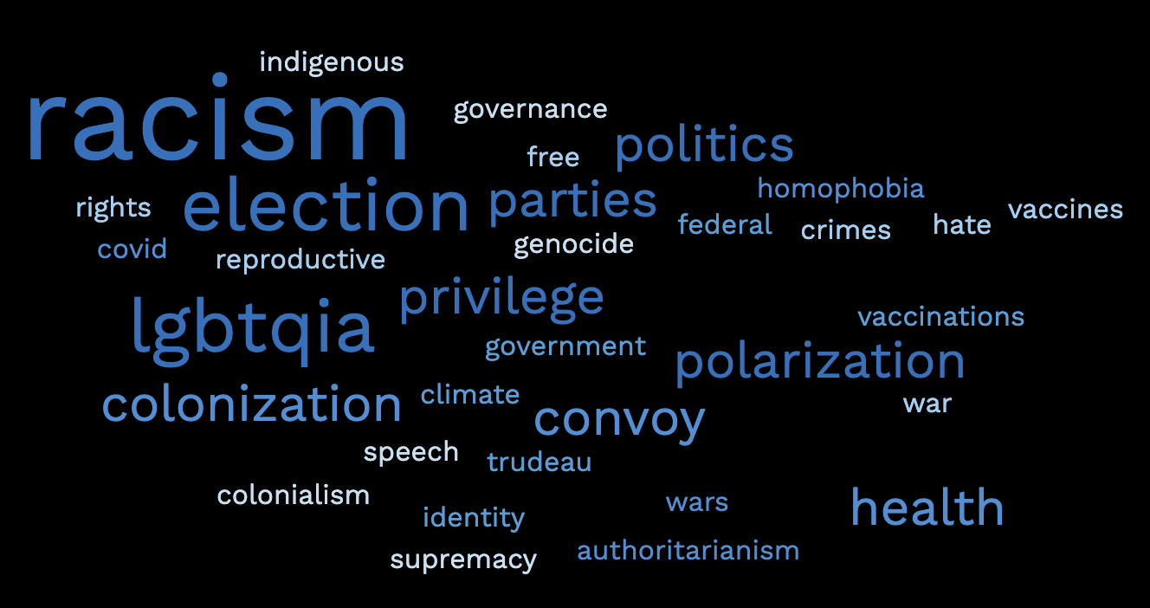
What’s a controversial issue you might want to discuss in your class?

Slide 4
Choosing a Topic
Choose an open topic — one that is currently a matter of live dispute
  i.e.”Should voting be mandatory?” (open) vs. “Should women have the right to vote?” (settled)
Choose a topic that relates directly to your curriculum
Reflect on what topics are appropriate for your students and your classroom dynamics
Once you’ve chosen a topic, narrow it into a specific issue for discussion
  i.e “What role should the government play (if any) in reducing carbon emissions?” (narrow) vs. “What should we do about climate change?” (too broad)

Slide 5
Preparing for Discussion
Choose a discussion protocol to create structure and foster inclusive participation
Assign pre-reading or schedule the discussion for the end of a unit to ensure that the discussion is informed
Communicate learning goals and expectations to students
Review class norms before beginning the discussion

Slide 6
Practice Protocol: Structured Academic Controversy
Consider using the SAC protocol when you want students to:
Discuss a controversial issue with two clear sides
Develop deep, nuanced understanding of a complex issue
Practice active listening
Emphasize reflection and consensus-building rather than debate

Slide 7
Protocol: Structured Academic Controversy
Discussion Prompt:
Teachers should not share their political views with their students.

Slide 8
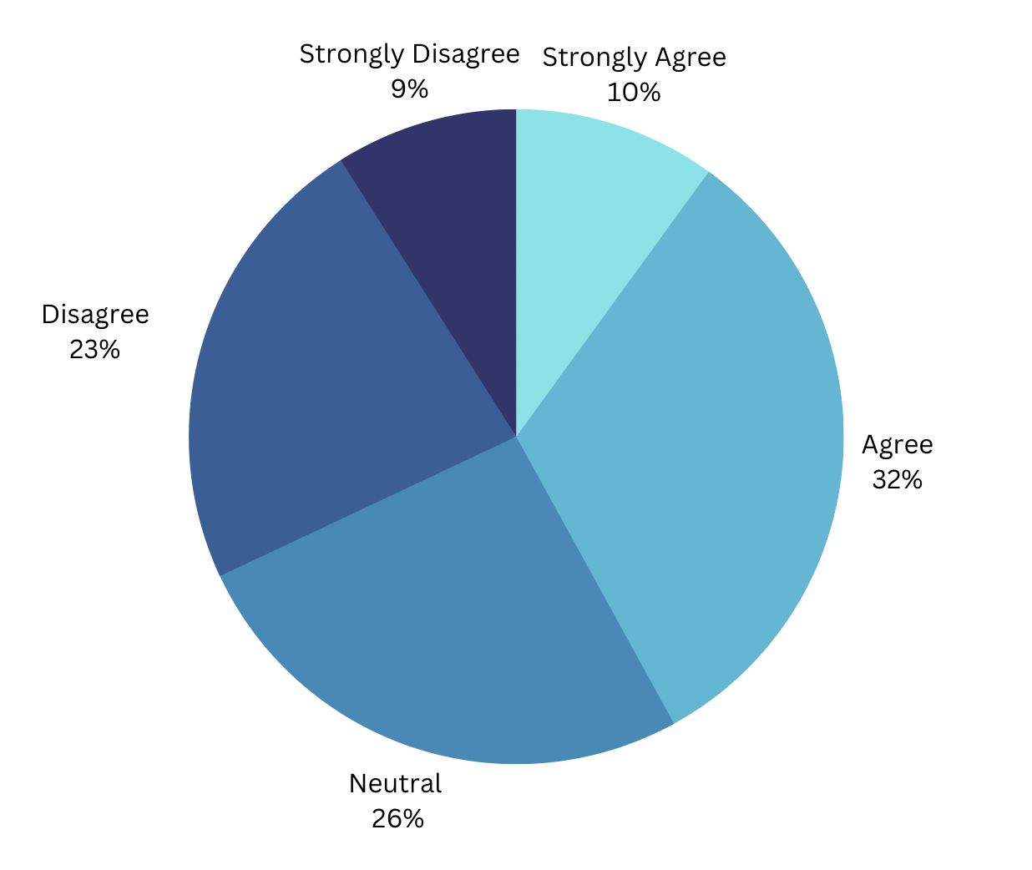
Teachers should not disclose their personal beliefs/opinions in the classroom

Slide 9
Protocol: Structured Academic Controversy
Split into 2 groups of 4. Decide which group will agree with the prompt and which will disagree.
You don’t have to agree personally with the position you are assigned. Your goal is just to determine the best arguments or evidence for your side.
Assign a timekeeper (person who went to bed the latest last night)
Identify the best 3 arguments in support of your assigned position. Prepare a short presentation to make the case for your side of the issue. (5 mins)
The “Agree” side presents their arguments while the “Disagree” side listens and takes notes. No interruption is allowed. (3 mins)

Slide 10
Protocol: Structured Academic Controversy
The “Disagree” side restates the “Agree” side’s positions and asks clarifying questions. These questions should seek to build understanding of the position (2 min).
The “Disagree” side presents their arguments while the “Agree” side listens and takes notes. No interruption is allowed (3 mins).
The “Agree” side restates the “Disagree” side’s positions and asks clarifying questions. These questions should seek to build understanding of the position (2 min).
Come together to see if you can find common ground. You no longer have to argue the position you were assigned (5 mins).
  Identify the strongest and weakest arguments of both sides.
  If you are unable to come to any agreement, explain the fundamental differences between the positions.

Slide 11


Group Debrief
What were some of the main points in favor or against that your group discussed?
Do any of you see the issue in a different way? Will you do anything different in class moving forward?

Slide 12

Quick Stretch
Starting again right at 11:00

Slide 13
Challenges in Classroom Discussion
By their nature, discussions are unpredictable
Even with careful planning and preparation a discussion can sometimes go in directions that you may not have anticipated

Slide 14
How do we address the problem?
How do we respond in ways that address any harm?
How do we manage our own reactions?

Slide 15
Dilemma Dialogue Protocol
Purpose: To address a problem by surfacing the nuance of a situation, before reaching conclusions
Discussion: Each table will discuss a scenario in which a student makes a problematic comment
Output: Together we will come up with a list of guidelines for addressing these and similar scenarios

Slide 16
Instructions
Assign a timekeeper and a group note-taker
Read the dilemma scenario provided. Take a few minutes to individually jot down any initial thoughts and questions you have about the prompt. (3 minutes)
Take turns responding to the prompt: each group member takes 1 minute (max) to briefly share their initial thoughts. (4 minutes)
Explore the scenario as a group, focusing on understanding the situation and factors at play. Discuss what actions a teacher could take: in the moment, after class is over, and before the next problem arises. (8 minutes)
Have the group note-taker write down your group’s ideas on the Dilemma Dialogue Brainstorming sheet
Total Time: 15 minutes

Slide 17
SCENARIO
During a group discussion on the underrepresentation of women in the tech industry, a male student comments that women have no place in the workforce, and that they belong at home, taking care of their husbands. At first it seems like parody of bygone values, but the student seems serious. Further inquiry reveals he’s been watching videos of Andrew Tate — a violent and misogynistic influencer whose videos were viewed 11.6 billion times before he was banned from TikTok. The student adds there’s “nothing wrong with being sexist.” A female student yells that he doesn’t know what he’s talking about, and the class becomes chaotic.

Slide 18
Consolidation
Thoughts about the scenario?
Brainstorming approaches - what could a
teacher do:
  In the moment
  After class is over
  Before the next time

