Slide 1
Digital Platforms & Verification Skills

Slide 2
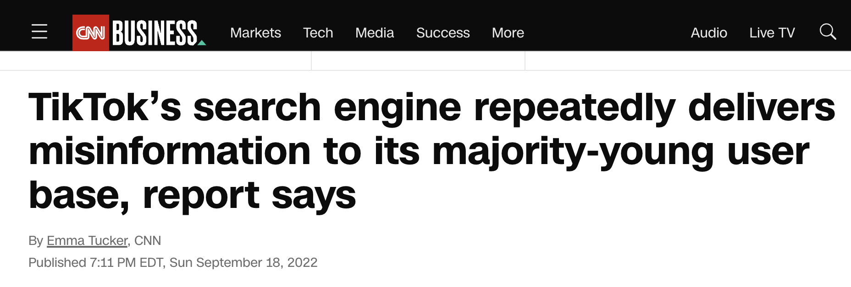
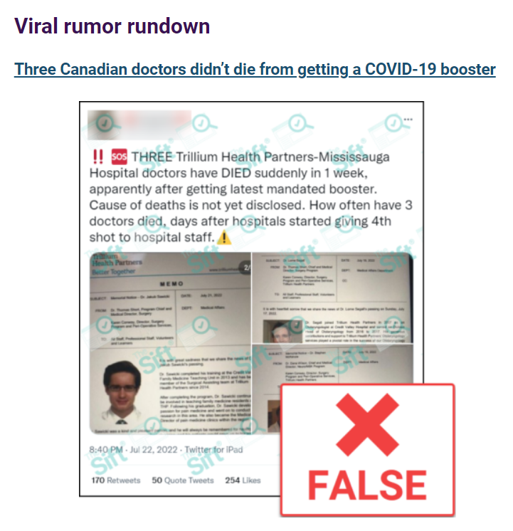
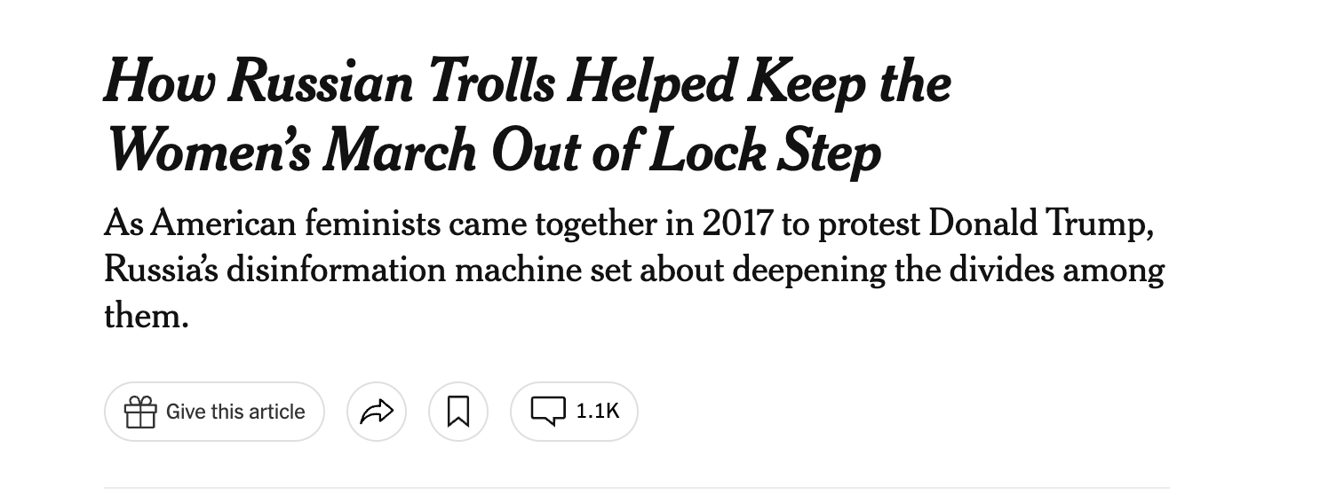

Slide 3
Informed Citizenship
How do we evaluate the information that we see and hear?

Slide 4
Encourages students to:
Understand the importance of being an informed citizen
Care about what is true or credible
Habitually evaluate sources and claims
Seek out information from reliable sources

Slide 5
Examples page: ctrl-f.ca/en/PDTCA

Slide 6
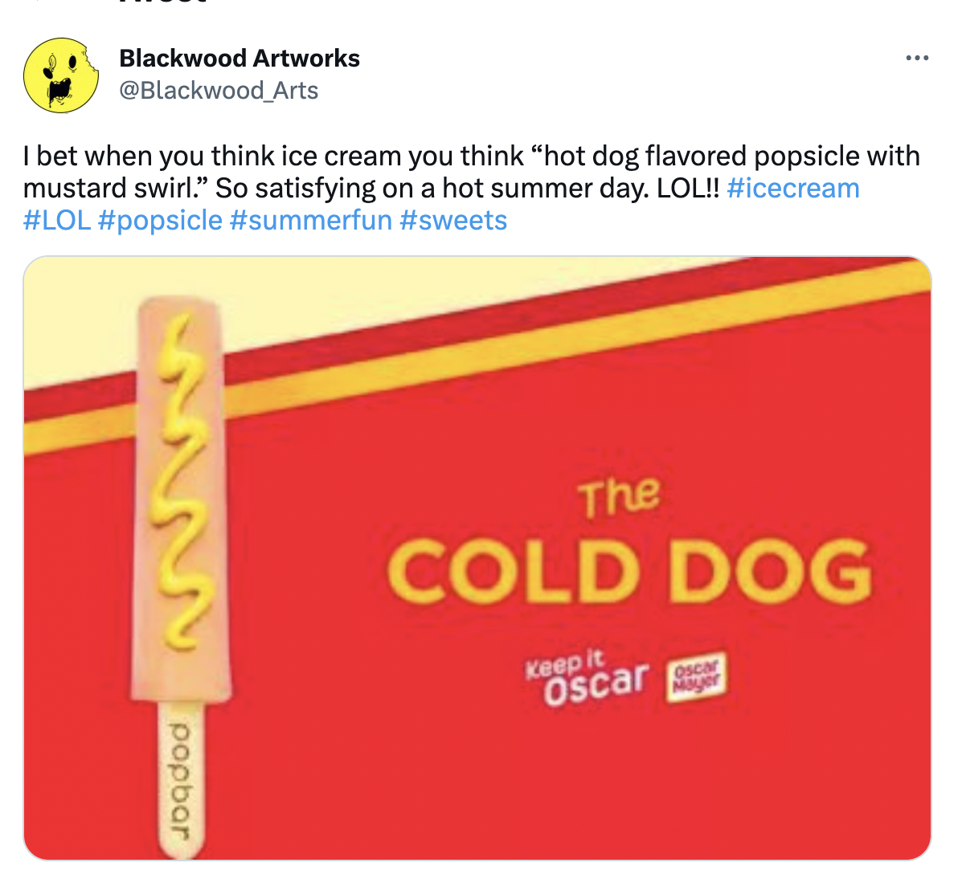
Are These Real?
Both fake?
Both real?
One real one fake?

Slide 8
‘Vertical’ vs. ‘Lateral’ Reading
vs.

Slide 9
Three key lateral reading skills
Investigate the Source
Who made the information? What is their reputation?
Check the Claim
Are known credible sources saying the same thing?
Trace the Information
Has this information changed in the re-telling?
Evidence-based
ctrl-f.ca

Slide 10
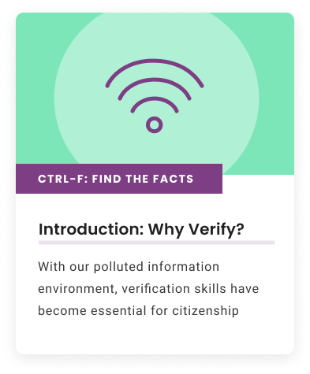
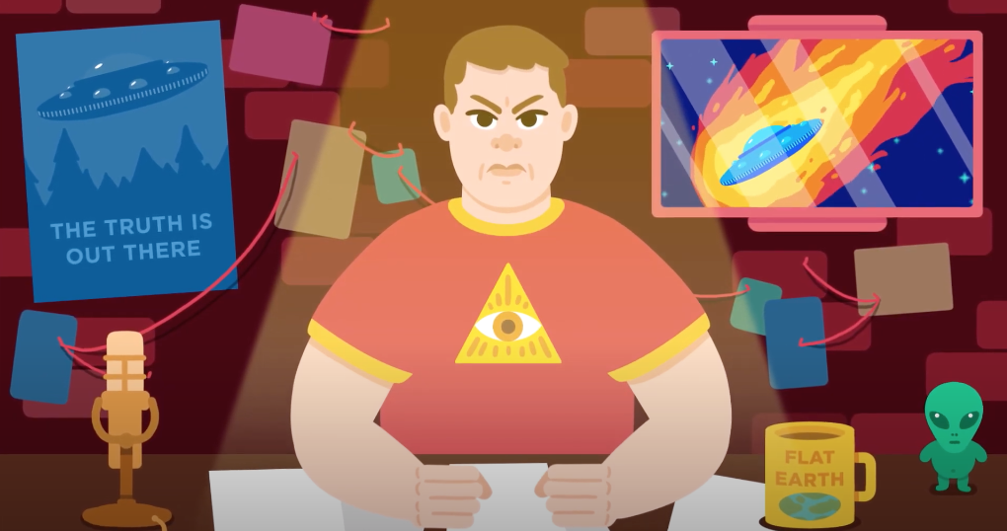
CTRL-F: Why Verify?
What is information pollution? How does false and misleading information spread online?

Slide 11
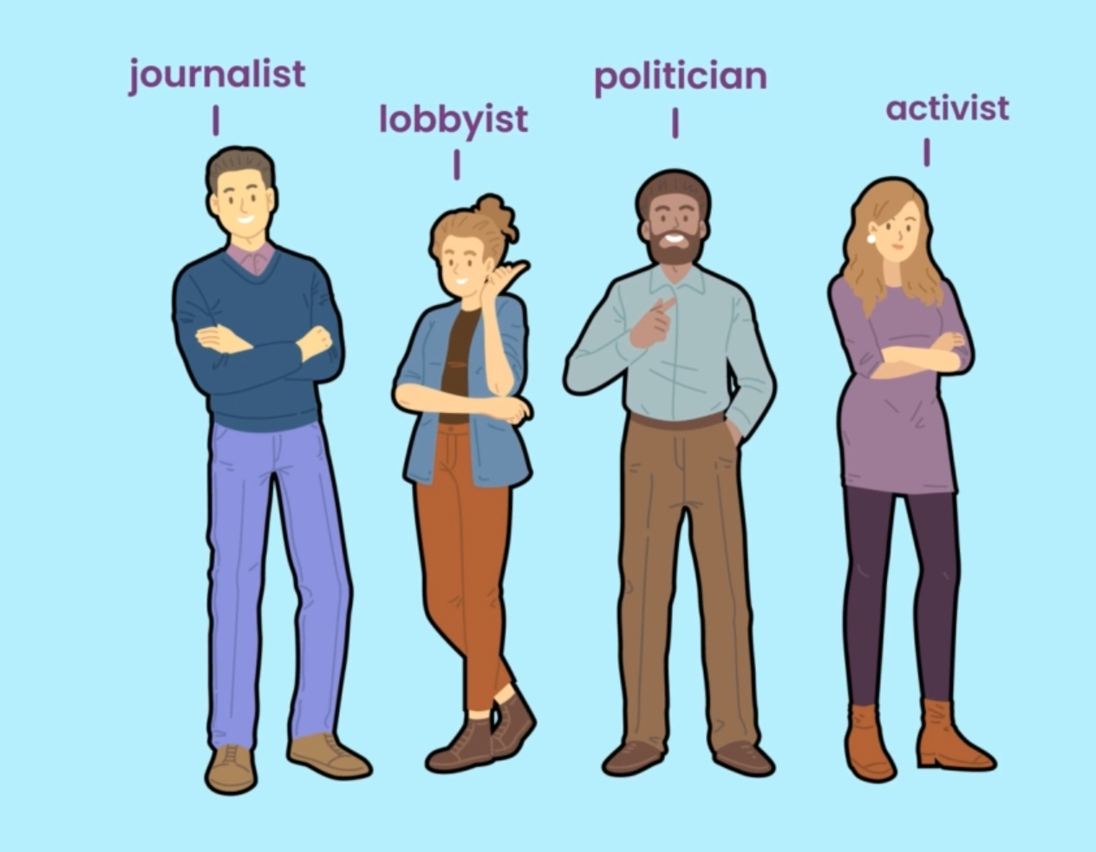
Investigate the Source
Who made the information?
What is the reputation of the source?

Slide 12
Demo: Just Add Wikipedia
ctrl-f.ca/en/PDTCA

Slide 13
Just Add Wikipedia

Slide 14
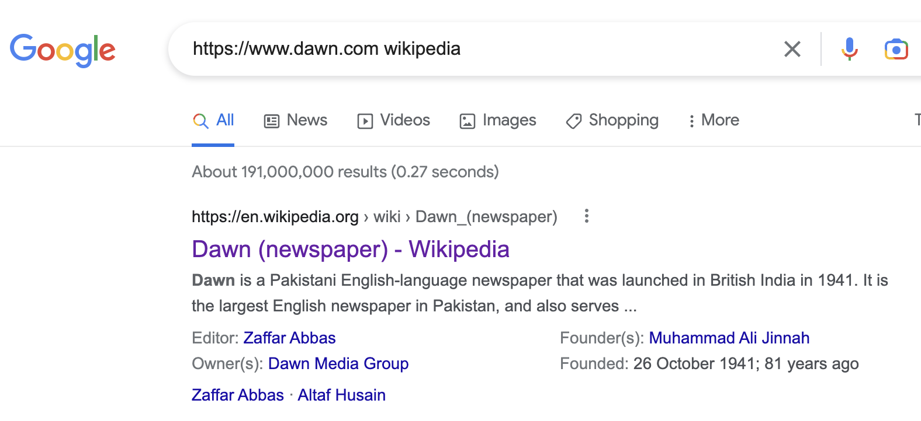
Just Add Wikipedia

Slide 15
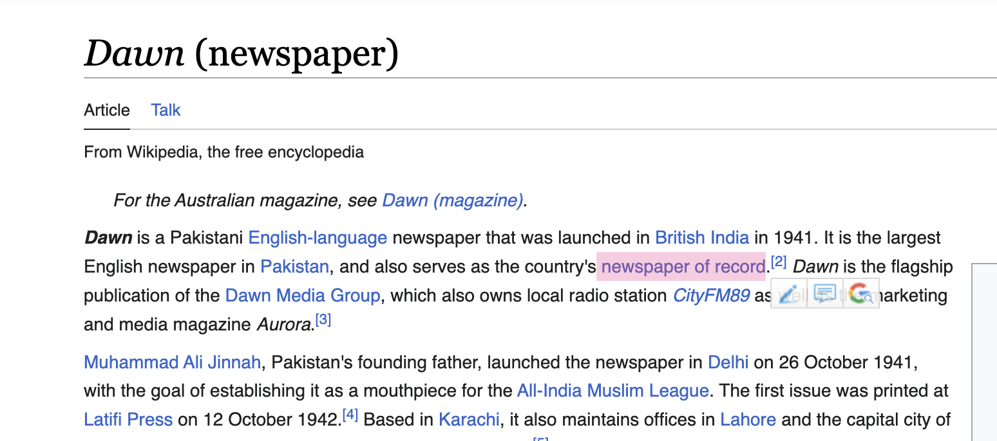
Just Add Wikipedia

Slide 16
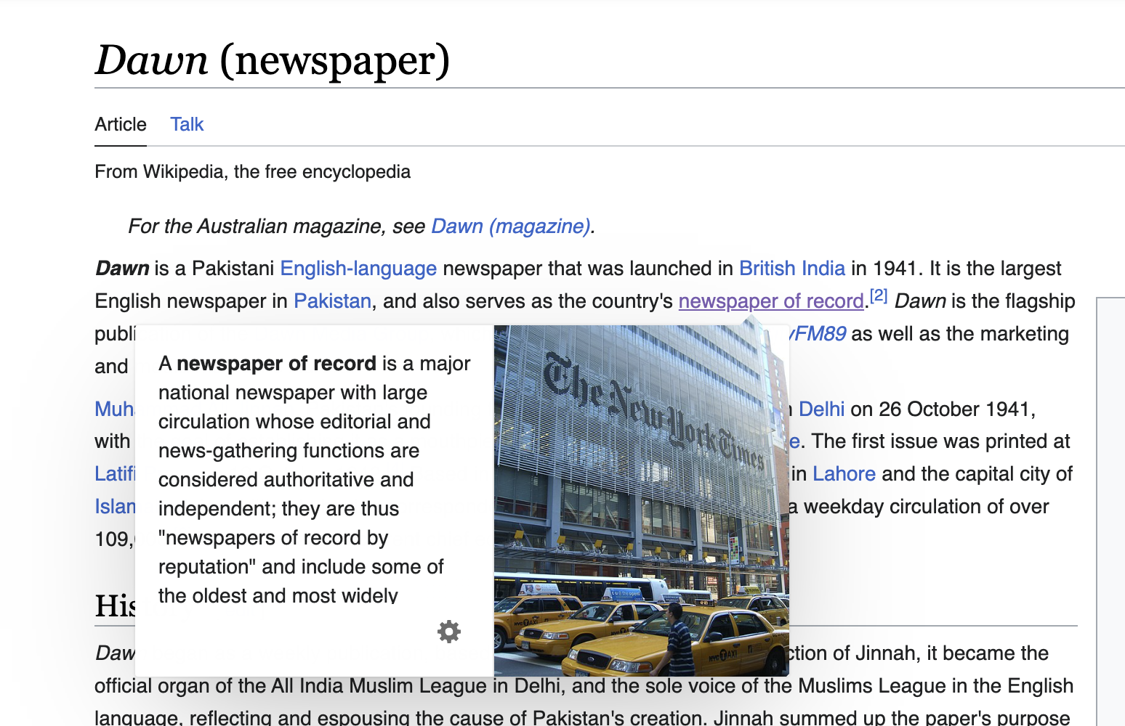
Just Add Wikipedia

Slide 17
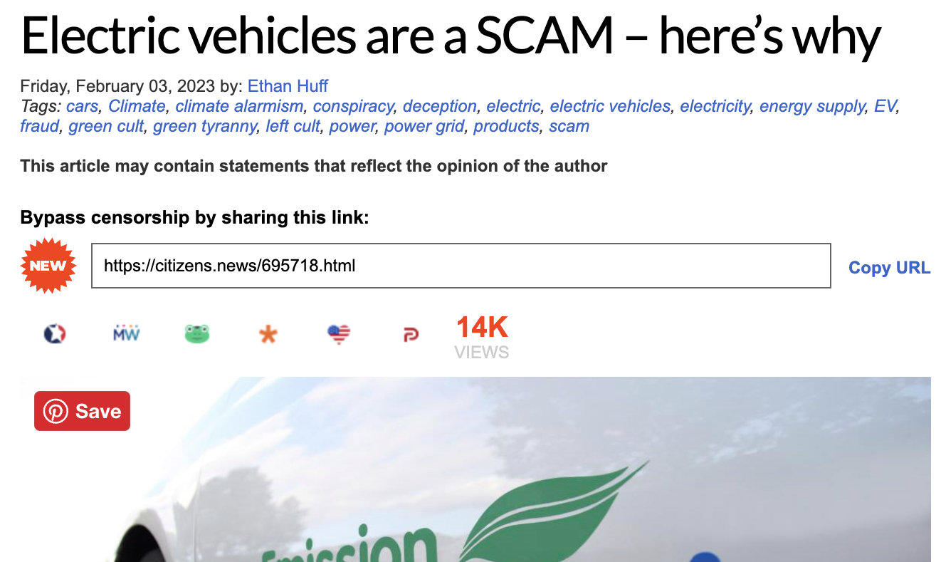
Practice: Just Add Wikipedia
Find new example
ctrl-f.ca/en/PDTCA

Slide 18
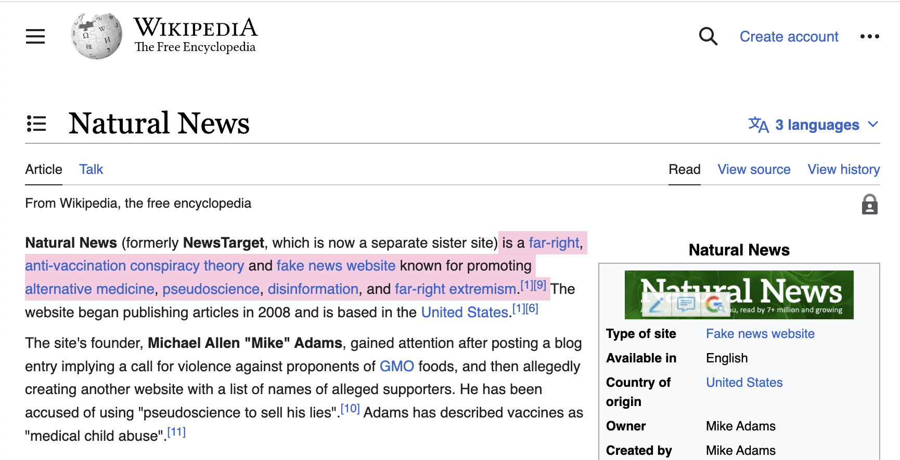
Just Add Wikipedia

Slide 19
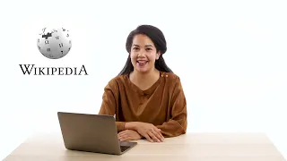
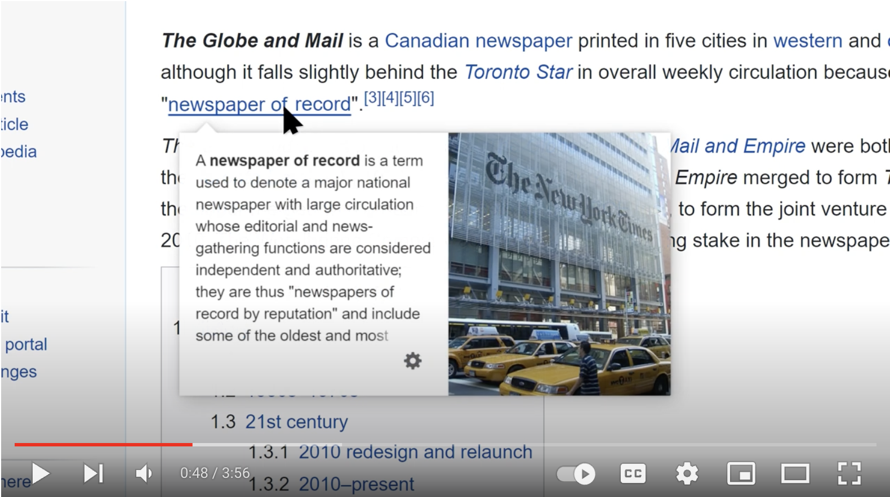
Wikipedia Videos
Why Use Wikipedia?
Tips and Tricks for using Wikipedia

Slide 20
Check the Claim
What are other sources saying?
Has the story been verified or debunked?

Slide 21
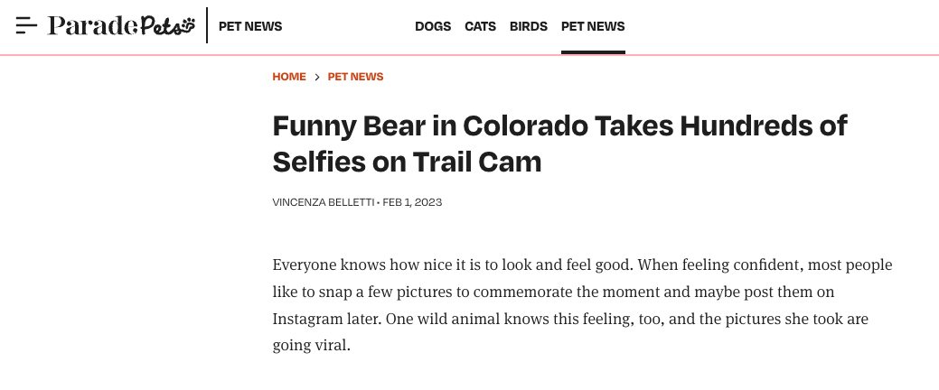
Practice: Check Other Sources
ctrl-f.ca/en/PDTCA

Slide 22
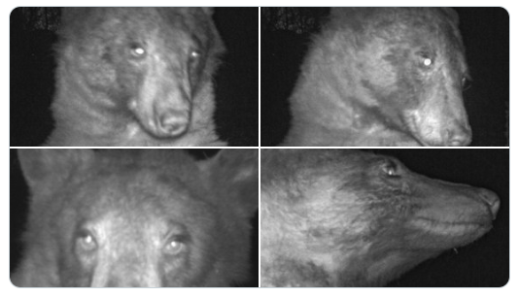
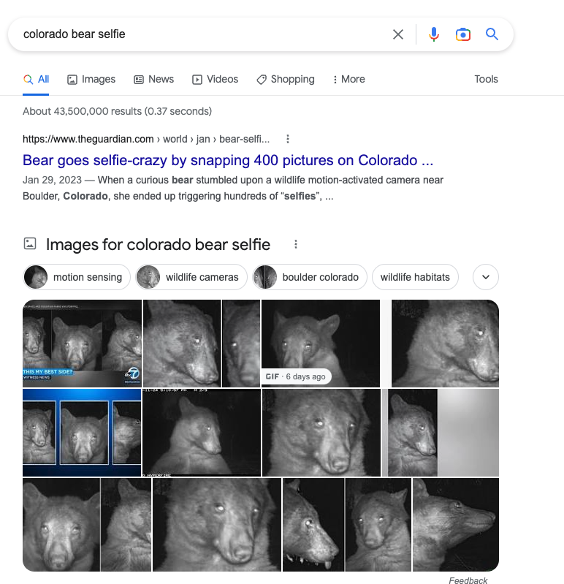
Practice: Check Other Sources

Slide 23
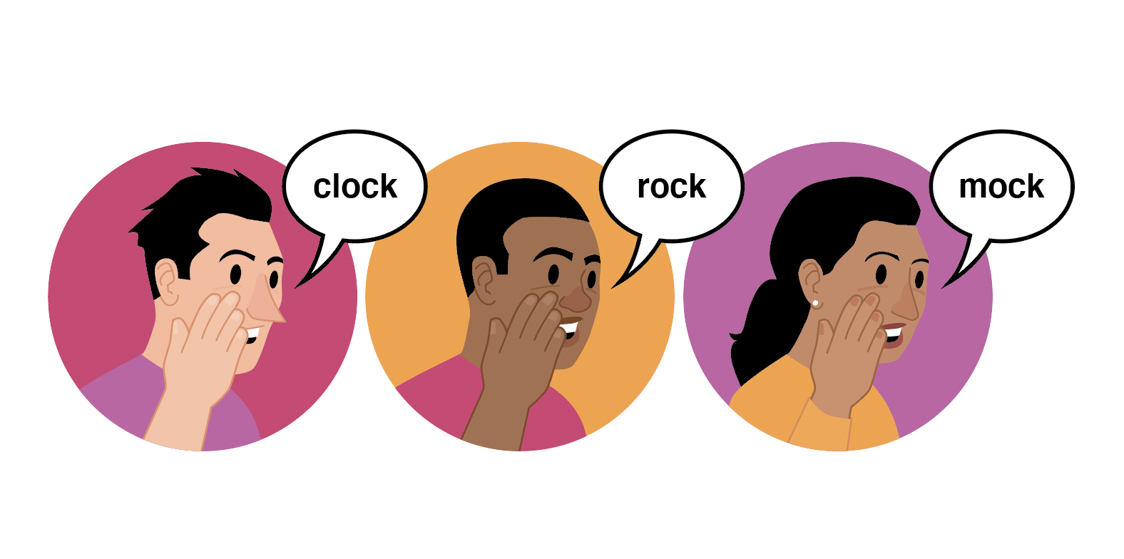
Trace the Information
How close can you get to original source?
Has the information changed in the re-telling?
Key Skills:
Click Through
Find
Check the Date
Reverse Image Search

Slide 24
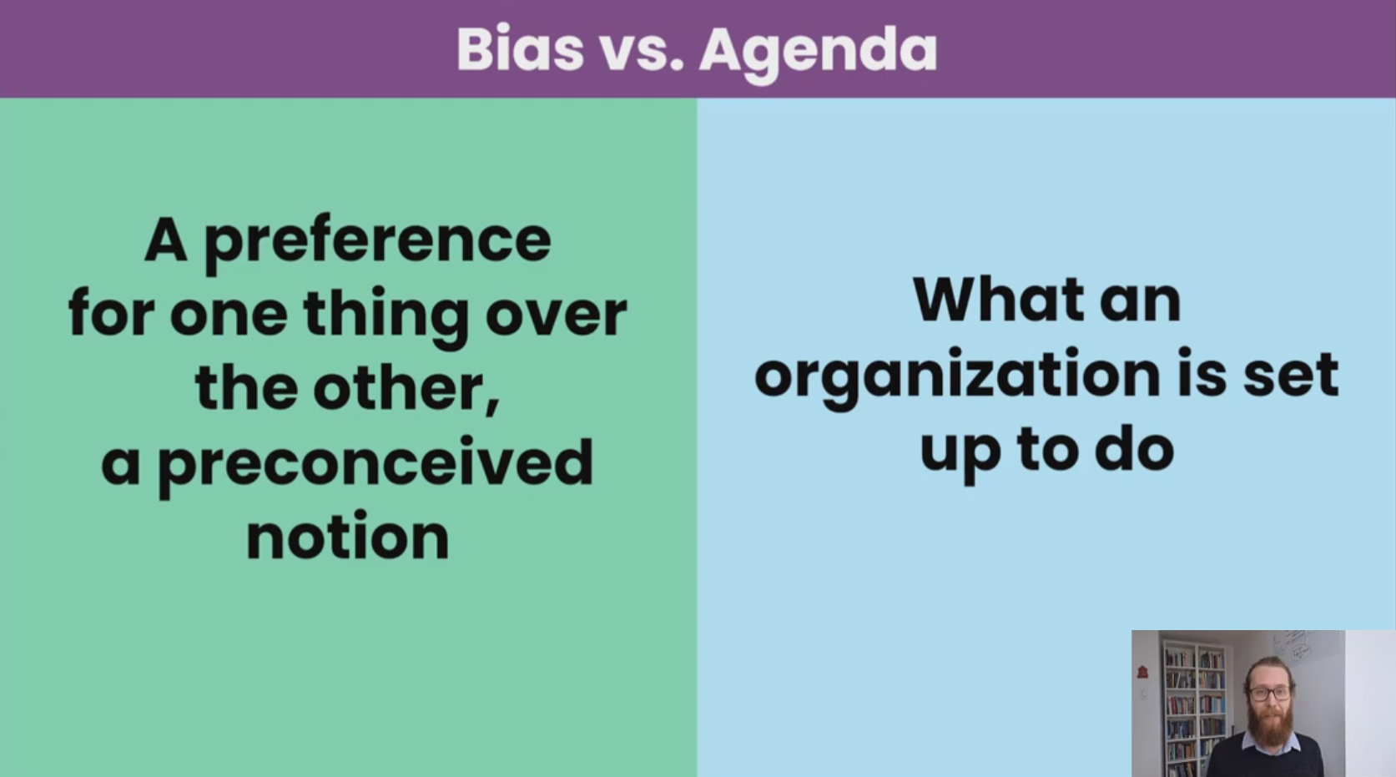
CTRL-F Workshop (virtual)
March 7 @ 4:30 PM MT
March 15 @ 1:30 PM MT
April 4 @ 4:30 PM MT
April 19 @ 1:30 PM MT
To register: ctrl-f.ca/en/workshops
(asynchronous version also available)

Slide 25
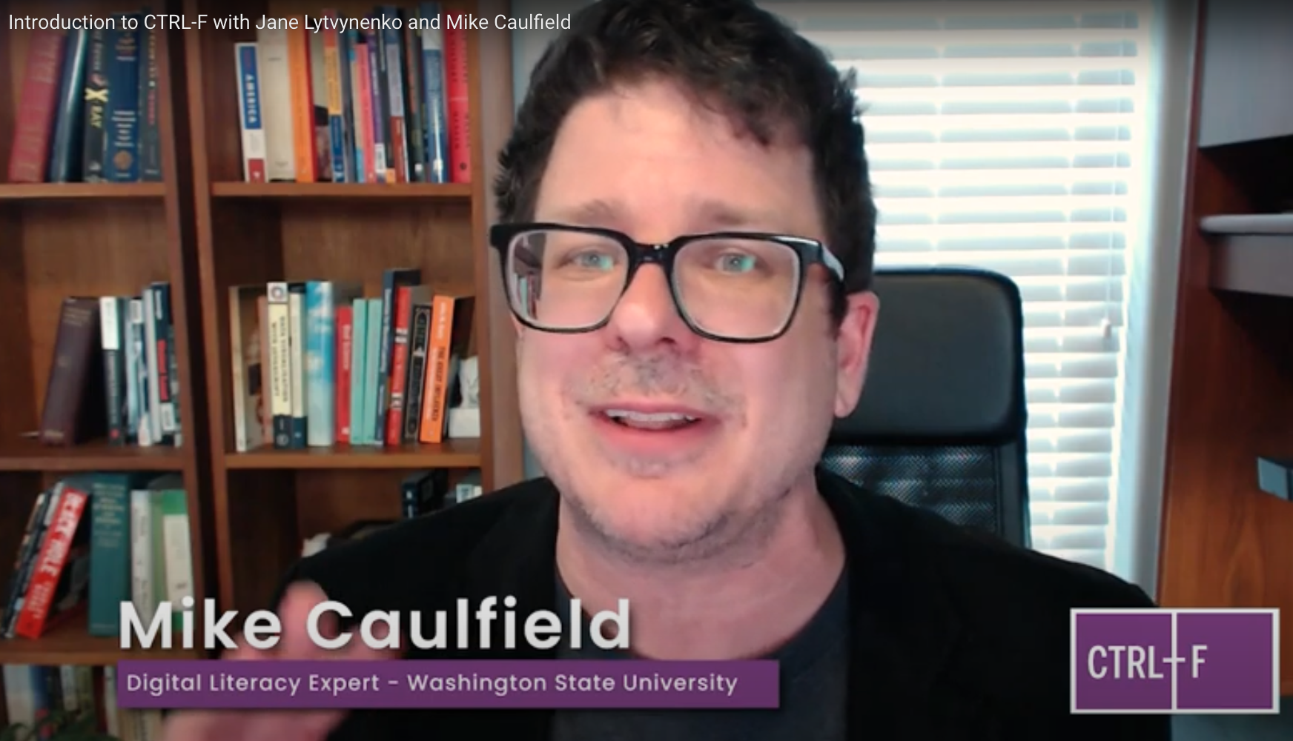
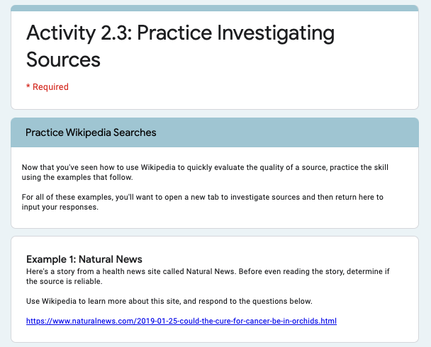
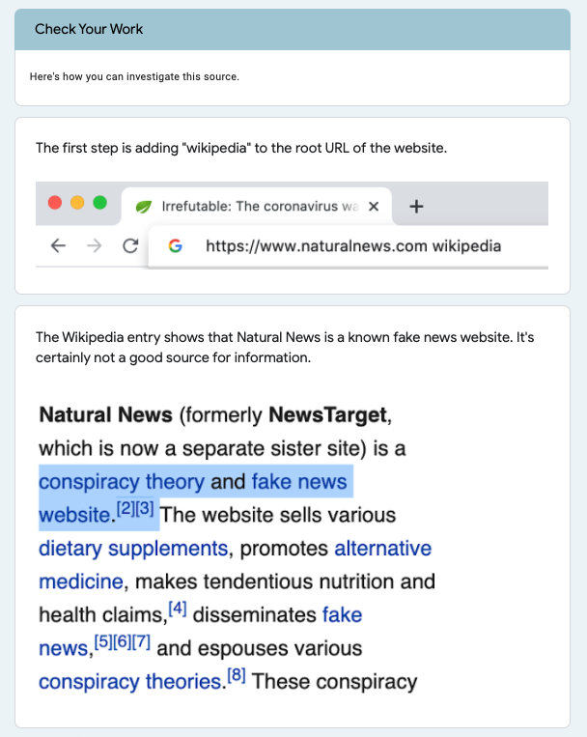
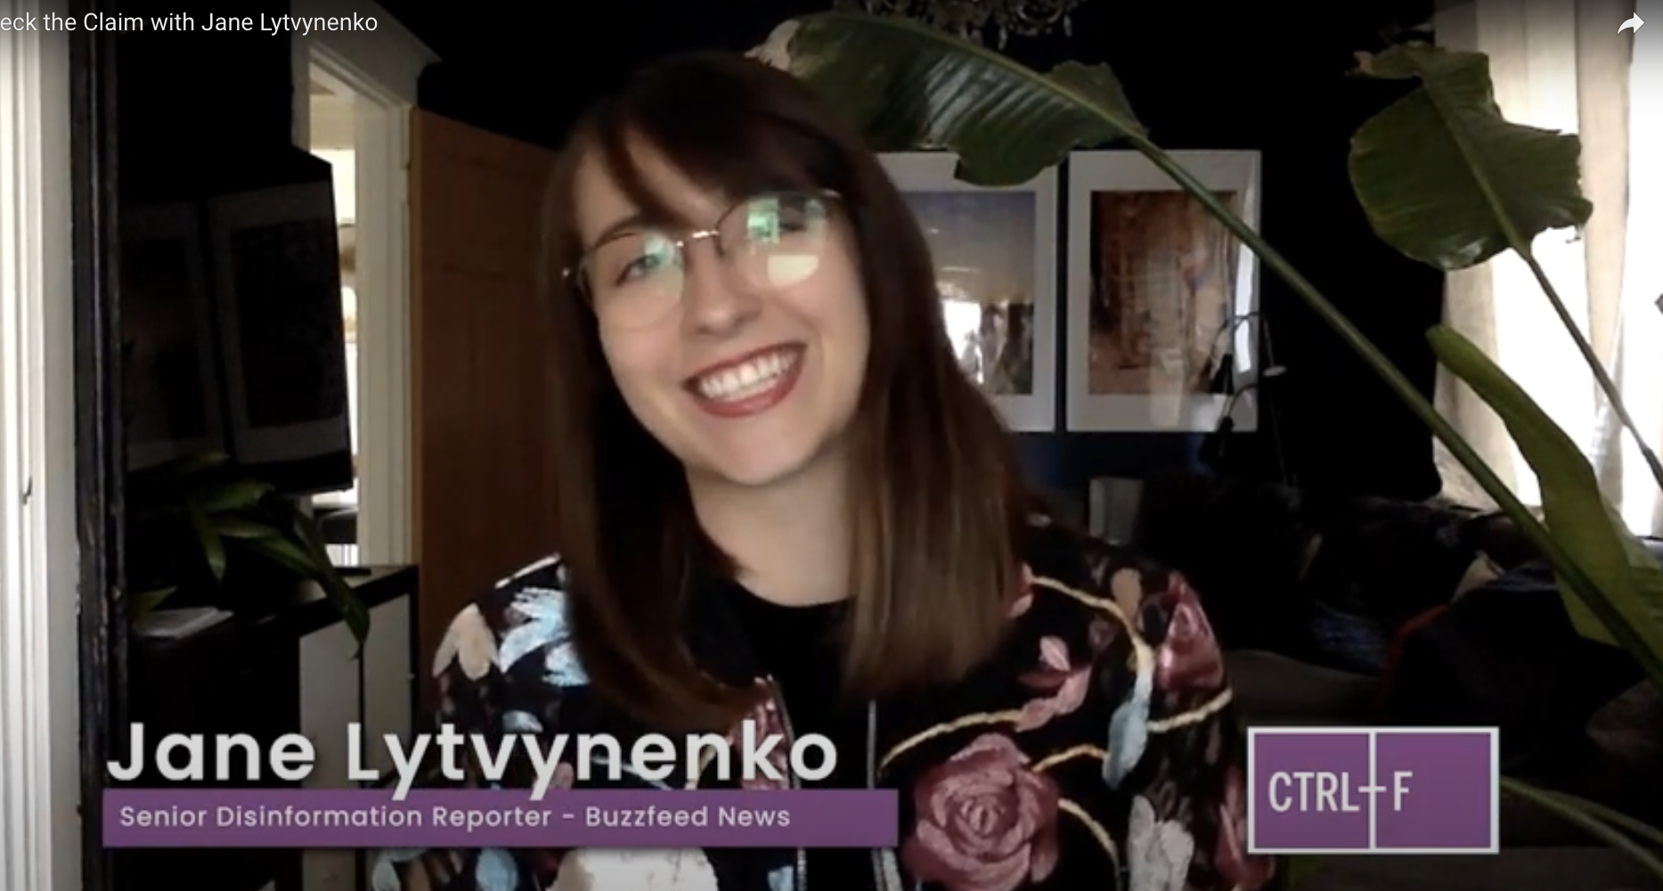
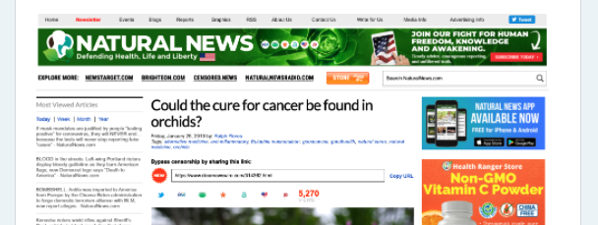
Free with registration
Expert-led videos
Step-by-step practice
• Grades 7-12
• 7 hours of class time
• Lesson plans, slide decks, assessments
• Multiple formats (Google, Microsoft forms)
• English / French
ctrl-f.ca

Slide 26
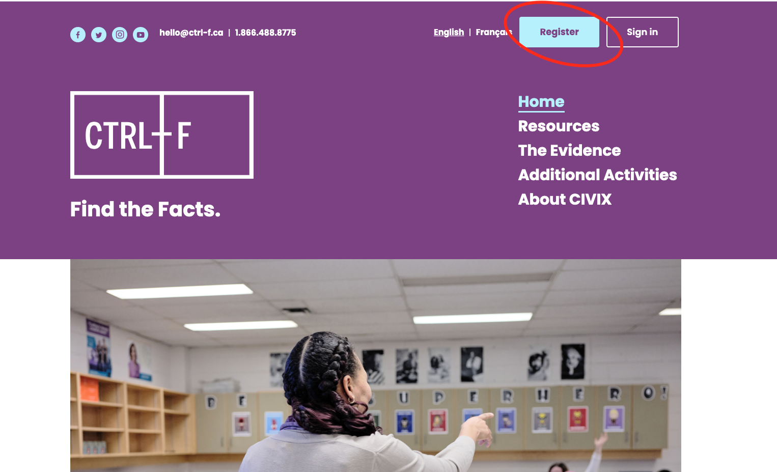
How to register
ctrl-f.ca

Slide 27
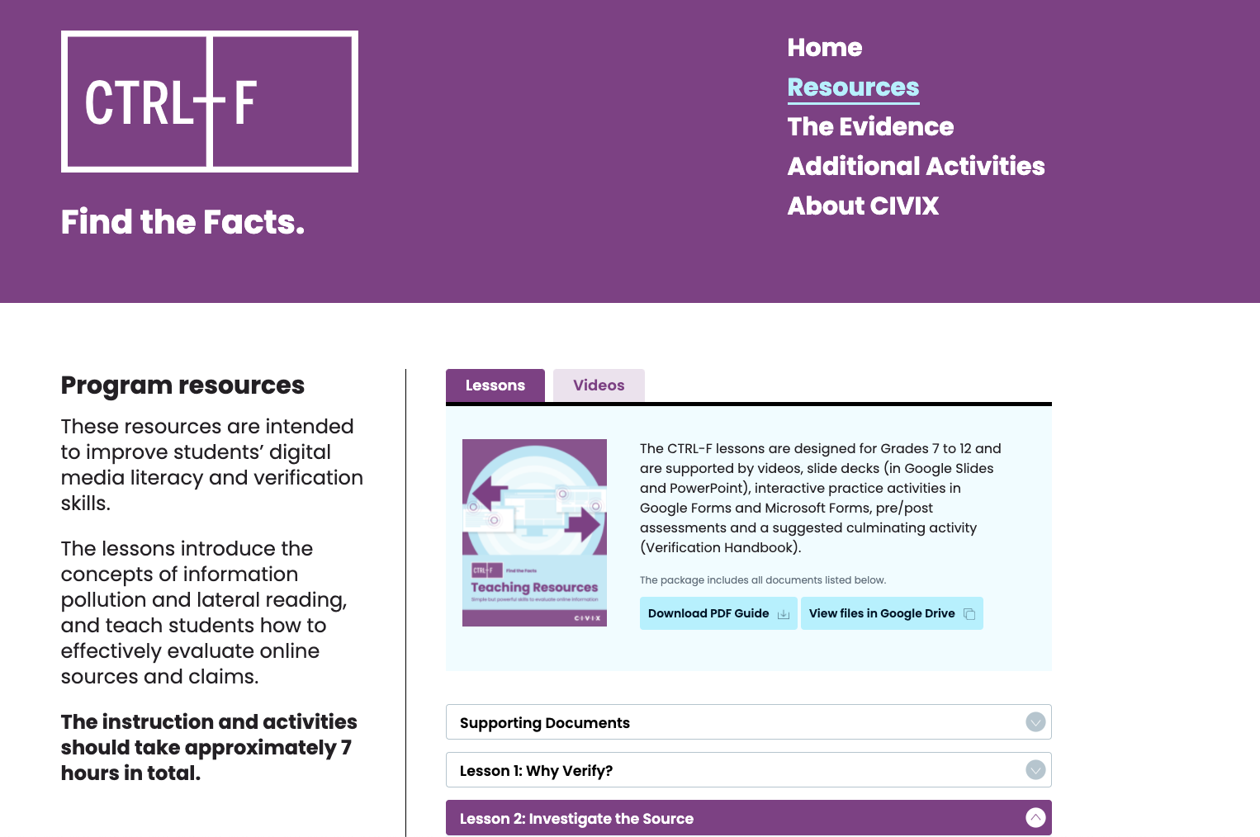
ctrl-f.ca/resources
(Registration required)

Slide 28
ctrl-f.ca/resources
(Registration required)

Slide 29
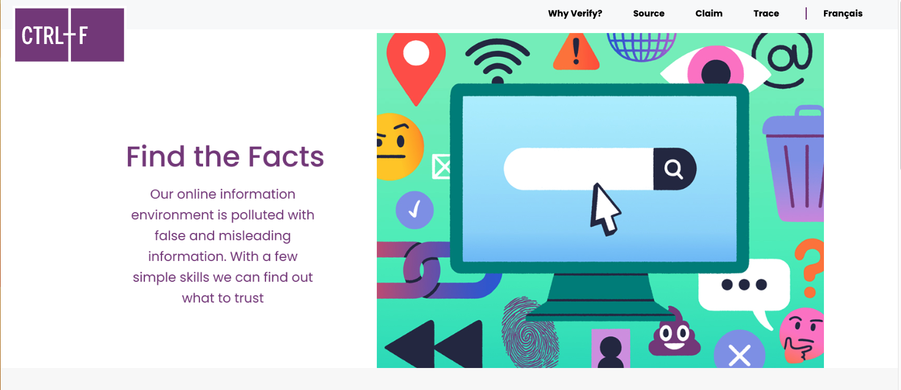
Student-facing practice site
ctrl-f.ca/en/student

Slide 30
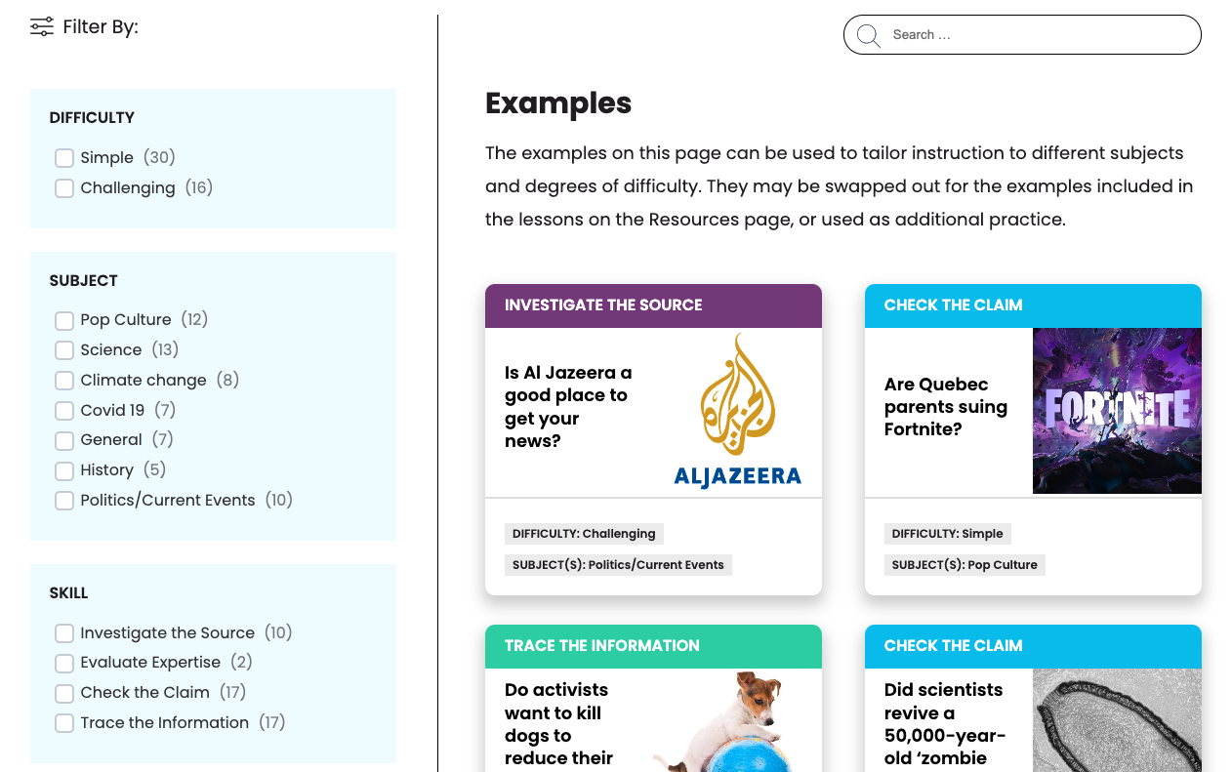
Filterable Example Bank
ctrl-f.ca/en/examples

Slide 31
Questions?
We’re happy to help!
Jessica Johnston — jessica@civix.ca

