Slide 1
Student Vote Alberta

Slide 2
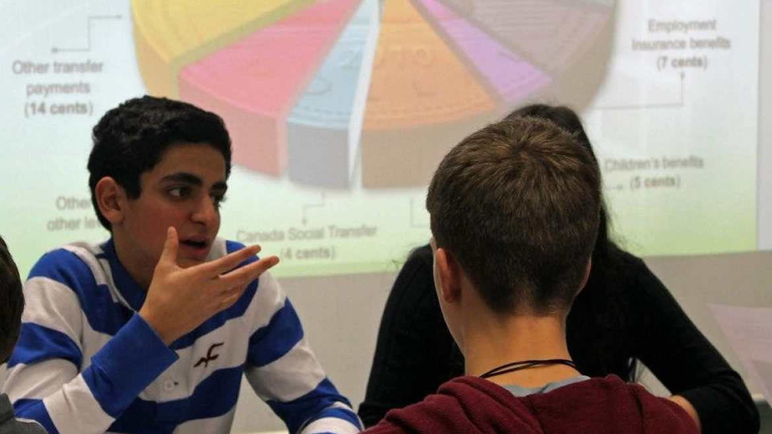
budgetconsultation.ca

Slide 3
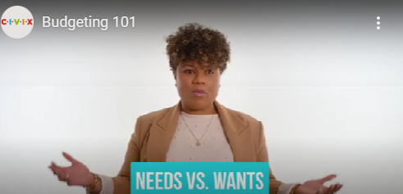
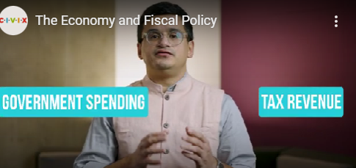
Budget Consultation Resources

Slide 5
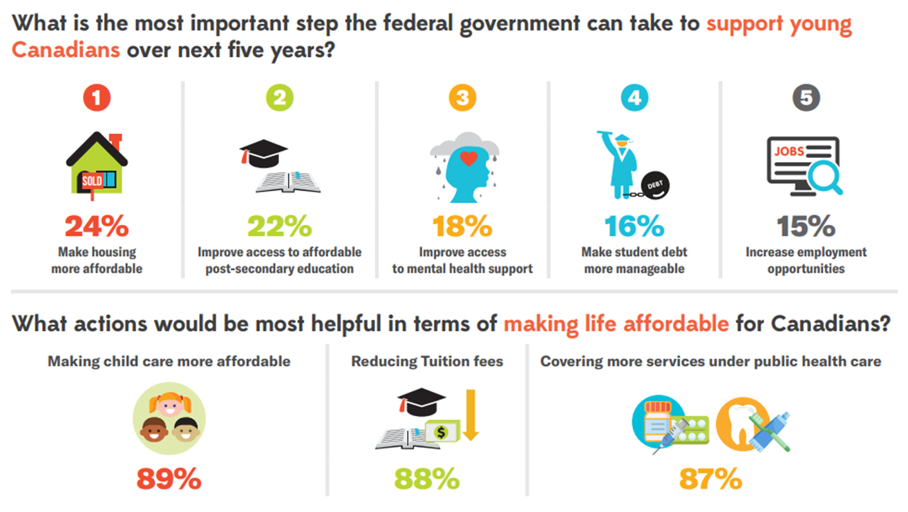
Student Budget Consultation: 2022 Results

Slide 6
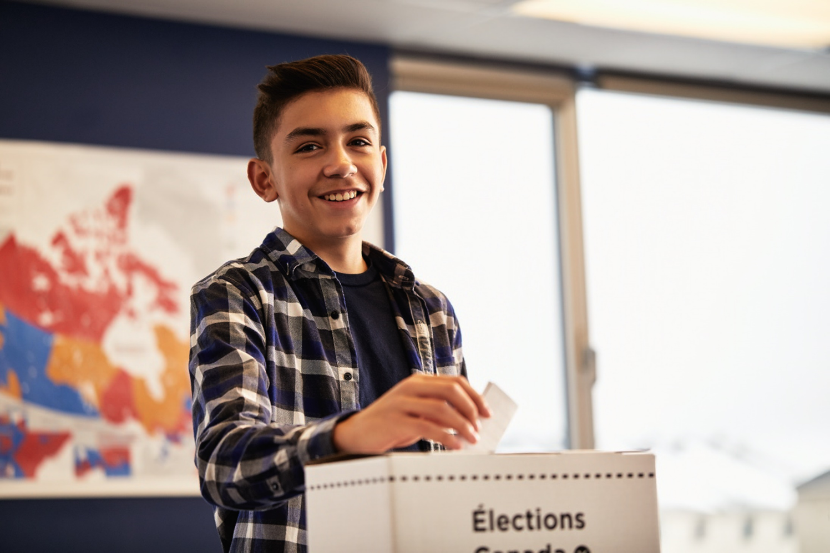

Slide 7
What do we know about voter turnout?

Slide 8
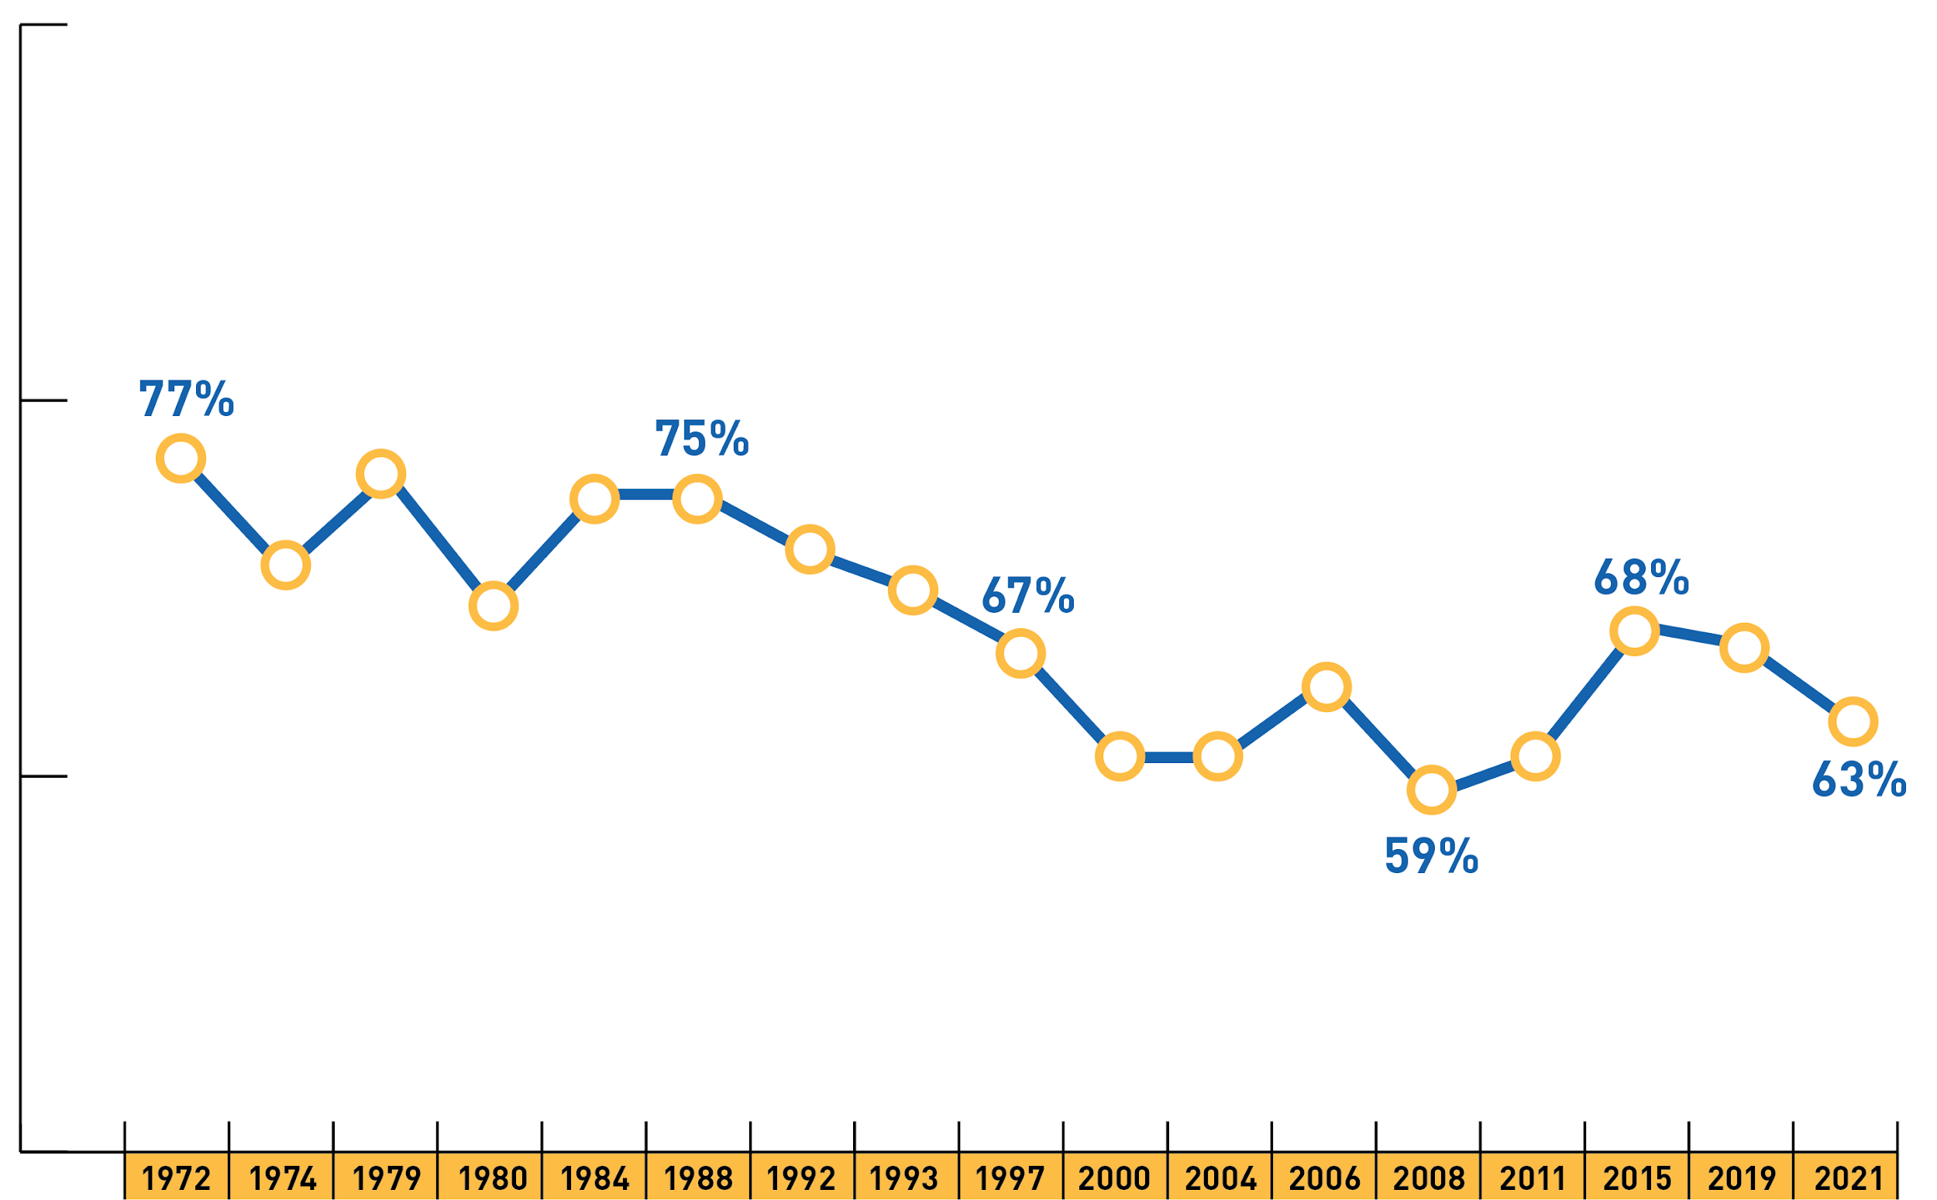
Voter Turnout - Federal Elections

Slide 9
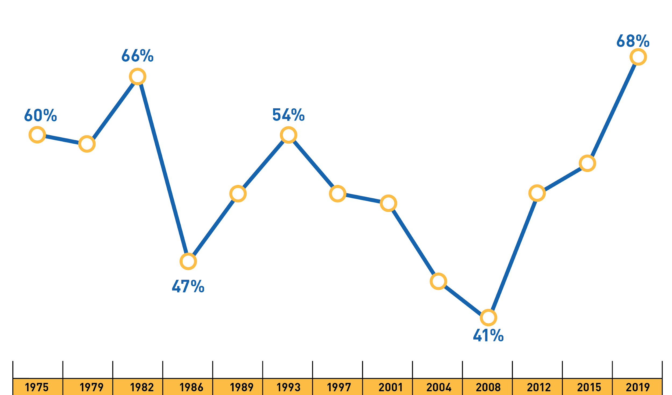
Voting Turnout – Alberta Elections

Slide 10
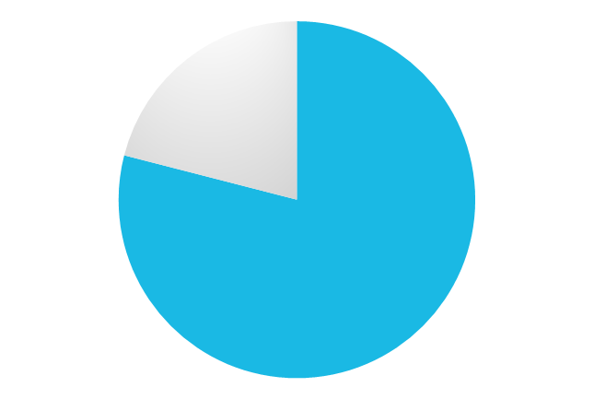
Turnout by Age Group
18-24 yrs: 57%
65-74 yrs: 79%
Elections Canada: 2015 election

Slide 11
What barriers do youth face to voting?

Slide 12
The Barriers

Slide 13
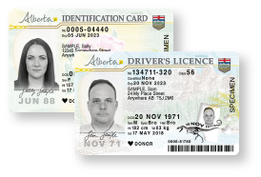
Access Barriers

Slide 14
Motivational Barriers

Slide 15
The Profile of a Young Voter
High level of political knowledge
Believes that voting is a civic duty
Interested in politics
Discussed politics while growing up
Contacted by candidates or parties
Influenced by family

Slide 16
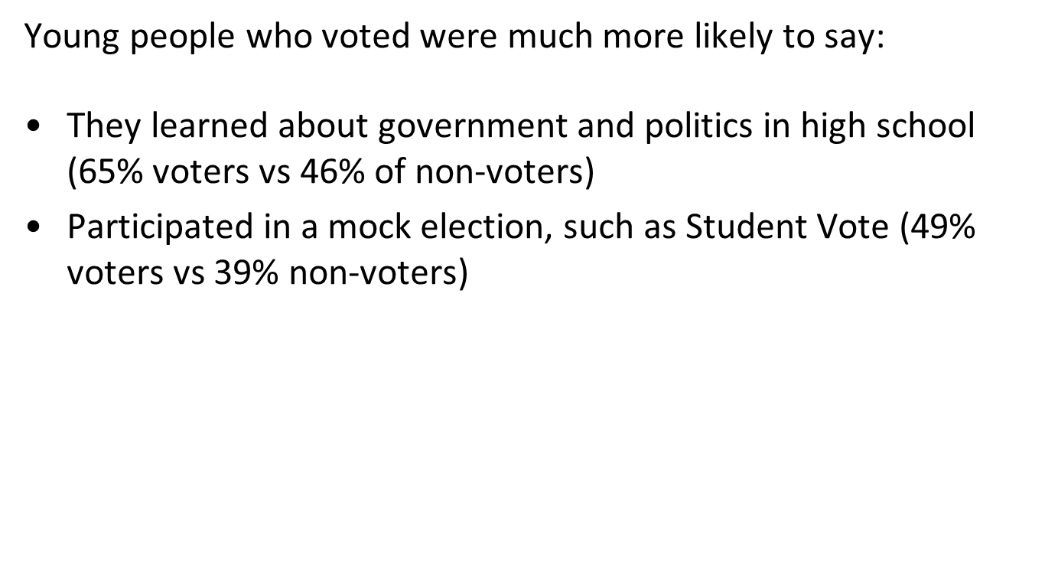
The Value of Civic Education

Slide 17
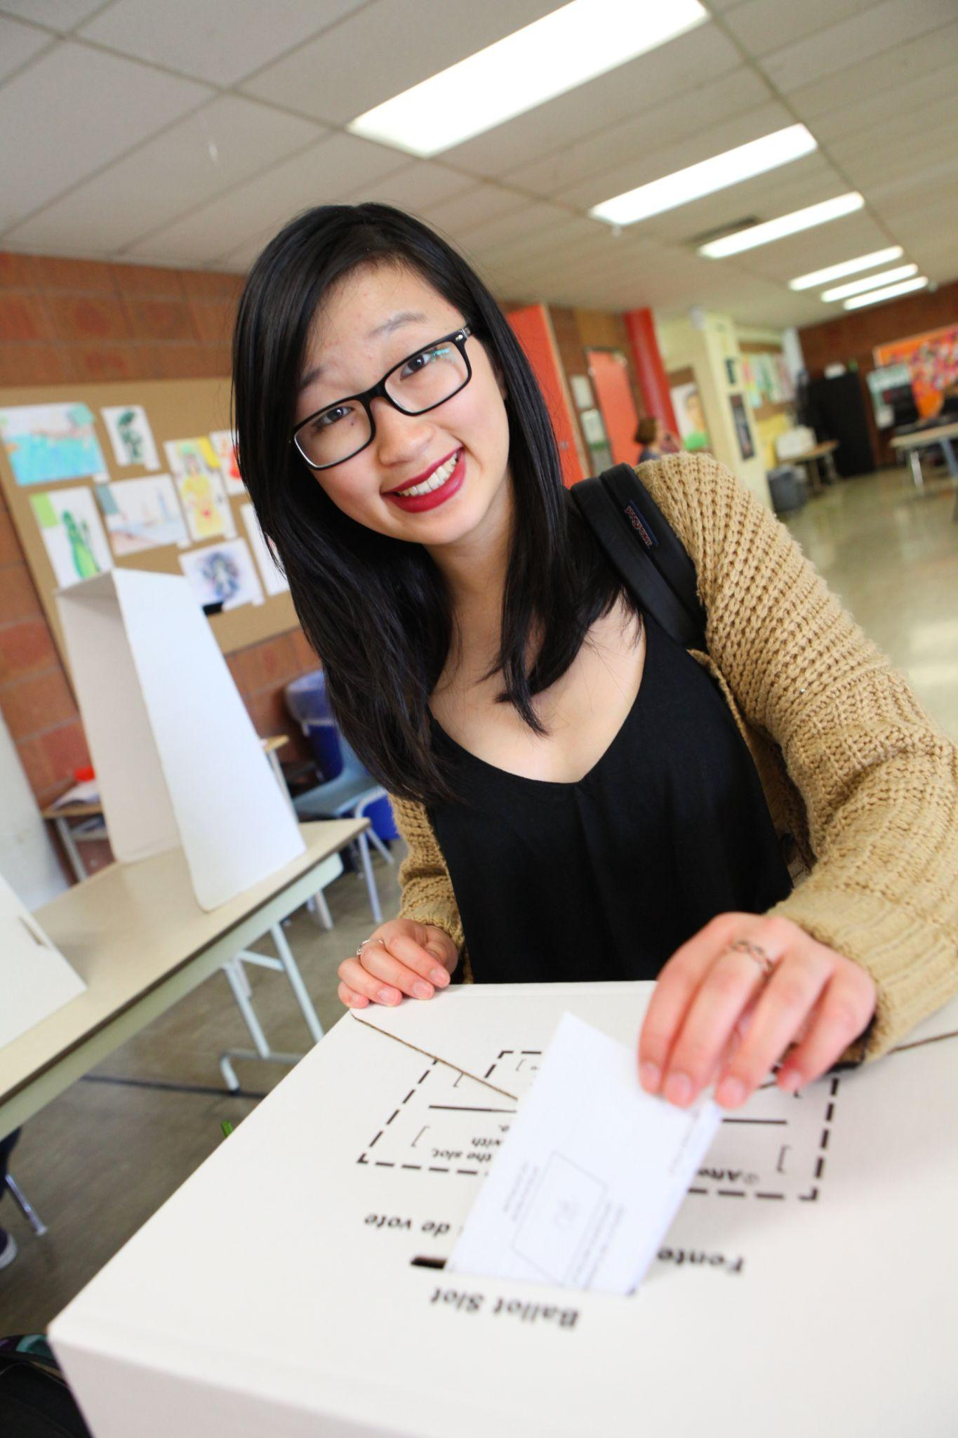
Student Vote - Background
“Parallel election” for youth under the voting age
Uses the election as a teachable moment
Targeted at grades 4 to 12
Offered at all levels of elections in most jurisdictions across Canada
60 elections in Canada since 2003
Since 2018, we have also organized four Student Vote projects in Latin America

Slide 18
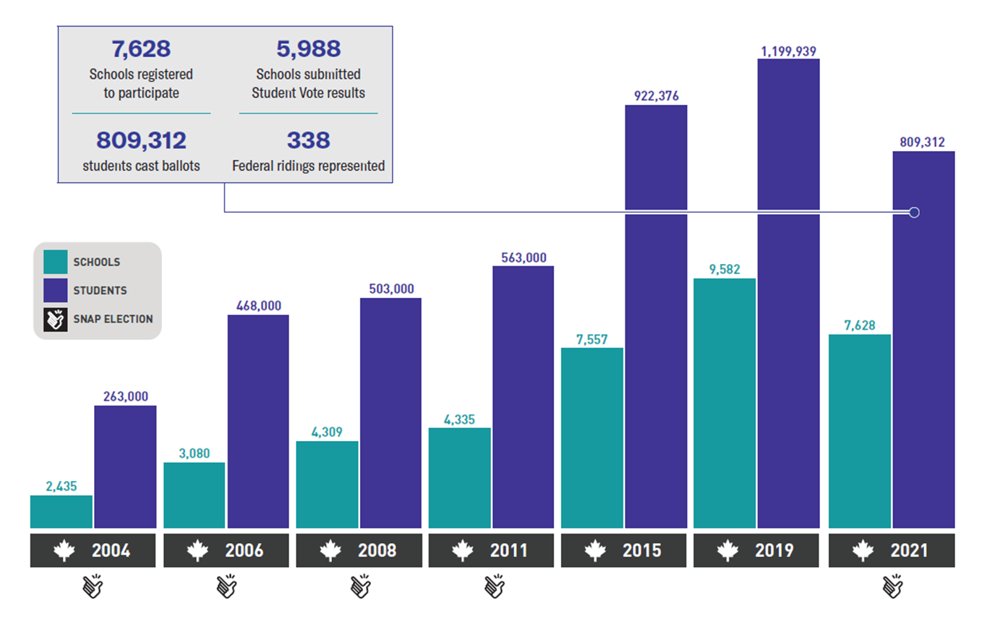
Student Vote - Federal Elections

Slide 19
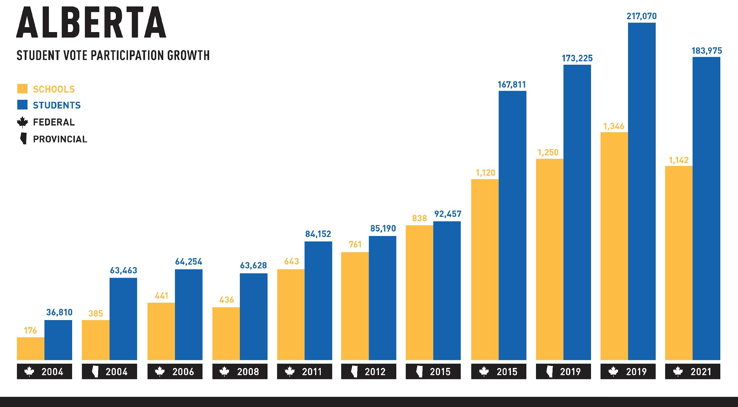
Student Vote – Alberta Elections

Slide 20
What should I know Student Vote Alberta?

Slide 21
Key dates - 2023 Provincial election
Registration: Open now until early May
Program launch: mid-April
Writs issued: May 1
Nominations close: May 11
Student Vote Days: May 24, 26 and 29
Election day: May 29

Slide 22
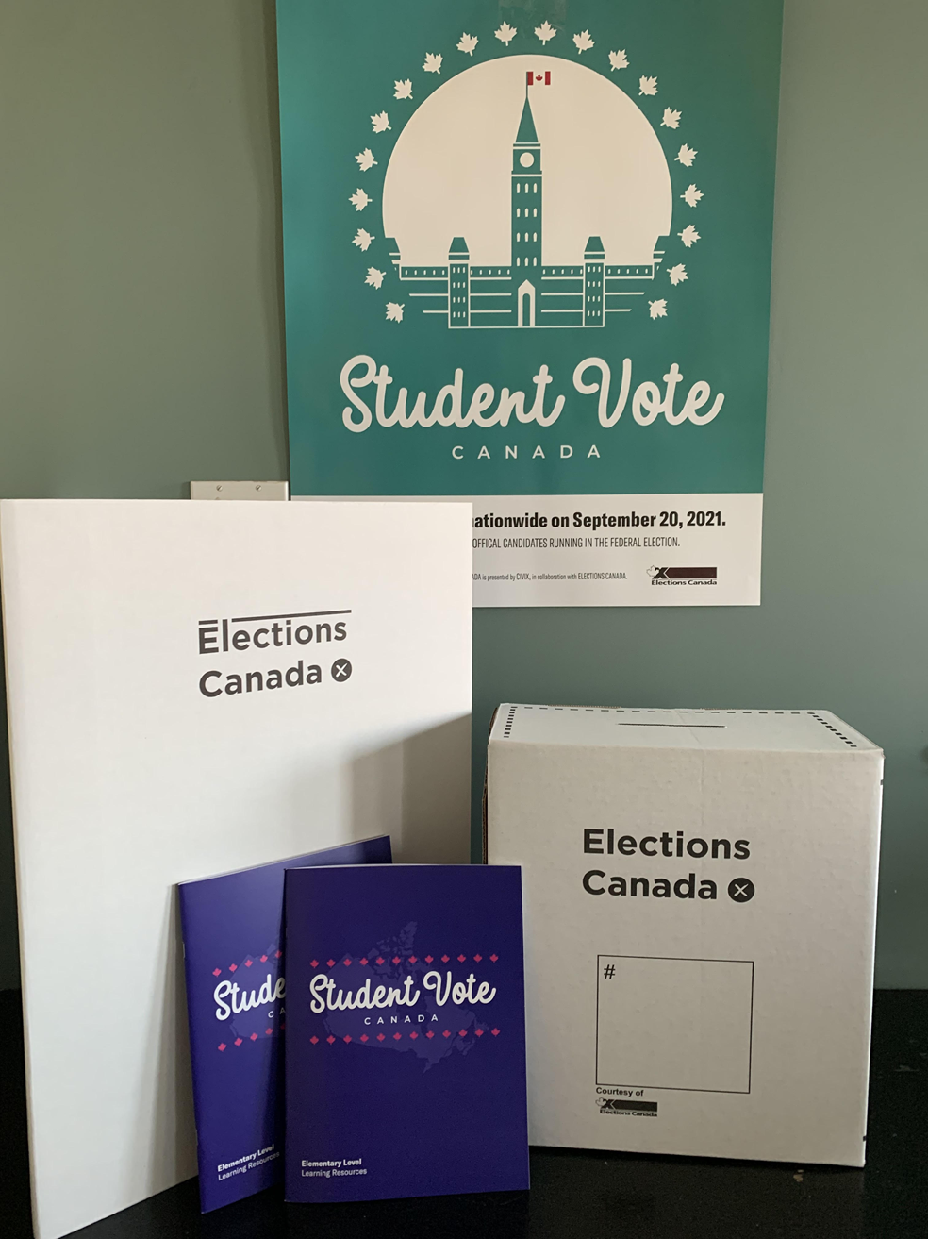
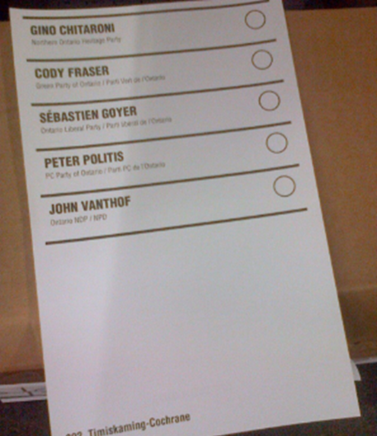
Student Vote Materials
Program website
Resource package
Ballot kits
Lesson plans, digital file formats
Slide decks
Explainer videos
Online interactives www.studentvote.ca/ab2023
Lesson plans
Student Vote posters
Electoral division maps
Ballot boxes and screens
Ballot kit
Statement of poll form
Election manual

Slide 23
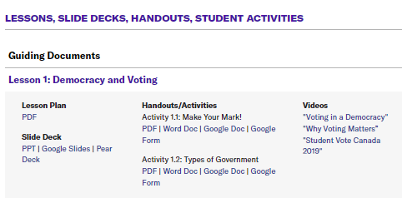
Resources on the Program Website

Slide 24
Alberta 2023: Lesson Plans
Elementary
Politics and Perspectives
Government and Democracy
Informed Citizenship
Questioning Images
Levels of Government
Political Parties
My Candidates
Campaign Communications
The Voting Process
Post-Election Analysis
High School
Democracy
Informed Citizenship
Voting Rights
Levels of Government
Alberta’s Provincial Government
Elections in Alberta
Campaign Communications
The Leaders’ Debate
The Voting Process
Post-Election Analysis

Slide 25
Tallest Tower Challenge
The Task: Build the tallest, most stable structure as possible that holds the marshmallow on top, using only the materials given.
20 sticks of spaghetti
1 metre of tape
1 metre yarn/rope
Jumbo marshmallow
Scissors
Logistics: Each group will receive instructions about the leadership and group dynamics for the task.
Time Allotment: 15 minutes (5 min to plan, 10 min to build)

Slide 26
Tallest Tower Challenge
Debrief:
Which tower was the best and why? What made the building process successful?
What feelings developed among group members under each type of involvement?
What factors contribute to a positive experience when working in groups? What factors contribute to a negative experience?

Slide 27
Feed for Thought: Election Edition
“Informed Citizenship” Lesson
Explore the link between information and decision-making with this experiential activity.

Slide 28
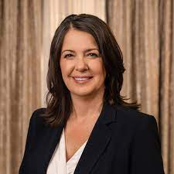
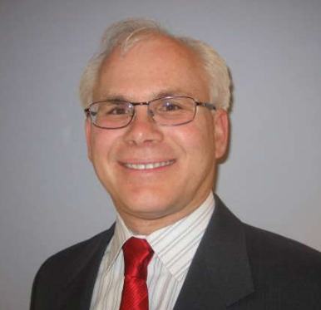
Party Leader Q & A Videos

Slide 29
Table Discussion
What do your students enjoy the most about the Student Vote program?
Share one genius hack you’ve discovered through your experience with the Student Vote program.
Give one practical tip for engaging more colleagues or classes in the program (making the program school-wide).

Slide 30
Student Vote - Best Practices
#1 – Use the CIVIX explainer videos to review key concepts

Slide 31
Student Vote - Best Practices
#2 – Employ a range of discussion protocols to support student-led conversations

Slide 32
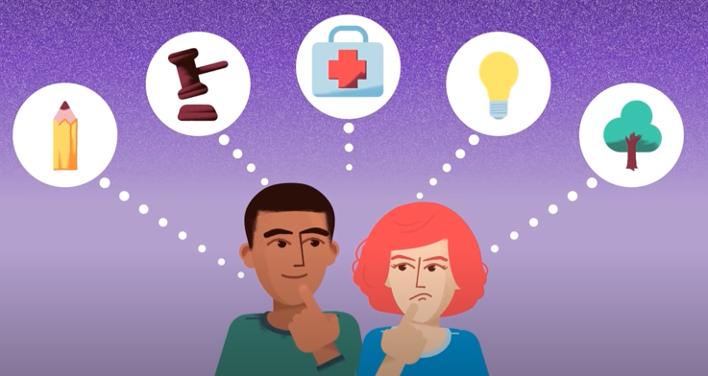
Student Vote - Best Practices
#3 – Explore issues that matter to your students, and compare the party’s promises

Slide 33
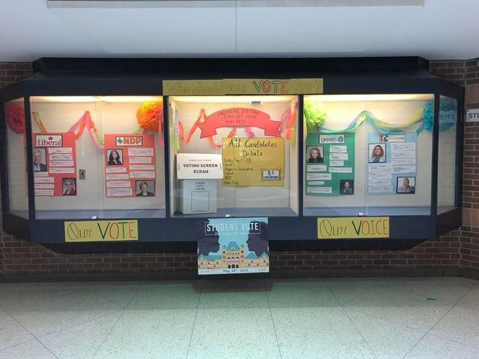
Student Vote - Best Practices
#4 – Create a bulletin board in your classroom or foyer

Slide 34
Student Vote - Best Practices
#5 – Engage with the candidates
All-candidates forum
One-on-one visit
“Political party” lunch
Email them student questions
Engage with them through social media

Slide 35
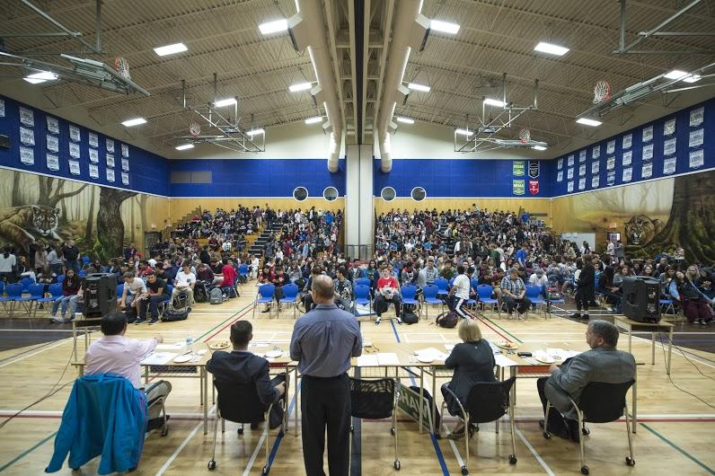
Student Vote - Best Practices

Slide 36
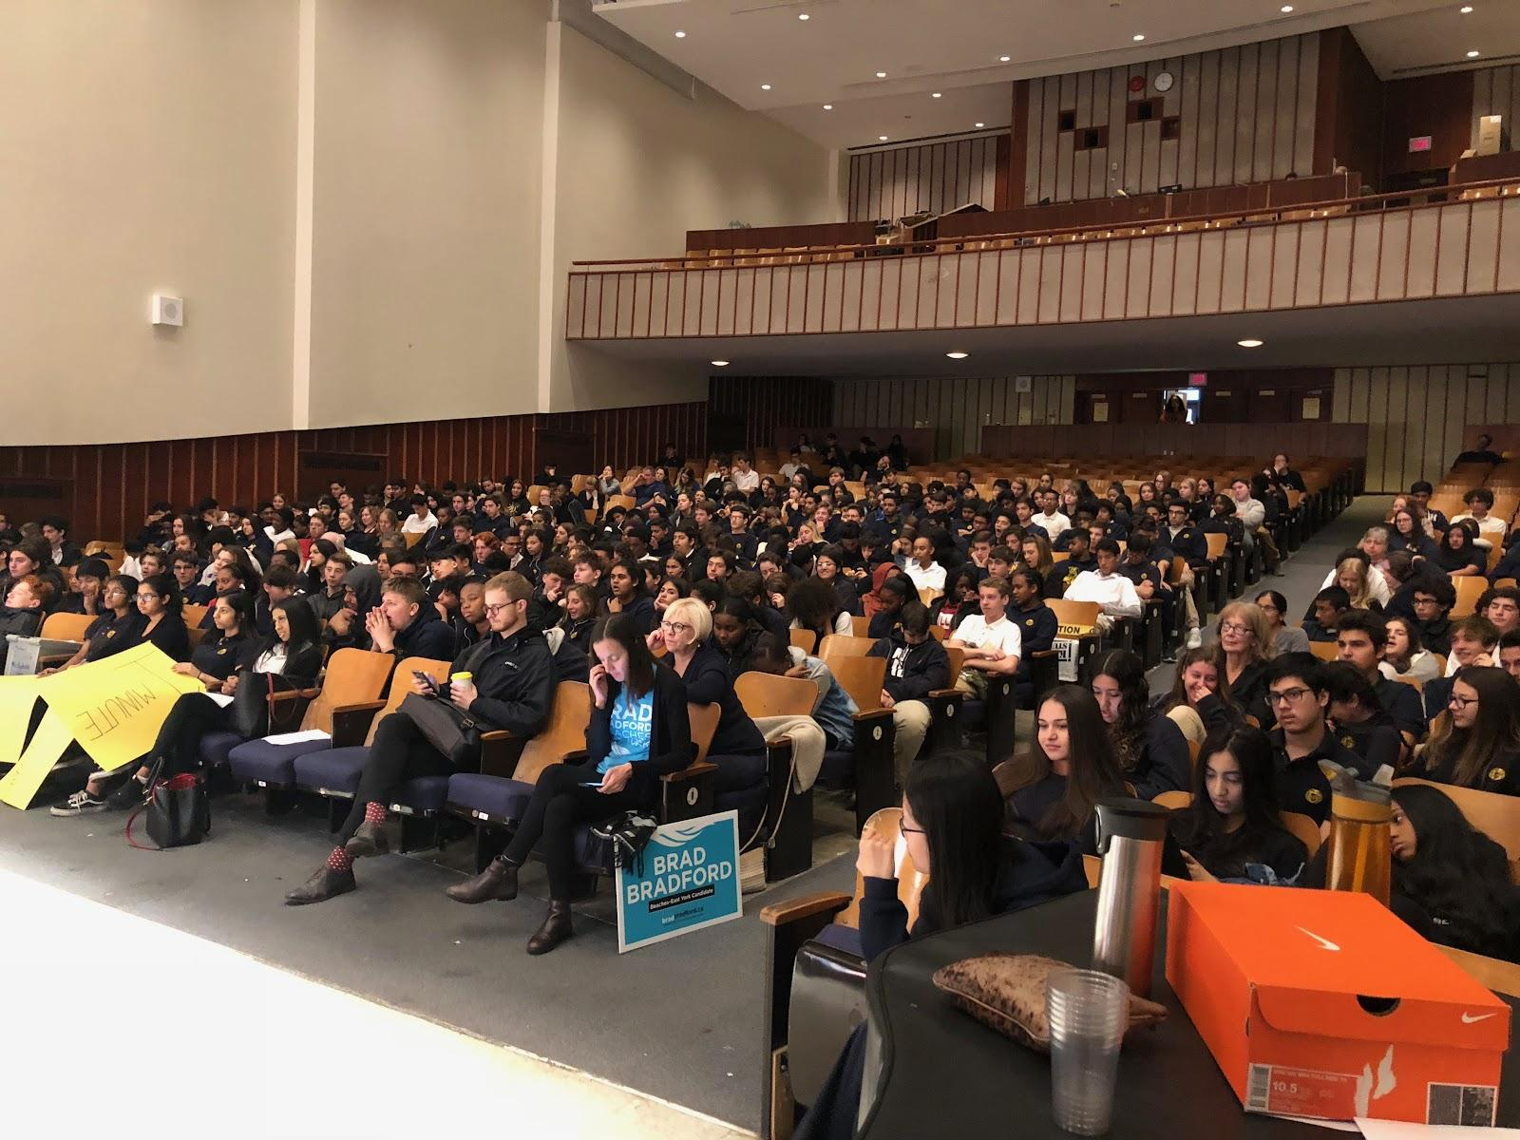
Tips for an All Candidates’ Debate
Check school division policy
Consult with administration
Students can organize and host event
Invite all registered candidates
Ask candidates not to campaign in
your school
Ask the whole school to participate
by submitting questions in advance
Create an agenda with timelines
Prepare thank you cards in advance
Invite the elected candidate to return for a visit post-election

Slide 37
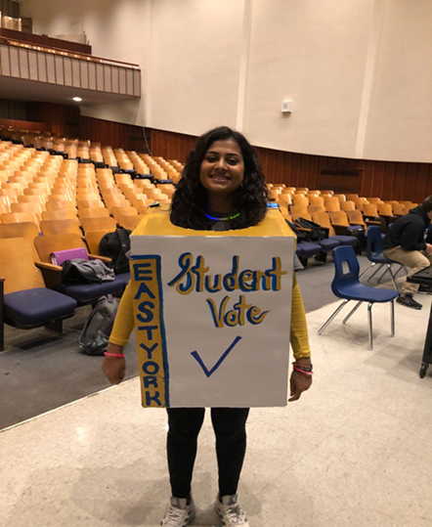
Student Vote - Best Practices
#6 – Empower students with the responsibility of running the program
Communications Team
Education Team
Events Team
Student Vote Day team
Media and Community Relations

Slide 38
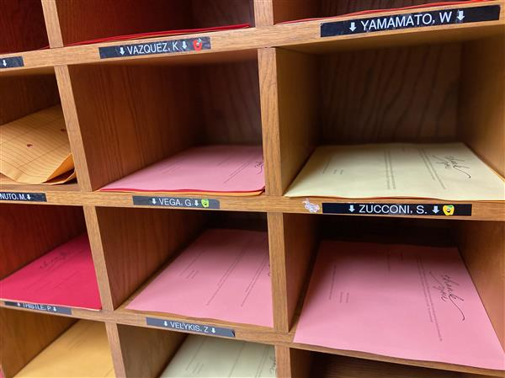
Student Vote - Best Practices
#7 – Involve your colleagues
Share a program outline early on
Send links to relevant lessons or videos
Suggest subject-related activities (i.e. “Get out the Vote Posters”)

Slide 39
Student Vote - Best Practices
#8 – Encourage political discussion at home
Send an email to parents early on to tell them about the program
Share take-home discussion questions or opinion polls
Share video resources or helpful links
Encourage parents to take their kids to the polls

Slide 40
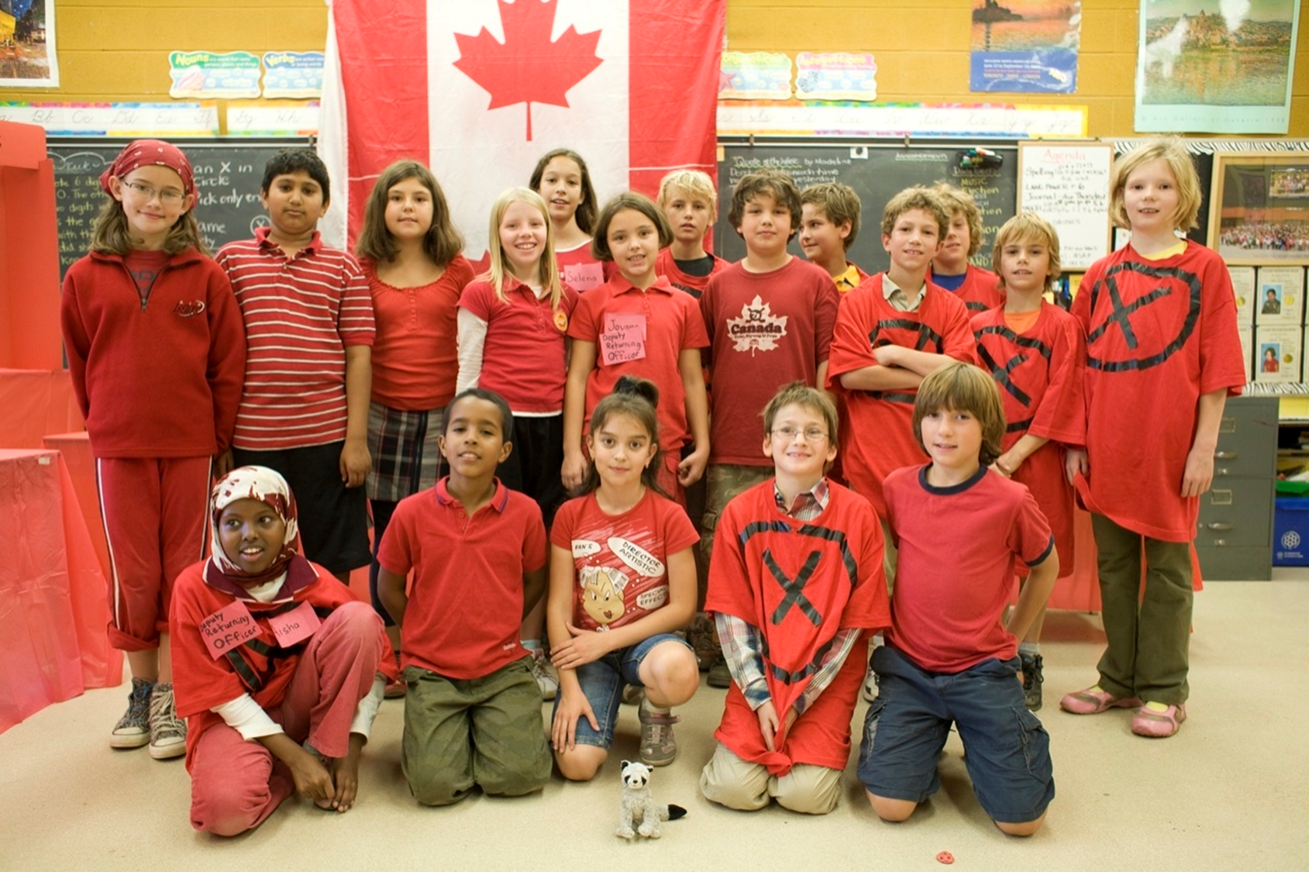
Student Vote - Best Practices
#9 – Make Student Vote Day a celebration!

Slide 41
Student Vote Outcomes

Slide 42
Keep in touch!
hello@civix.ca
@CIVIX_Canada
#StudentVoteAB

