Slide 1
Digital Platforms & Verification Skills

Slide 2
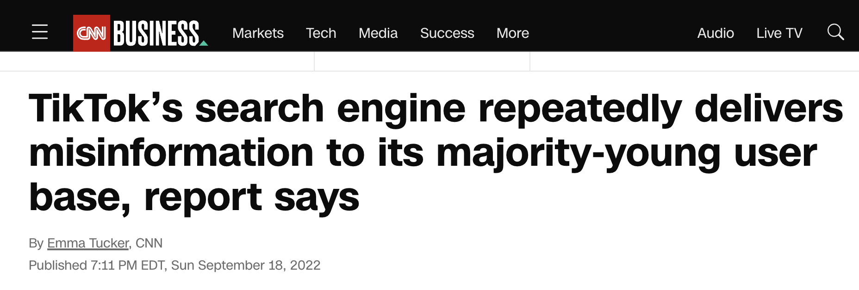
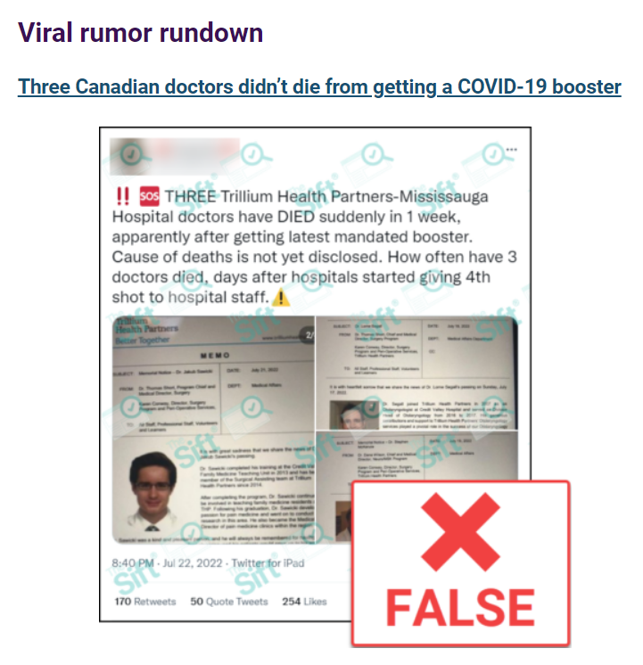
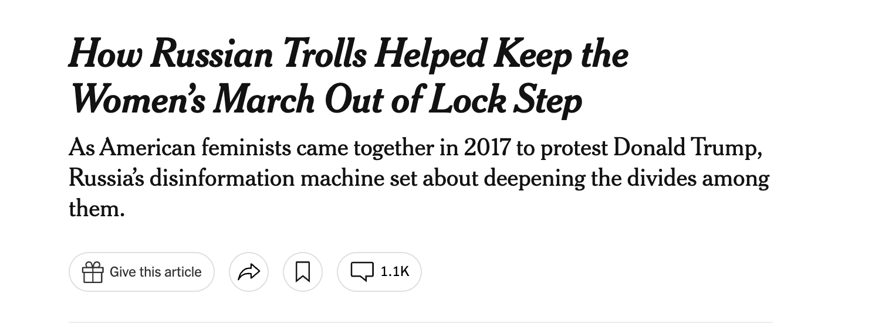

Slide 3
Informed Citizenship
How do we evaluate the information that we see and hear?

Slide 4
Encourages students to:
Understand the importance of being an informed citizen
Care about what is true or credible
Habitually evaluate sources and claims
Seek out information from reliable sources

Slide 5
Examples page: ctrl-f.ca/en/halifax

Slide 6
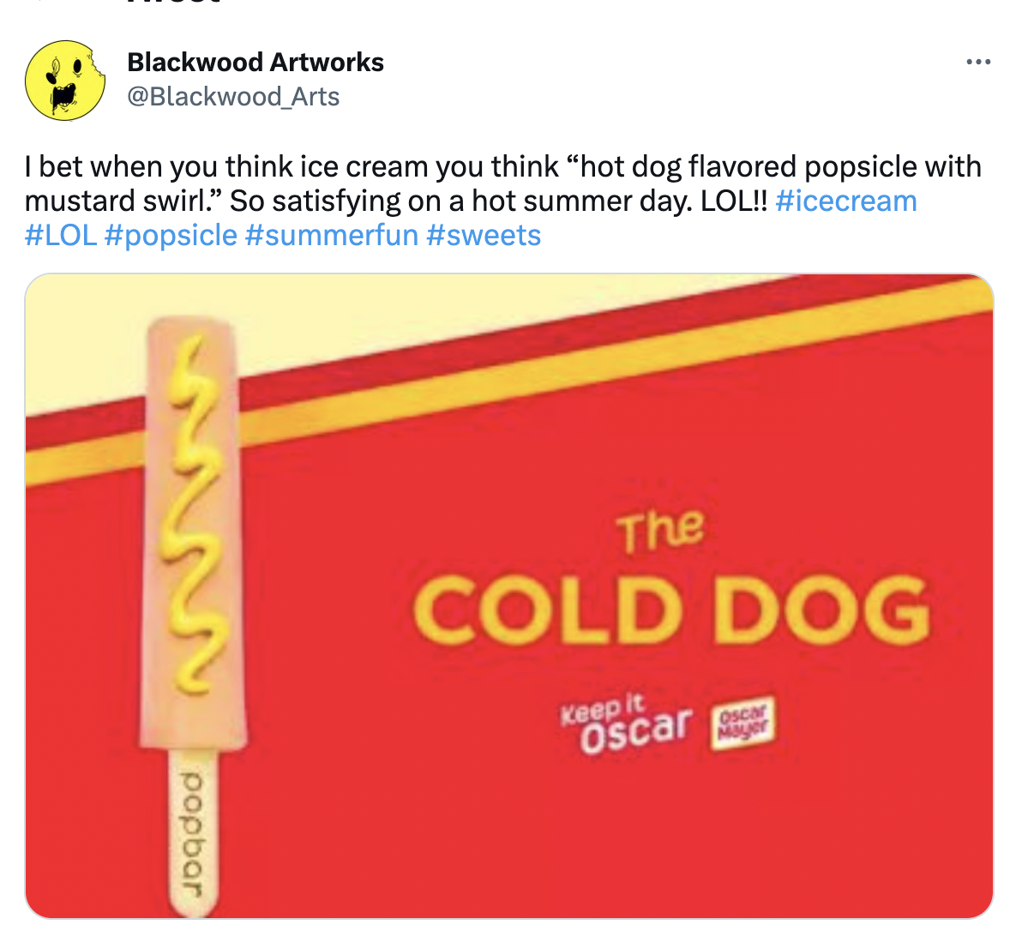
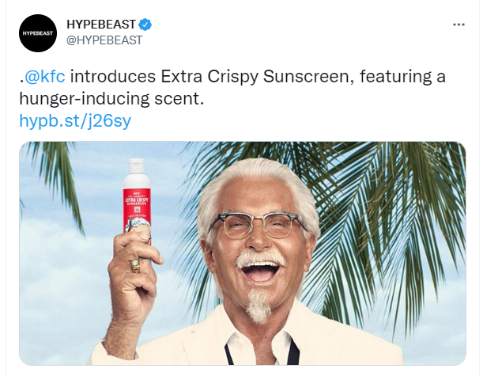
Are These Real?
Both fake?
Both real?
One real one fake?

Slide 7
Are these real?
ⓘ Start presenting to display the poll results on this slide.

Slide 9
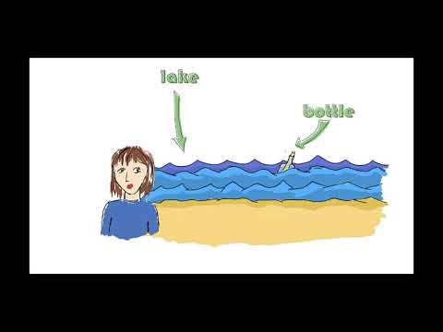

Slide 10
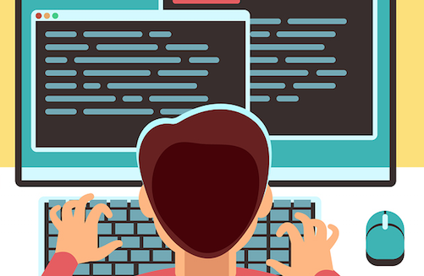
‘Vertical’ vs. ‘Lateral’ Reading
vs.

Slide 11
Three key lateral reading skills
Investigate the Source
Who made the information? What is their reputation?
Check the Claim
Are known credible sources saying the same thing?
Trace the Information
Has this information changed in the re-telling?
Evidence-based
ctrl-f.ca

Slide 12
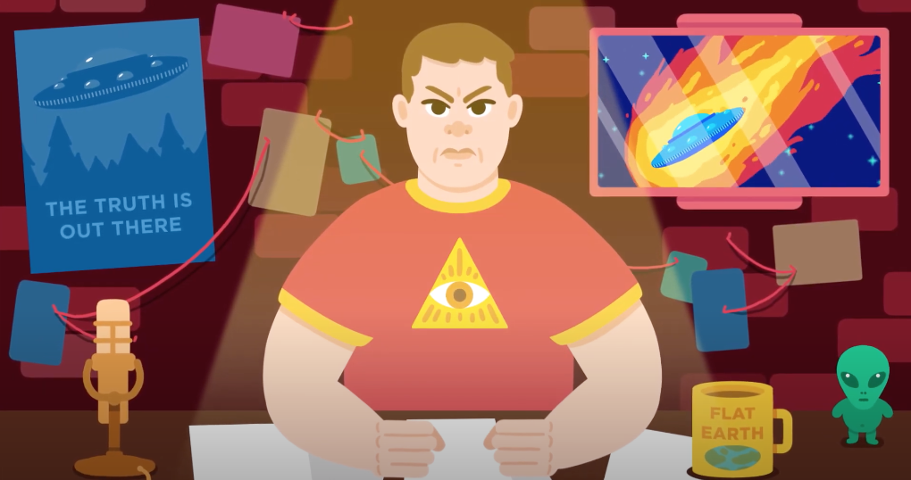
CTRL-F: Why Verify?
What is information pollution? How does false and misleading information spread online?

Slide 13
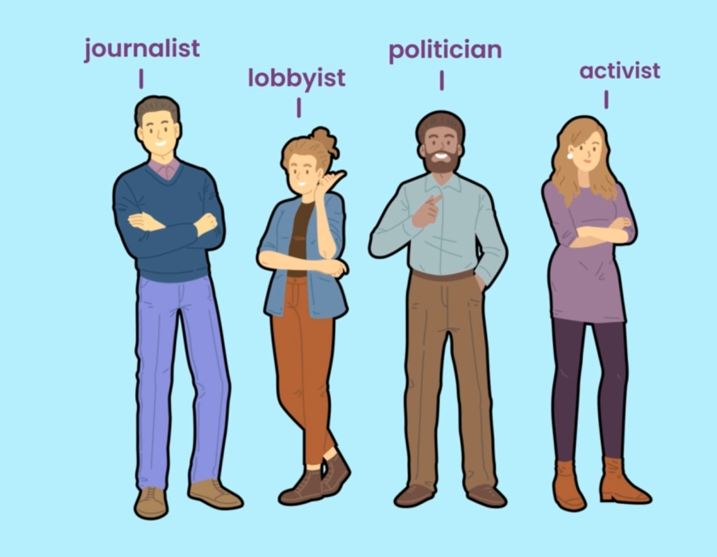
Investigate the Source
Who made the information?
What is the reputation of the source?

Slide 14
Just Add Wikipedia
ctrl-f.ca/en/halifax

Slide 15
Just Add Wikipedia

Slide 16
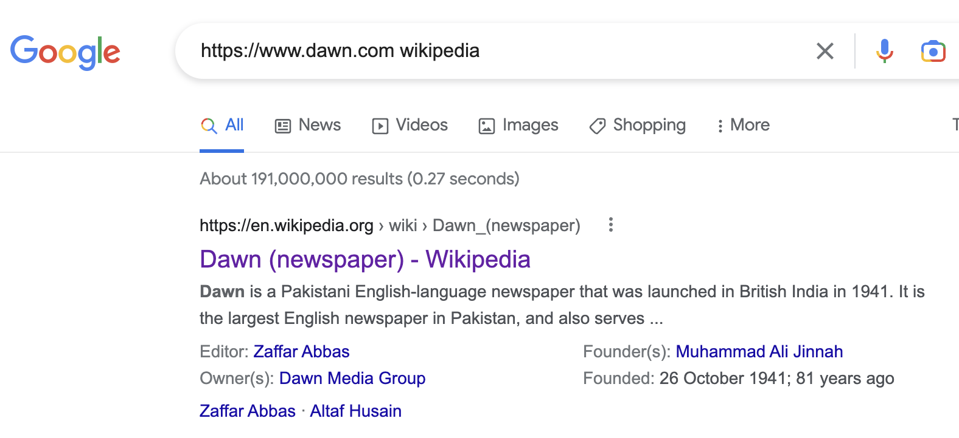
Just Add Wikipedia

Slide 17
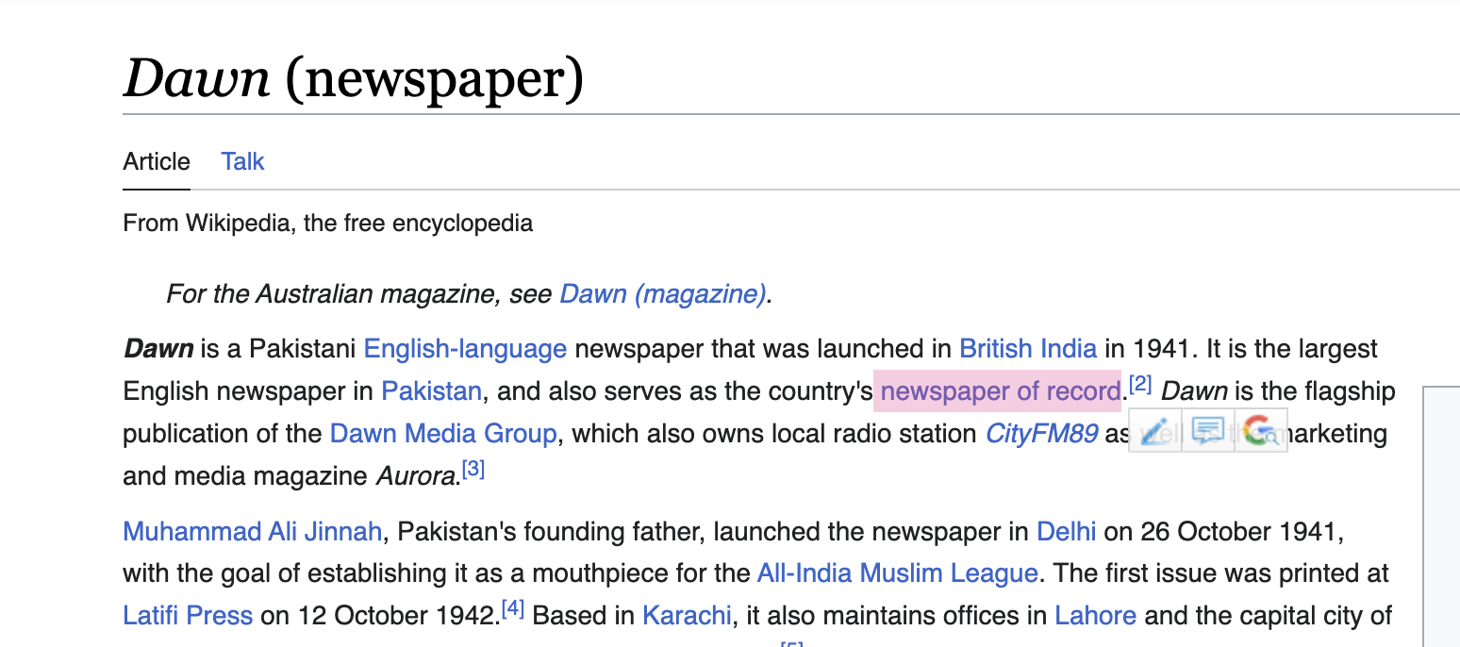
Just Add Wikipedia

Slide 18
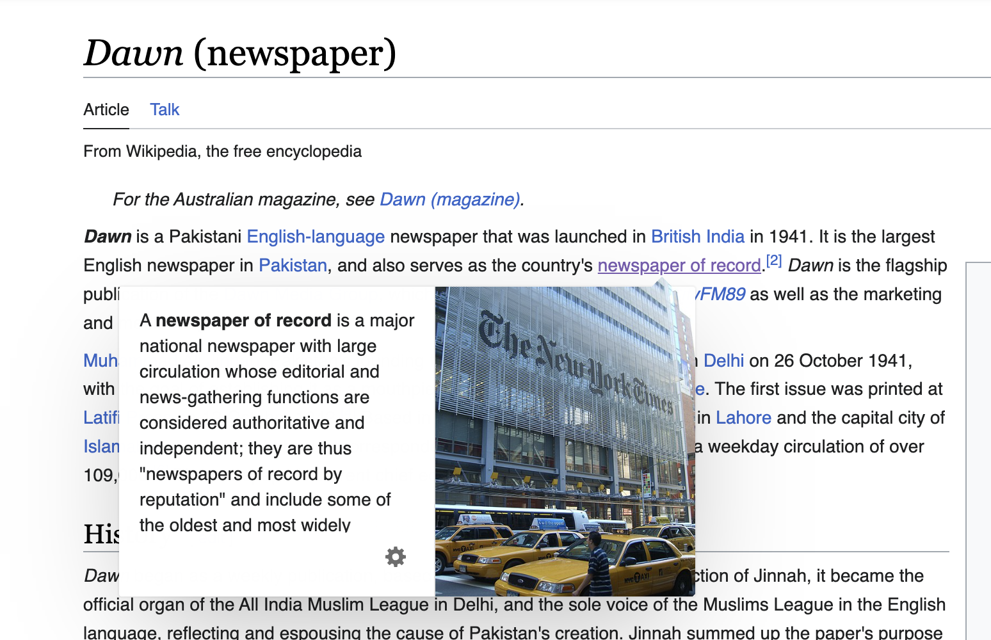
Just Add Wikipedia

Slide 19
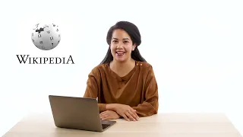
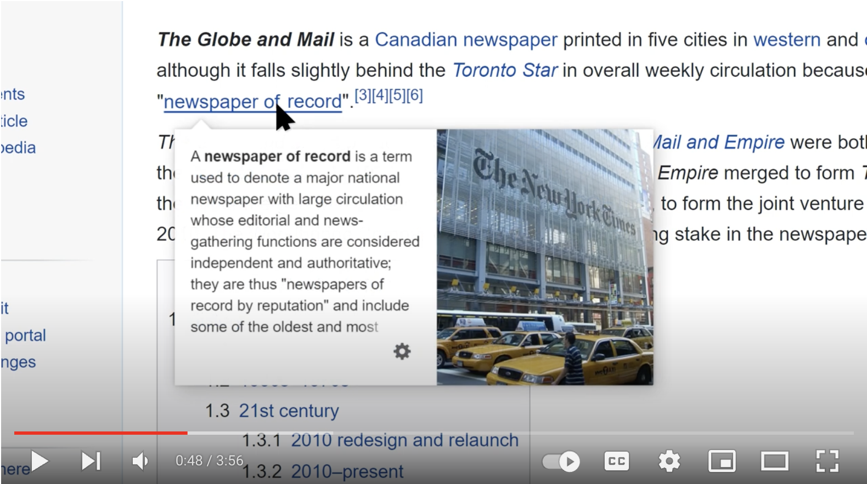
Wikipedia Videos
Why Use Wikipedia?
Tips and Tricks for using Wikipedia

Slide 20
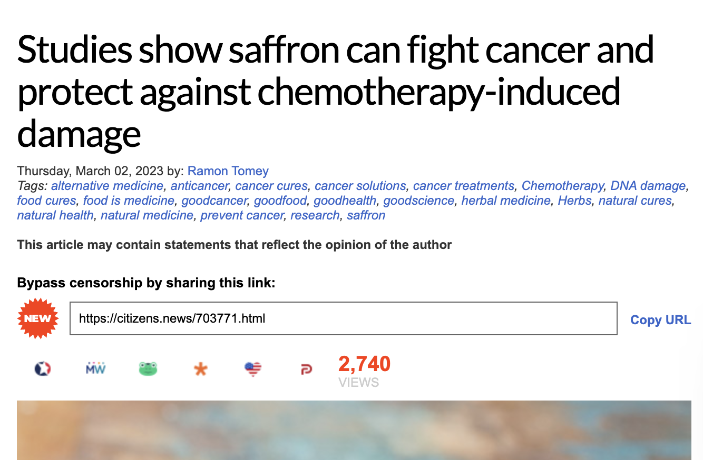
Practice: Just Add Wikipedia
https://www.naturalnews.com/2023-03-02-saffron-fights-cancer-protects-chemo-induced-damage.html

Slide 21
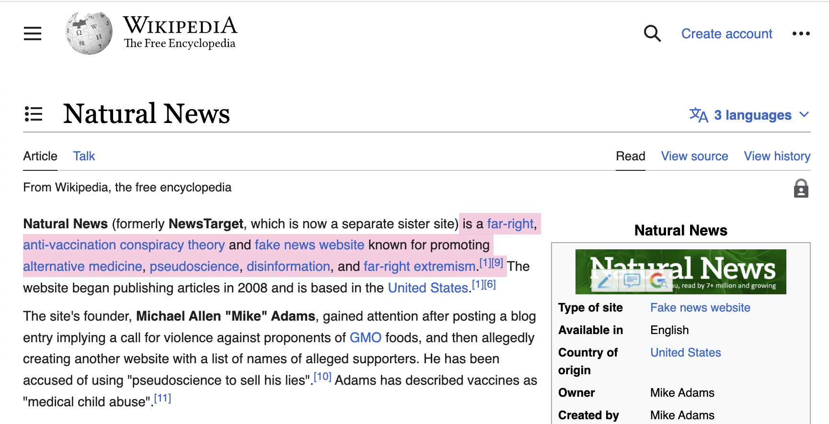
Just Add Wikipedia

Slide 22
Bias vs. Agenda
A preference for one thing over the other, a preconceived notion
What an organization is set up to do

Slide 23
Check the Claim
What are other sources saying?
Has the story been verified or debunked?

Slide 24
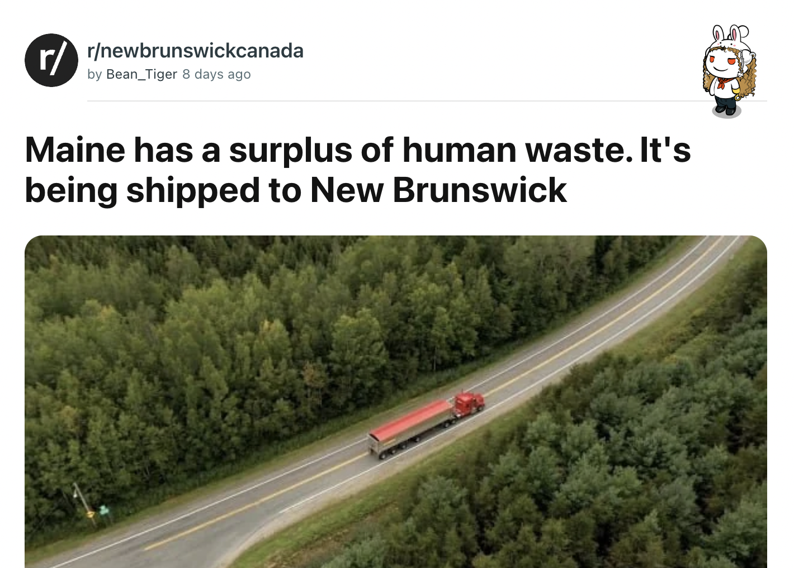
Check Other Sources

Slide 25
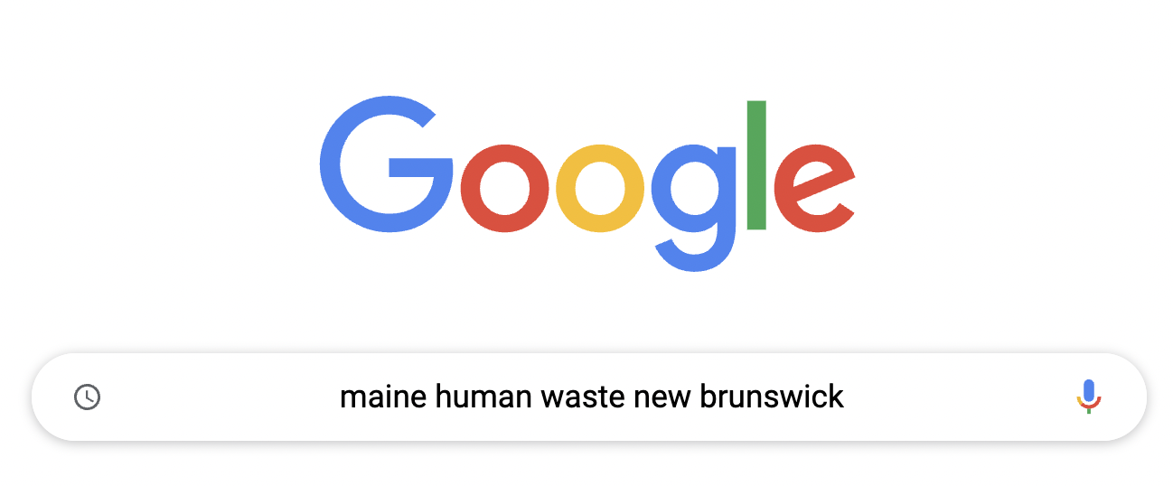
Check Other Sources

Slide 26
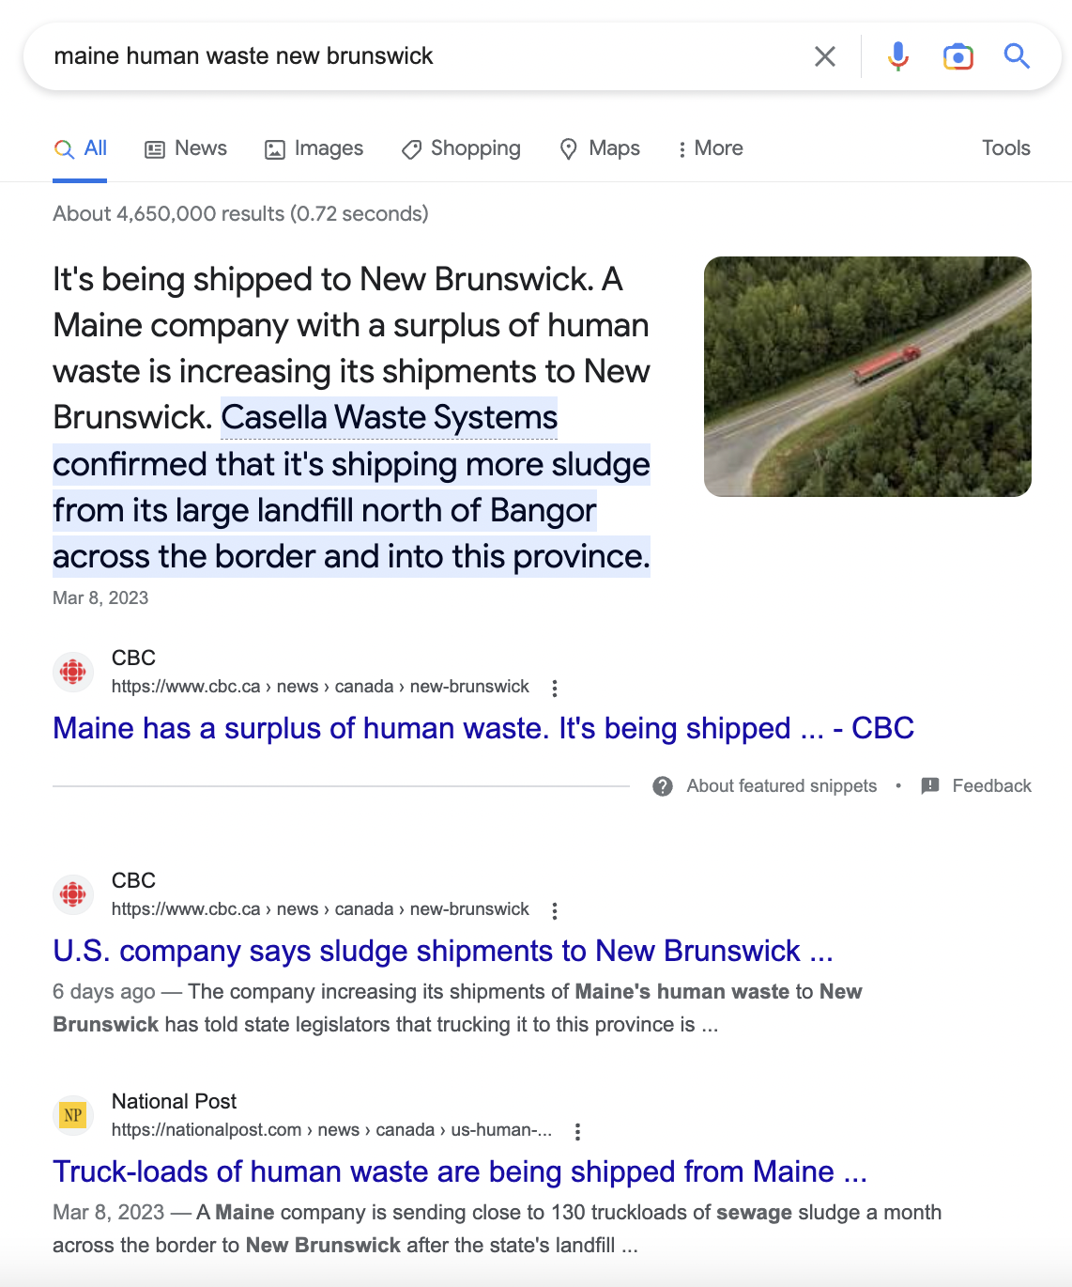
Check Other Sources

Slide 27
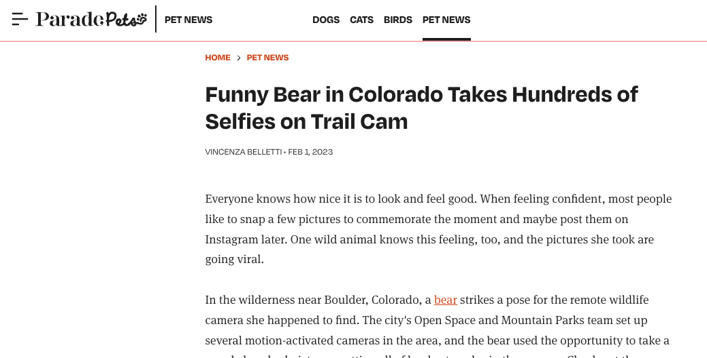
Practice: Check Other Sources
ctrl-f.ca/en/halifax
Did this happen, more or less?

Slide 28
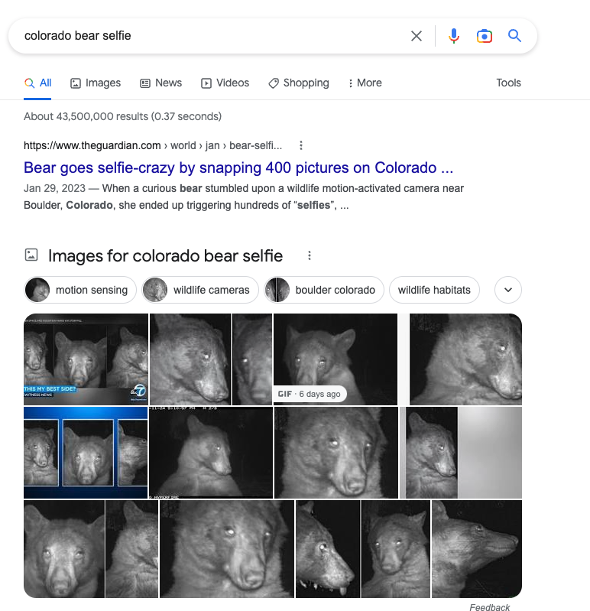
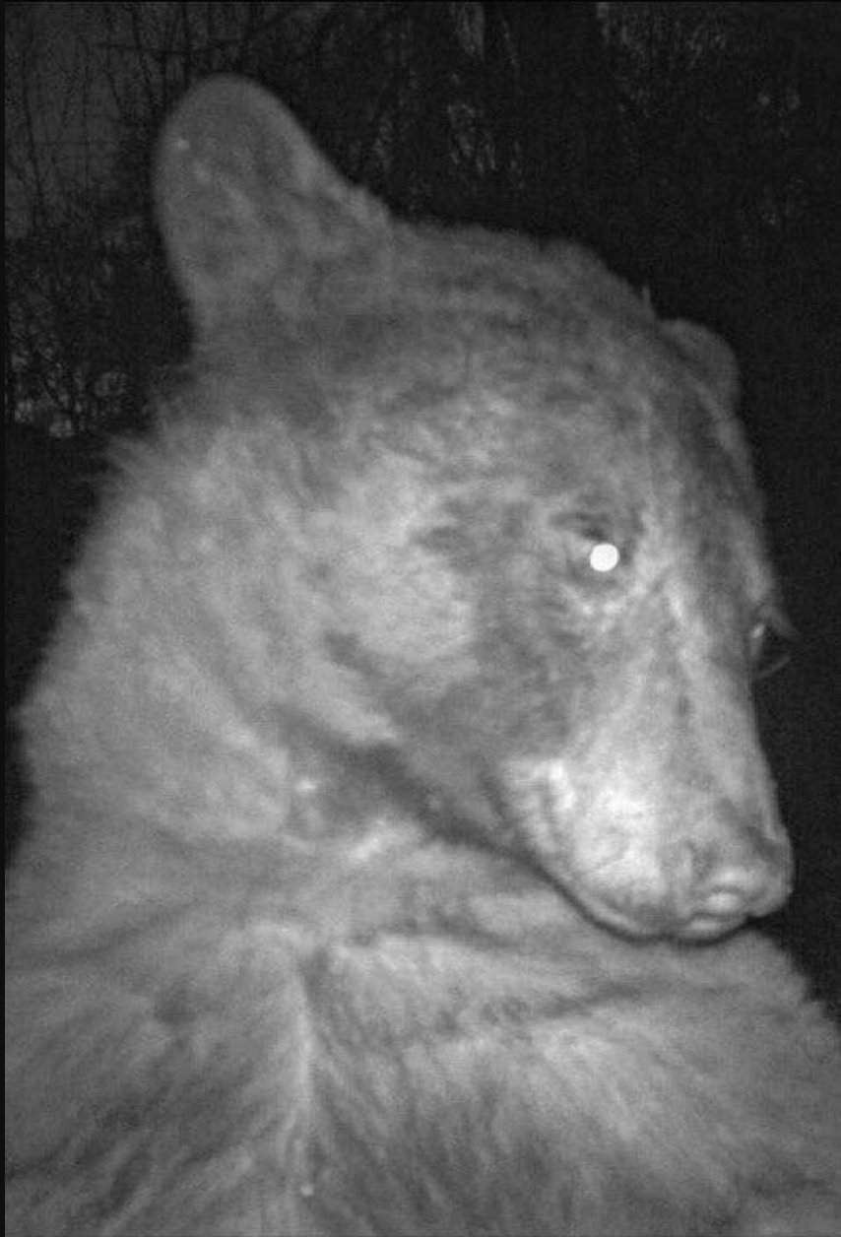
Practice: Check Other Sources

Slide 29
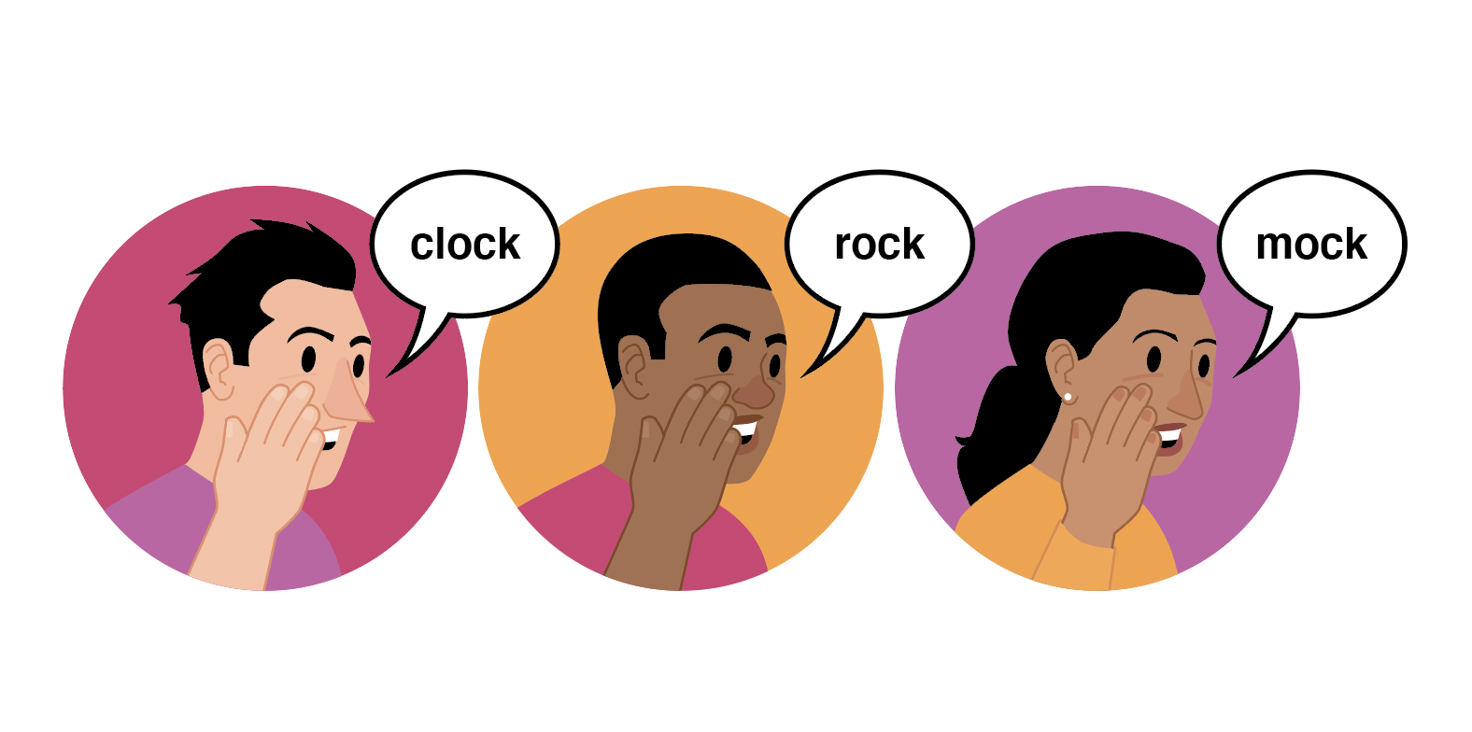
Trace the Information
How close can you get to original source?
Has the information changed in the re-telling?
Key Skills:
Click Through
Find
Check the Date
Reverse Image Search

Slide 30
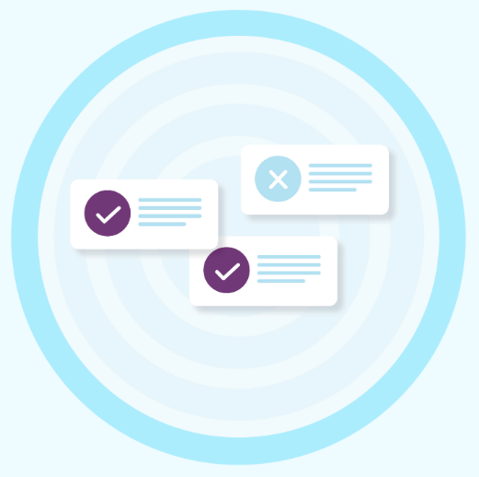
More Ways To Practice
CTRL-F Workshop (virtual)
April 4 @ 3:30 PM PT
April 19 @ 12:30 PM PT
To register: ctrl-f.ca/en/workshops

Slide 31
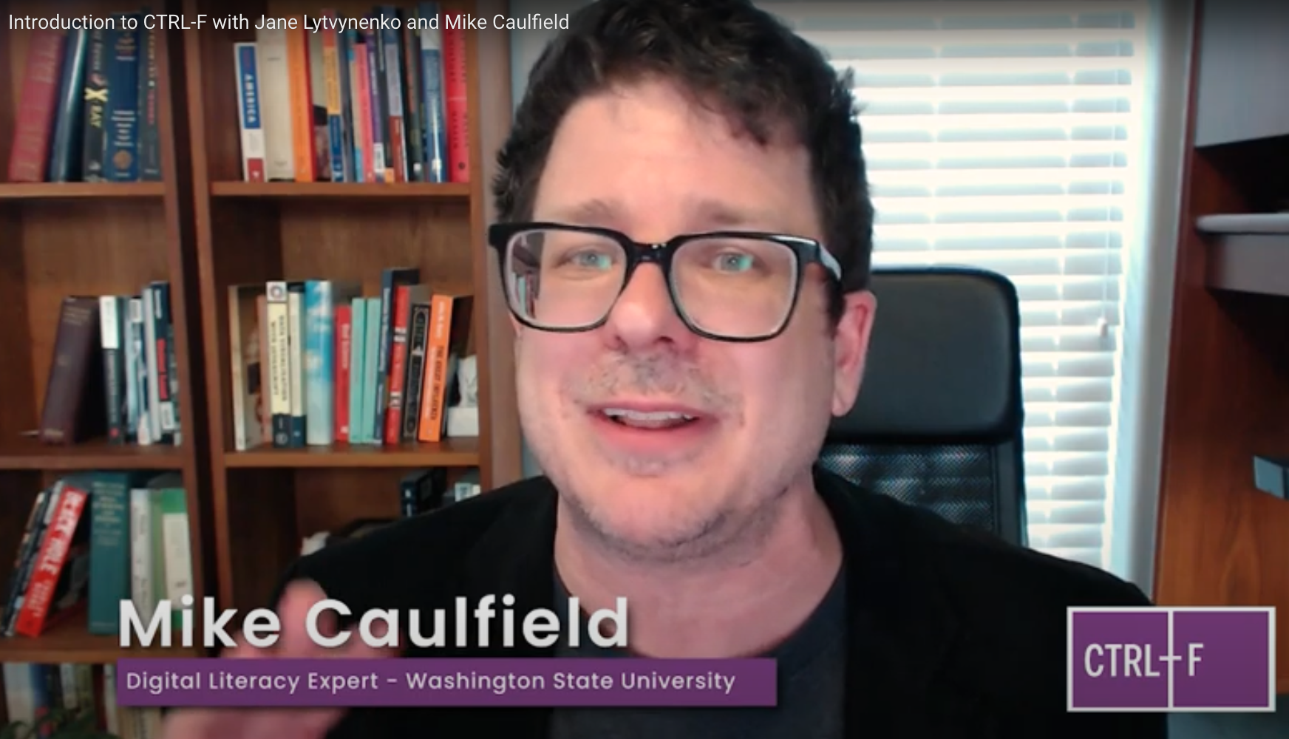
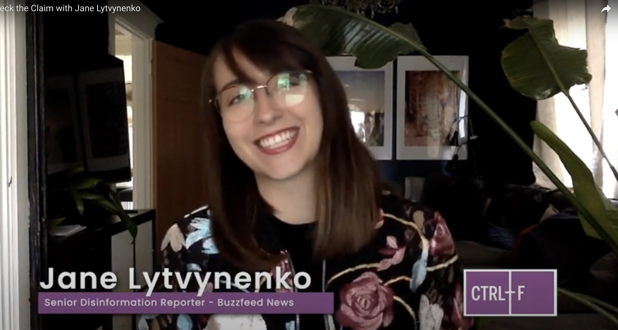
Free with registration
Expert-led videos
Step-by-step practice
• Grades 7-12
• 7 hours of class time
• Lesson plans, slide decks, assessments
• Multiple formats (Google, Microsoft forms)
• English / French
ctrl-f.ca

Slide 32
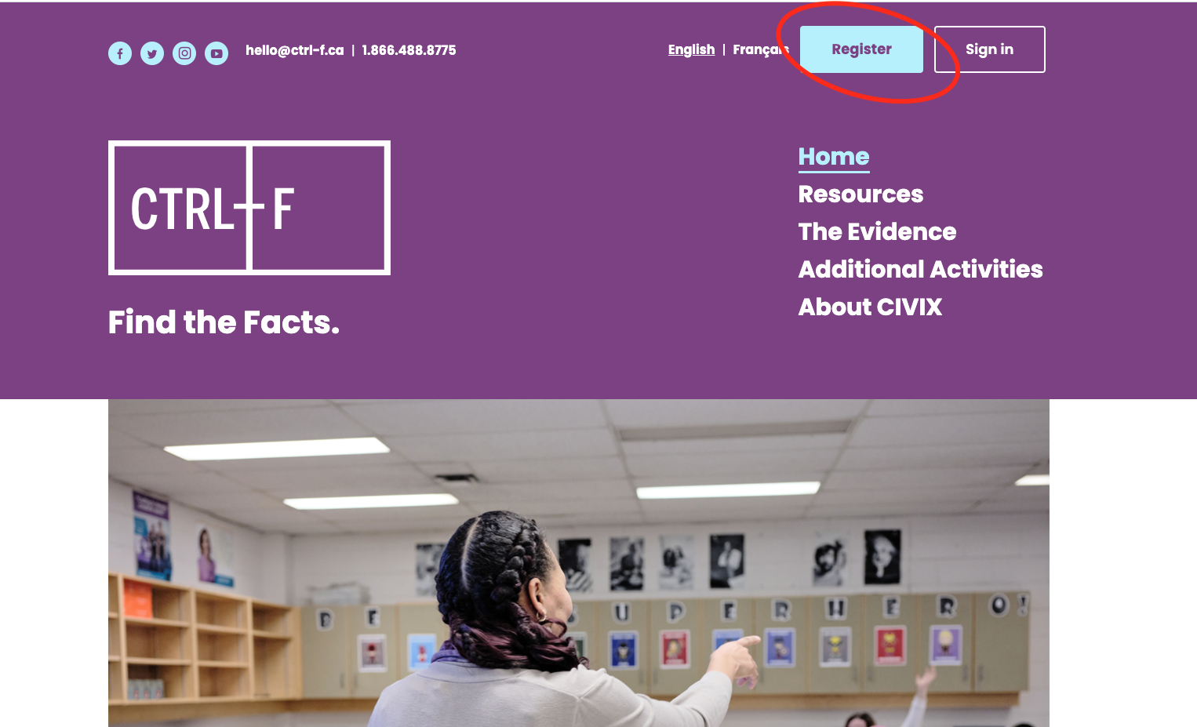
How to register
ctrl-f.ca

Slide 33
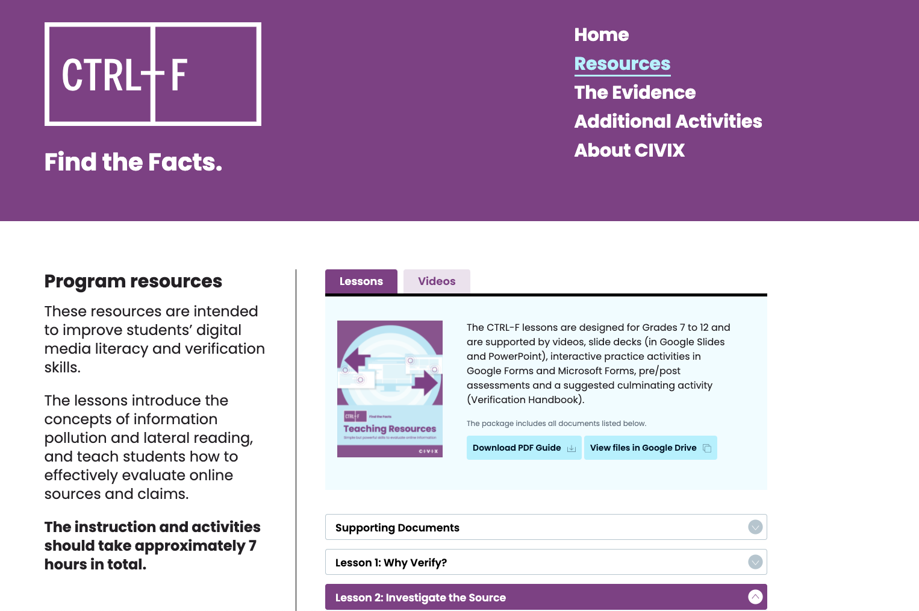
ctrl-f.ca/resources
(Registration required)

Slide 34
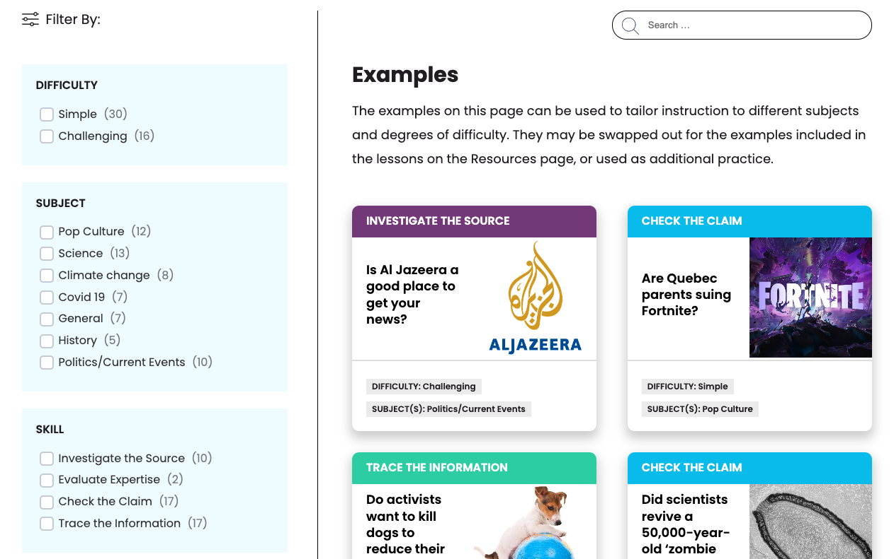
Filterable Example Bank
ctrl-f.ca/en/examples

Slide 35
Measuring the CTRL-F impact
2020/21 School Year: 80 teachers / 2 hours of virtual training / 2,324 students in grades 7 to 12 / Matched control group of 363 students / ~ 7 hours of CTRL-F instruction
CIVIX partnered with expert researchers to test these tools to understand their impact on Canadian middle- and high-school students' ability to reason through online sources and claims

Slide 36
Pretest: the baseline isn’t good
Only 6% identified the agenda of an advocacy group
79% percent read vertically, analyzing the post to reach conclusions

Slide 37
Posttest: CTRL-F Works
Sixfold increase in lateral reading
41 point increase in reasoning
59% on posttest
11% on pretest
50% Cited key context on posttest
9% on pretest
vs
vs

Slide 38
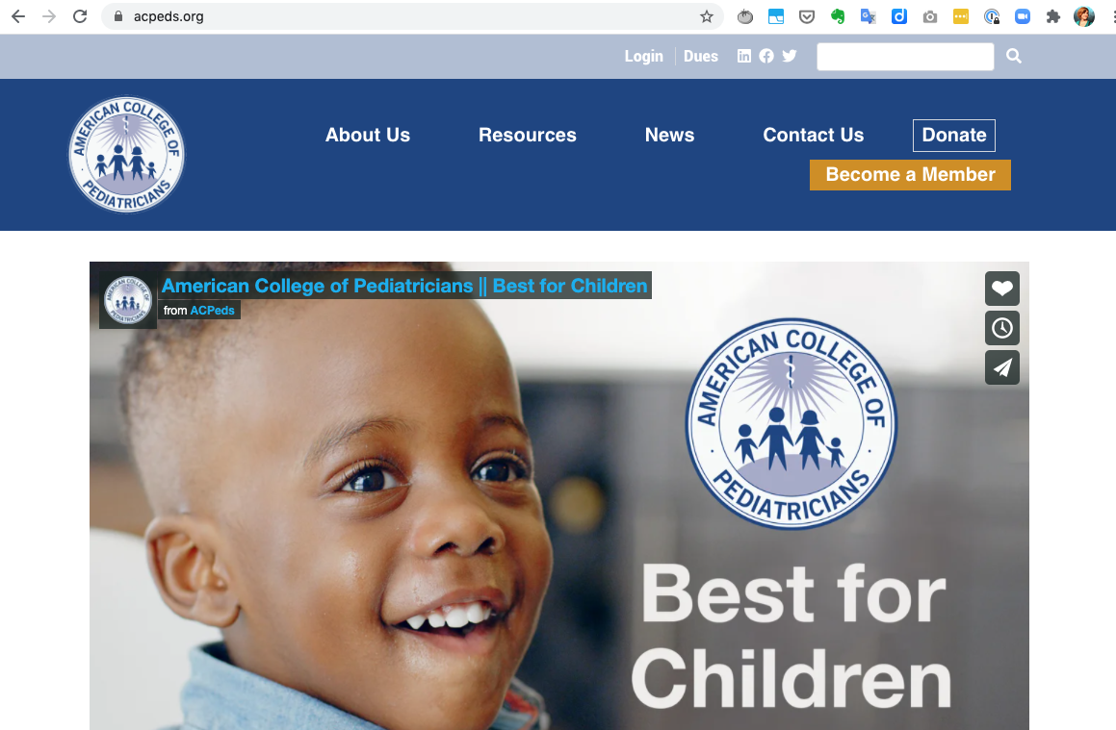
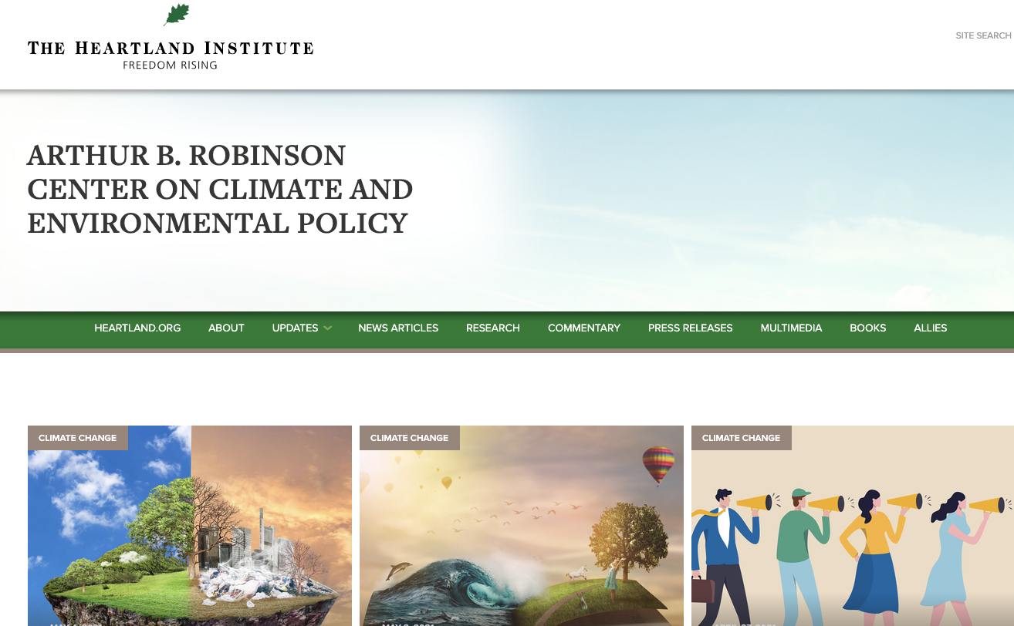
Student A pretest response:
American College of Pediatricians, anti-LGBT advocacy group
Student A posttest response:
Heartland Institute, Climate-change denial group
"The website isn’t cluttered with advertisements. There is contact information. They have stated their objectives."
“At first, it seemed like the site was reliable, but after reading the Wikipedia site for a bit I found out that they are a leading promoter of climate change denial.”

Slide 39
Questions?
Dimitri Pavlounis — dimitri@civix.ca

