Slide 1
Democracy Bootcamp
Session 1: Facilitating Effective Discussions
8:45 to 9:25

Slide 2
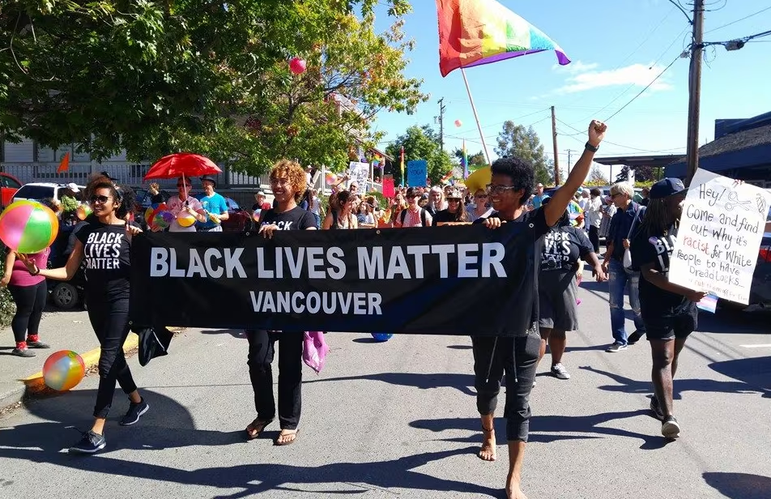
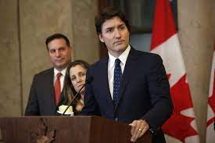
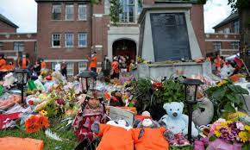
There’s always lots to talk about…
...

Slide 3
PoliTalks Supports Educators
Intentional and structured approach
New ideas, new ways of presenting familiar ones
Here to make classroom discussions easier!

Slide 4
Embracing Structure
Takes the guesswork out of discussion
Facilitates inclusive participation
De-centres the teacher and gives students more agency
Supports the development of skills that can be applied in more spontaneous discussions

Slide 5
Benefits of Structured Classroom Discussion
Students who participate in structured political classroom discussions have been shown to be more:
...
Engaged in class
Interested in news and politics
Confident in their discussion abilities
Interested in listening to different opinions
Likely to vote

Slide 6
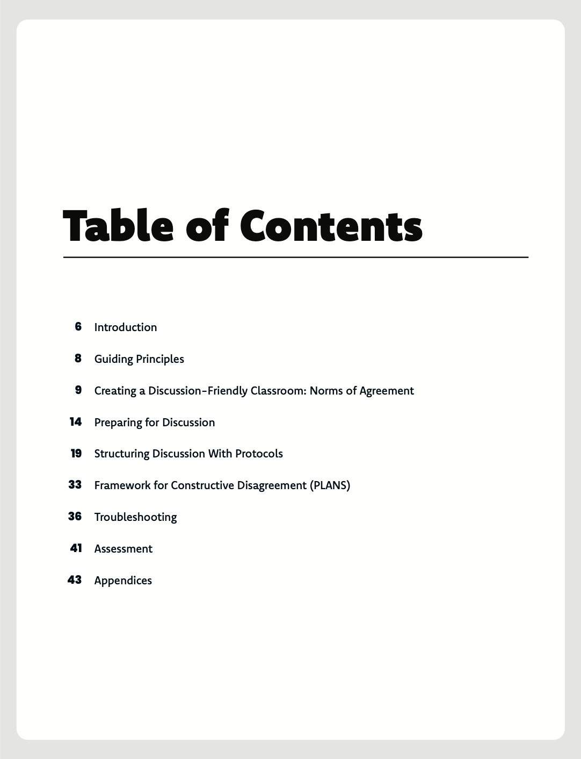
‘Constructive Discussions’ Guide
Table of Contents image here
Cover image TK

Slide 7
Considering the phrase ‘constructive discussion,’ what words or phrases come to mind?
ⓘ Start presenting to display the poll results on this slide.

Slide 8
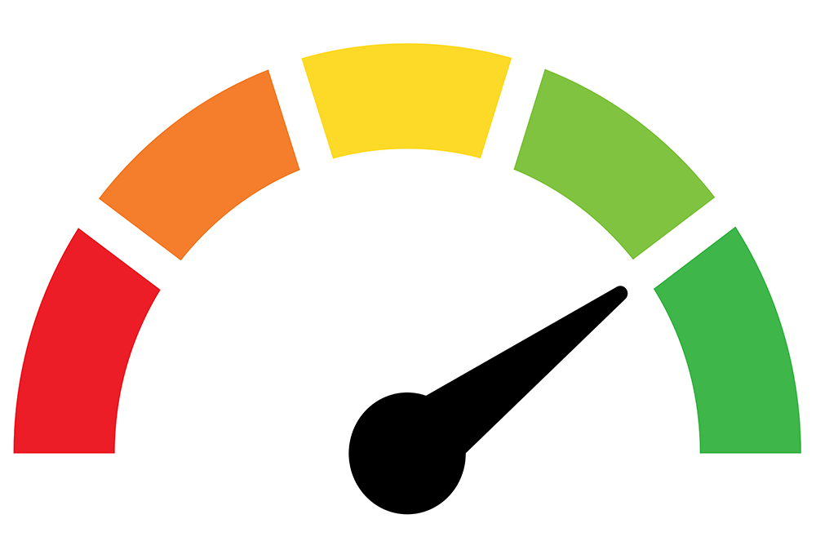
What is a ‘Constructive Discussion’?
An exchange of ideas that:
favours curiosity over judgement
promotes understanding over resolution (we don't need to agree)
leads to a deeper and more nuanced understanding of an issue by all participants
takes winning off the table (not a debate)
...

Slide 9
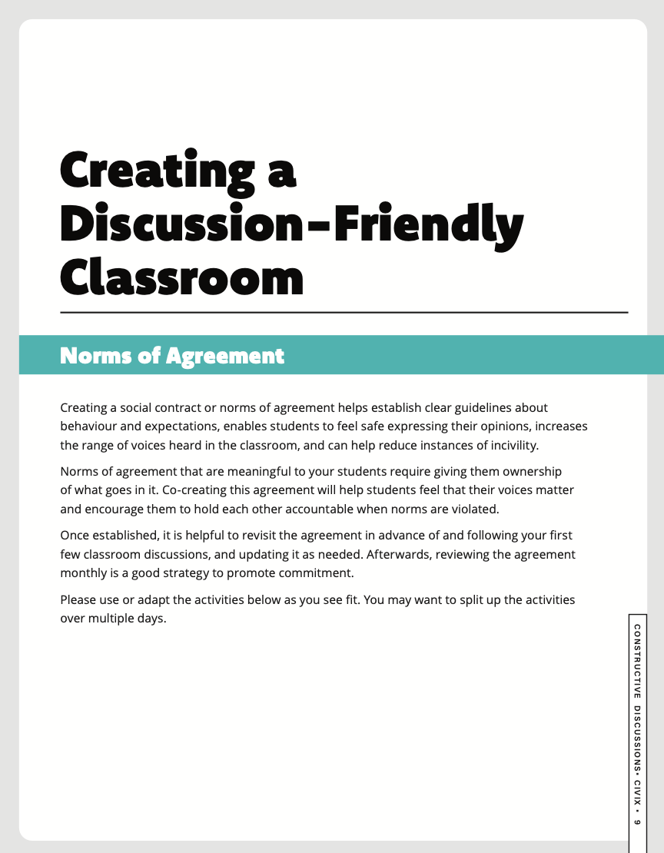
Norms of Agreement for Classroom Discussion
Co-created norms for behaviour related to discussion
Allows students voices heard, to feel invested in processes
Provides agreed-on reference for handling problems when they arise
Should be reviewed regularly and updated as needed

Slide 10
Possible Norms
Respond with curiosity instead of judgement.
Criticize ideas, not individuals.
Give everyone the opportunity to speak.
If someone shares an idea or opinion that helps your own learning, show appreciation.
If you say something that offends someone, apologize, even if the offence was not intended.

Slide 11
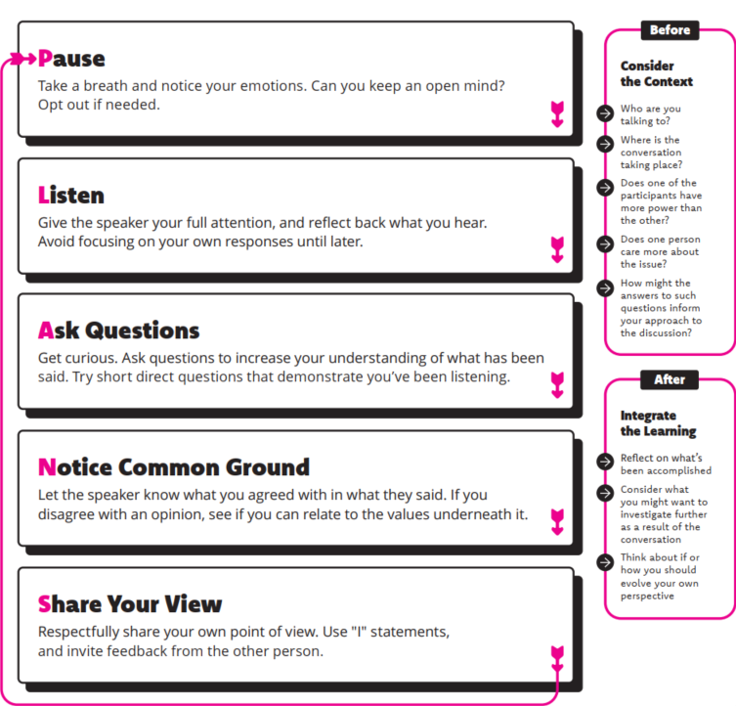
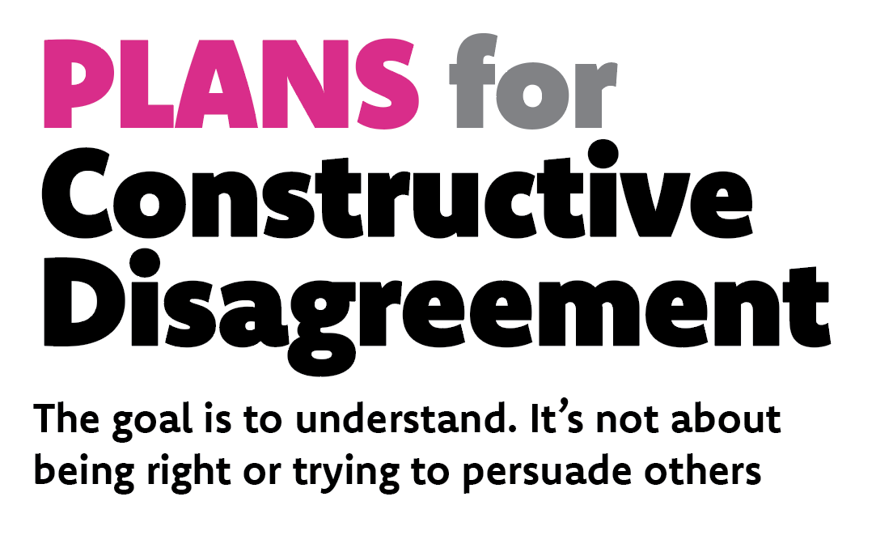

Slide 12
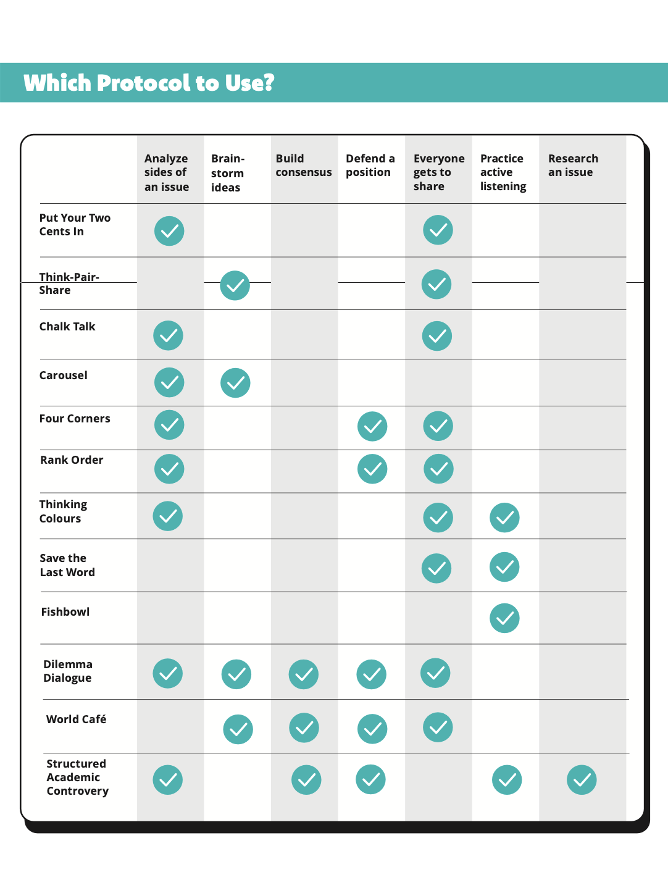

Slide 13
Rank-Order Protocol: Attributes of Classroom Discussion

Slide 14
Rank Order Protocol: Discussion Attributes
Rank the following 5 attributes of classroom discussion from most to least important. Make some short notes to explain your thinking.
Everyone Participates: All students participate actively in the discussion (this can include active listening).
Diversity of Opinions: Multiple viewpoints on a given issue are expressed and defended.
Appropriate Use of Evidence: Students support their opinions with evidence that is relevant and accurate.
Minimal Teacher Involvement: Students lead and direct the vast majority of the discussion, and the instructor only intervenes to facilitate or mediate when necessary.
Respectful Environment: Students follow the rules of classroom etiquette and treat each other with respect at all times.

Slide 15
Rank Order Protocol Activity
Rank discussion attributes from most important (1) to least important (5). Jot down some notes if needed. (4 minutes)
Divide the table into two groups of 3-4.
Assign a timekeeper (person who has been a teacher the longest).
Take turns sharing order and reasoning. Person with the most recent birthday goes first. (2 minutes each — 8 min total)
Discuss and compare — What differences do you notice? What accounts for these differences? Does anyone want to change the order they started with? (3 minutes)

Slide 16
Coming out of your discussion, how did you rank your discussion attributes?
ⓘ Start presenting to display the poll results on this slide.

Slide 17
Debrief
Rank order activities are a great way to get students thinking about complex issues in a low-stakes way
Constructive Discussions contains additional discussion protocols that have been developed by researchers and practitioners

