Slide 1
Democracy Bootcamp
Session 2: Perspectives & Biases
9:30 to 10:15

Slide 2
Perspectives and Biases
Having constructive discussions requires:
Understanding where your beliefs come from
Taking others’ perspective and getting curious about why they believe what they believe
An openness to new ideas and receptiveness to new information
Recognizing that we’re all prone to making mistakes

Slide 3
Resource Overview: Perspectives
Lesson Themes
Identities and Pluralism
Perspectives and Opinions
Political Ideologies
Underlying Values
...

Slide 4
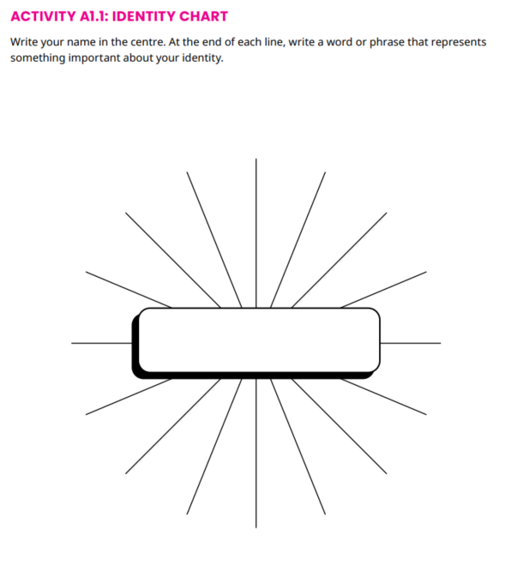
Identities and Pluralism
Analyze the key factors that shape students’ identities
Evaluate the importance of pluralism
Activity: Identity chart and discussion

Slide 5
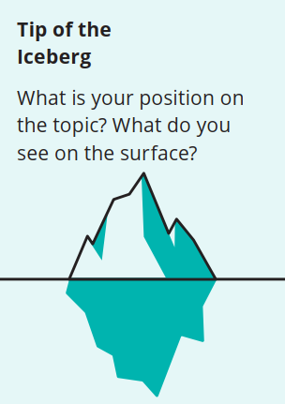
Perspectives and Opinions
Understand how different perspectives can lead to different ways of seeing the world
Get curious about the views of classmates
Iceberg Activity: What Makes Up Your Perspective?
Think-Pair-Share: Comparing Perspectives

Slide 6
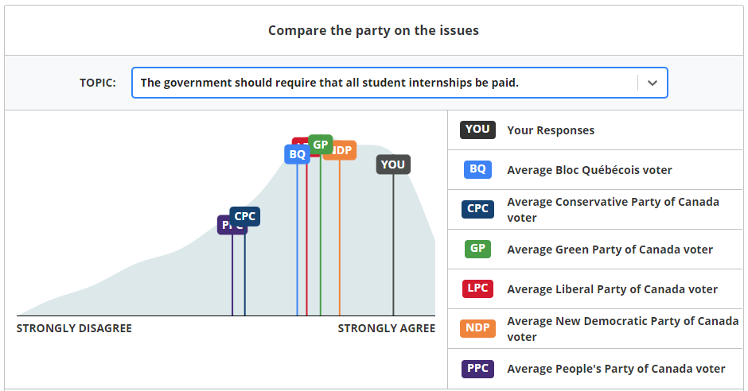
Political Ideologies
Describe different ideologies on the political spectrum
Analyze their current placement on the political spectrum
Activity: Youth Vote Compass
Discussion: Political Perspectives

Slide 7
Underlying Values
Analyze how the values you prioritize influence your views
Take the perspective of someone who prioritizes different values
Reflect on the social values they find most important
Activity and Discussion
Value Cards

Slide 8
Freedom
Equality
Prompt: Uniforms should be mandatory in schools.
Financial Liberty
Sample response - disagree
People should have the freedom to choose to wear what they want
Some traditions encourage people to wear different clothes, especially during celebrations
Security isn’t really important here, so I’ll skip it
Tradition
Security
Respecting Others

Slide 9
Activity: Value Cards
Deal three cards to each player, face up, one on top of the other. The topmost is the most important, middle second most, bottom third most. Read out your cards and definitions.
Read the prompt on screen. Consider: how would someone who prioritized those values respond to the prompt? Each partner takes a turn in explaining their response.
Now deal three new cards. How did your response change based on your new values?
Prompt 1: 5 minutes
“The government needs to do more to reduce the gap between rich and poor.”
Prompt 2: 5 minutes
“The government should not control what can and cannot be said online.”

Slide 10
Take a look through all the value cards. Which do you think play the biggest role in shaping your own perspectives?
ⓘ Start presenting to display the poll results on this slide.

Slide 11
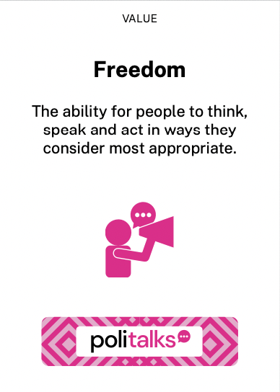
Prompt: The government should have more control over what Canadians are allowed to say in public.
Why might someone with this value disagree with this statement?
Why might someone with this value agree with this statement?

Slide 12
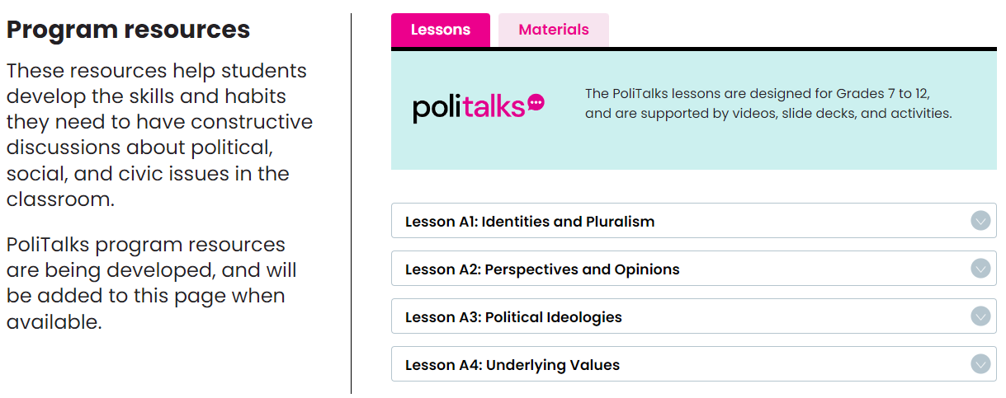
Accessing Resources - politalks.ca

Slide 13
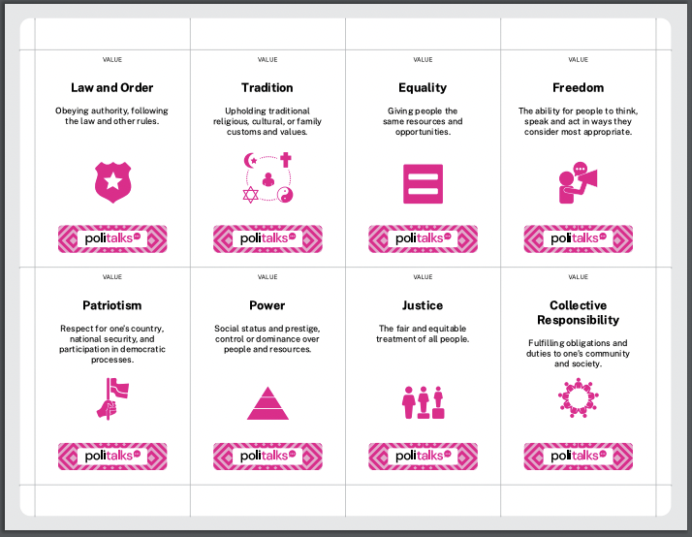
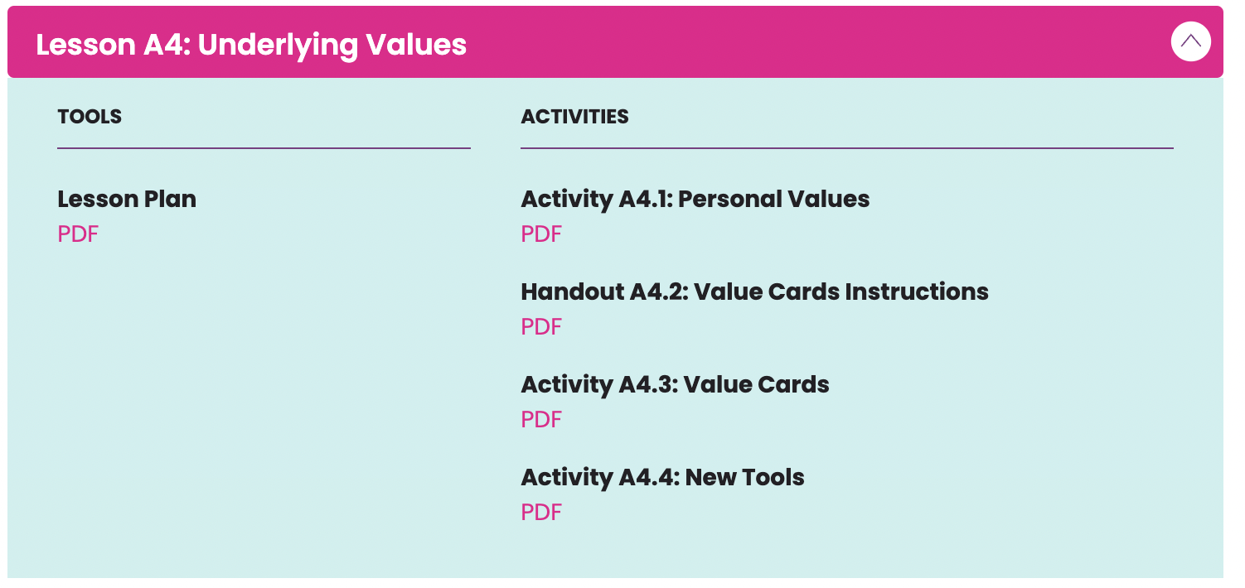
Accessing Resources - politalks.ca

Slide 14
Upcoming Resource Overview: Cognitive Biases
Lesson Themes
Biased Thinking
Confirmation Bias
In-Group/Out-Group Bias
...

Slide 15
Biased Thinking
Understand the role of cognitive biases in shaping how we receive and process information
Recognize that we all have biases, and don’t have the objectively correct view on everything
Recognize that it’s easier to see biases in others than it is to see in ourselves
Activity: Bias Blind Spot
Come on in, the water’s fine!

Slide 16
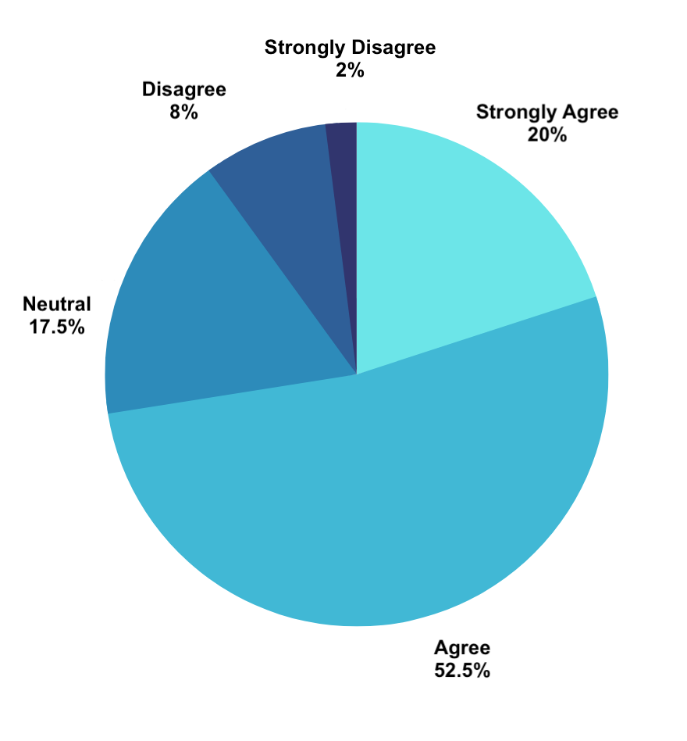
“I feel confident facilitating political discussions in my classroom”

Slide 17
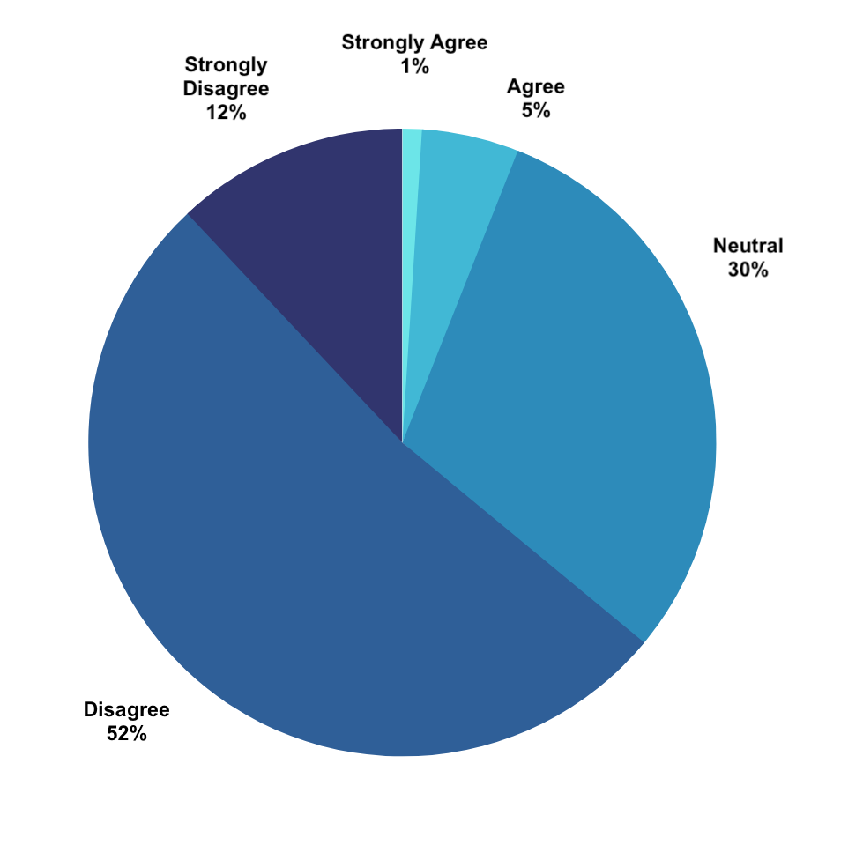
“Most teachers feel confident facilitating political discussions in the classroom”

Slide 18
Confirmation Bias
Confirmation Bias: Our tendency to seek out and interpret information in a way that confirms what we already believe
Analyze the impact of confirmation bias on information- seeking behaviour
Reflect on ways to mitigate the effects of confirmation bias

Slide 19
In-Group Bias
In-Group Bias: Our tendency to give preferential treatment to those who are members of our groups.
Understand in-group bias, and identify instances where it occurs
Recognize how in-group bias can create divisions and polarization

