Slide 1

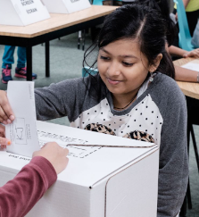
Best Practices for Student Vote

Slide 2
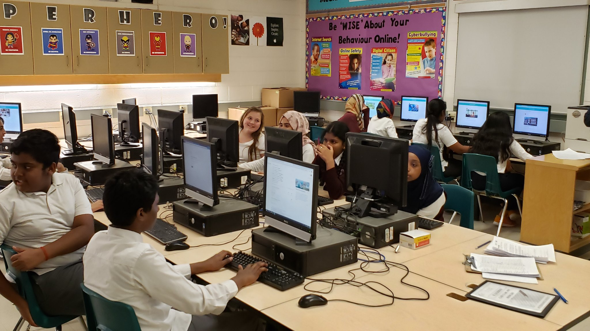
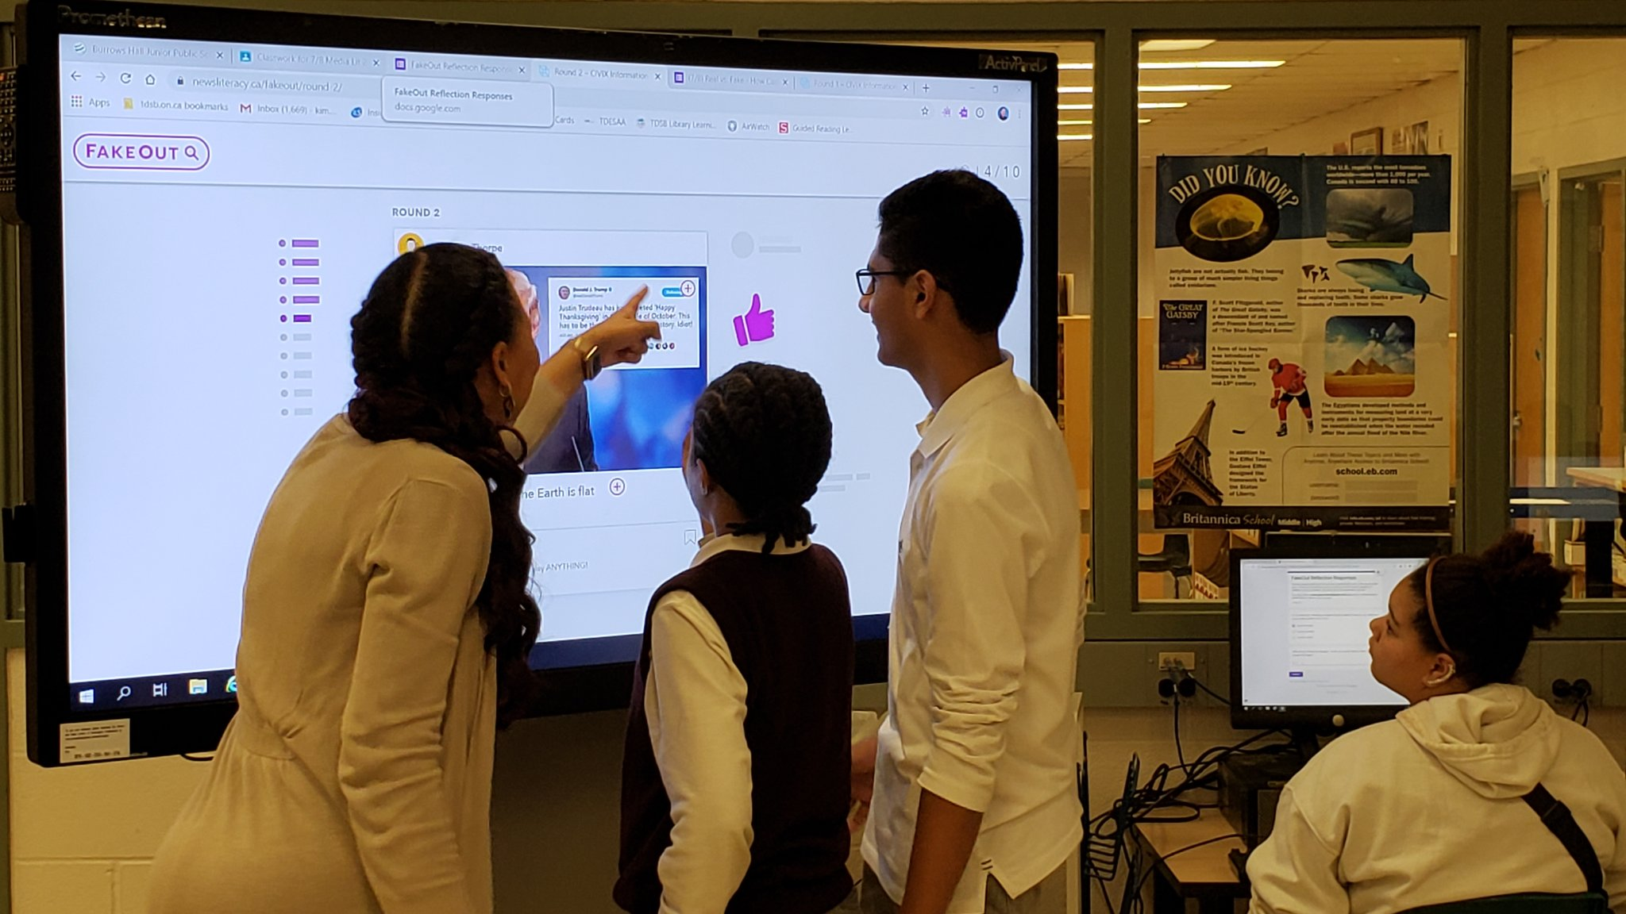
Kim Davidson
Incorporate digital resources into your lessons for increased student engagement

Slide 3








Kim Davidson
CIVIX has a catalogue of animated videos (in both English and French!) available through YouTube that explain key concepts in a clear and concise way

Slide 4

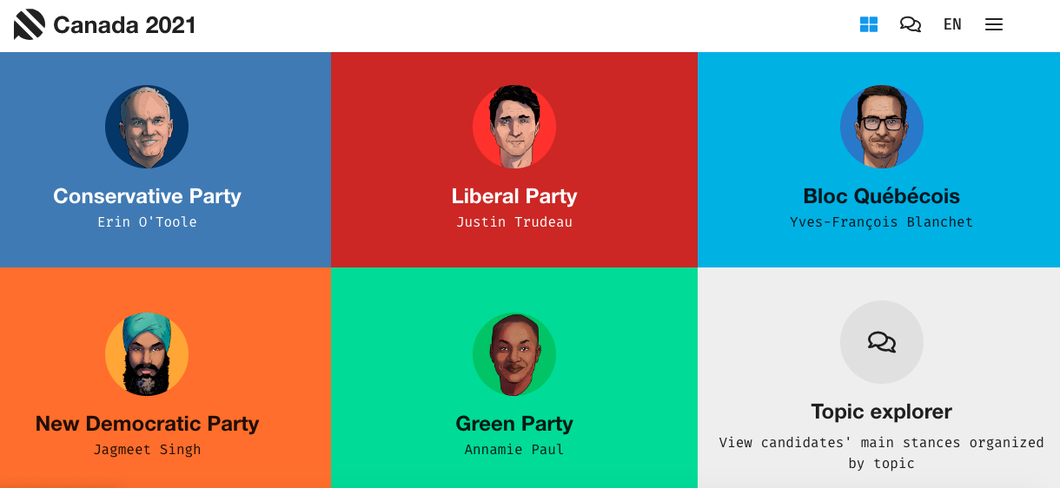
Kim Davidson
Other online tools include Pollenize and
Vote Compass (Youth Edition)

Slide 5
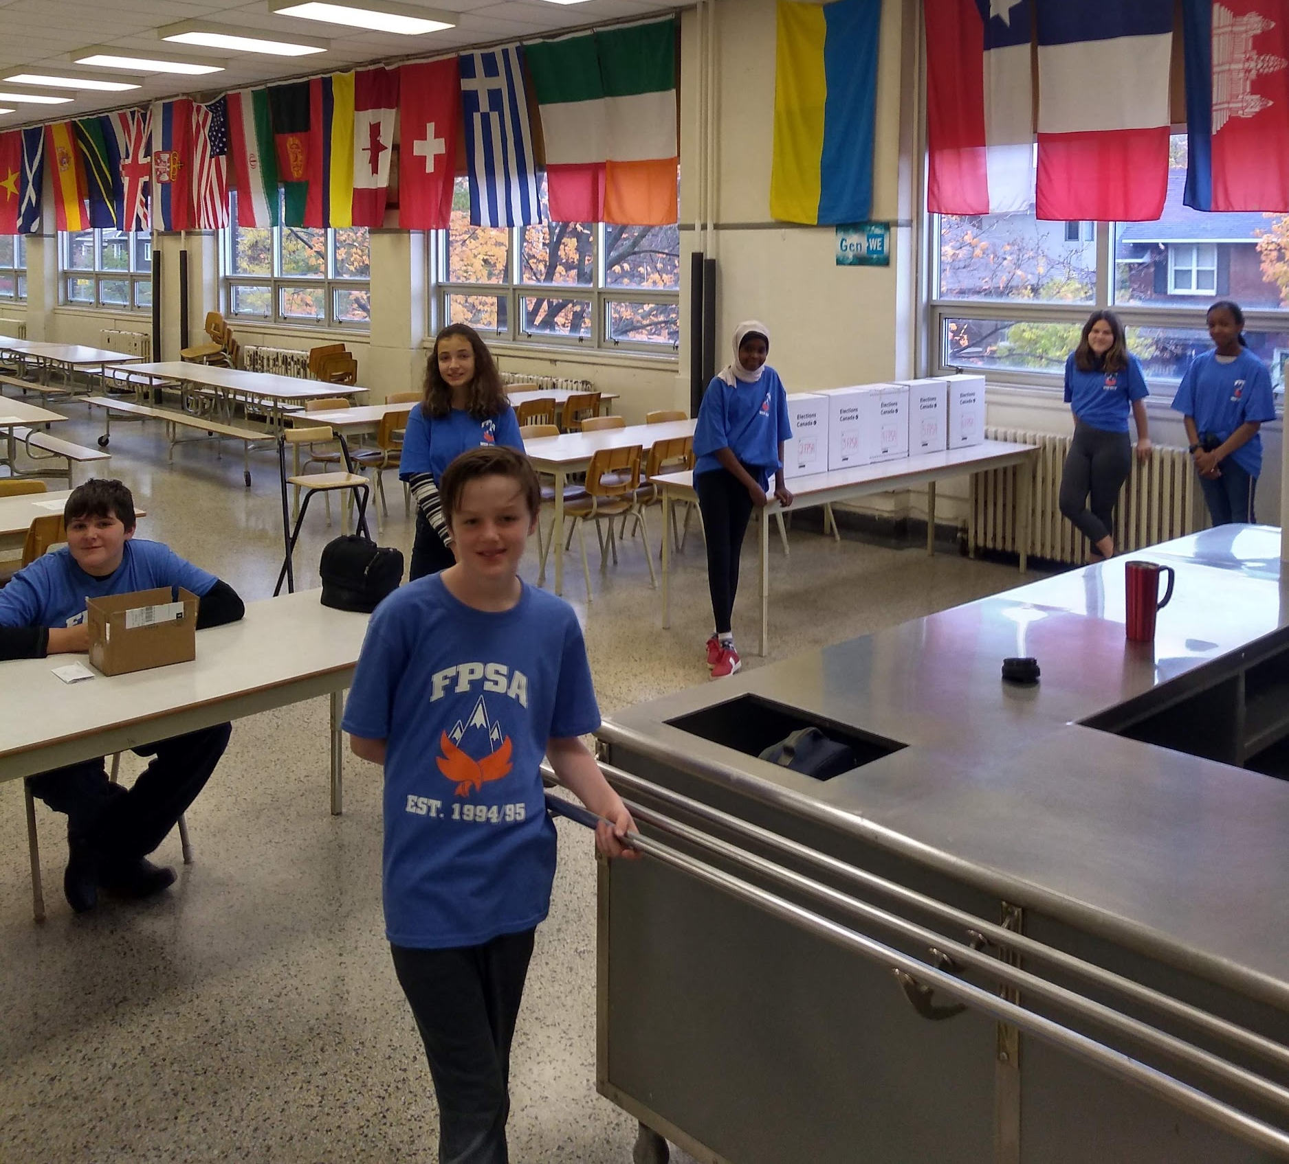
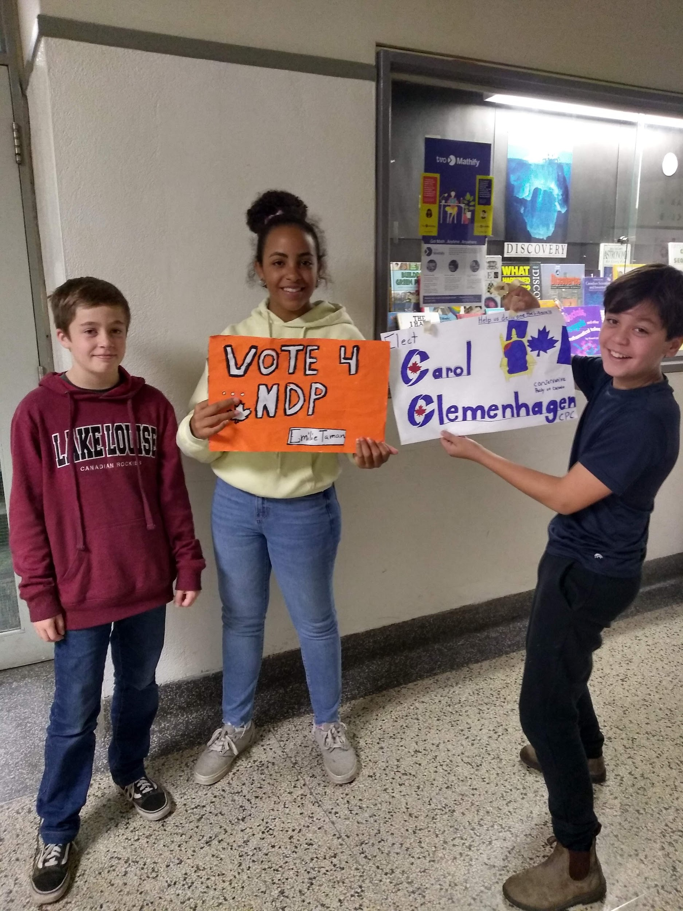
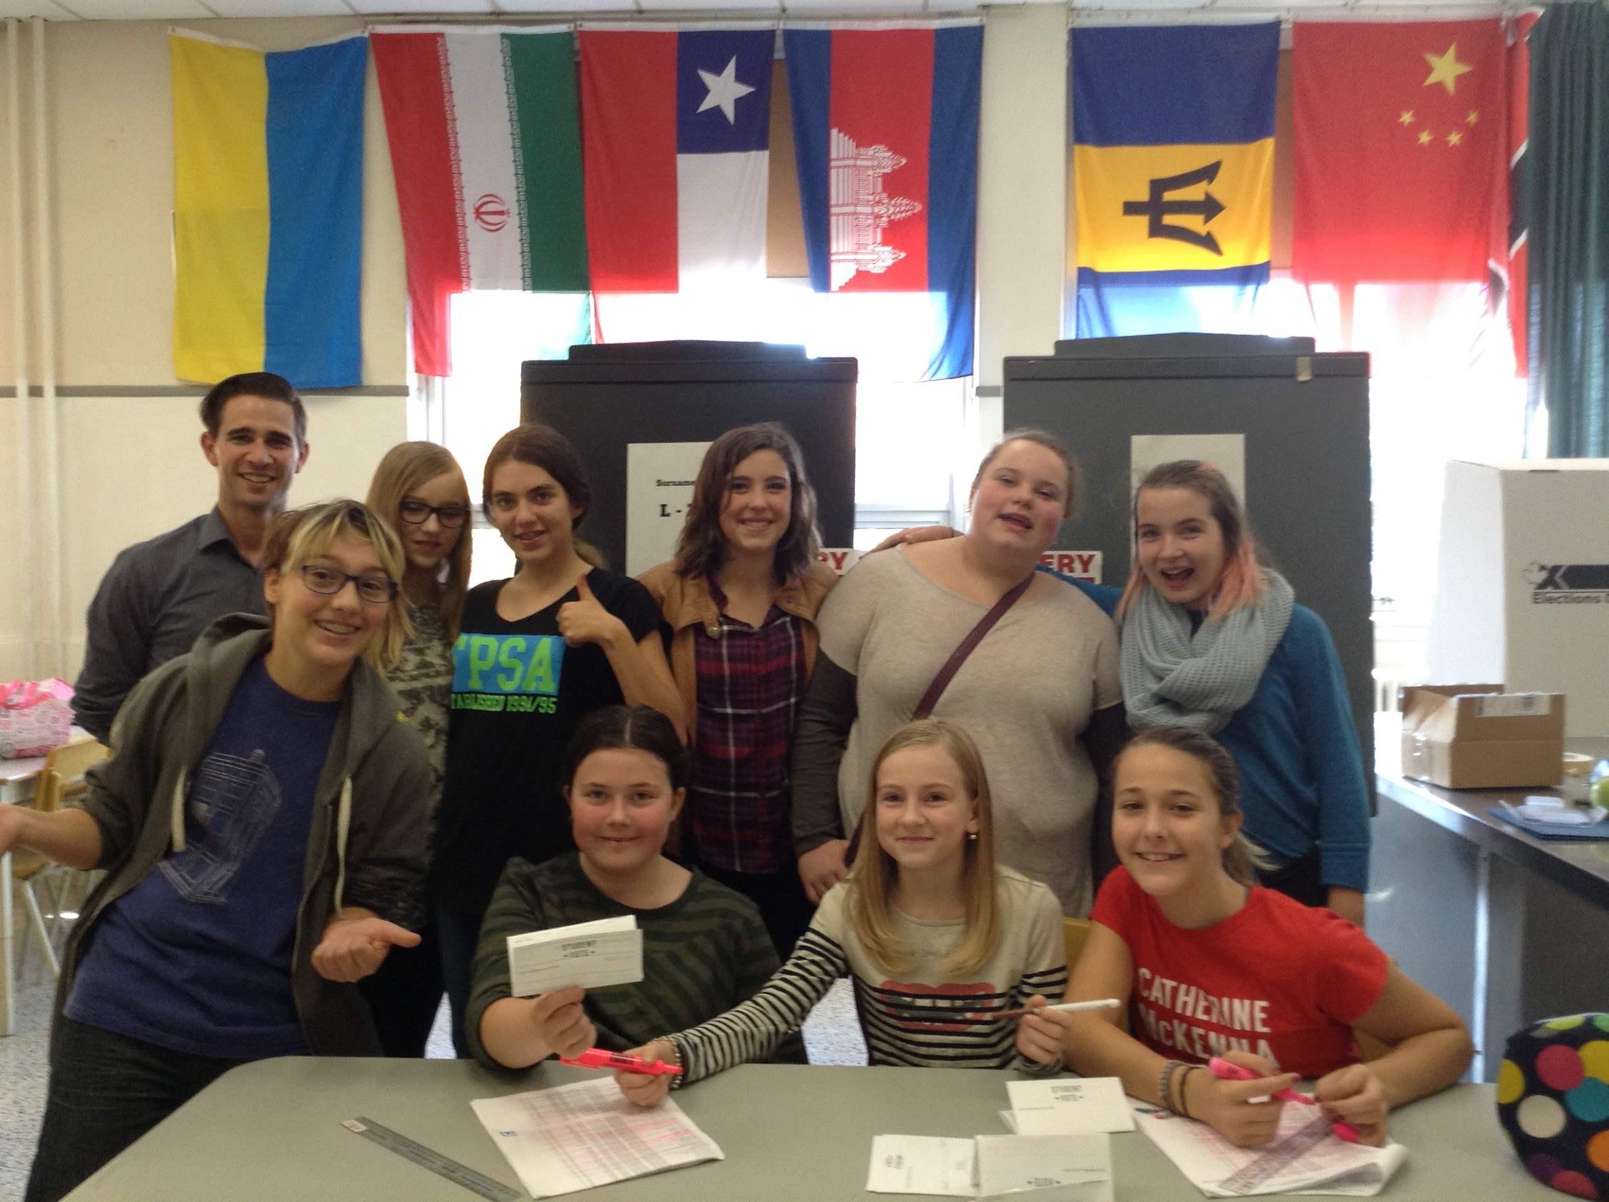
Matthew Herrington
Elections Club
Multi-Grade Groupings
Democracy Champs
  Explore Election Issues
  Share w/ classes
Town Hall Prep
  Agendas, Scripts, Deck

Slide 6
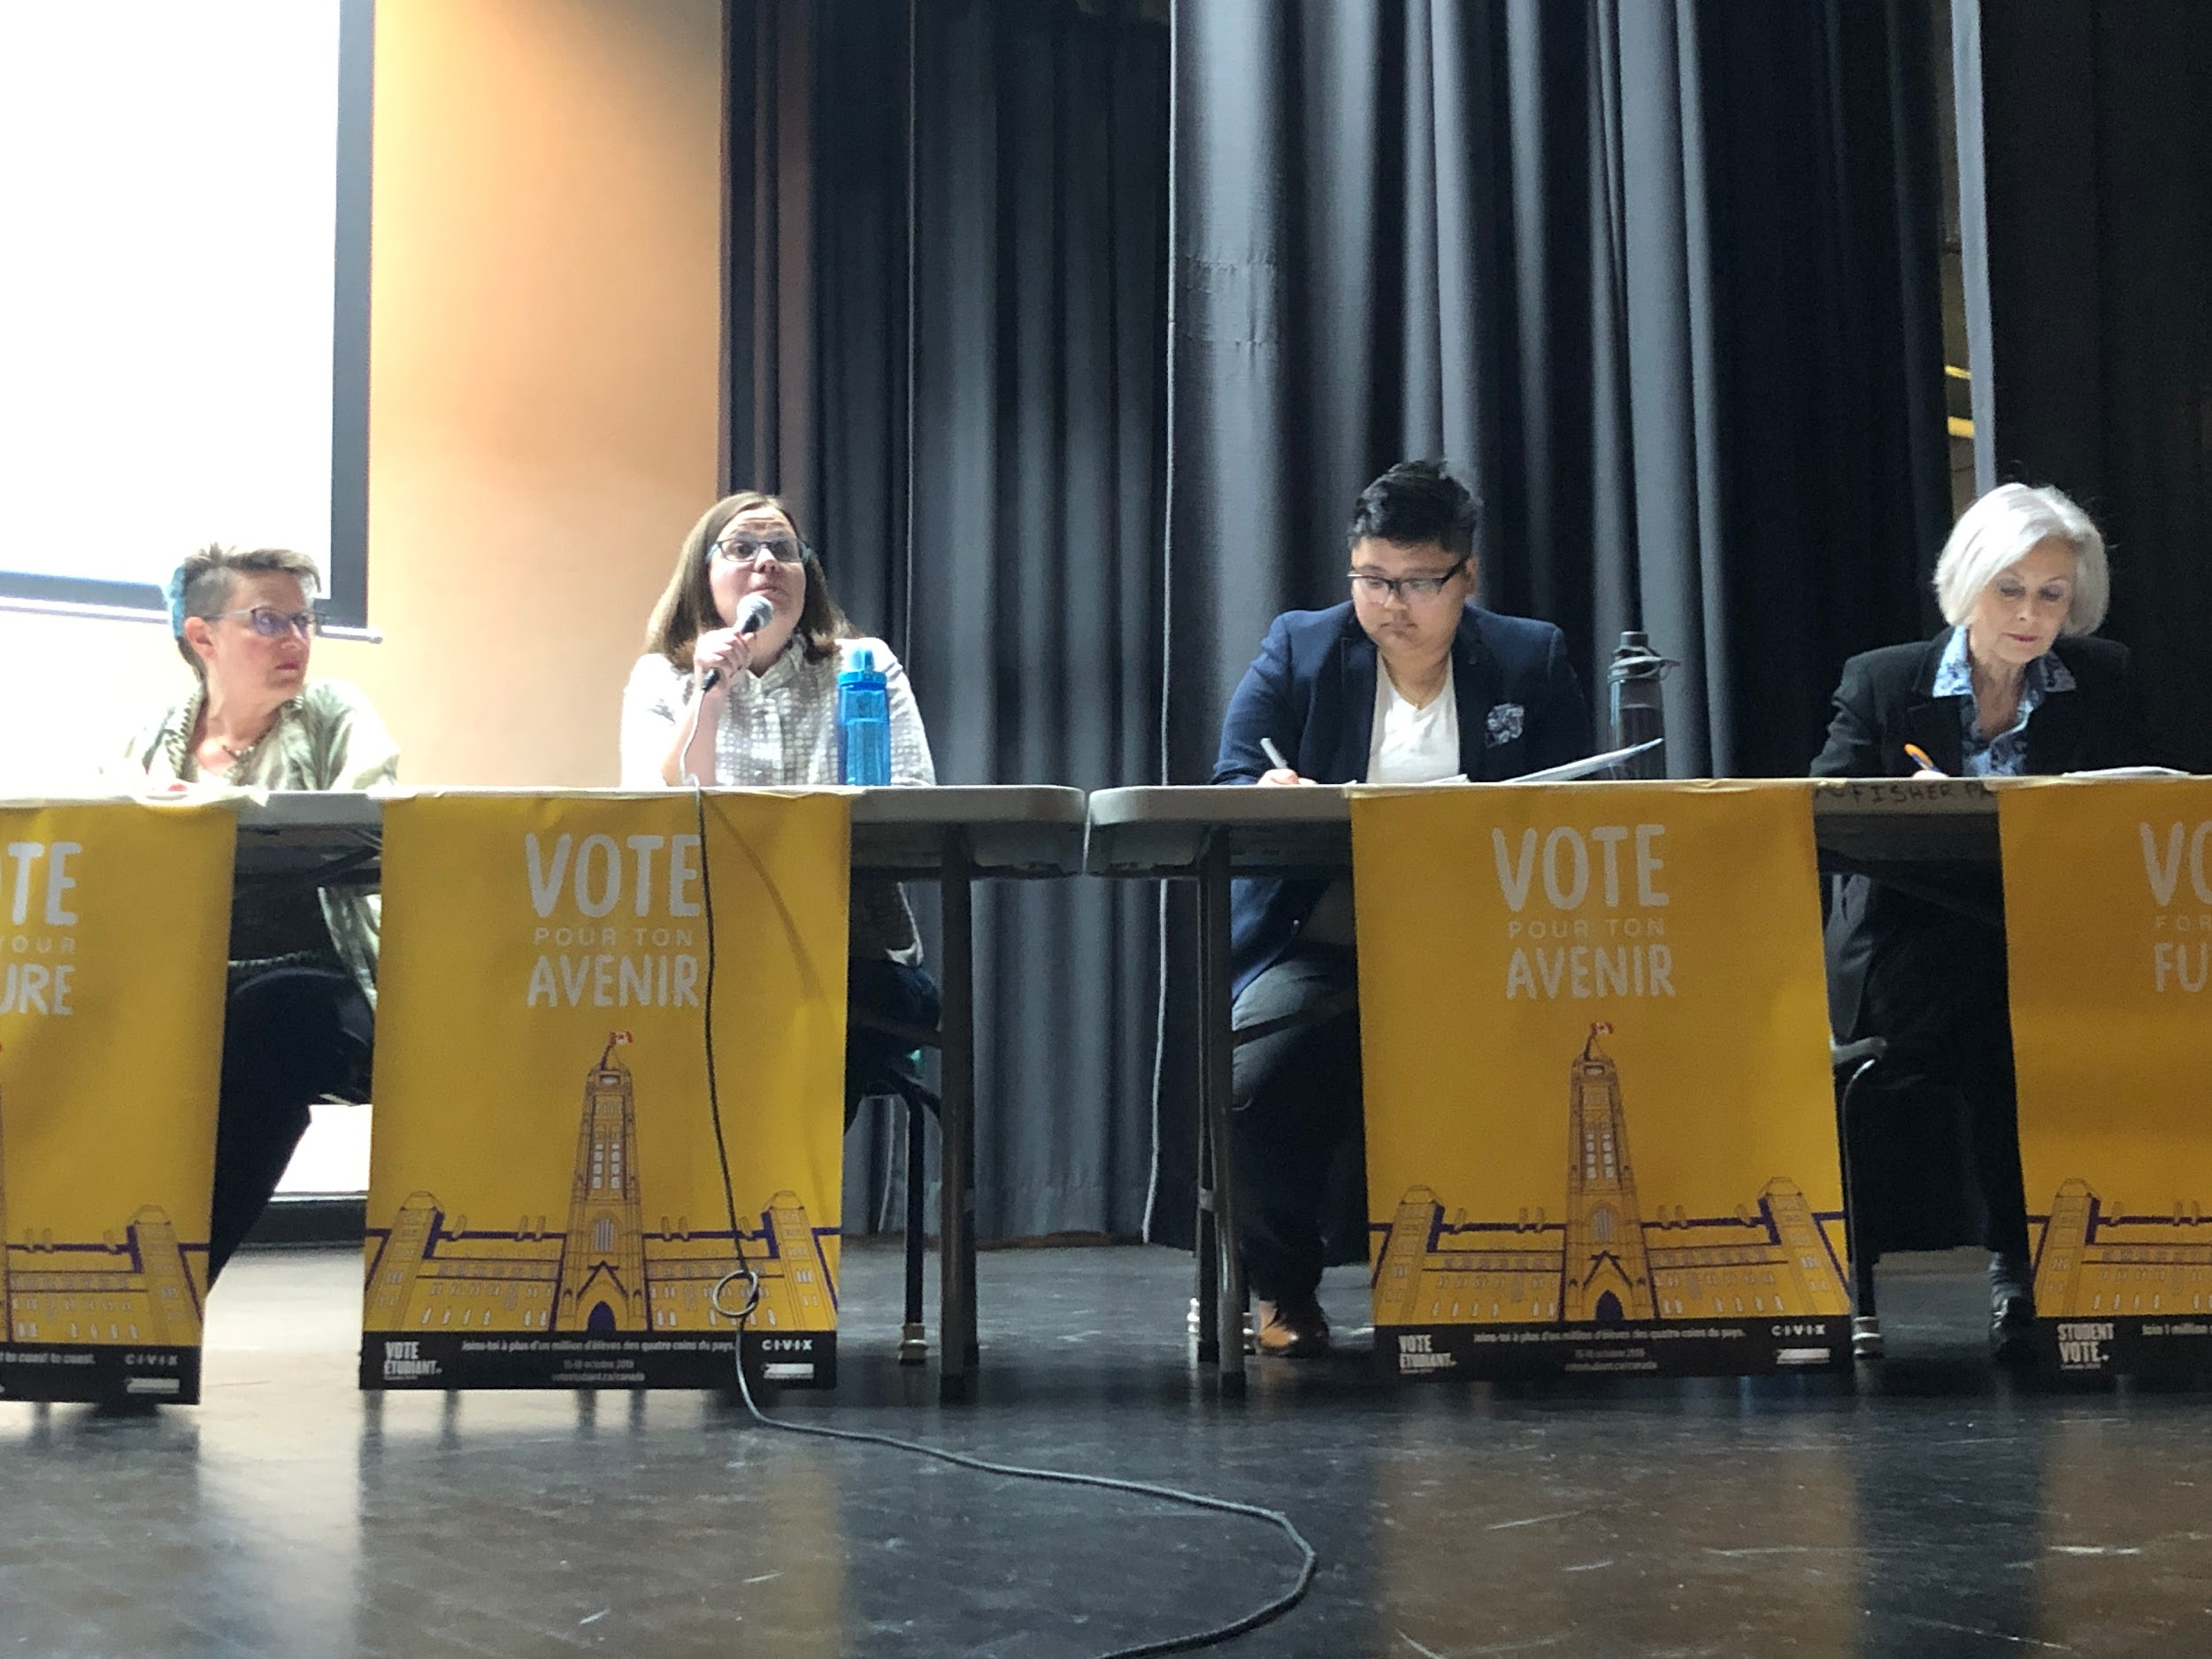
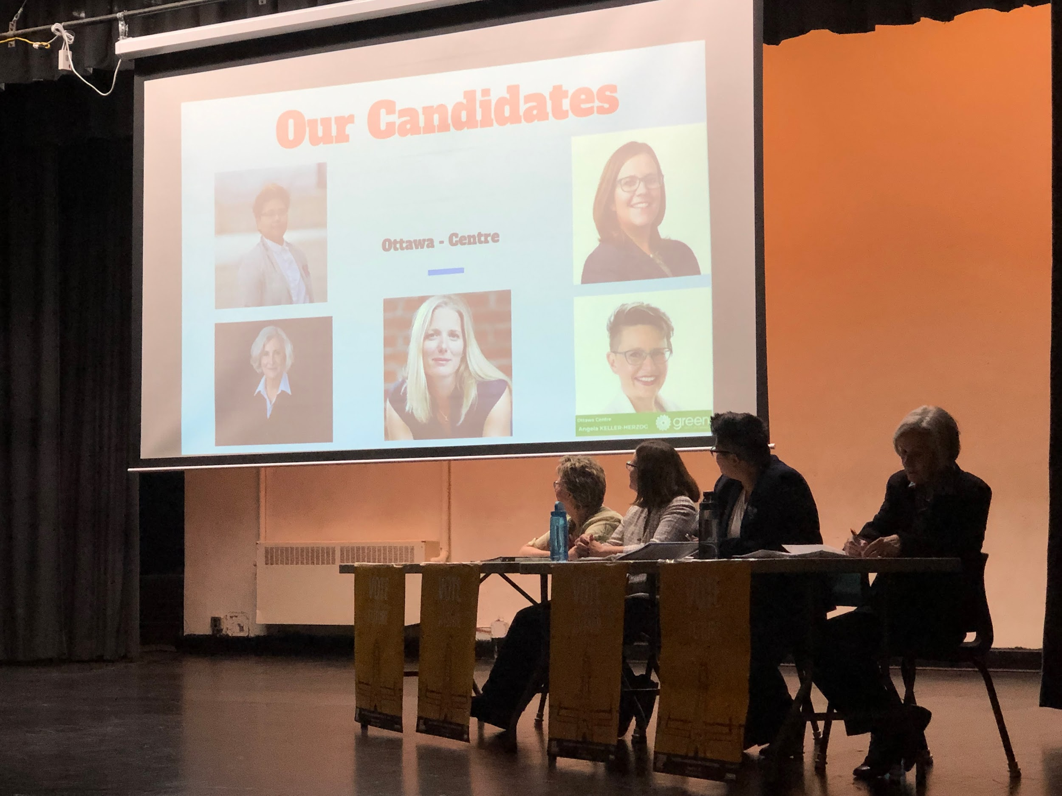
Matthew Herrington
2.1) All Candidates Town Hall
Invites
  Candidates: invite and request bio
  Moderator
  Provide Board PPM on Election Activities

Slide 7
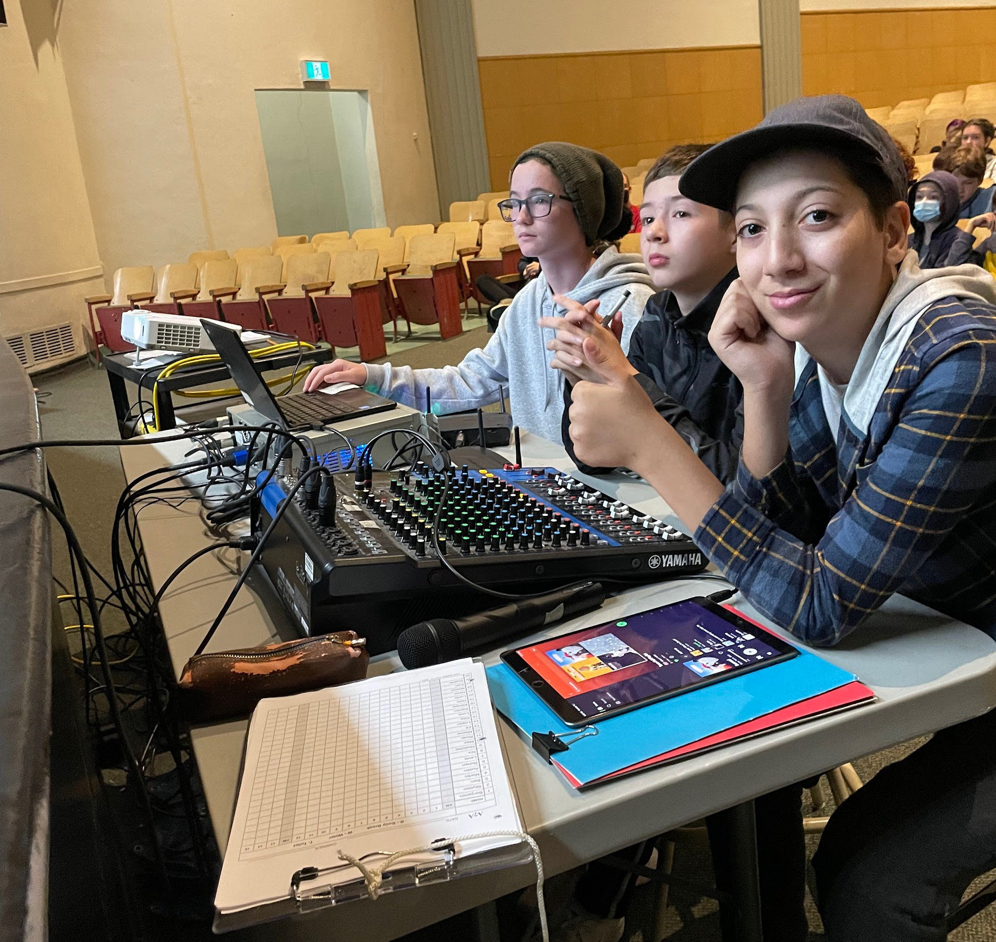
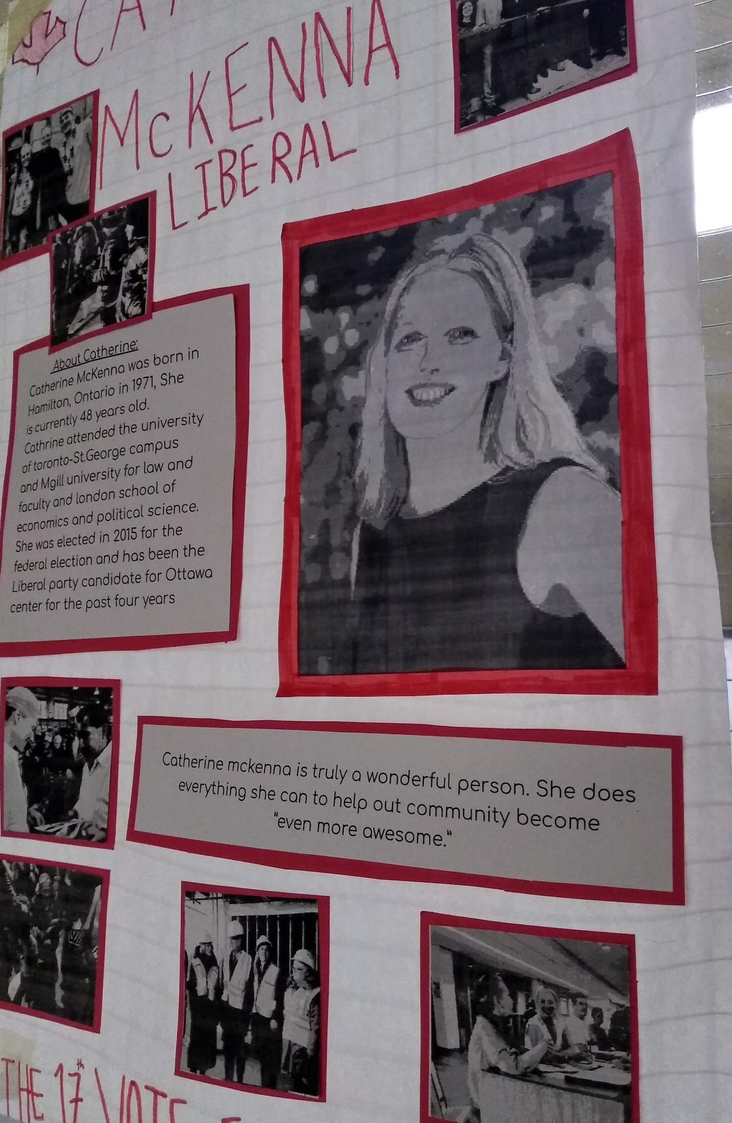

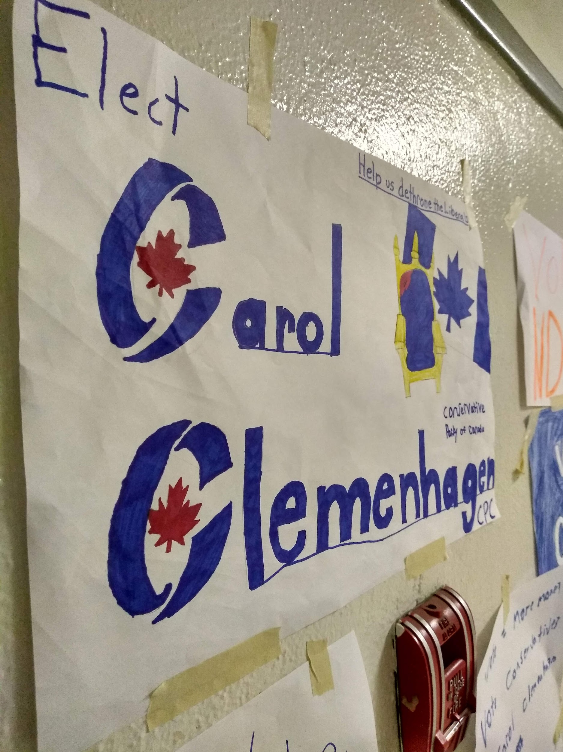
Matthew Herrington
2.2)All Candidates
Town Hall
School Engagement
  Staff and Students
    AV Club
    Poster Creation
    Student Questions
  Pre and Post Town Hall Polling
  Feeder School Invites

Slide 8
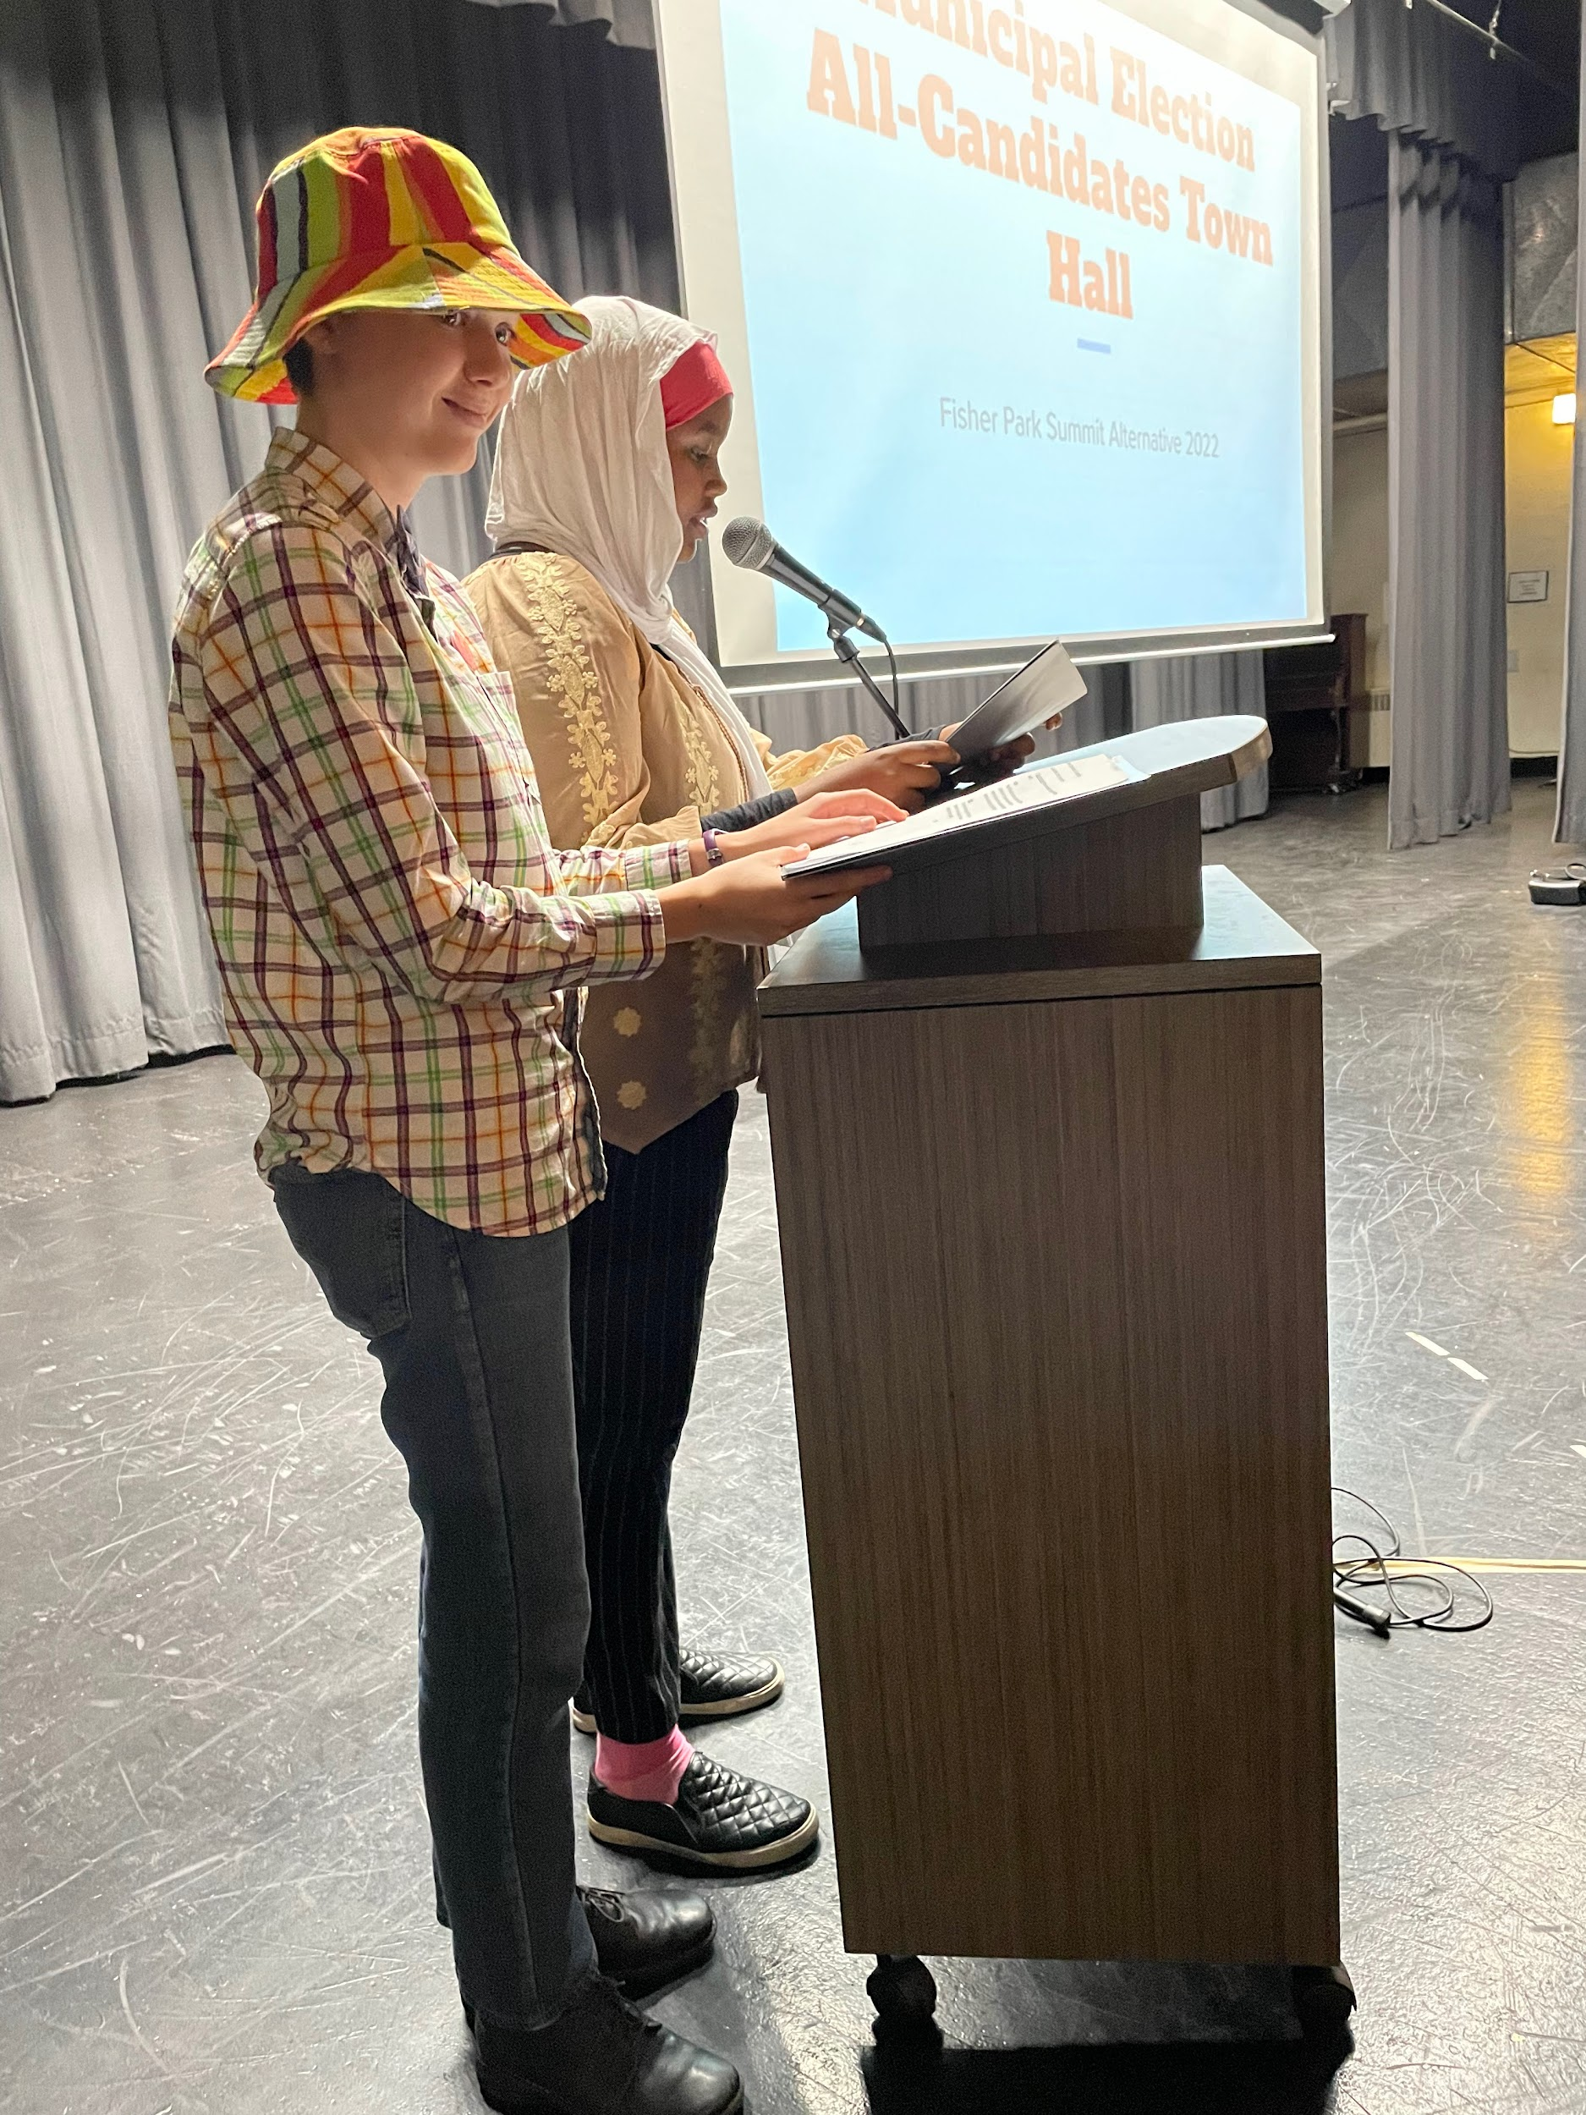
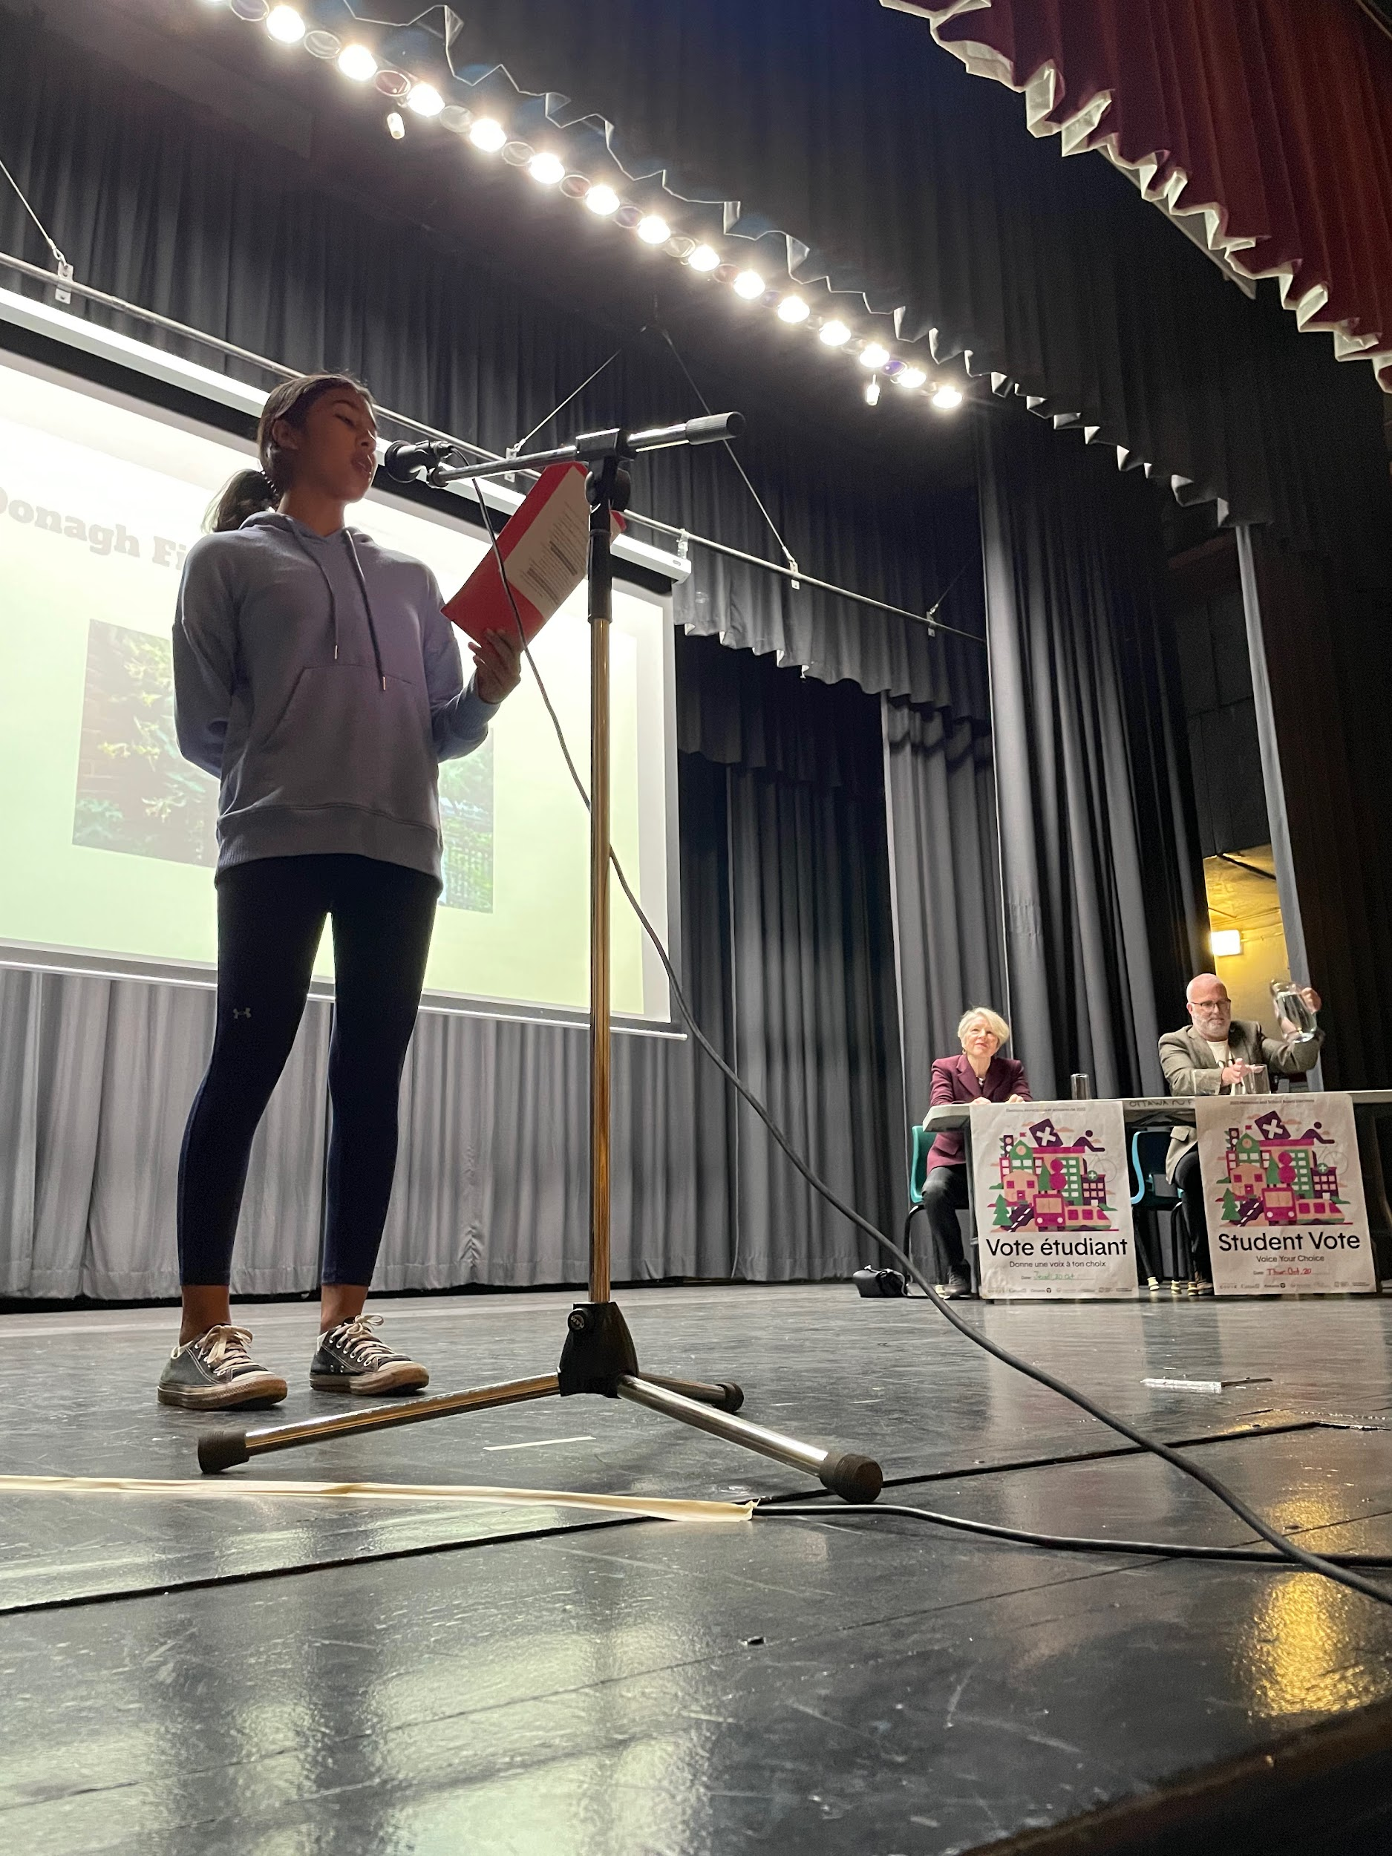
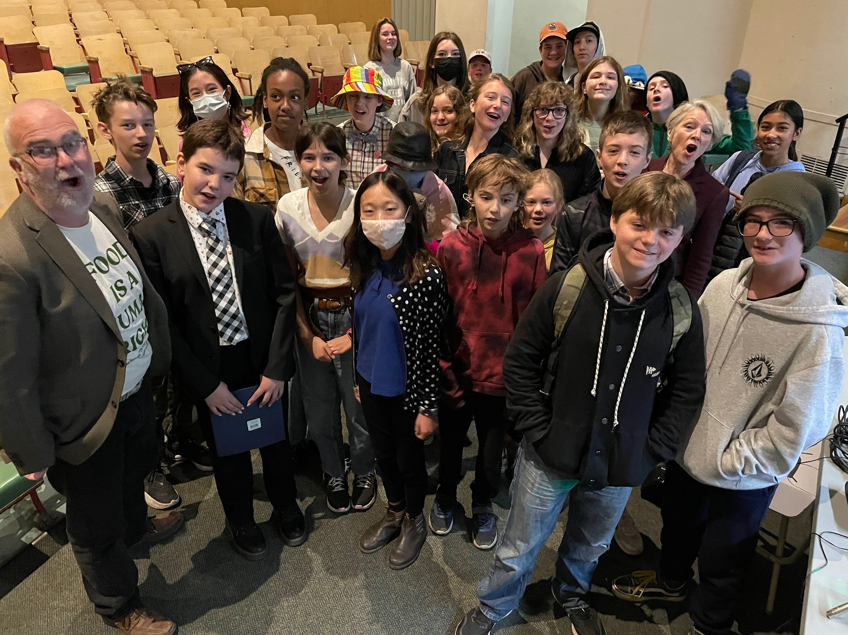
Matthew Herrington
2.3) All Candidates
Town Hall
The Event:
  Student Voice
    MCs, Candidate Bios, Student Questions
  60 mins max
  Provide Access to Candidates Pre and Post

Slide 9
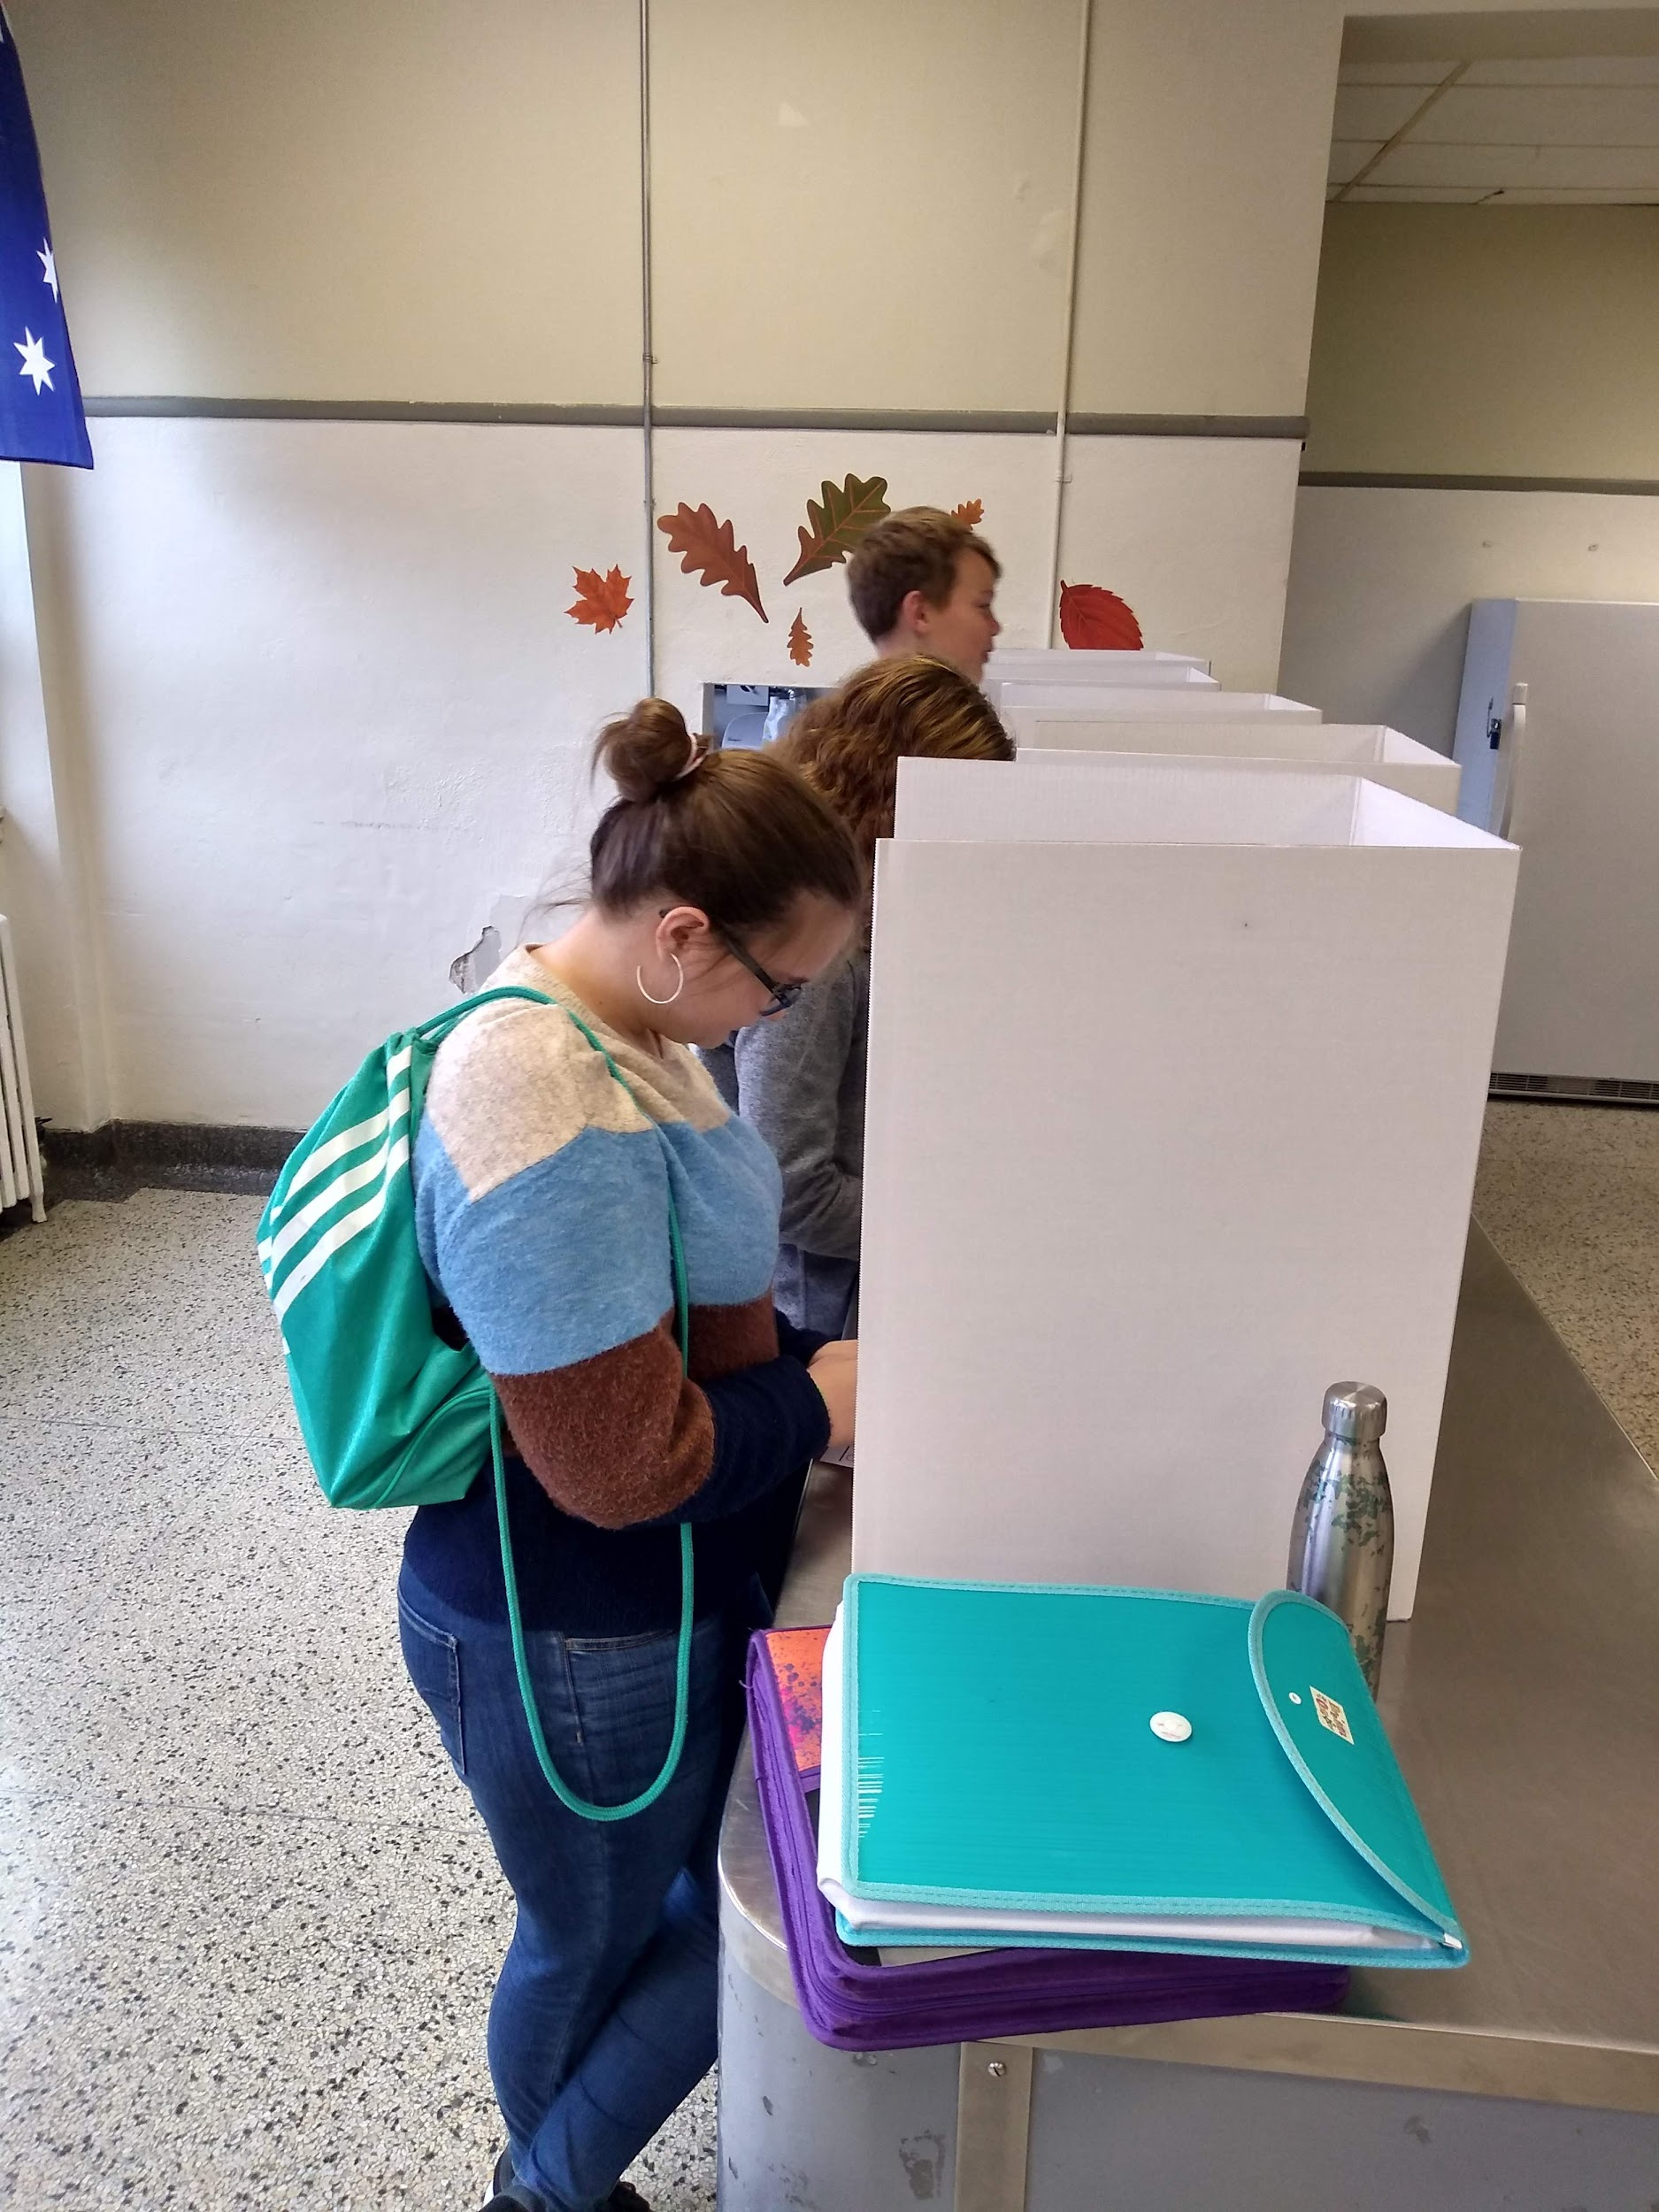
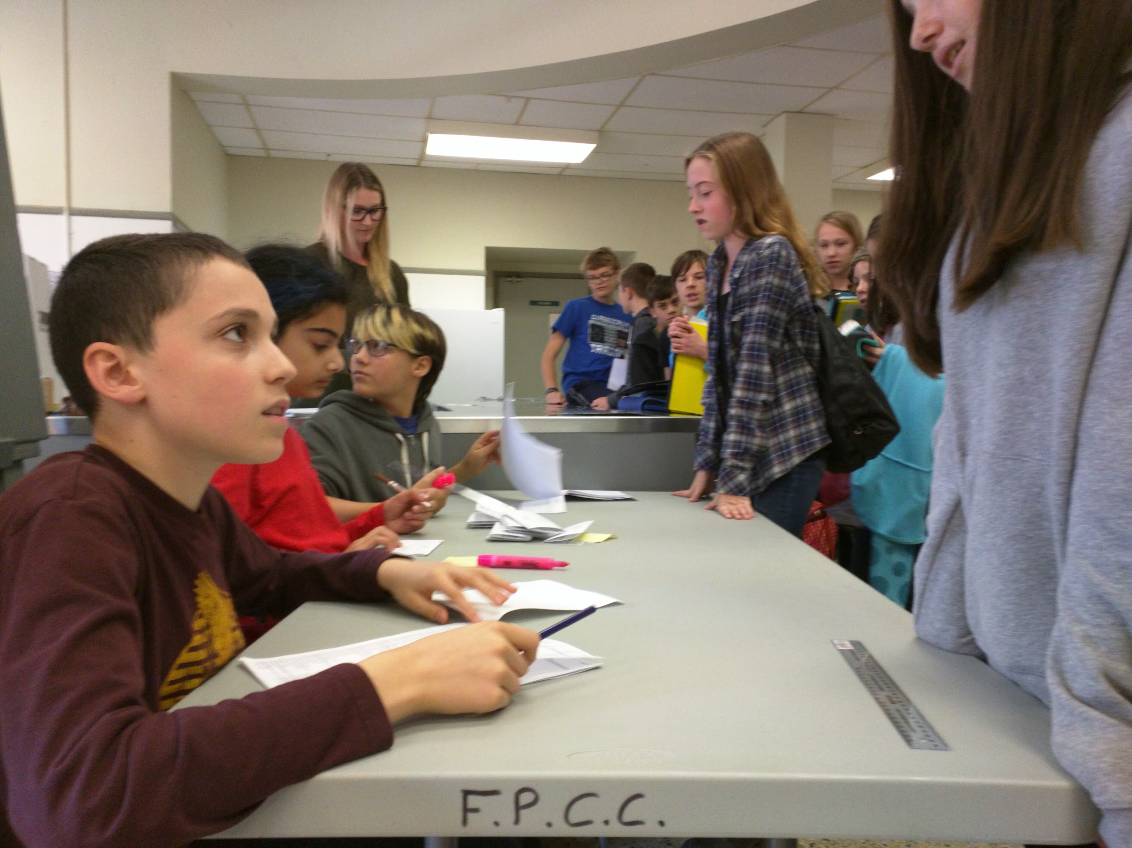
Matthew Herrington
3.1) Student Vote Day
ASAP after Town Hall
Pre-plan with the Club
  Assign rolls using CIVIX Guide
  Practice rolls
  Gather supplies
Communicate Vote Day Plan with colleagues
Ask office for Master List

Slide 10
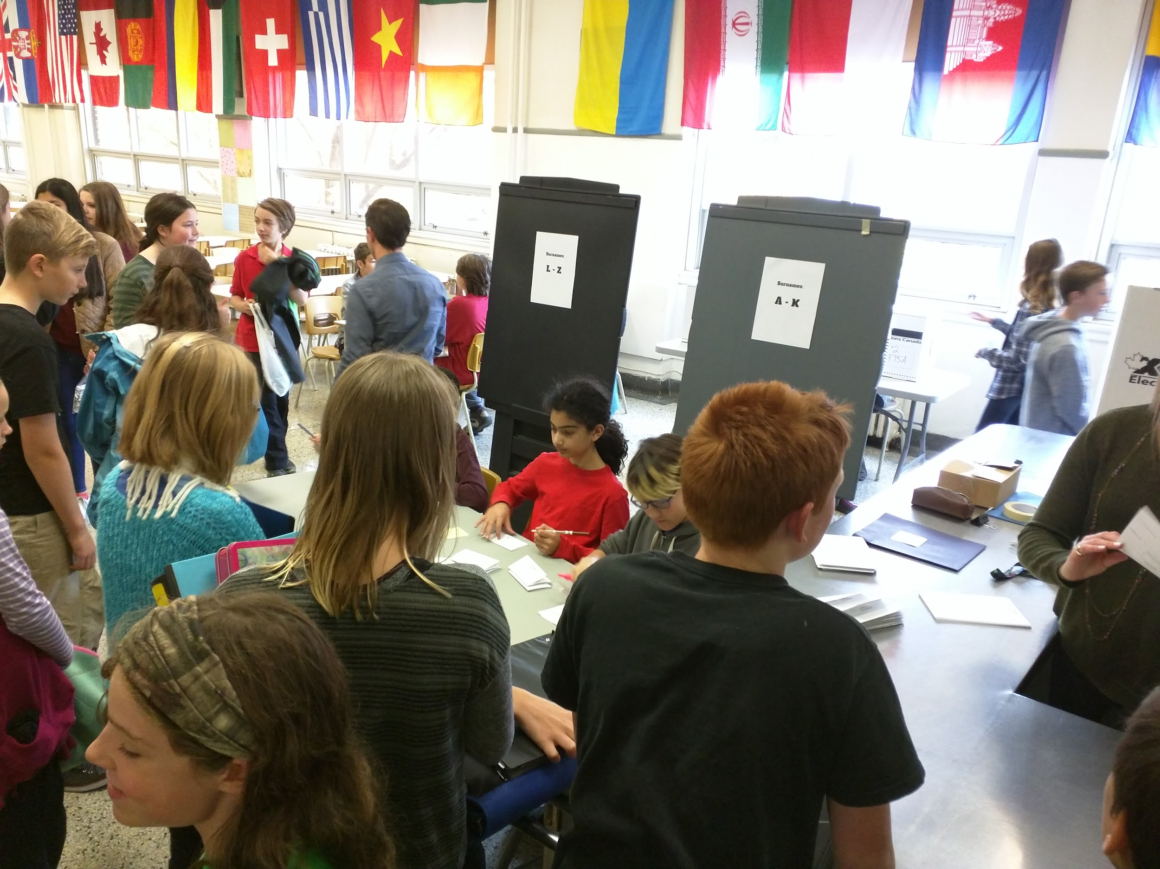
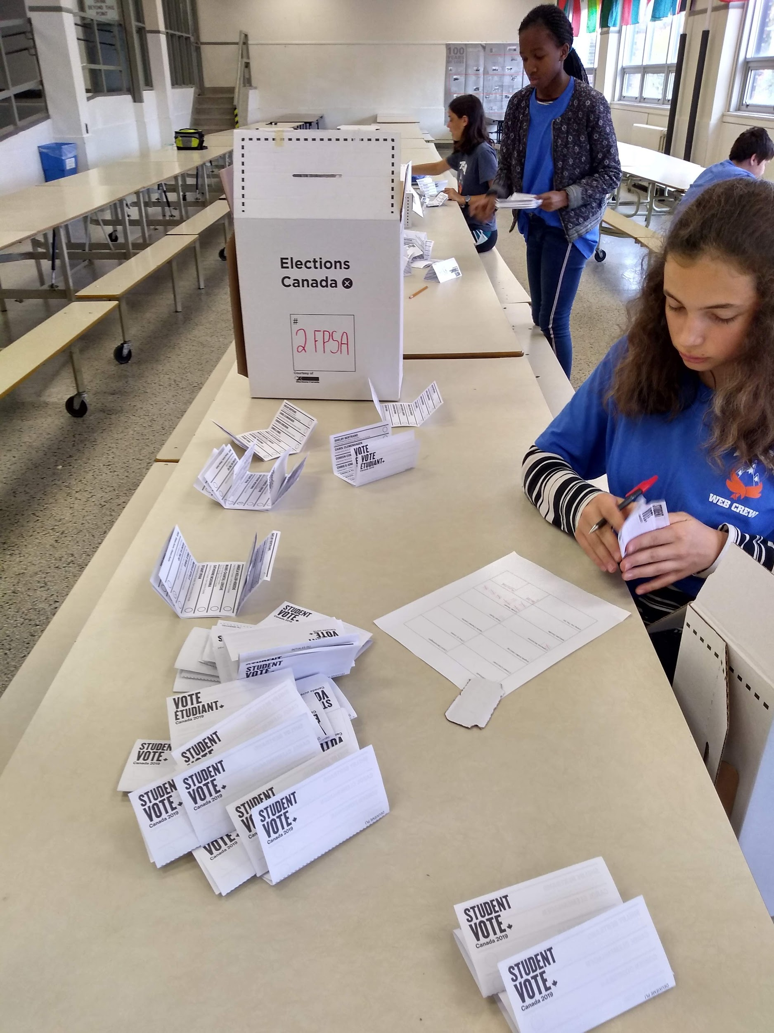
matthew.herrington@ocdsb.ca
3.2) Student Vote Day
Location?
Time of Day
  Homeroom call down
or
  Drop-in at break
Counting Votes and Sharing Results

Slide 11
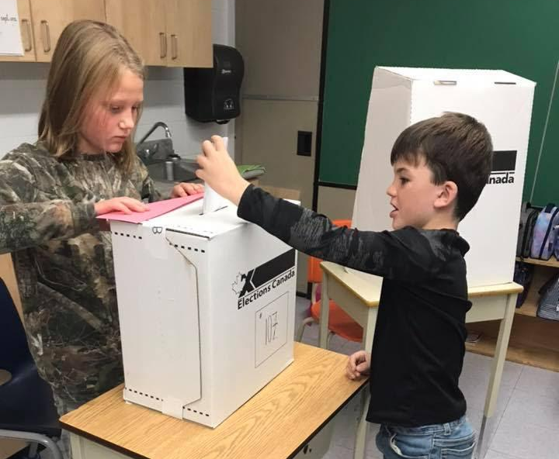
Heather Earle
Do a lot of work on general understanding of government - levels and responsibilities - and a citizen’s role in a democracy

Slide 12
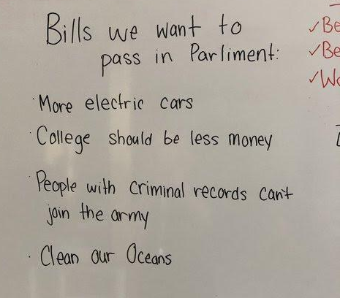
Heather Earle
Access great bilingual resources from CIVIX, Library of Parliament and Ontario Legislative Assembly

Slide 13
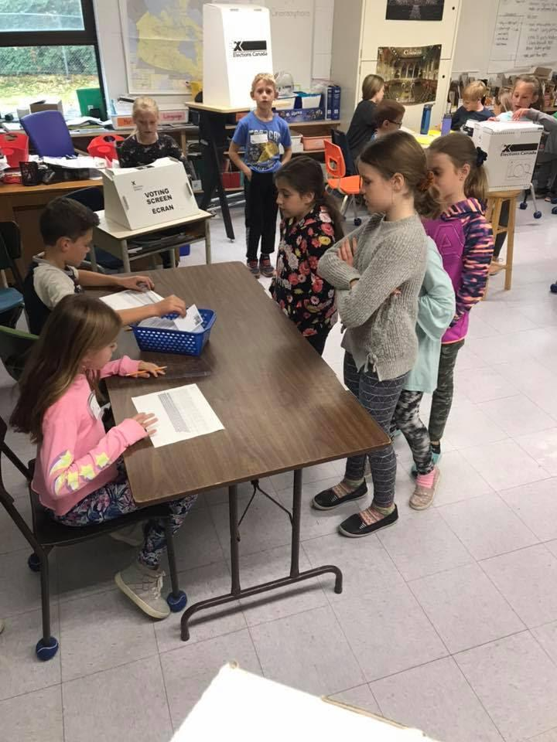
Heather Earle
Make the whole school aware of Student Vote activities - share resources and plan with colleagues

Slide 14
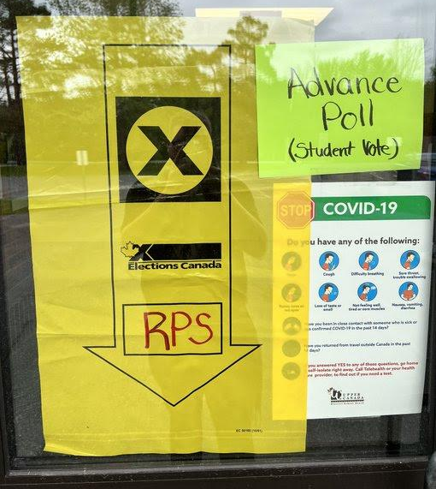
Heather Earle
Make parents/family/ guardians aware of Student Vote program and encourage home support

Slide 15
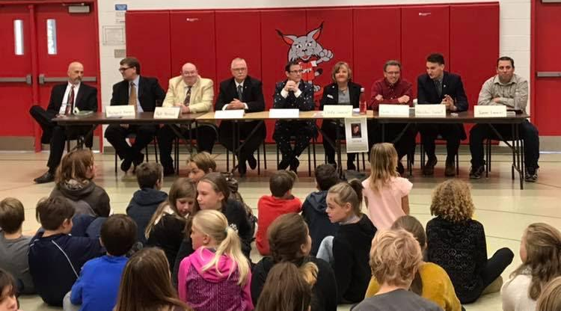
Heather Earle
Invite candidates in for a Q&A with students

Slide 16
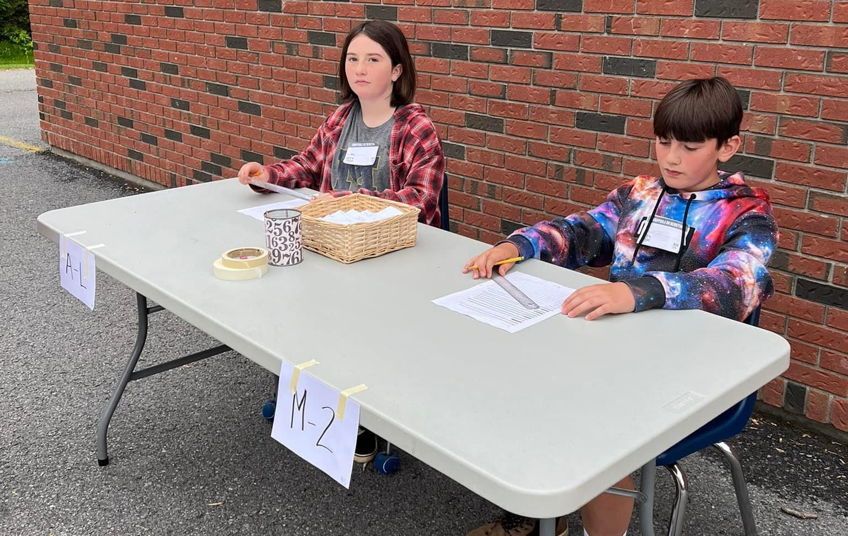
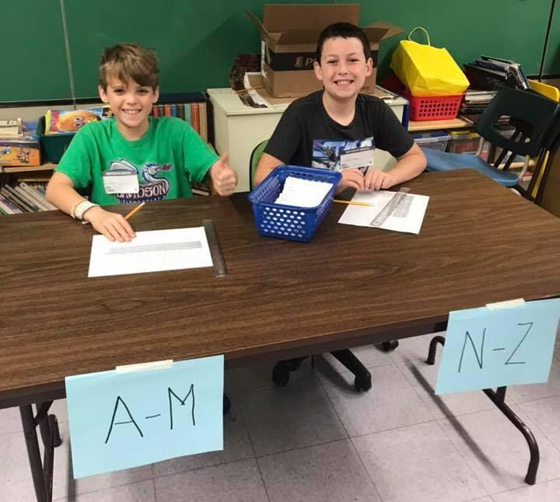
Heather Earle
Involve as many students as much as possible in the logistics of the vote

Slide 17
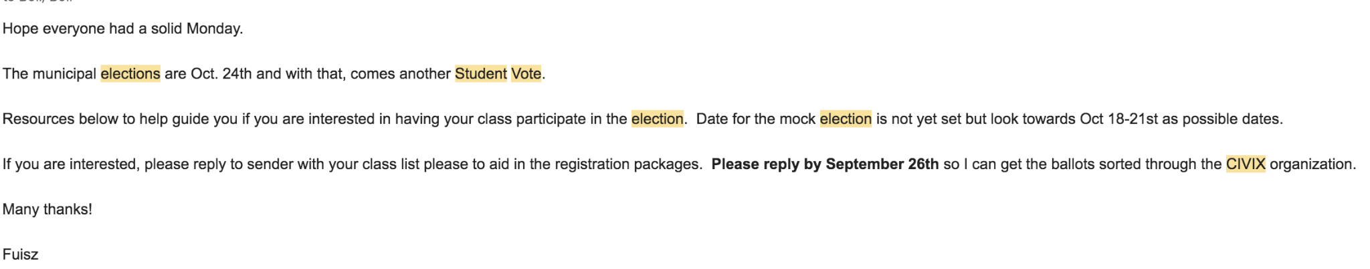
Allison Fuisz
Reaching out to colleagues well in advance to share the vote will be happening/seeing who else would be involved
Confirm with admin the date you’d like to host a vote
Send an email sharing the date, location (library/caf are great spots)

Slide 18
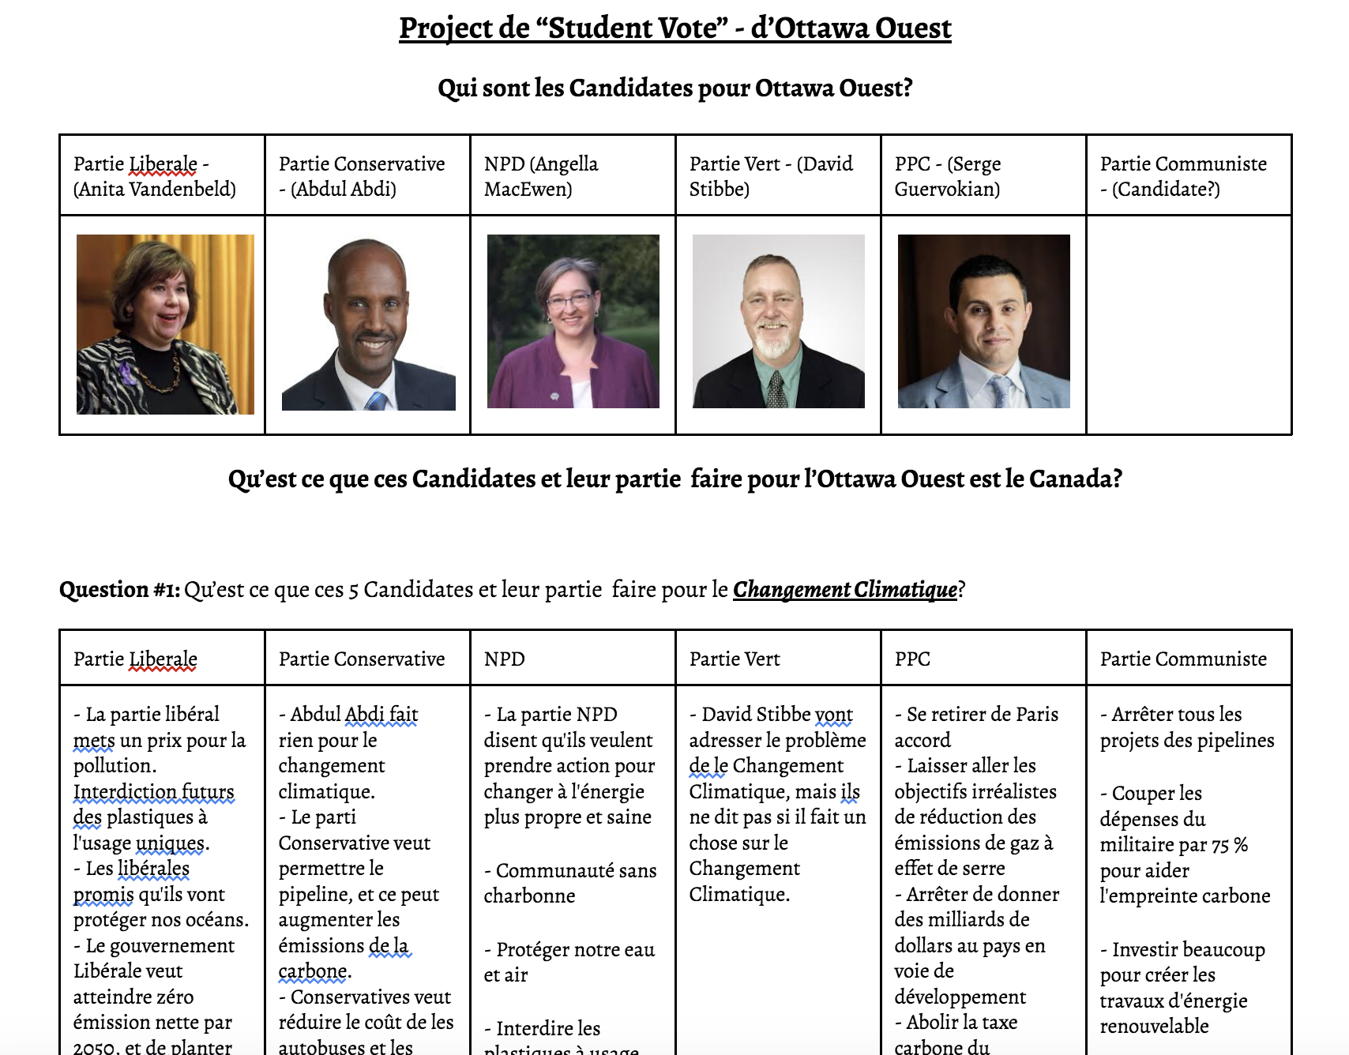


Allison Fuisz
2. Having students work in collaborative groups to research the political parties on their ballot & sharing the facts/platforms with other classes &/or creating posters/media pieces

Slide 19
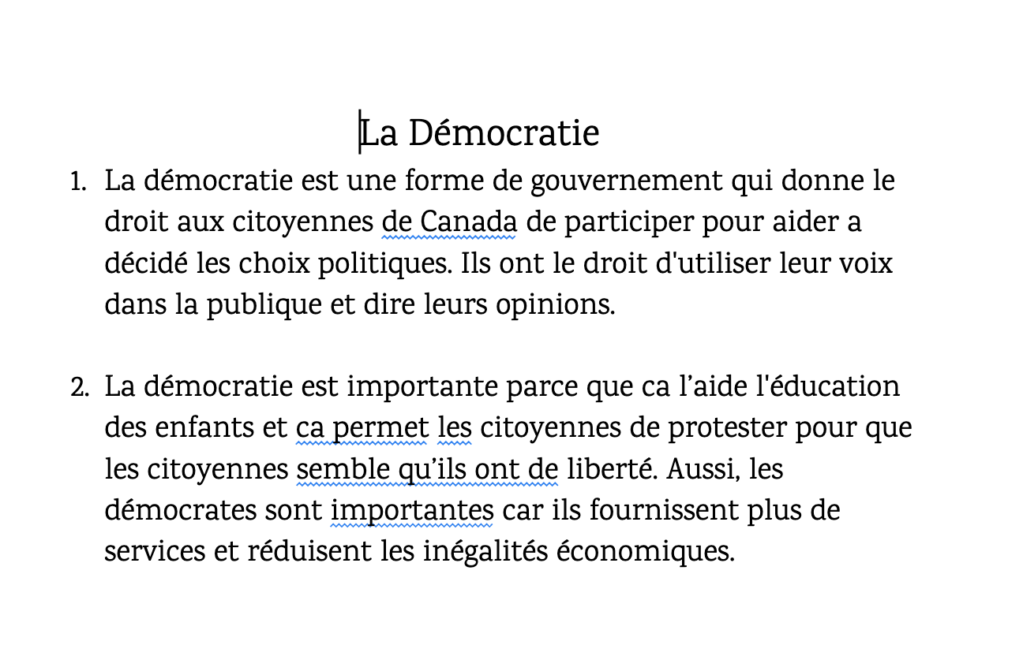
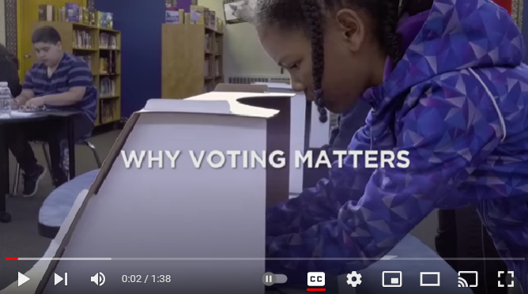
Allison Fuisz
Referencing the importance of a vote, democracy as a whole & why it matters

Slide 20
Table Discussion
Share one genius hack you’ve discovered through your experience with the Student Vote program.
Give one practical tip for engaging more colleagues or classes in the program (making the program school-wide).

Slide 21


Slide 22
