Slide 1


CTRL-F: Digital Media Literacy
1:40 - 2:45

Slide 2
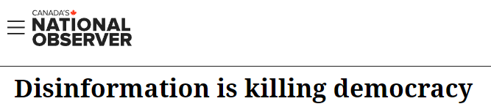
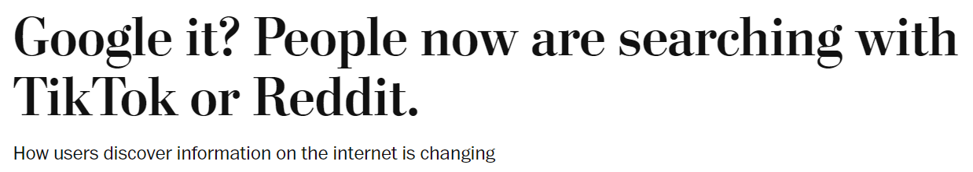
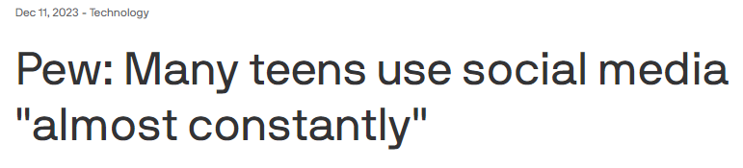
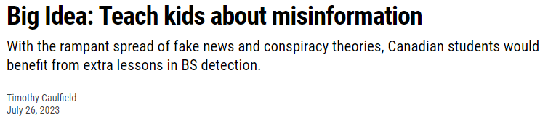
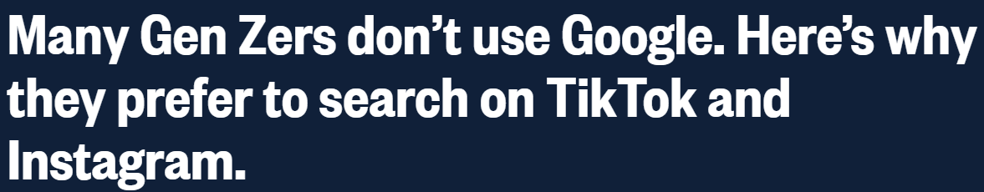
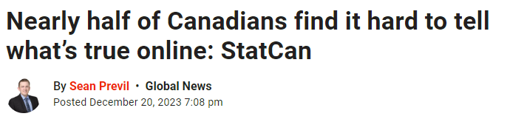
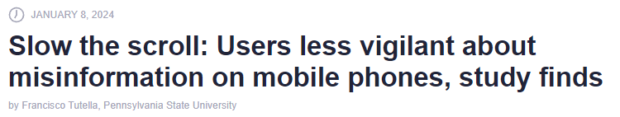
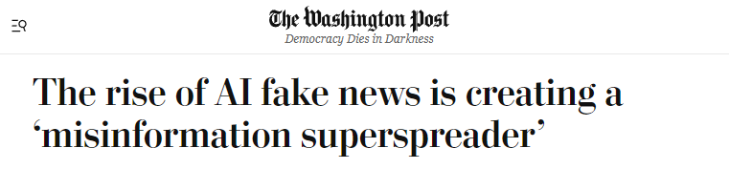


Slide 3



Informed Citizenship
How do we evaluate the information that we see and hear?

Slide 4
Digital media literacy
Equips students with the habits and skills they need to effectively find and evaluate online information.

Slide 5

To evaluate online information student must first understand how to find reliable information and sources.
Topics include:
Limitations of social media as an information source
Components of a SERP
Constructing effective queries
How algorithms sort what we see online
Differentiating between facts and opinions
Online Search
Skills

Slide 6




1. What can I do online?
Youth are increasingly using social media as search engines, but this can lead them astray.
In this lesson students:
Students reflect on where they get their information from online
Understand what social media and search engines are for

Slide 7

2. Finding information online
In this lesson students:
learn about how search engines work
and how to identify the components of a search engine results page (SERP)
New Video: “How Search Engines Work”
Activity: Students perform searches and orient themselves to the different parts of a SERP

Slide 8
AND
3. Choosing search terms
OR
In this lesson students:
Learn how to refine search results using search operators and search tools
New video: “Choosing Search Terms”
Activity: Search Operator Treasure Hunt has students practice constructing searchers using search operators to find a secret location on Google Maps.
site:
-
“ “
biased words

Slide 9
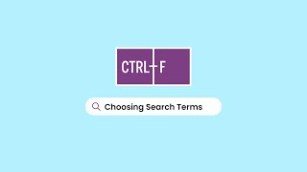

Slide 10

Search Operator Treasure Hunt
I need to meet my friend somewhere in Canada. The only problem is they’ve hidden the coordinates to their location in a puzzle that requires searching for some information online.
In groups of 3 or 4 fill out the out the answers and decipher the code!
The first group to get find the secret location will will a prize.

Slide 11

Search Operator Treasure Hunt: Demo
What movie is the quote “all one can do is the next right thing” from? Make sure to use quotation marks in your search.

Slide 12

Search Operator Treasure Hunt: Demo
Demo: What movie is the quote “all one can do is the next right thing” from? Make sure to use quotation marks in your search.
F | R | O | Z | E | N |  | 2

Slide 13
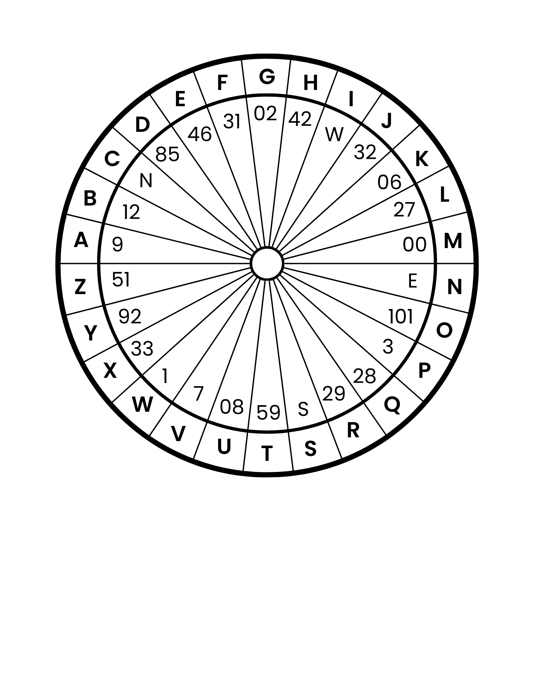
Search Operator Treasure Hunt: Demo
Use the wheel decipher the coordinates.
Secret Code:
Coordinates:
F | R | O | Z | E | N |  | 2
Z |  |  | ' |  | . |  | " |  | , |  |  |  | ' |  | . |  | "
 |  |  | ' |  | . |  | " |  | , |  |  |  | ' |  | . |  | "

Slide 14
Search Operator Treasure Hunt: Demo
Use the wheel decipher the coordinates.
Secret Code:
Coordinates:
F | R | O | Z | E | N |  | 2
Z |  |  | ' |  | . |  | " |  | , |  |  |  | ' |  | . |  | "
51 |  |  | ' |  | . |  | " |  | , |  |  |  | ' |  | . |  | "

Slide 15

Search Operator Treasure Hunt: Demo
Be precise!
Write all spaces, zeros, and punctuation
Type into Google Maps:
53 29’30.9”N, 112 02’08.9”W

Slide 16
Search Operator Treasure Hunt
Gather all the clues
Generate a secret code
Decode that code using the code wheel
Put the coordinates in Google Maps
Click on the image and write down what you see

Slide 17

4. Algorithms
In this lesson students learn:
What algorithms are and how they work
How Google uses algorithms to provide search results
How algorithms can be manipulated and why it is important to exercise click restraint
New Video: “How Search Engines Work: Algorithms”

Slide 18

4. Algorithms
Activity: Be the Algorithm
Take on the role of an algorithm and experience how Google decides which results to show
Learn that the top results aren’t always the best

Slide 19

5. Facts and Opinions
In this lesson students:
learn to differentiate between facts and opinions
perform searches and identify facts and opinions from their search results
Video: “Fact or Opinion”
Activity: Fact or Opinion is an online interactive that teaches students tips for distinguishing facts from opinions.

Slide 20
Connections with CTRL-F: Verification Skills
Scaffolded Learning:
Online Search equips students with the skills they need for the Verification module.
Lessons are flexible and accessed on the same website.
Online Search Skills
Verification Skills

Slide 21
Online Search Skills
Verification Skills
The abundance of information online
Information pollution
Limitations of social media as an information source
Investigating the reputation of & choosing credible sources
Navigating SERPs
Identifying agenda
Constructing effective search queries
Evaluating expertise
Algorithms & click restraint
Verifying claims using a keyword search
Differentiating facts and opinions
Contextualizing information & images

Slide 22

Verification Skills
Teach your students the evidence-based skills that professional fact-checkers use
Encourages students to:
Understand the importance of being an informed citizen
Care about what is true or credible
Habitually evaluate sources and claims
Seek out information from reliable sources

Slide 23
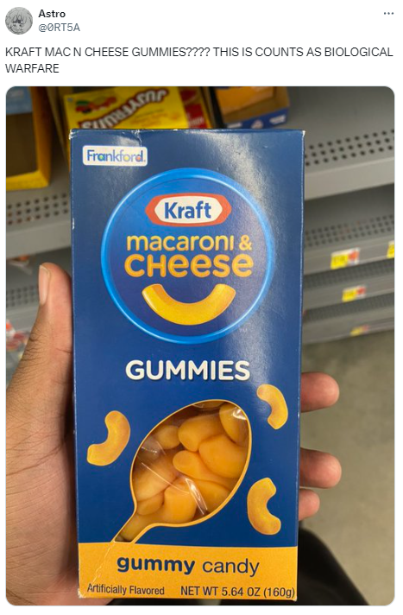

Are
These
Real or Fake?

Slide 24

Are
These
Real?
One real, one fake?

Slide 25


‘Vertical’ vs. ‘Lateral’ Reading
vs.

Slide 26

Lateral Reading Skills
Investigate
the Source
Who made the information? What is their reputation?
Check
the Claim
Are known credible sources saying the same thing?
Trace the Information
Has this information changed in the re-telling?

Slide 27
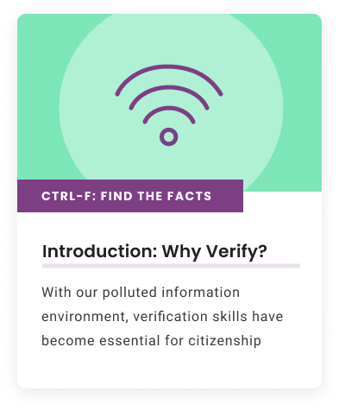
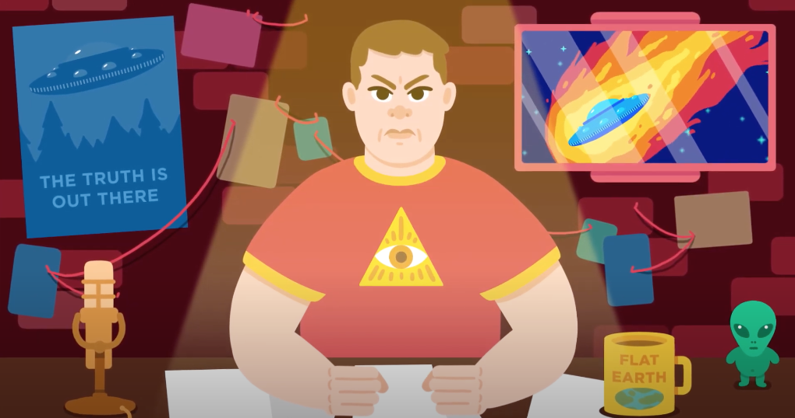
CTRL-F: Why Verify?
What is information pollution? How does false and misleading information spread online?

Slide 28
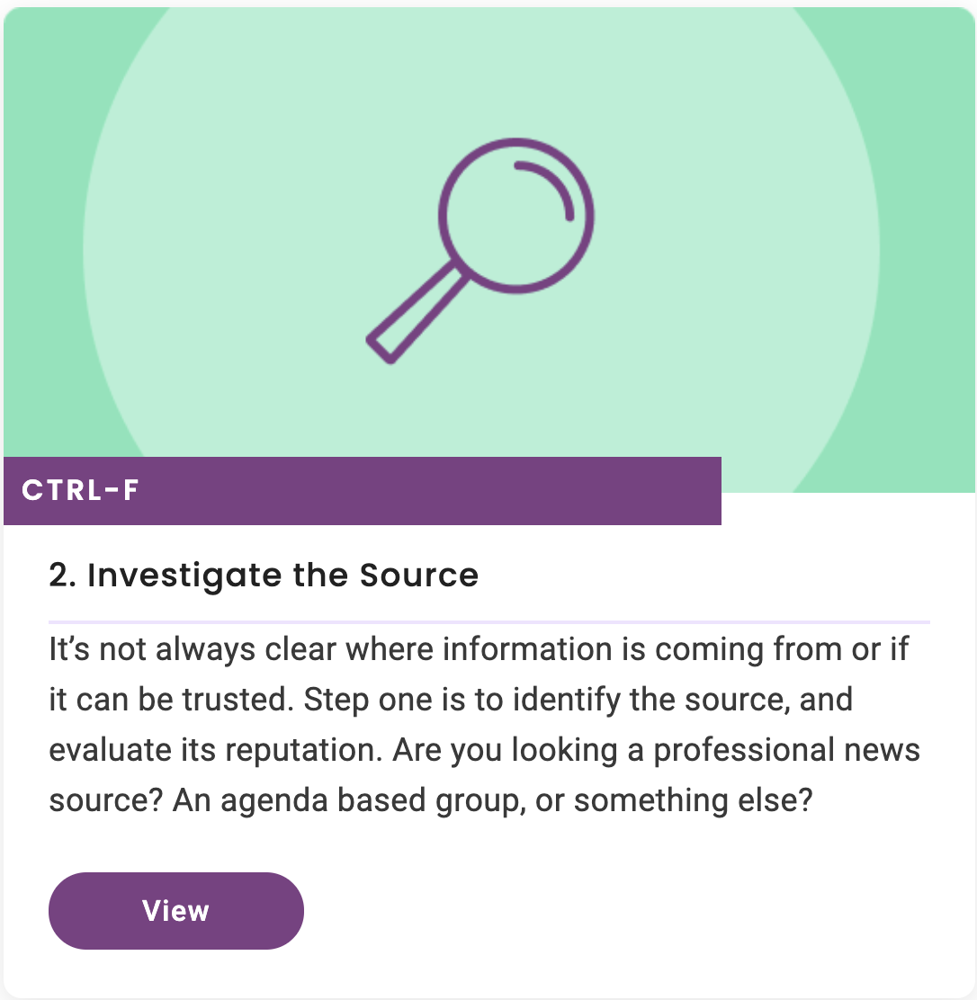
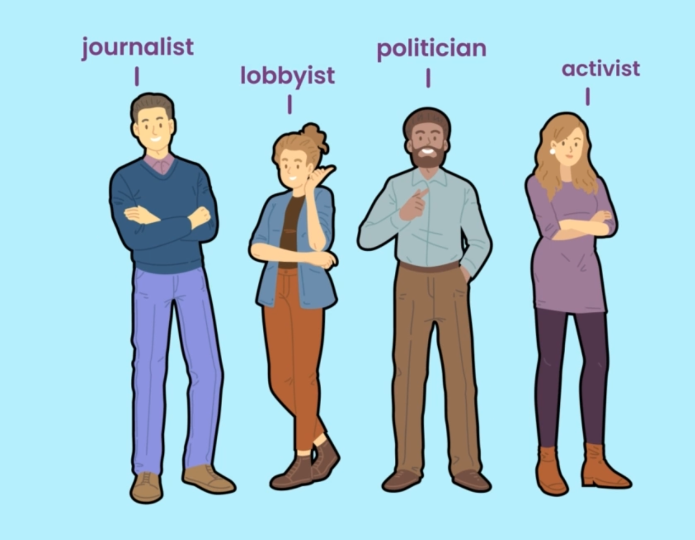

Strategy #1 Investigate the Source

Slide 29
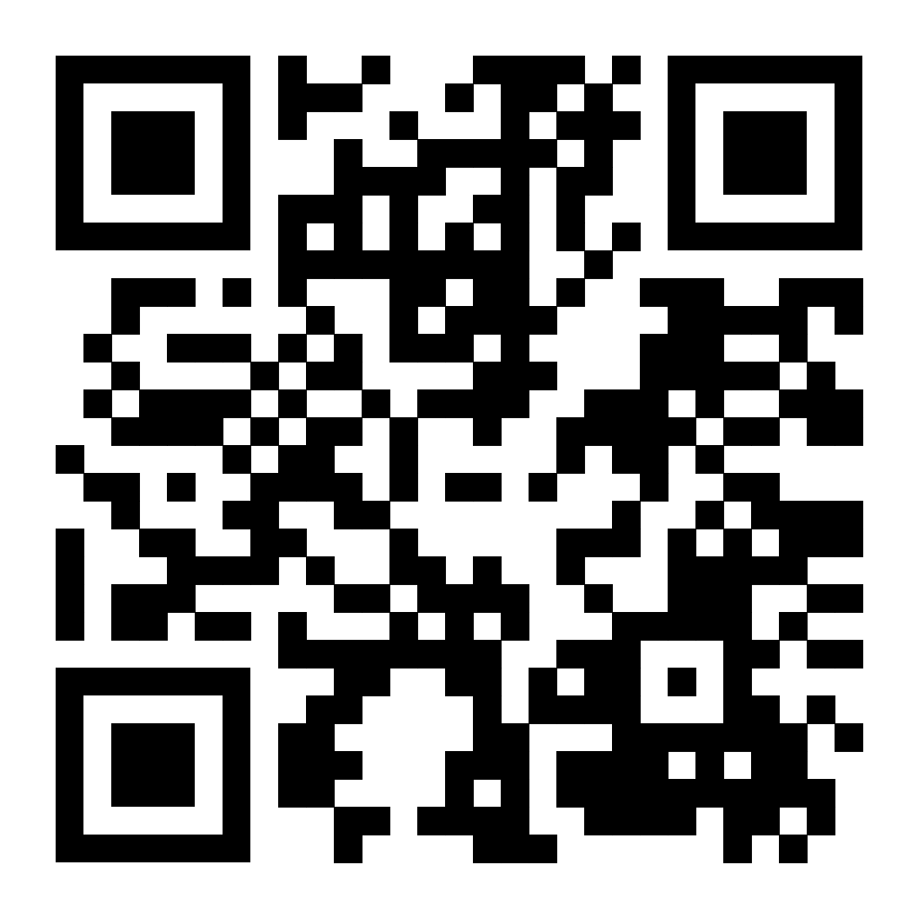
To Access Examples
Option 1:
Go to ctrl-f.ca/en/on24
Option 2:
Use the QR code

Slide 30
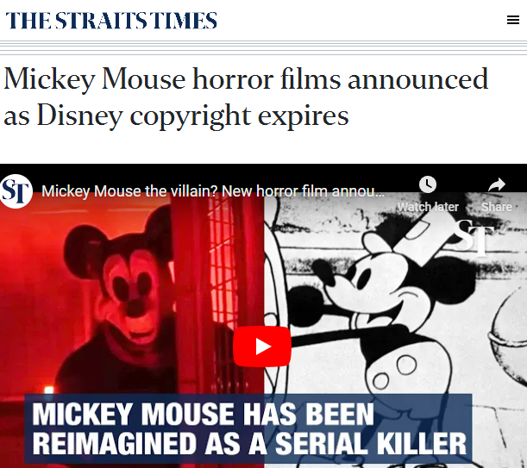
Demo: Just Add Wikipedia
Investigate the reputation this source using Wikipedia.

Slide 31





Strategy #2: Check the Claim
What are other sources saying?
Has the story been verified or debunked?

Slide 32
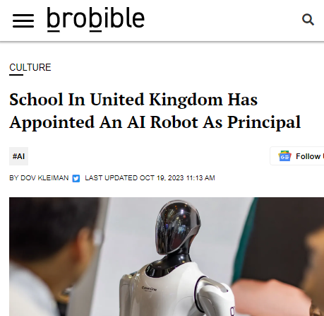
Demo: Check the Claim
Use a keyword search to see if other reliable sources have reported on this story

Slide 33
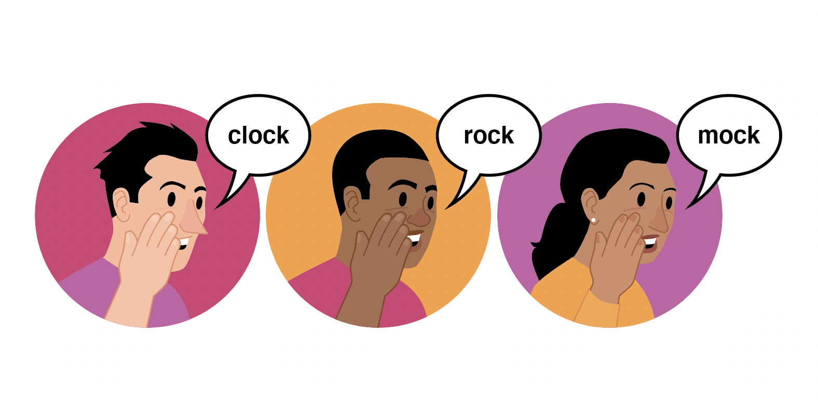
Strategy #3: Trace the Information
How close can you get to original source?
Has the information changed in the re-telling?
Key Skills:
Click Through
Find
Check the Date
Reverse Image Search

Slide 34
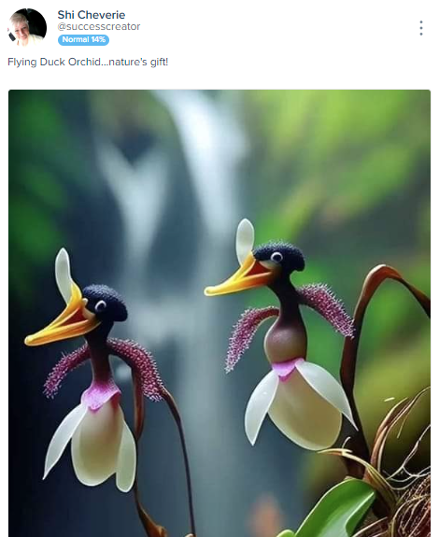
Demo: Reverse
Image Search
Use a reverse image search to trace this image closer to its original context.

Slide 35

Coming Soon: AI Resources
More AI examples in CTRL-F resources
Learning about and demystifying AI
Lateral reading as it applies to AI-generated misinformation

