Slide 1

Democracy Bootcamp
Session 1: Facilitating Effective Discussions
8:50-9:55

Slide 2
What we’ve learned
93% of teachers agreed that students need to study and discuss controversial issues to become engaged citizens but only 55% say the practice is encouraged at their school
74% of teachers said that discussing politics or controversial issues has become ‘more difficult’ (50%) or ‘much more difficult’ (24%) in the last 2-3 years
26% of elementary teachers identified Andrew Tate as someone their students either follow on social media or reference in class. This number increased to 48% among teachers of intermediate grades and to 67% among high school teachers.
Overall, teachers feel like their school system does not prioritize classroom discussion as much as it should

Slide 3

Introducing PoliTalks
PoliTalks supports educators in building discussion-friendly classrooms.
It provides resources and activities designed to build the knowledge, attitudes, and skills students need to engage in constructive discussion
...

Slide 4

What is a discussion-friendly classroom?
Students raise questions and express their opinions in order to engage meaningfully
Students respect one another and listen actively
What is a constructive discussion?
Prioritizes understanding over resolution - we don’t have to agree
Not a debate - take “winning” off the table
Learning about others’ perspectives and gaining a deeper understanding of an issue

Slide 5
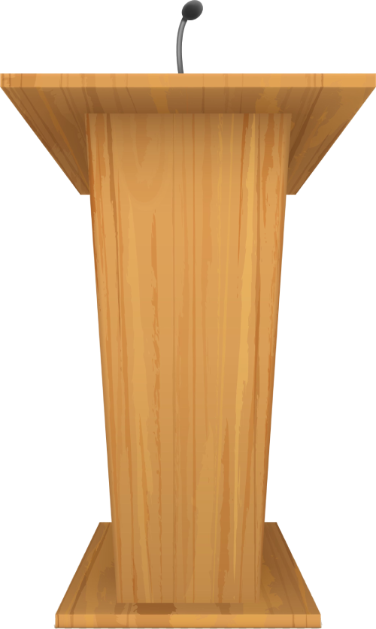
Politics in the Classroom
There’s lots happening in the world that students want to discuss, but it’s not always easy to know how to address controversial issues
Teachers can feel apprehensive about discussing politics in the classroom
Real benefits to bringing political issues into the classroom and providing an opportunity for students to develop discussion skills

Slide 6
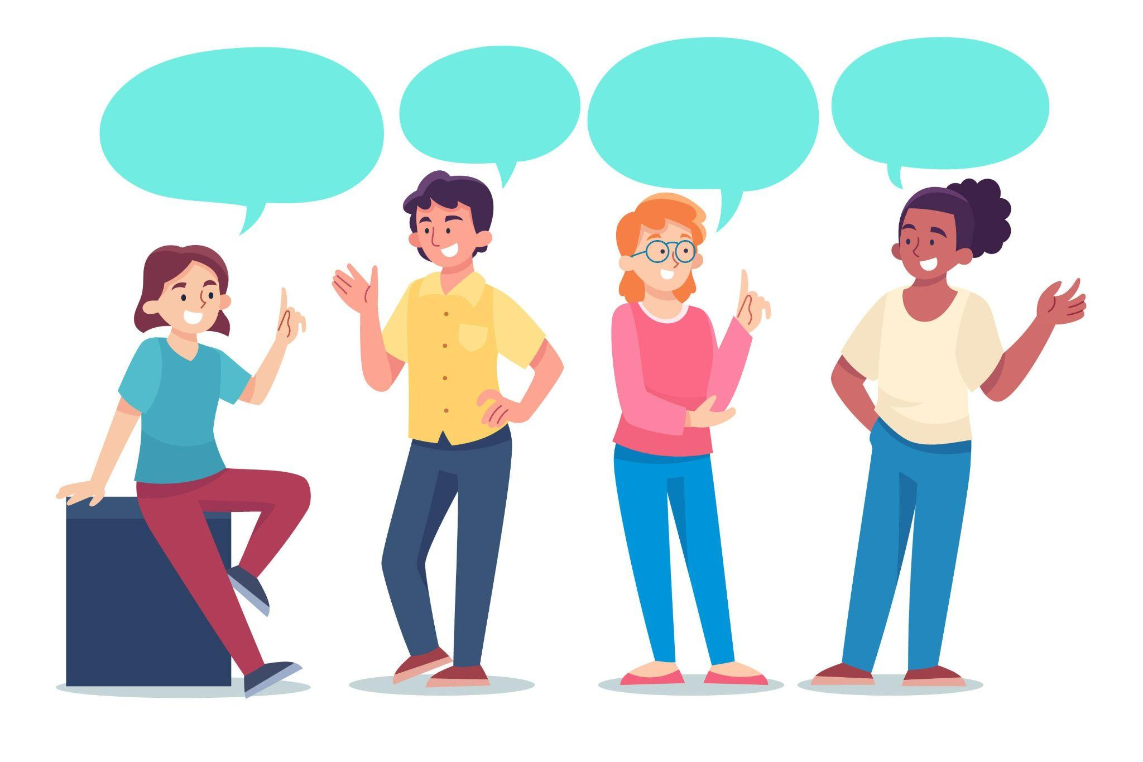
Benefits of Classroom Discussion
Students who participate in discussions of controversial political issues in classes:
Are more engaged in the class
Become more confident in their ability to participate in discussions
Demonstrate increased political knowledge
Express more interest in politics
Follow the news more regularly
Are more likely to engage in political
discussions with those who have different
ideologies
Are more interested in listening to different
opinions

Slide 7

Discussion Guide
Guiding Principles
Creating a Discussion-Friendly Classroom: Norms of Agreement
Preparing for Discussion
Framework for Constructive Disagreement (PLANS)
Troubleshooting
Appendix: Activities and Handouts
Table of Contents image here
Cover image TK

Slide 8


Norms of Agreement for Classroom Discussion
Co-created norms for behaviour related to discussion
Allows students voices heard, to feel invested in processes
Provides agreed-on reference for handling problems
when they arise
Should be reviewed regularly and updated as
needed

Slide 9
Possible Norms
Respond with curiosity instead of judgement.
Criticize ideas, not individuals.
Give everyone the opportunity to speak.
Avoid making assumptions or generalizations about others.
If you don’t understand something, ask a question.
If someone shares an idea or opinion that helps your own learning, show appreciation.
Everyone has a right to pass.
If you say something that offends someone, apologize, even if the offence was not intended.

Slide 10
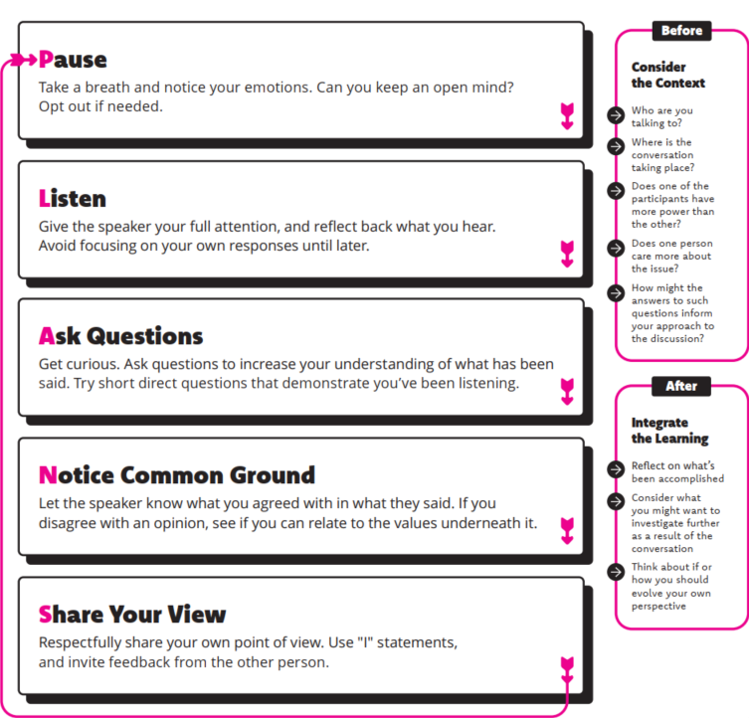
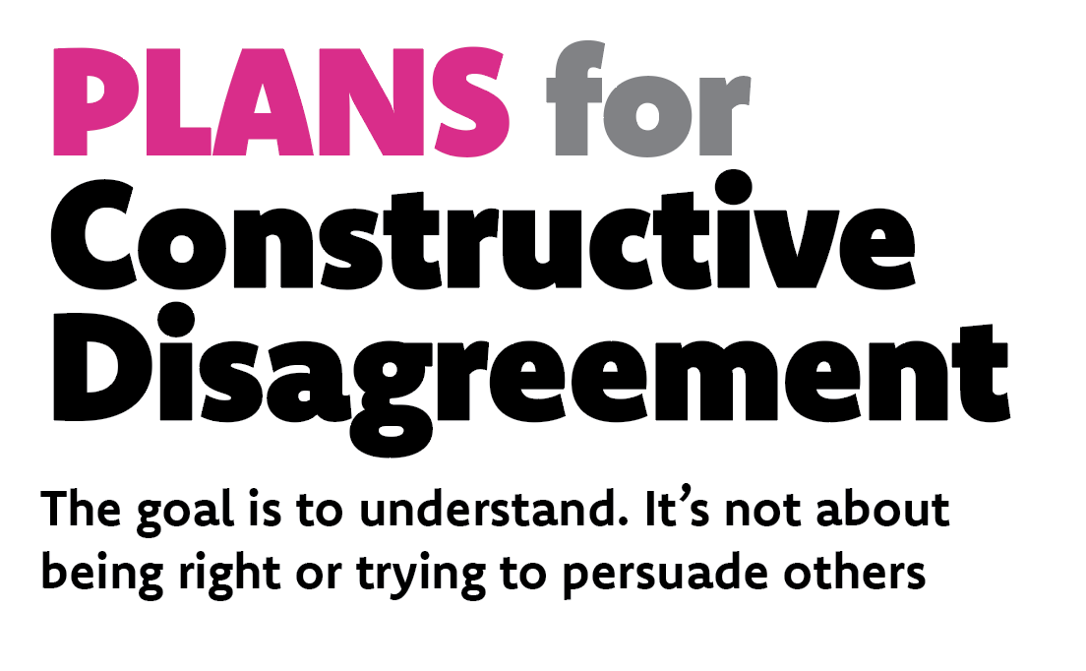

Slide 11
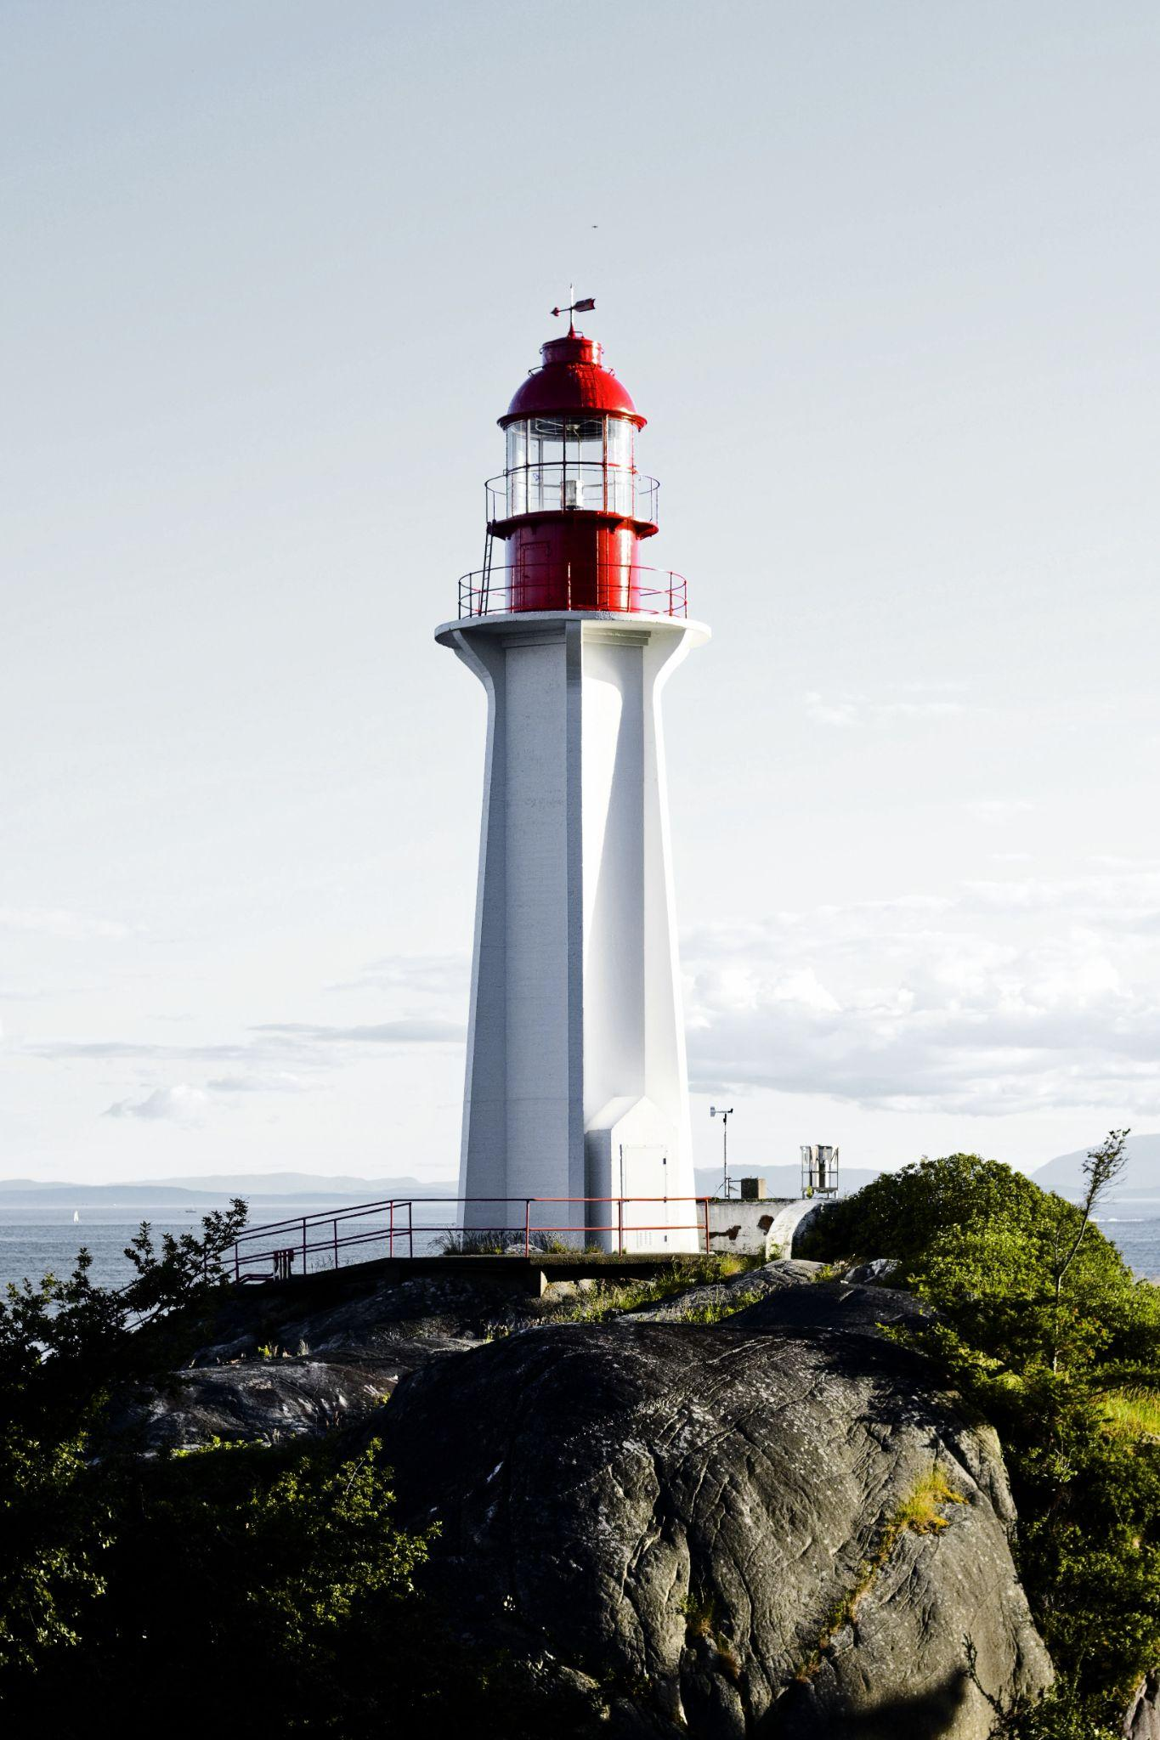
Discussion Protocols
Ideas for ways to structure discussions in your class
Simple: quick and easy to set up, no experience necessary
Moderate: a little more instruction or prep needed, allows for deeper engagement
Involved: takes the most time, but perfect for experienced discussers

Slide 12
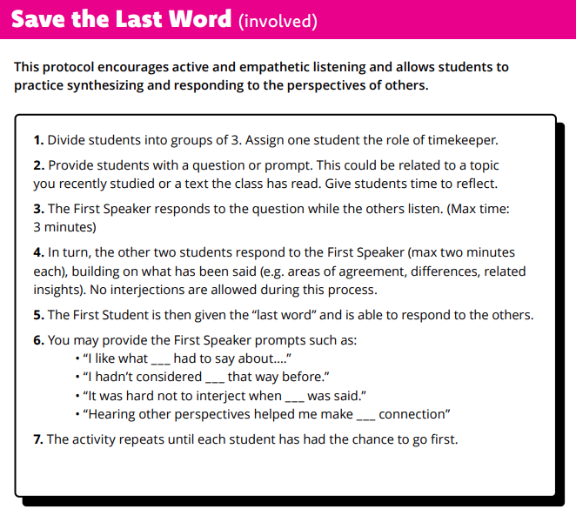
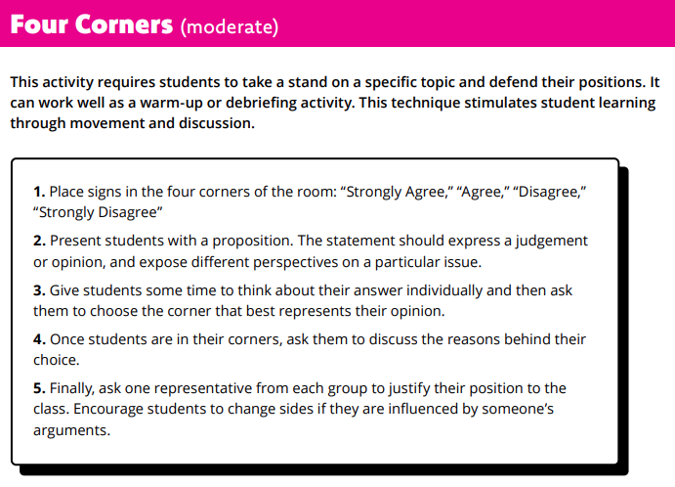
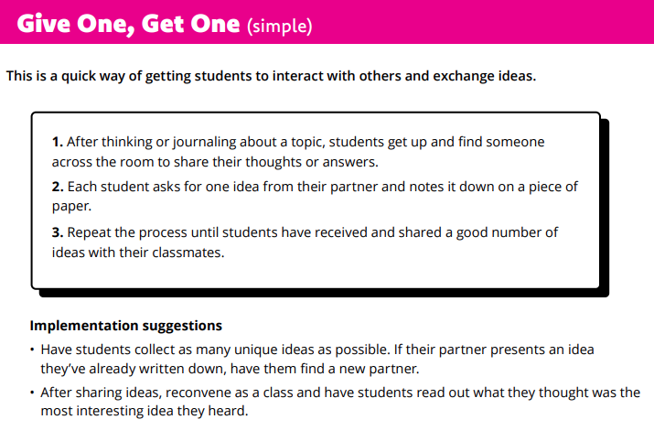

Slide 13
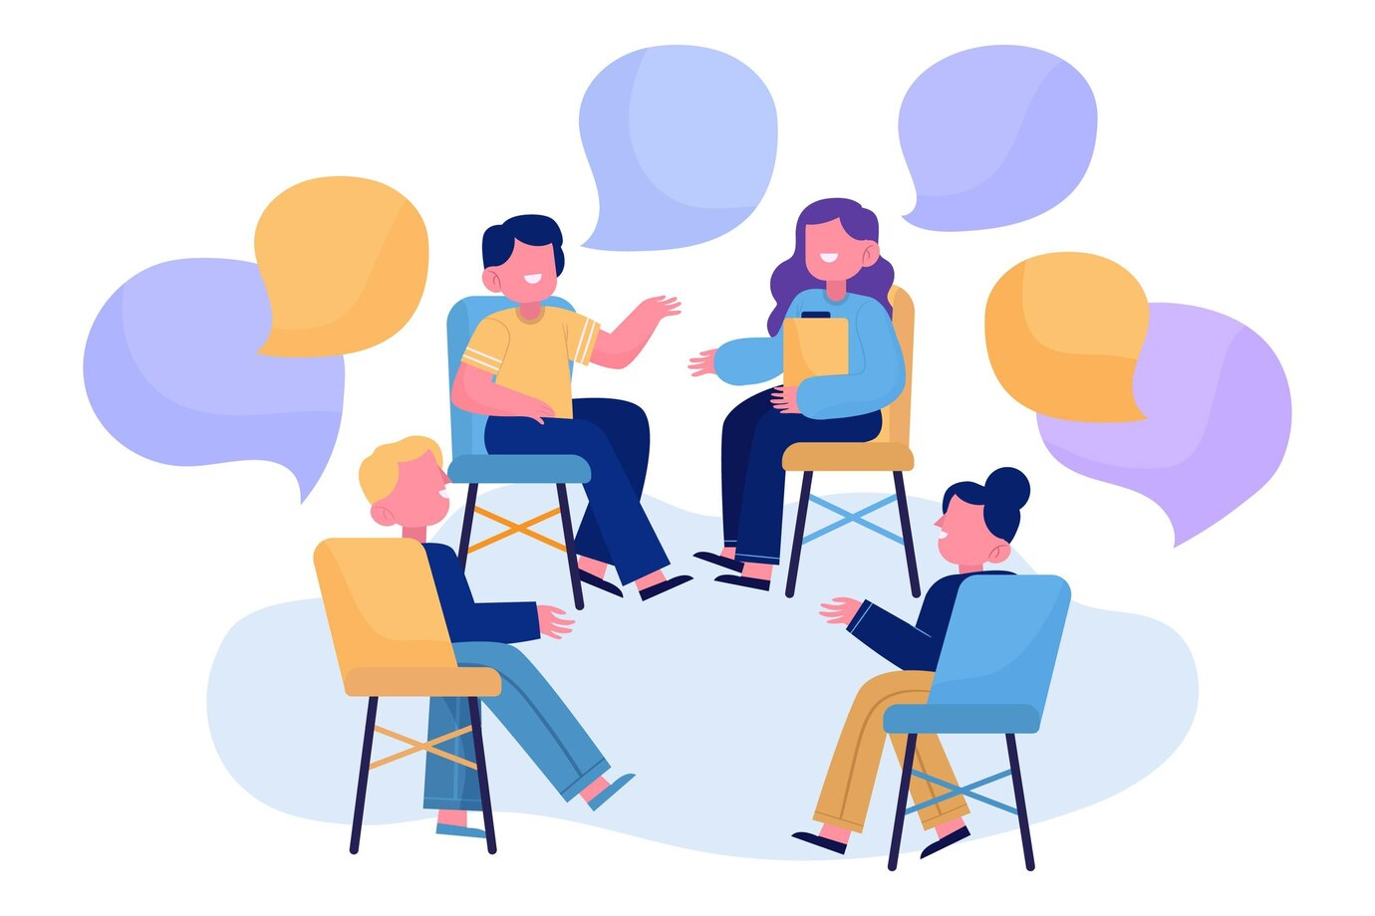
PoliTalks: Elementary Lessons
PoliTalks lessons for grades 4-8
Scaffolds skills and knowledge to help students start discussing important issues
4 lessons on identity, perspectives, discussion roles, and disagreements

Slide 14
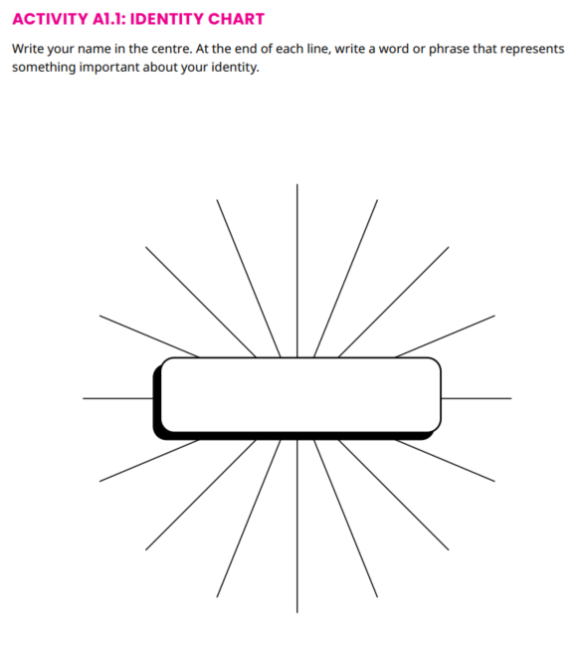
1. Identity and Diversity
Analyze the key factors that shape students’ identities
Reflect on how there is a diversity of other identities and views
Activity: Identity chart and discussion

Slide 15
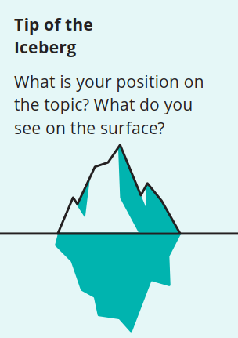
2. Different Perspectives
Understand how different perspectives can lead to different ways of seeing the world
Get curious about the views of classmates
Iceberg Activity: What Makes Up Your Perspective?

Slide 16




3. Engaging With Others
Students reflect on their experiences having discussions
Learn about being an active listener
Take on different discussion roles
Activity and Discussion: Animal Cards

Slide 17

4. What is the Goal of Discussion?
The focus of a discussion should be understanding, not winning
Practice having a discussion on a topic that they disagree about
Employ strategies to move past the disagreement and gain understanding

Slide 18
Activity: Animal Cards
Each person will rank the items from most important (1) to least important (5). Jot down any notes. (4 min)
Shuffle and distribute one animal card to each person at your table. For the remainder of the discussion you will take on the personality of your animal. Keep your animal secret.
Work together to try to come up with a ranking that everyone in the group can agree on. The Wolf will keep time and make sure everyone participates. (12 min)
After you have completed your group ranking, each person will reveal their animal and description to the rest of the group (4 min)
Total Time: 20 minutes

Slide 19

Debrief
Animal Cards get students to develop empathy and reflect on different approaches to discussions
Constructive Discussions contains additional discussion protocols that have been developed by researchers and practitioners

Slide 20
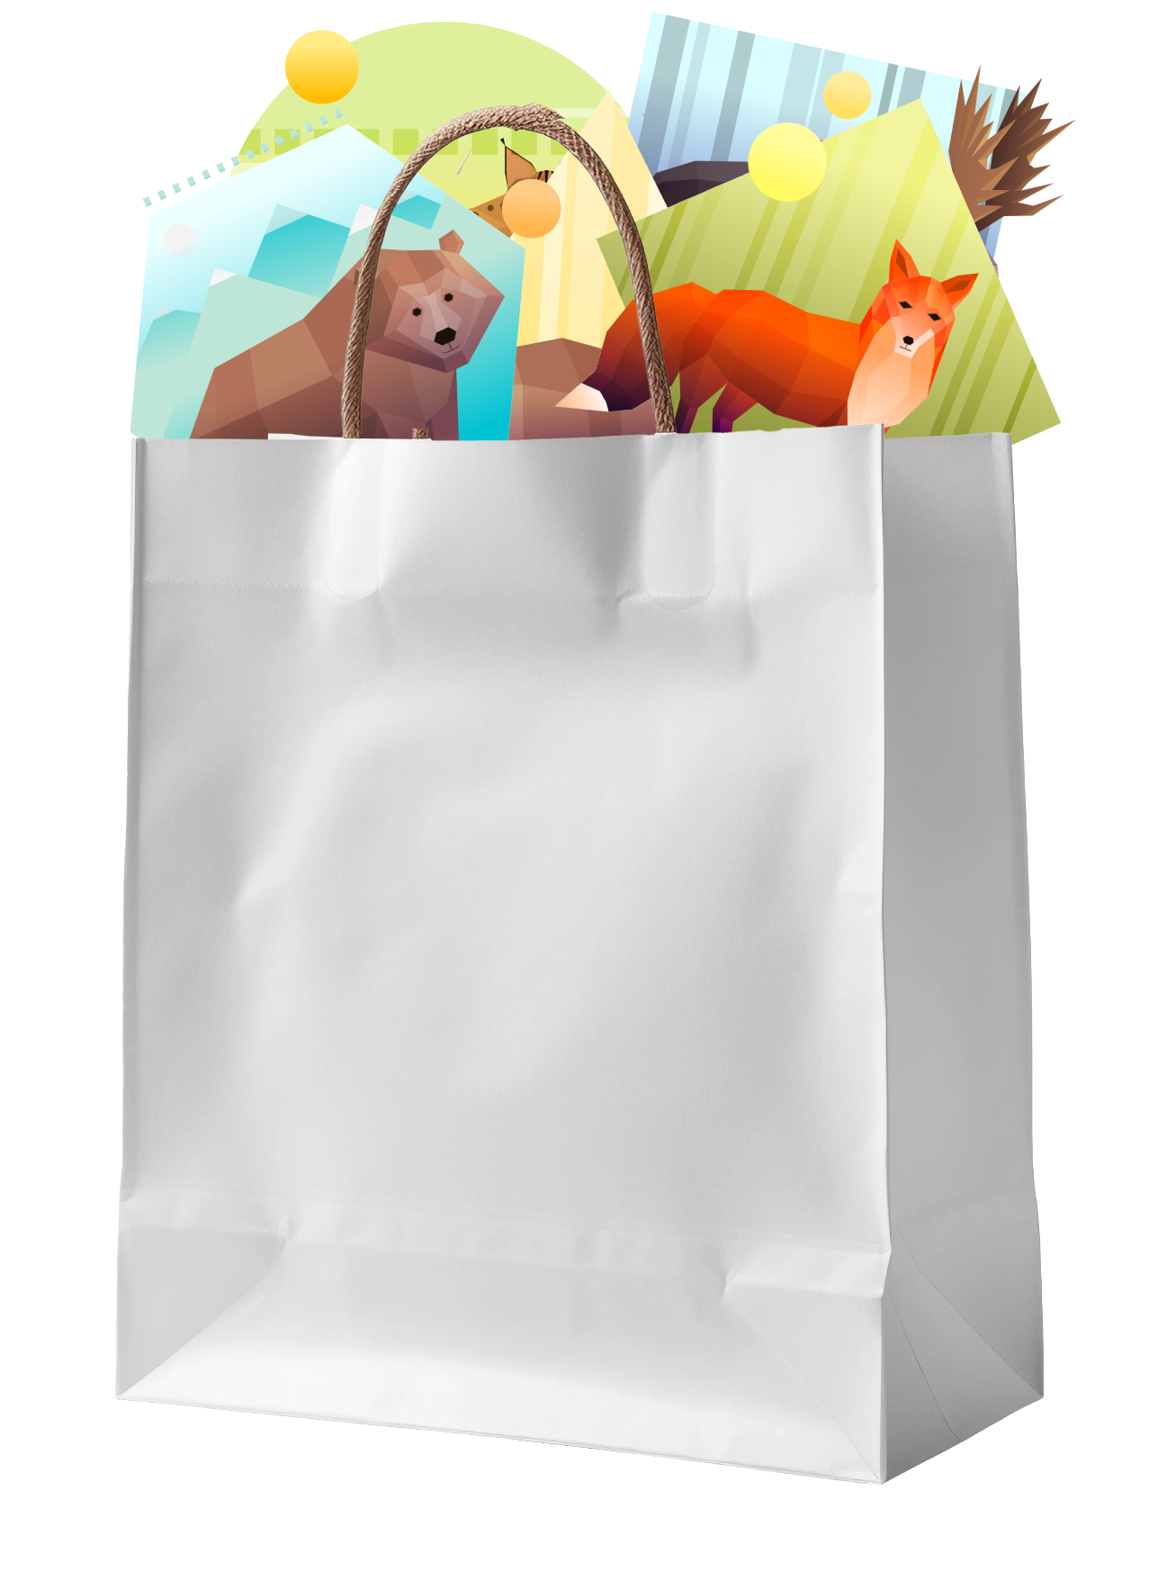
Everyone gets 3 packs to try out with your class
A copy of the Animal Cards activity
Pick them up at lunch or at the end of the day

Slide 21


Additional PoliTalks Resources
PoliTalks resources for intermediate elementary/middle school or high school
Perspectives
Identities and Pluralism
Perspectives and Opinions
Political Ideologies
Underlying Values
Biased Thinking
Biased Thinking
Confirmation Bias
In-Group Bias
politalks.ca/resources

Slide 22
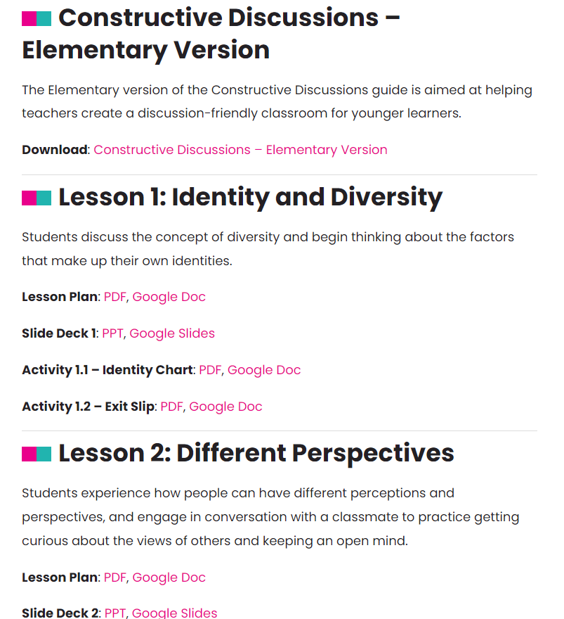
Accessing Elementary Resources
Resources are in development, and we’d love your feedback!
We will email you with details soon!
politalks.ca/elementary

Slide 23
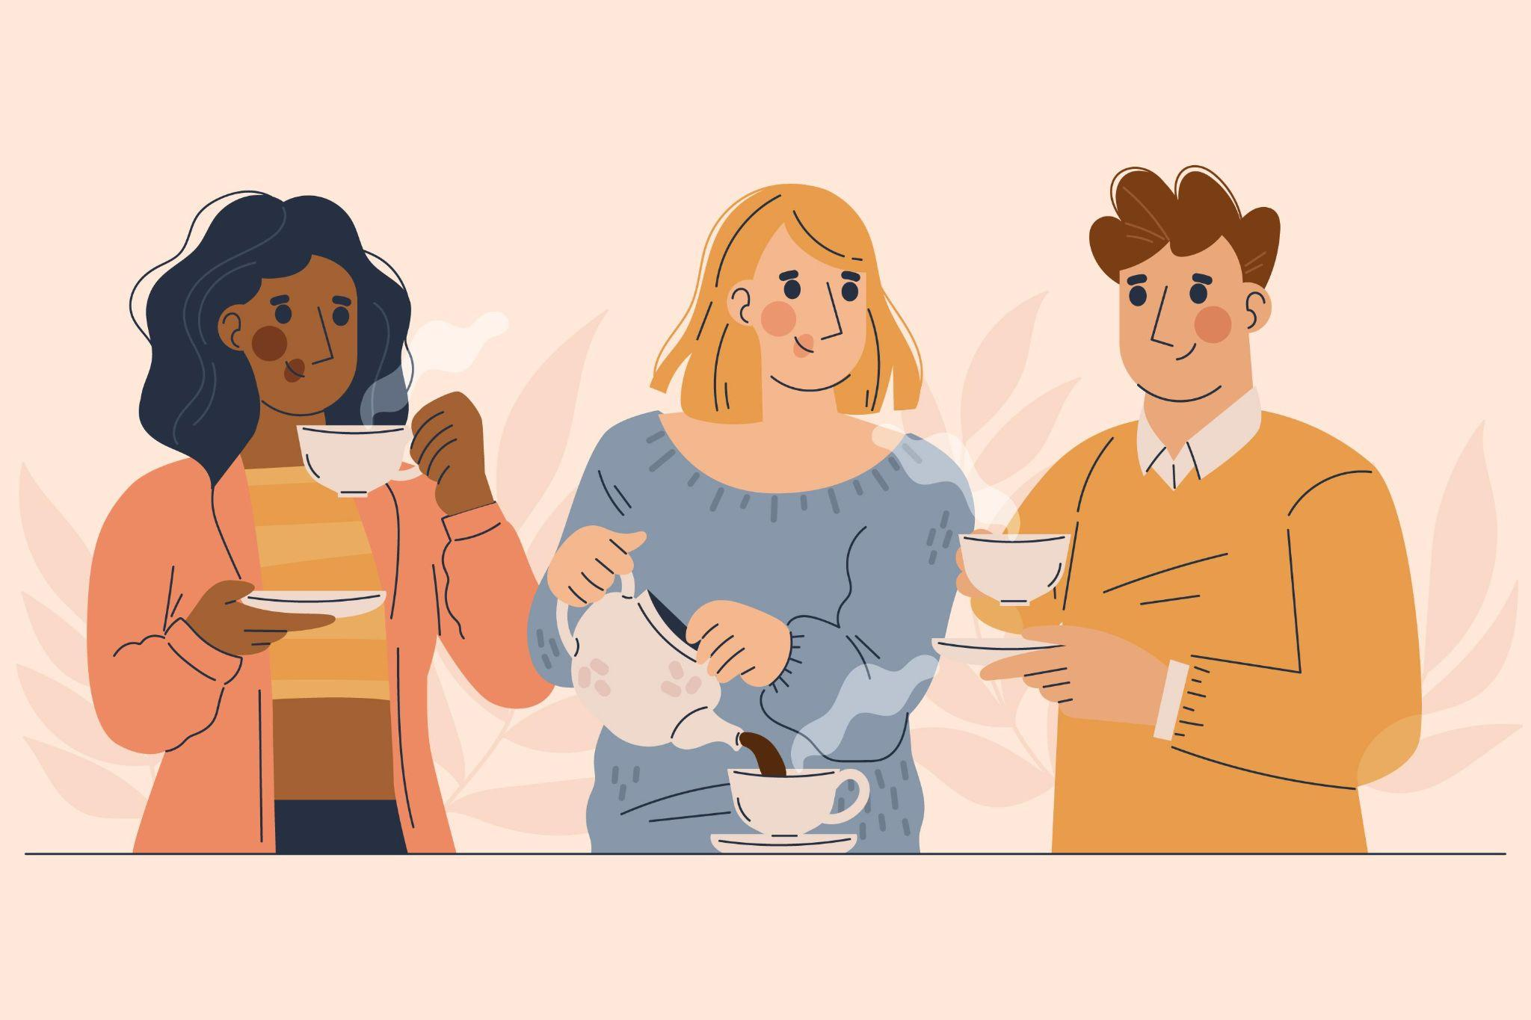
Time for a break!
Next session begins at 10:05

Slide 24
