Slide 1
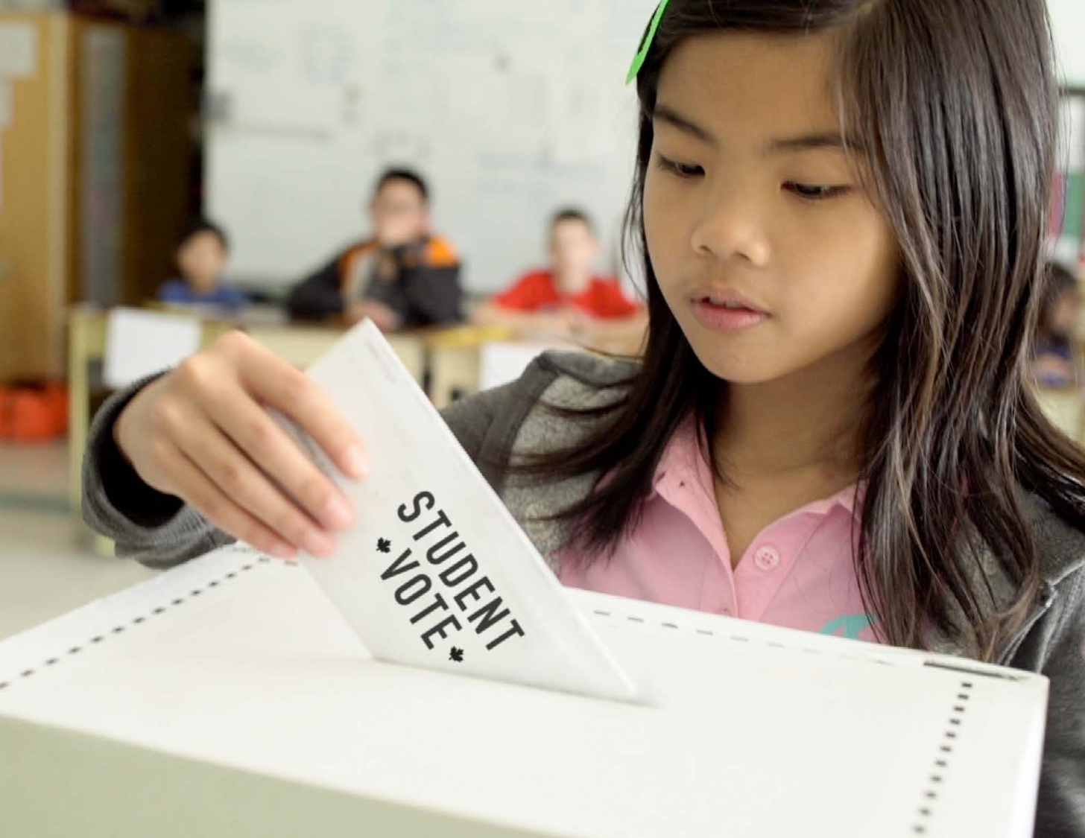


Slide 2
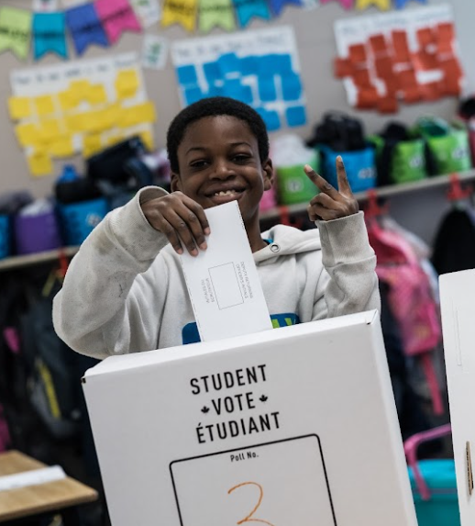
Student Vote
An authentic parallel election experience
Makes civic education compelling
Empowers students with the knowledge and skills to be engaged citizens

Slide 3
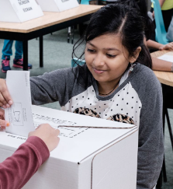
The case for support
Declining voter turnout, particularly among youth

Slide 4
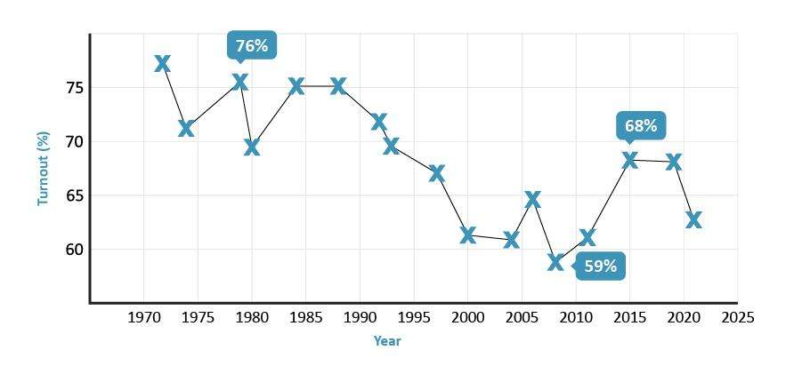
Voter turnout - Federal elections

Slide 5
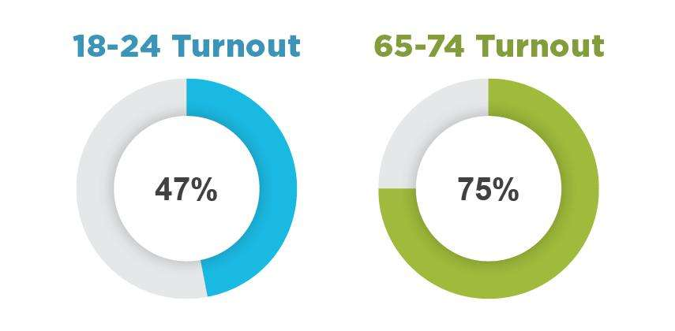
Gap in turnout by age group
Source: Elections Canada, 2021 Federal Election

Slide 6
The case for support
Declining voter turnout, particularly among youth
Voting is habitual

Slide 7
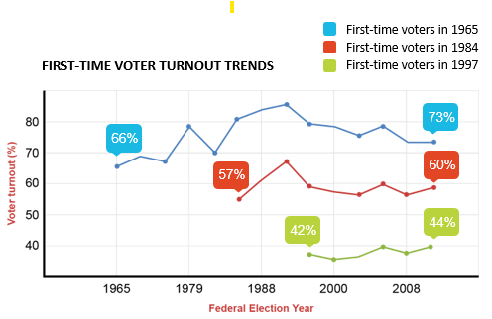
Voting is a habit

Slide 8
The case for support
Declining voter turnout, particularly among youth
Voting is habitual
Barriers to voting among youth

Slide 9



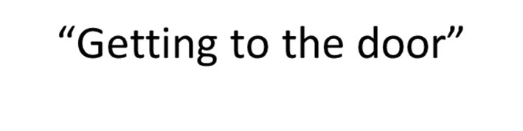
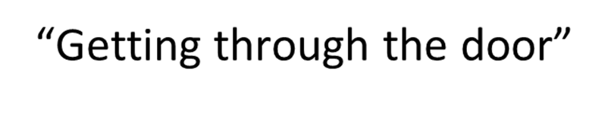
Barriers to Voting

Slide 10
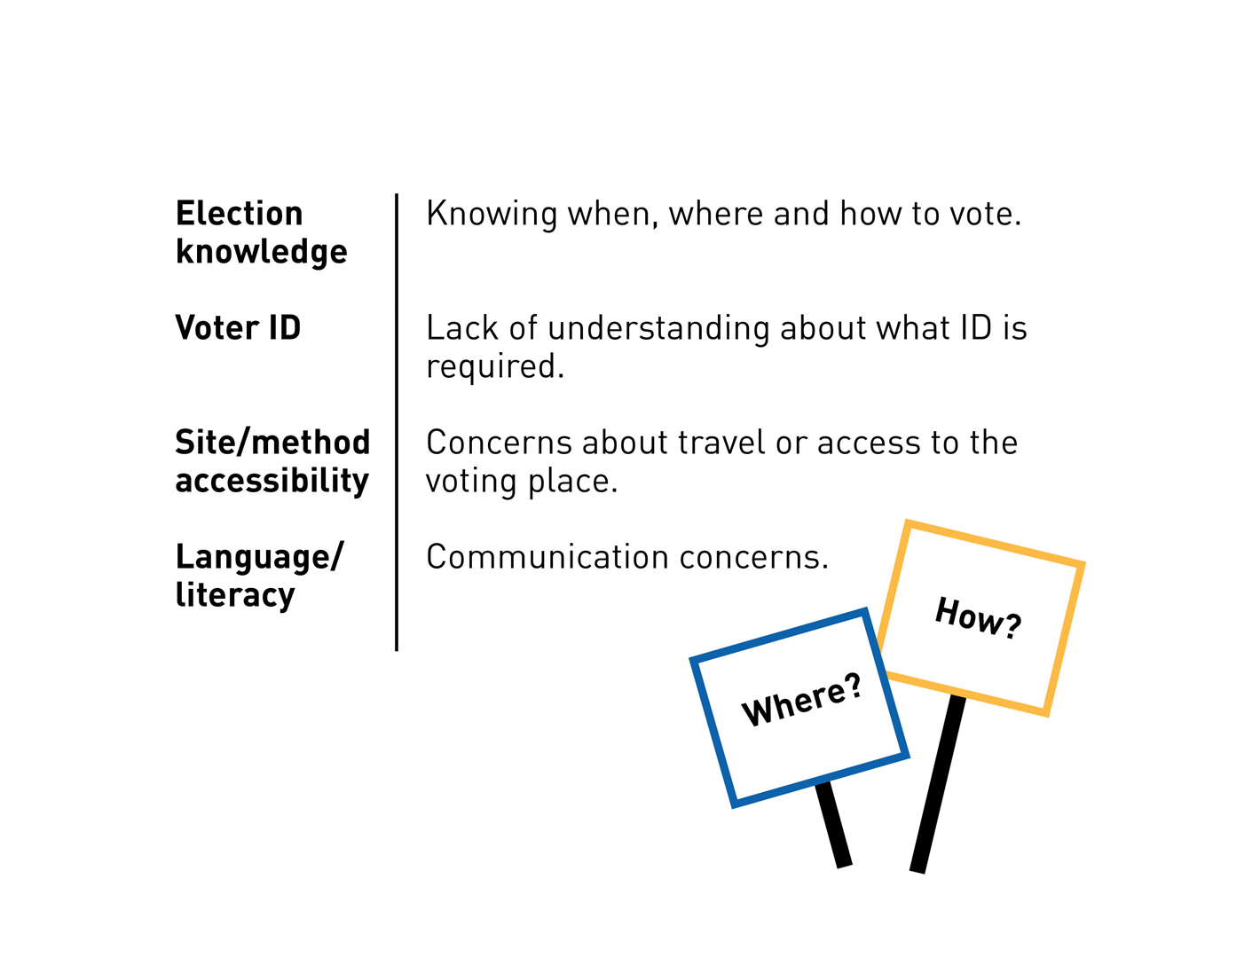
Access Barriers

Slide 11
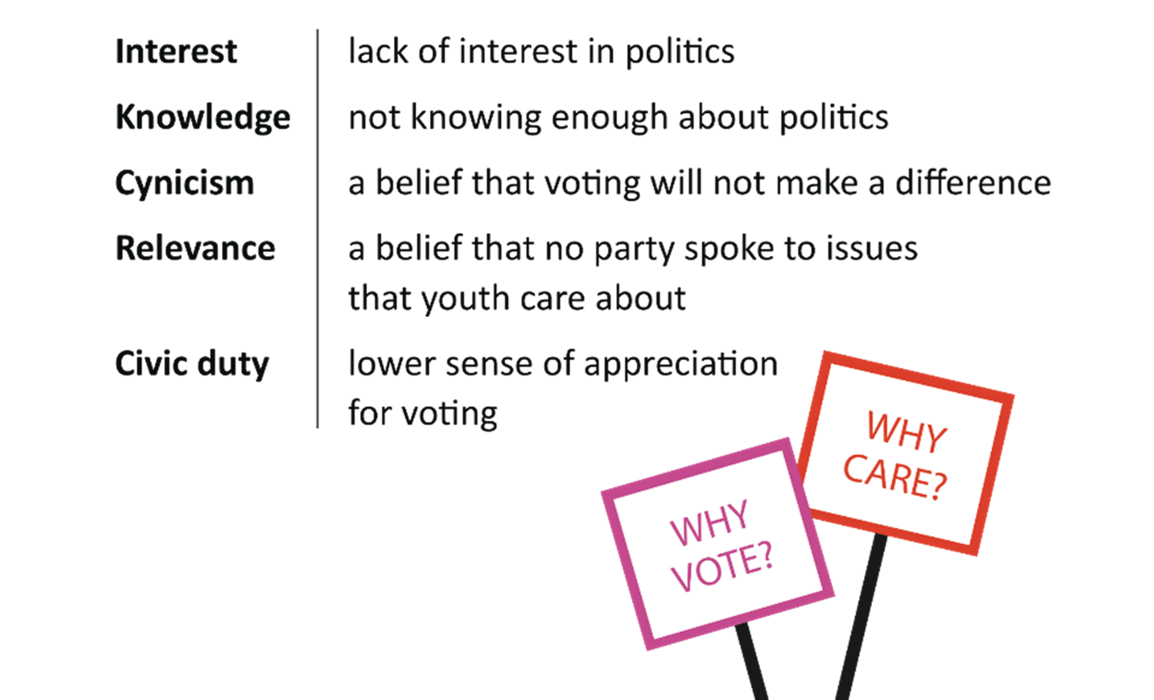
Motivational Barriers

Slide 12
The case for support
Declining voter turnout, particularly among youth
Voting is habitual
Barriers to voting among youth
Less political engagement at home
Early exposure is important

Slide 13
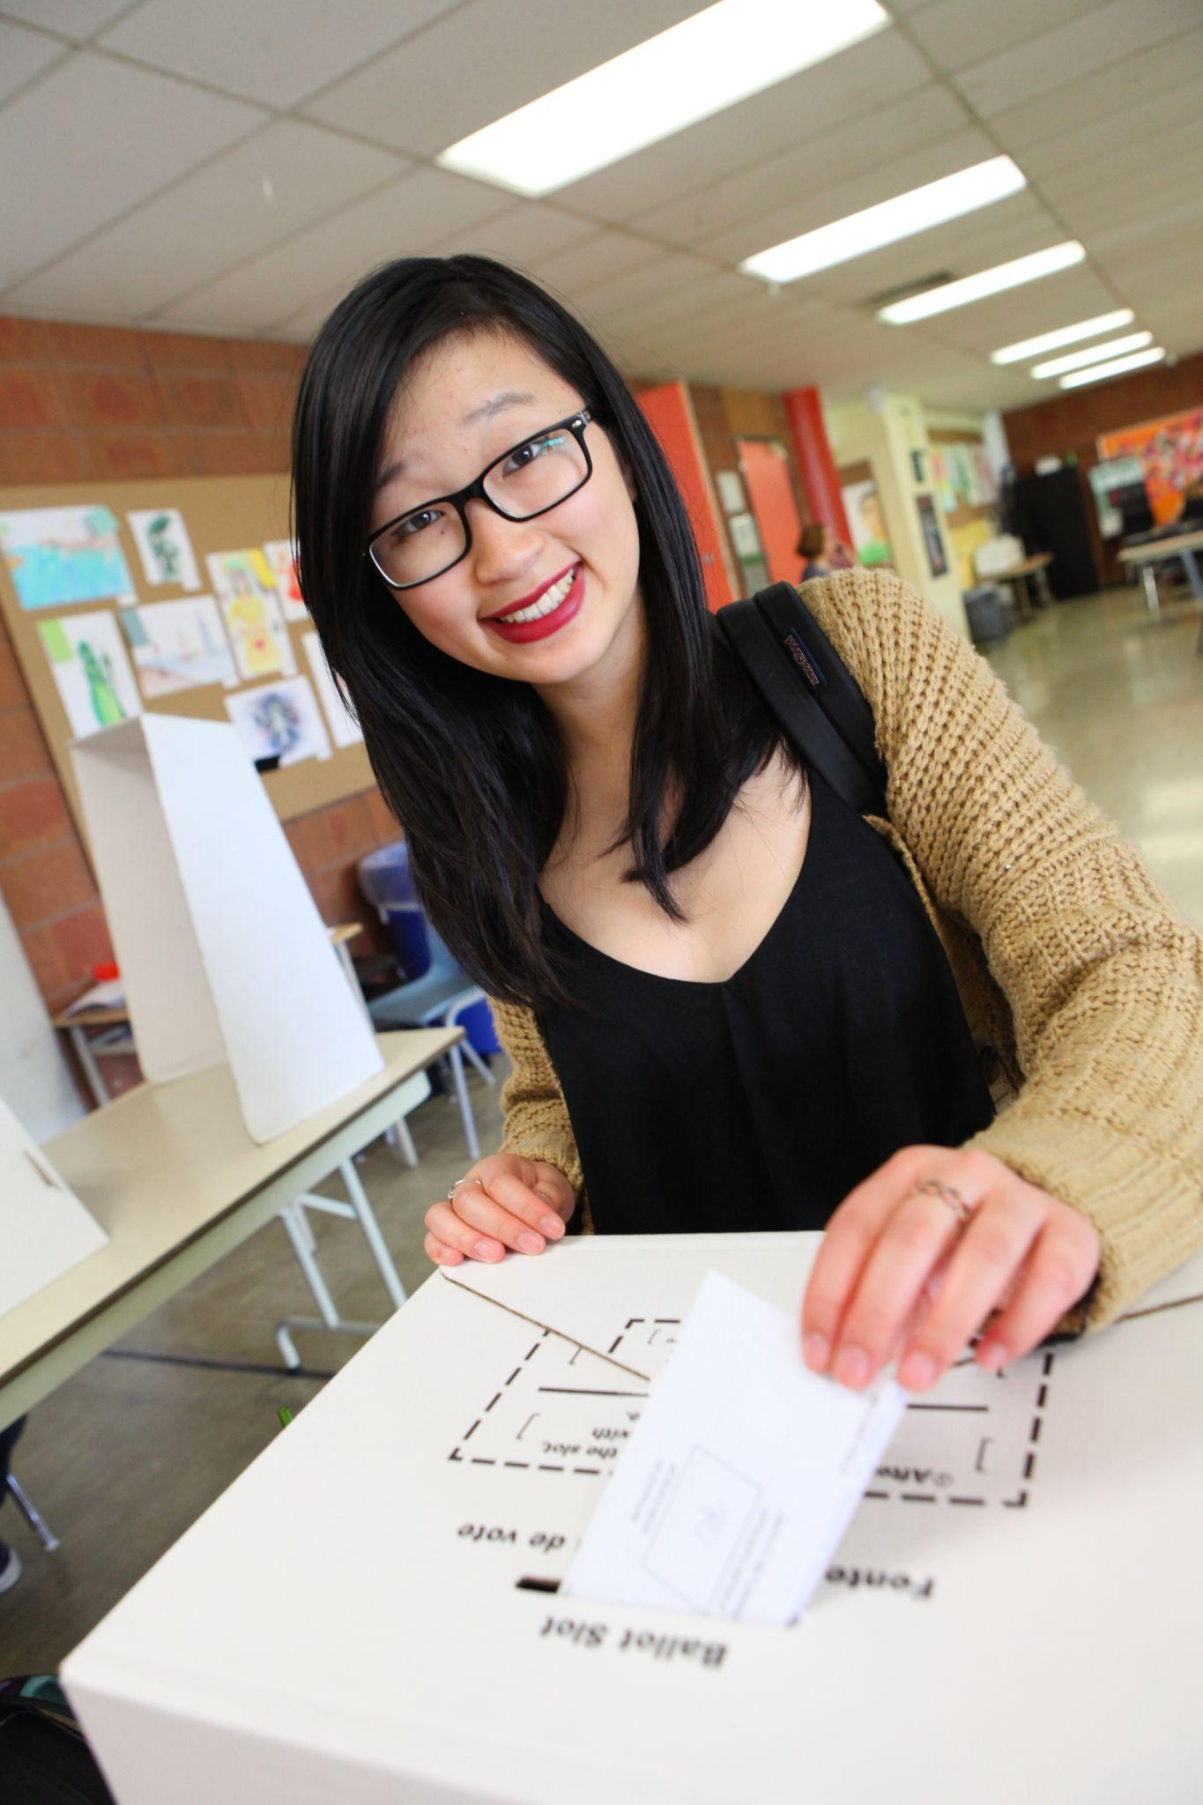
Student Vote objectives
Introduce the concepts of democracy and elections
Develop an interest in politics
Foster a sense of community
Strengthen civic responsibility
Spark political discussion
Build a habit of electoral participation

Slide 14
The scope
Designed for grades 4 to 12
Offered at all levels of elections in most jurisdictions across Canada
63 elections in Canada since 2003
Since 2018, we have also organized six Student Vote projects in Latin America

Slide 15


Slide 16
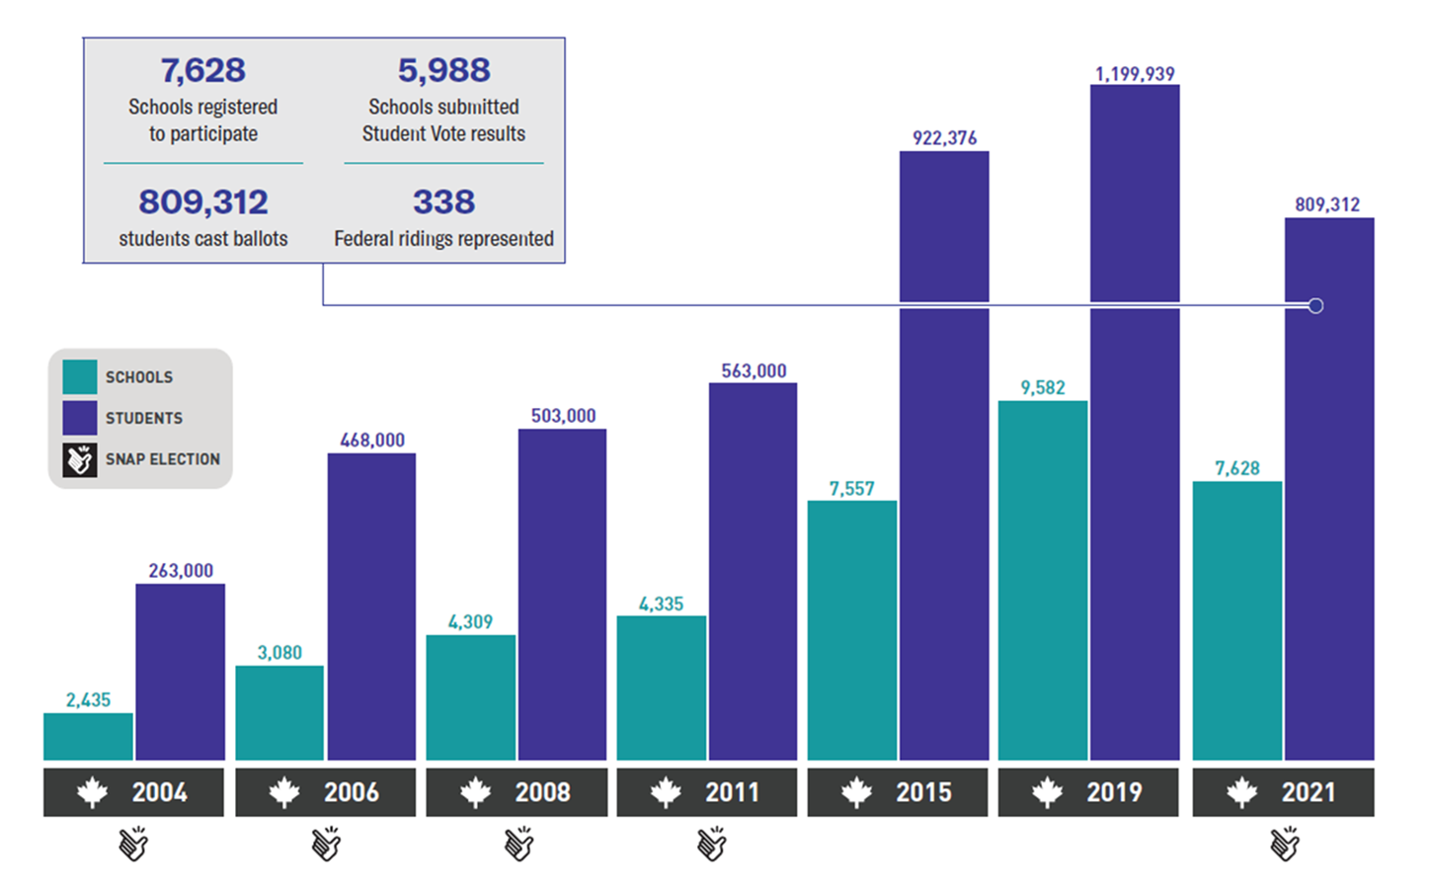
Federal election participation

Slide 17


The next federal election
On or before October 20, 2025

Slide 18




The steps
Register your school: The program is free and open to any school. One teacher acts as the ‘Team Leader’ and the main liaison.
Receive Materials: Schools receive learning resources, campaign posters, electoral district maps, ballot boxes and voting screens.
Engage with the campaign: Students learn about government and elections, and research and discuss the issues, candidates and platforms.
Student Vote Day: Students take on the roles of election officials and cast ballots for local candidates running in the their school's riding.

Slide 19
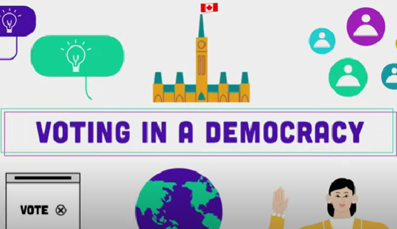
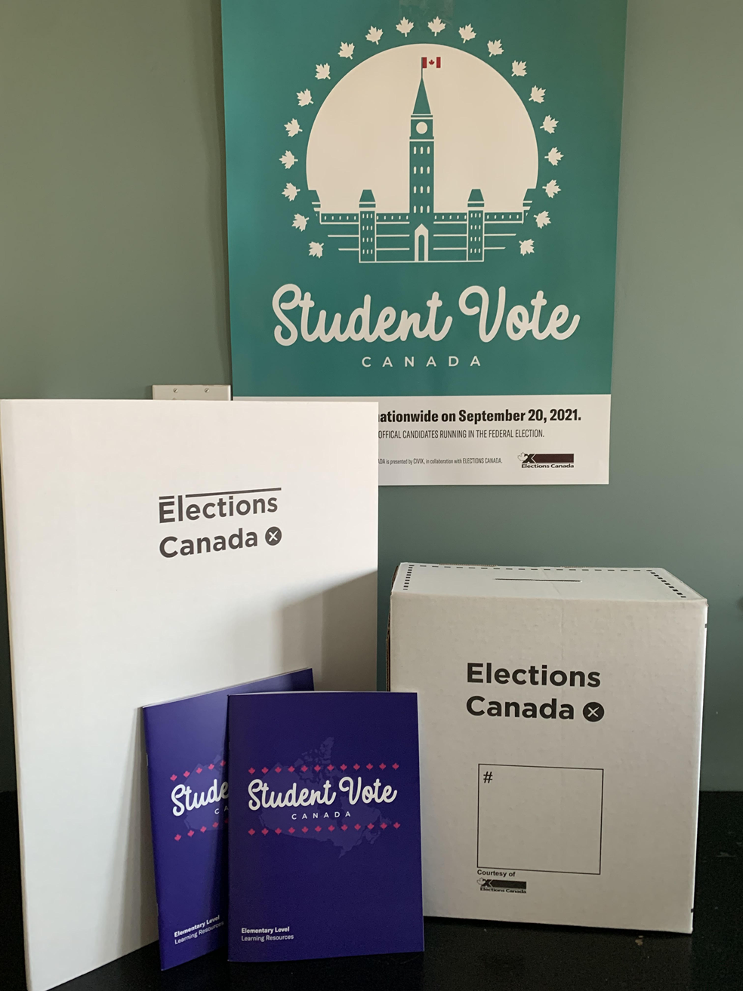
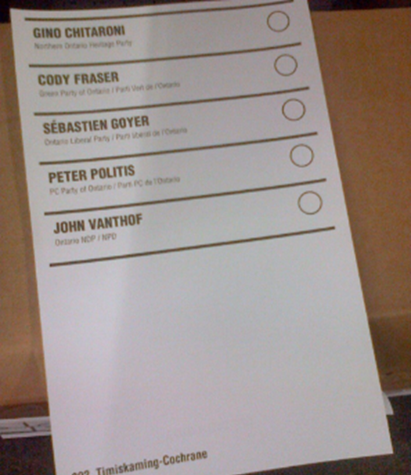
Program materials
SV election website
Resource package
Ballot kits
Lesson plans, digital files
Slide decks
Videos
Online interactives
Lesson plans
Student Vote posters
Electoral district maps
Ballot boxes and screens
Ballot kit
Statement of the poll form
Election manual

Slide 20
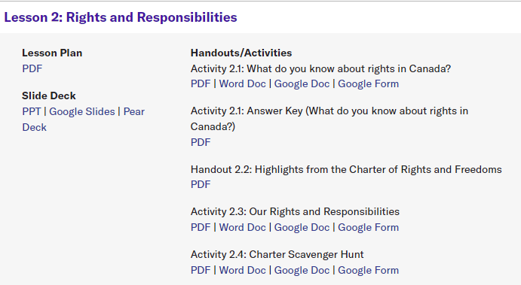
Resources on the election website

Slide 21
Program materials
SV election website
Resource package
Ballot kits
Lesson plans, digital files
Slide decks
Videos
Online interactives
Lesson plans
Student Vote posters
Electoral district maps
Ballot boxes and screens
Ballot kit
Statement of the poll form
Election manual

Slide 22
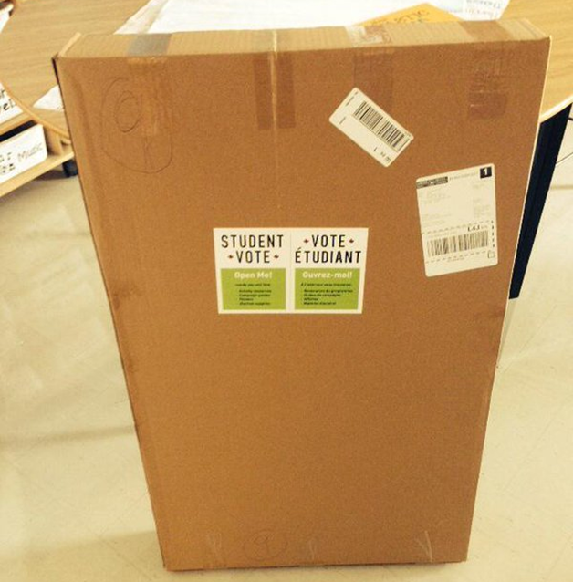
Package readiness
Look for a notification from Canada Post to track your package.
Alert your admin about the expected package.
Open the package and check the contents for accuracy.

Slide 23
Elementary Lessons: New Focus Areas
Best practices for building a discussion-friendly classroom (Classroom norms)
Discussion activities in each lesson with protocols to support constructive discussion skills
More close contact and tactile activities
Shorter lessons (40 min)
Activities for different subjects (i.e. Math)

Slide 24
Elementary Lessons
Fundamental Themes:
1: Democracy
2: Rights and Responsibilities
3: Governments in Canada
4: Federal Elections

Slide 25
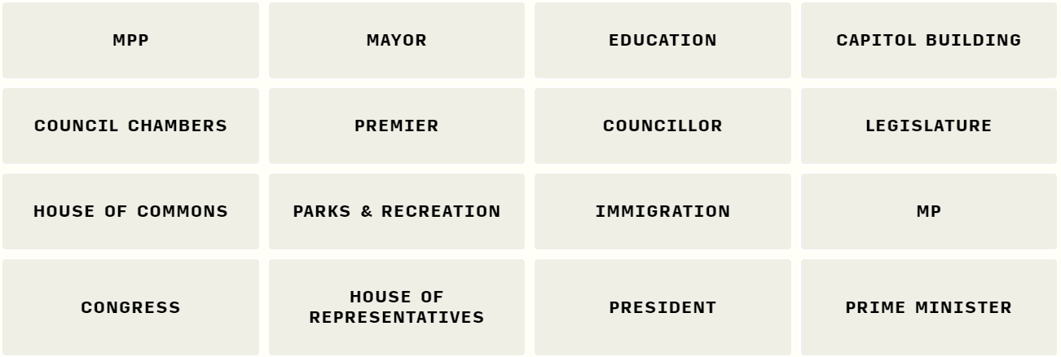
Connections game - Governments

Slide 26
Elementary Lessons
Election related Lessons:
5: Campaign Communication and Media
6: Political Parties
7: My Candidates
8: The Voting Process
9: Post-Election Analysis

Slide 27
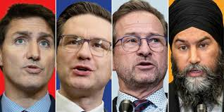
Party leader Q & A
5-6 Questions / Video responses

Slide 28




Pollenize
10-12 topics / Party platform summaries

Slide 29
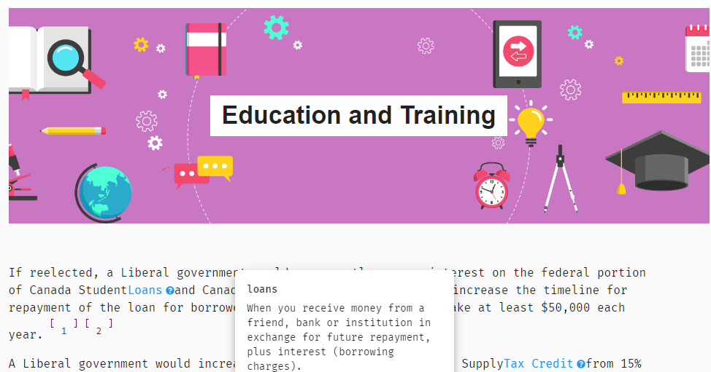
Pollenize

Slide 30
Learning about parties and candidates
Divide students into groups to research one party/candidate
Invite your candidates to your school or email them questions
Consult with news org sites - Party platform summaries/district profiles
Track social media announcements from each party during the campaign
Analyze campaign advertisements
Party leader Q&A videos (Student Vote resource)

Slide 31
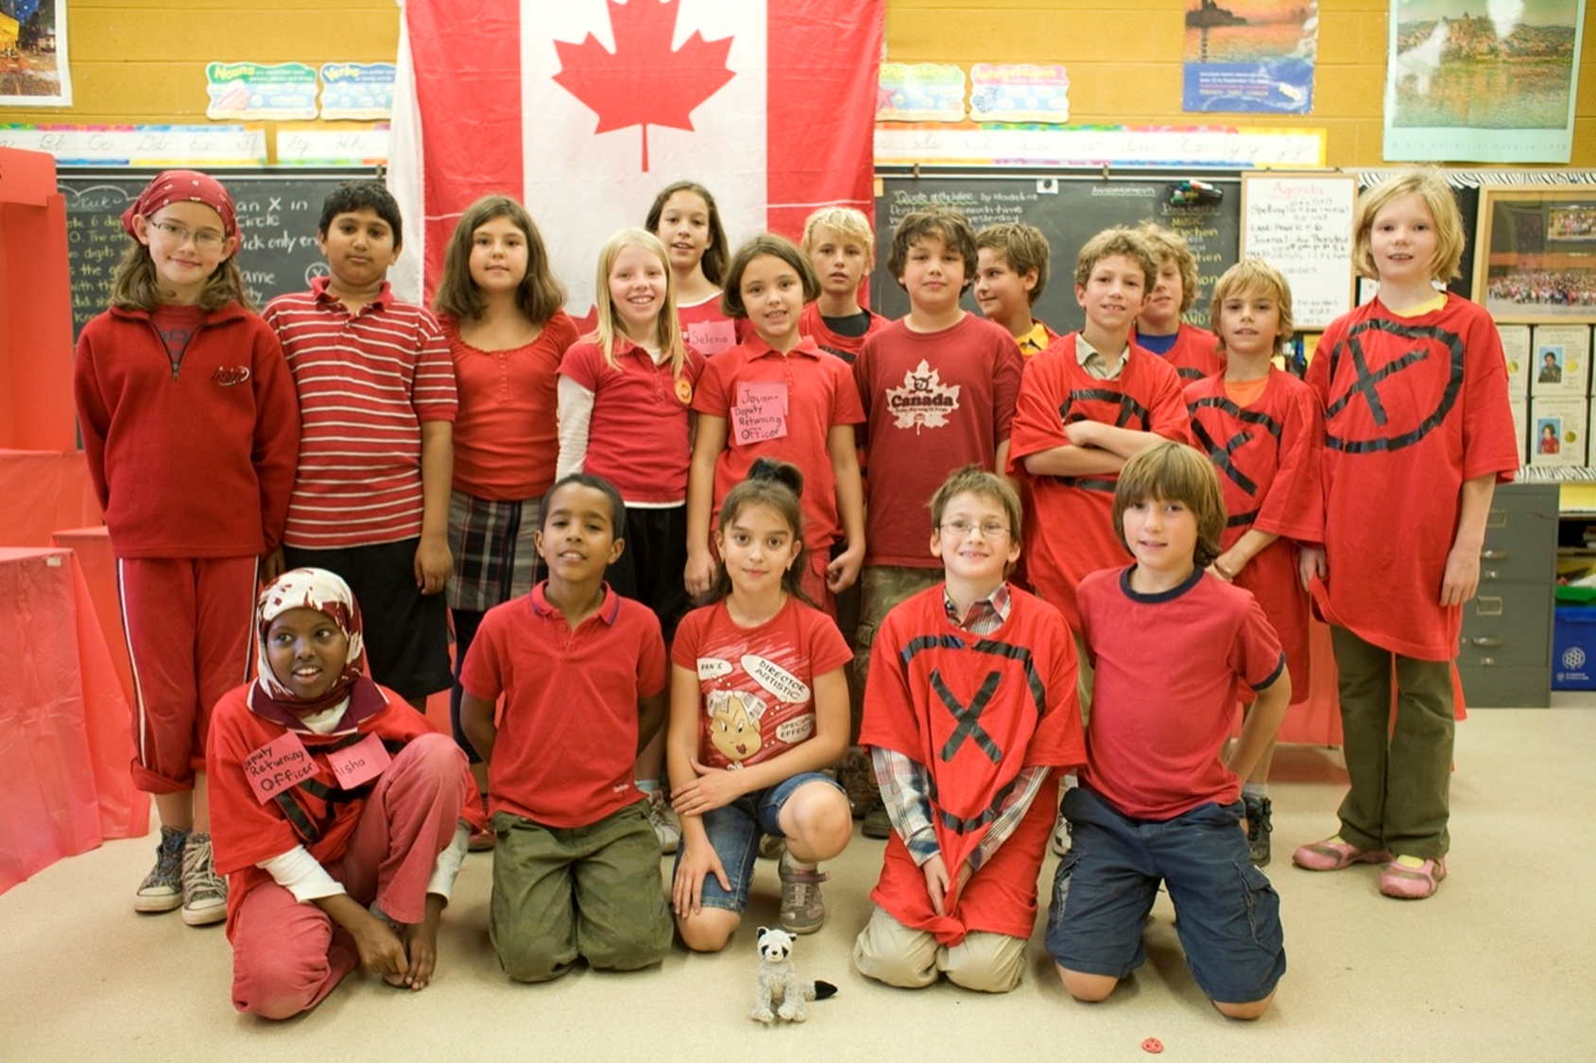
Student Vote Day

Slide 32
Options for Student Vote day
VOTE BY CLASSROOM - Classes arrange to vote at the voting location at pre-set times throughout the day.
HOMEROOM VOTING - Ballots distributed to each participating class and students vote in their home classroom.
MOBILE VOTING STATION - Designated election officials take mobile voting booths from classroom to classroom.

Slide 33
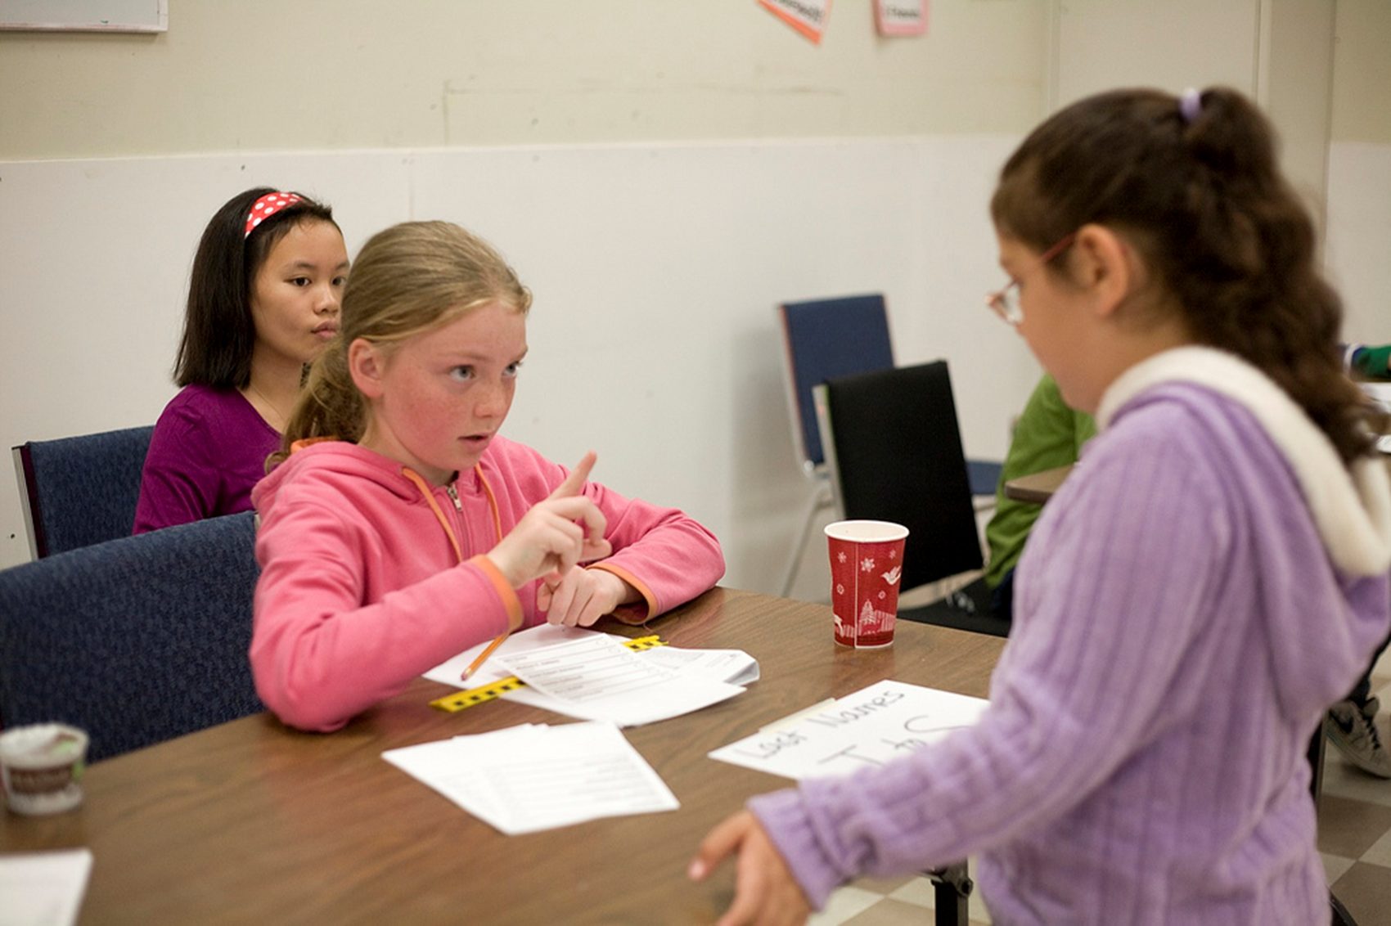
Tips for Student Vote day
Assign students to take on the roles of election officials
Use the templates to create Voter IDs and use a voters list
Create ‘I am a Voter’ stickers to participants (mailing labels work great)

Slide 34
Student Vote Results
Please keep your results confidential until the after the polls close
Share any news coverage
Look at the breakdown on the Student Vote election results and analyze the results
  How did schools vote in your electoral district?
  How does Student Vote compare to the general election results?

Slide 35





Results: Federal 2021
PARTY | Student Vote |  | General Election
 | Seats | Vote % | Seats | Vote %
 | 118 | 24.1% | 160 | 32.6%
 | 88 | 25.1% | 119 | 33.7%
 | 21 | 2.1% | 32 | 7.6%
 | 108 | 28.5% | 25 | 17.8%
 | 3 | 9.8% | 2 | 2.3%

Slide 36

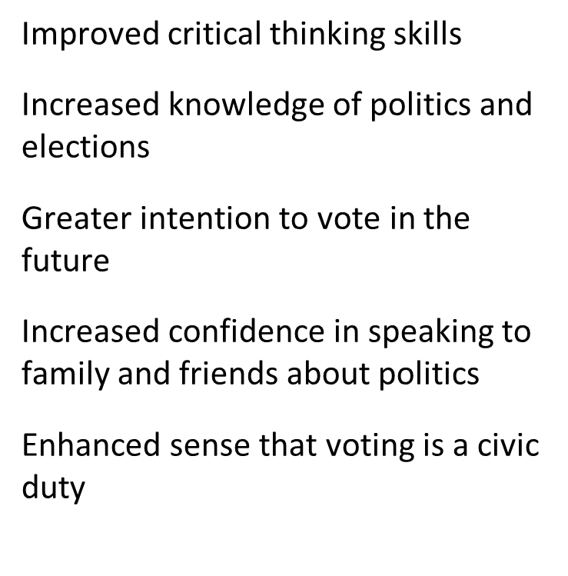



Student Outcomes

Slide 37

Outcomes among Families
90% felt the program increased their families’ opportunities to learn more about elections and politics
50% stated that they knew more about politics because of their child’s involvement
58% felt that the program increased their own interest in politics
28% reported that their child’s participation positively influenced their decision to vote

