Slide 1
Democracy Bootcamp
Discussing Political Issues
10:15 - 11:25

Slide 2
What we’ve learned
93% of teachers agreed that students need to study and discuss controversial issues to become engaged citizens but only 55% say the practice is encouraged at their school
74% of teachers said that discussing politics or controversial issues has become ‘more difficult’ (50%) or ‘much more difficult’ (24%) in the last 2-3 years
26% of elementary teachers identified Andrew Tate as someone their students either follow on social media or reference in class. This number increased to 48% among teachers of intermediate grades and to 67% among high school teachers.
Overall, teachers feel like their school system does not prioritize classroom discussion as much as it should

Slide 3
Introducing PoliTalks
PoliTalks supports educators in building discussion-friendly classrooms.
It provides resources and activities designed to build the knowledge, attitudes, and skills students need to engage in constructive discussion.
...

Slide 4
Elementary
Secondary
...
...
Primaire
Secondaire

Slide 5
Politics in the Classroom?
There’s lots happening in the world that students want to discuss, but it’s not always easy to know how to address controversial issues
Teachers can feel apprehensive about discussing politics in the classroom
Real benefits to bringing political issues into the classroom and providing an opportunity for students to develop discussion skills

Slide 6
Do not edit
How to change the design
What are some issues your students are talking about?
Presenting with animations, GIFs or speaker notes? Enable our Chrome extension

Slide 7
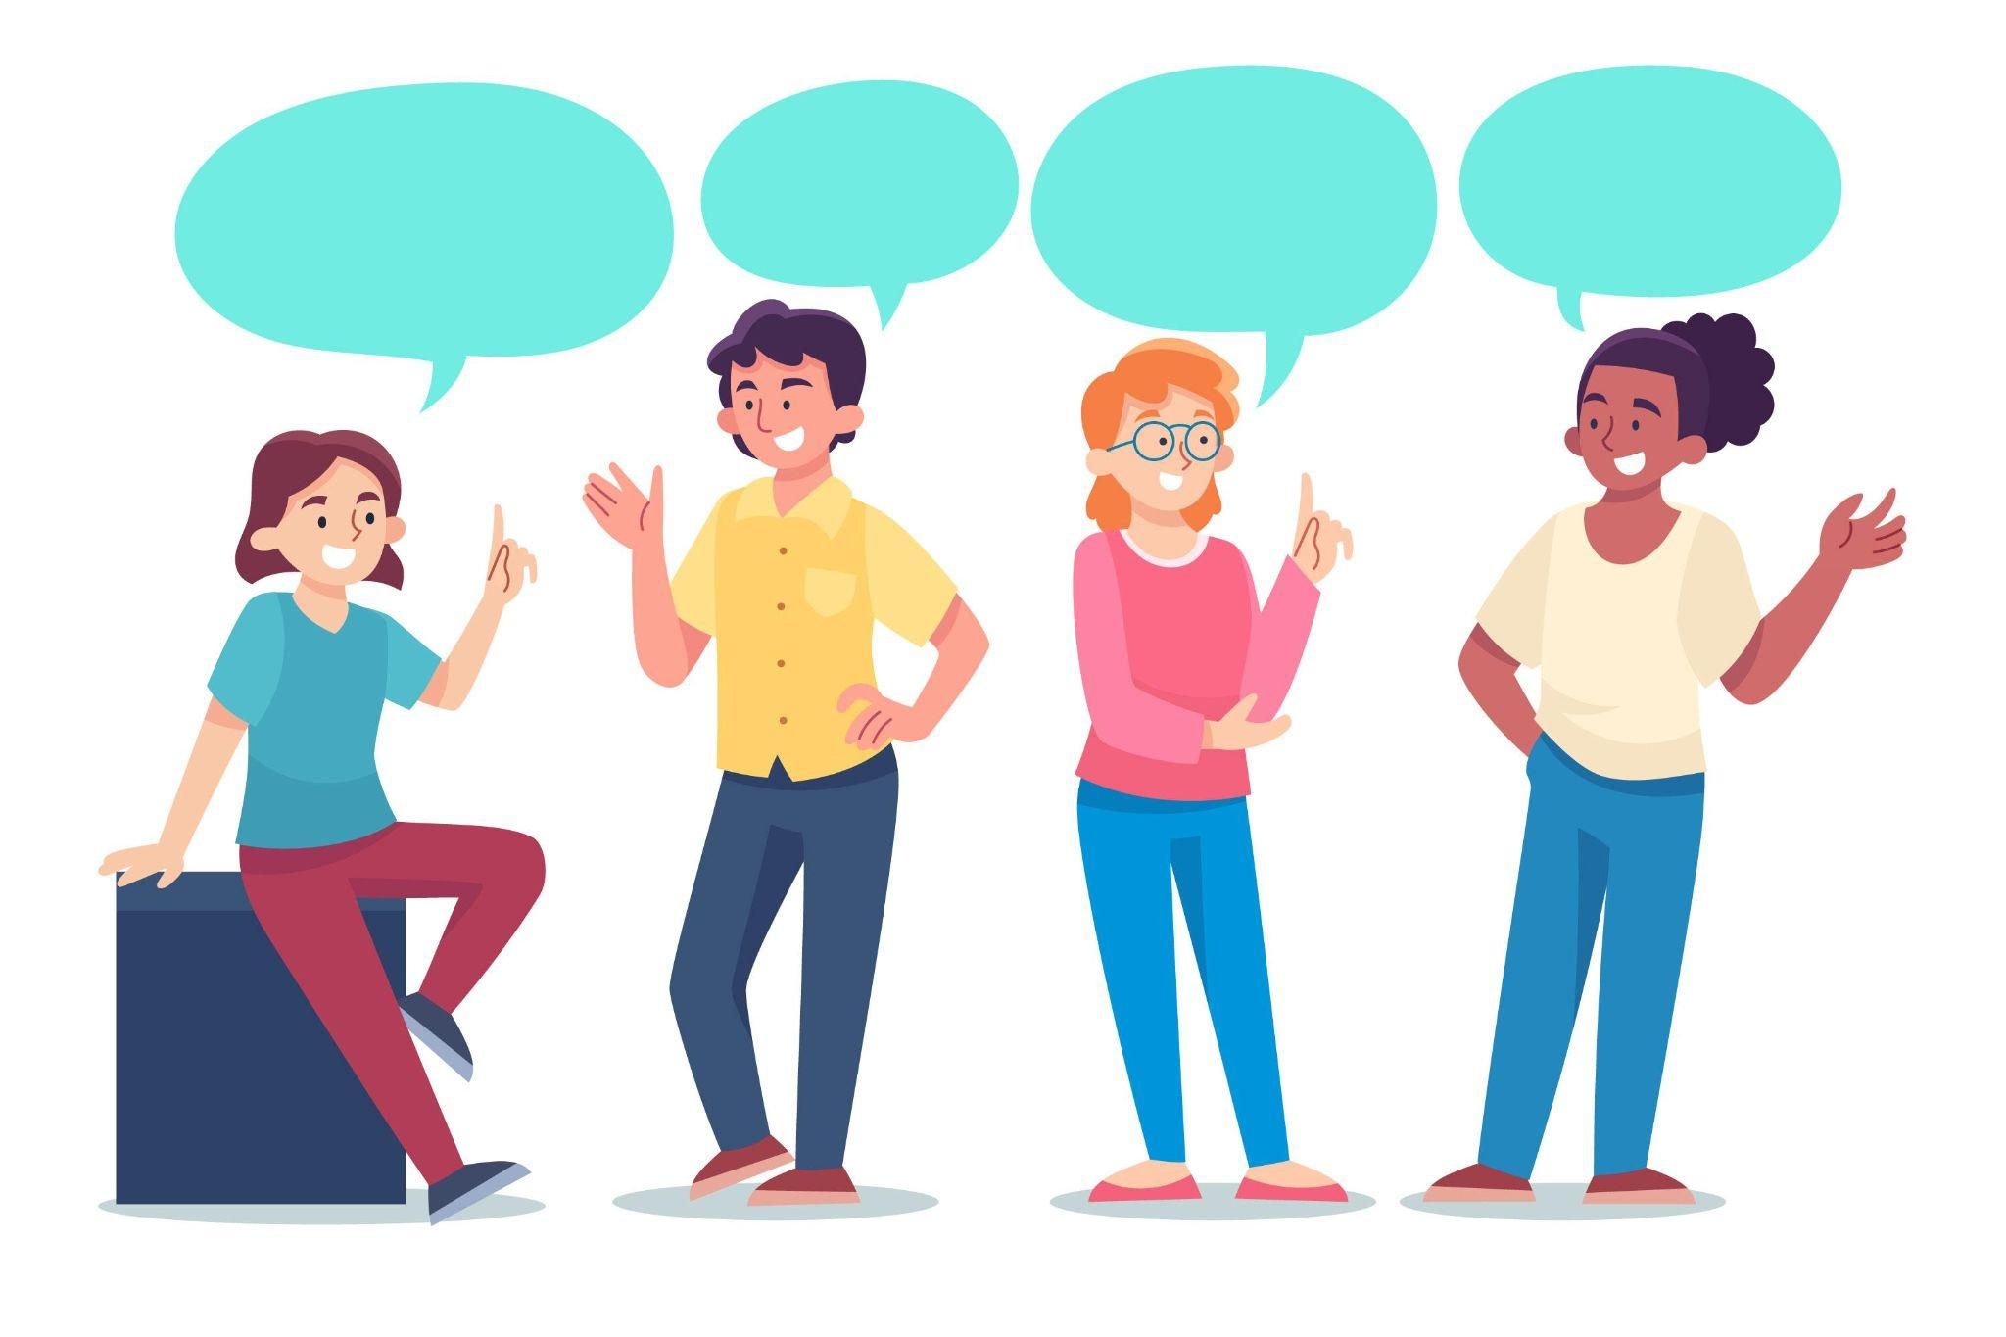
Benefits of Classroom Discussion
Students who participate in discussions of controversial political issues in classes:
Demonstrate increased political knowledge
Express more interest in politics
Follow the news more regularly
Are more likely to engage in political discussions with those who have different ideologies
Are more interested in listening to different opinions

Slide 8
Discussion Guide
Guiding Principles
Creating a Discussion-Friendly Classroom: Norms of Agreement
Preparing for Discussion
Framework for Constructive Disagreement (PLANS)
Troubleshooting
Appendix: Activities and Handouts
Table of Contents image here
Cover image TK

Slide 9
Rank Order: Why is it so hard to talk about politics?
There are a lot of factors that can make political discussions difficult. Rank the following factors by what you think is the most to least significant.
Make some short notes to explain your thinking.
Politicians and political parties creating divisions among Canadians
The spread of false and misleading information online
A hostile environment on social media
Increasing polarization on important issues
Increasing intolerance toward people with different viewpoints

Slide 10
Rank Order Protocol Activity
Rank items from most significant (1) to least significant (5). Jot down some notes if needed. (3 minutes)
Divide into two groups.
Assign a timekeeper (person who has been a teacher the longest).
Take turns sharing order and reasoning. Person with the most recent birthday goes first. (2 minutes each)
Discuss and compare — What differences do you notice? What accounts for these differences? Does anyone want to change their ranking after the discussion? (5 minutes)

Slide 11
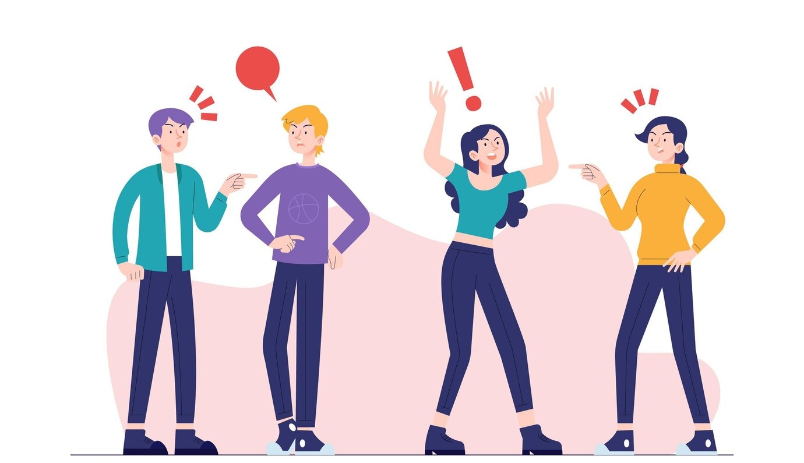
Why is it hard to talk about politics?
We often approach others with anger, frustration, and distrust instead of curiosity
There are lots of factors out in the world that make it hard to talk about politics constructively
Part of the problem has to do with how we process information and interact with others

Slide 12
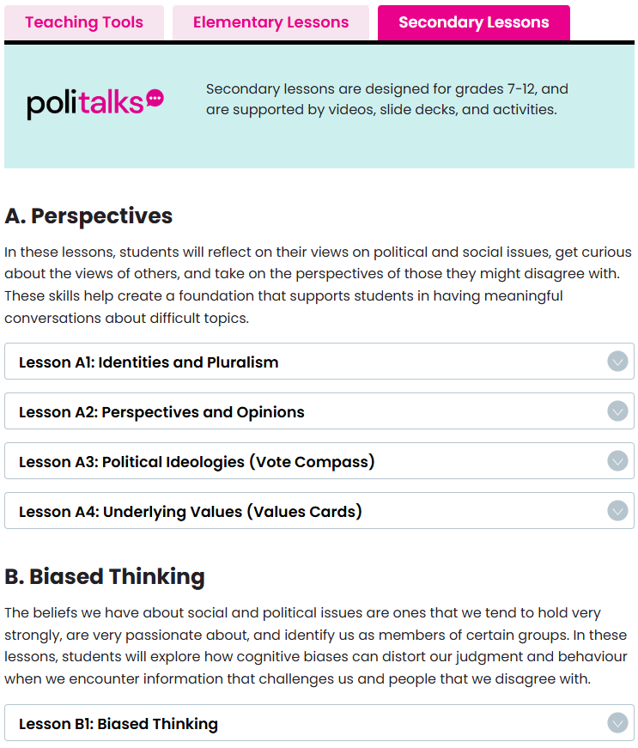
Lessons Overview
A. Perspectives
B. Biased Thinking
C. Constructive Discussions

Slide 13
Do not edit
How to change the design
I toss a fair coin 10 times in a row and record the results: H if it lands heads, T if it lands tails.
Which of the following sequences is most likely to occur?
Presenting with animations, GIFs or speaker notes? Enable our Chrome extension

Slide 14
Do not edit
How to change the design
Between the 1990s and today, violent and property crime in the USA has:
Presenting with animations, GIFs or speaker notes? Enable our Chrome extension

Slide 15
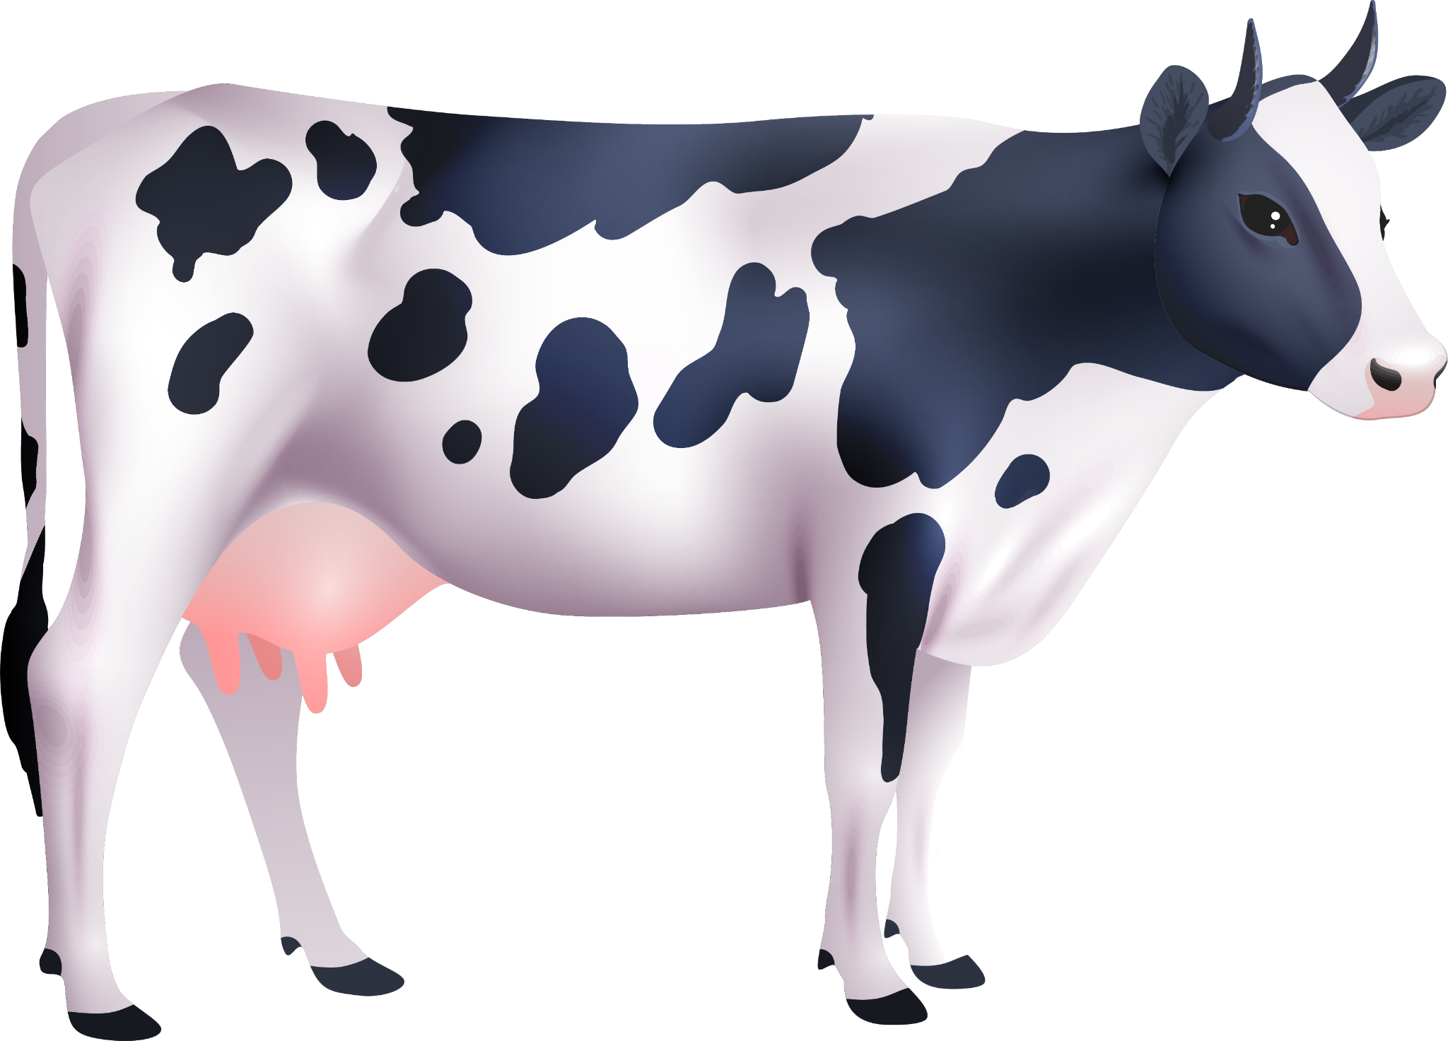
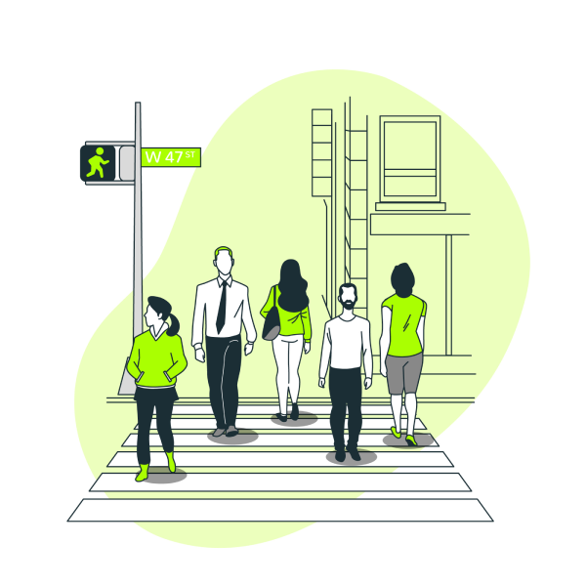
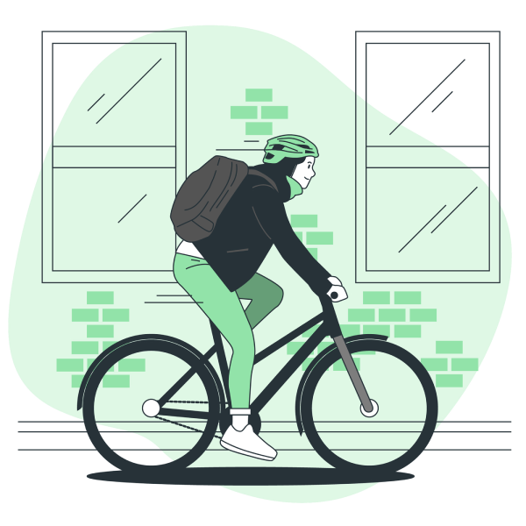
Biased Thinking
VS.
...
Cognitive biases: errors in reasoning that result from:
Our brains having to process a lot of information quickly
Our brains trying to protect us from perceived harms
VS.
VS.

Slide 16
B. Biased Thinking
Biased Thinking
Confirmation Bias
In-Group Bias

Slide 17
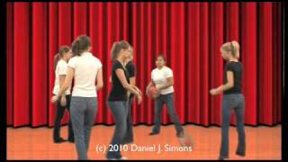

Slide 18
There are lots of cognitive biases
“Climate change isn’t real because it was really cold yesterday!”
“Sarah wears ripped jeans, has piercings and tattoos. She must like punk music.”
“My horoscope is super accurate, I’m such a Scorpio!”

Slide 19
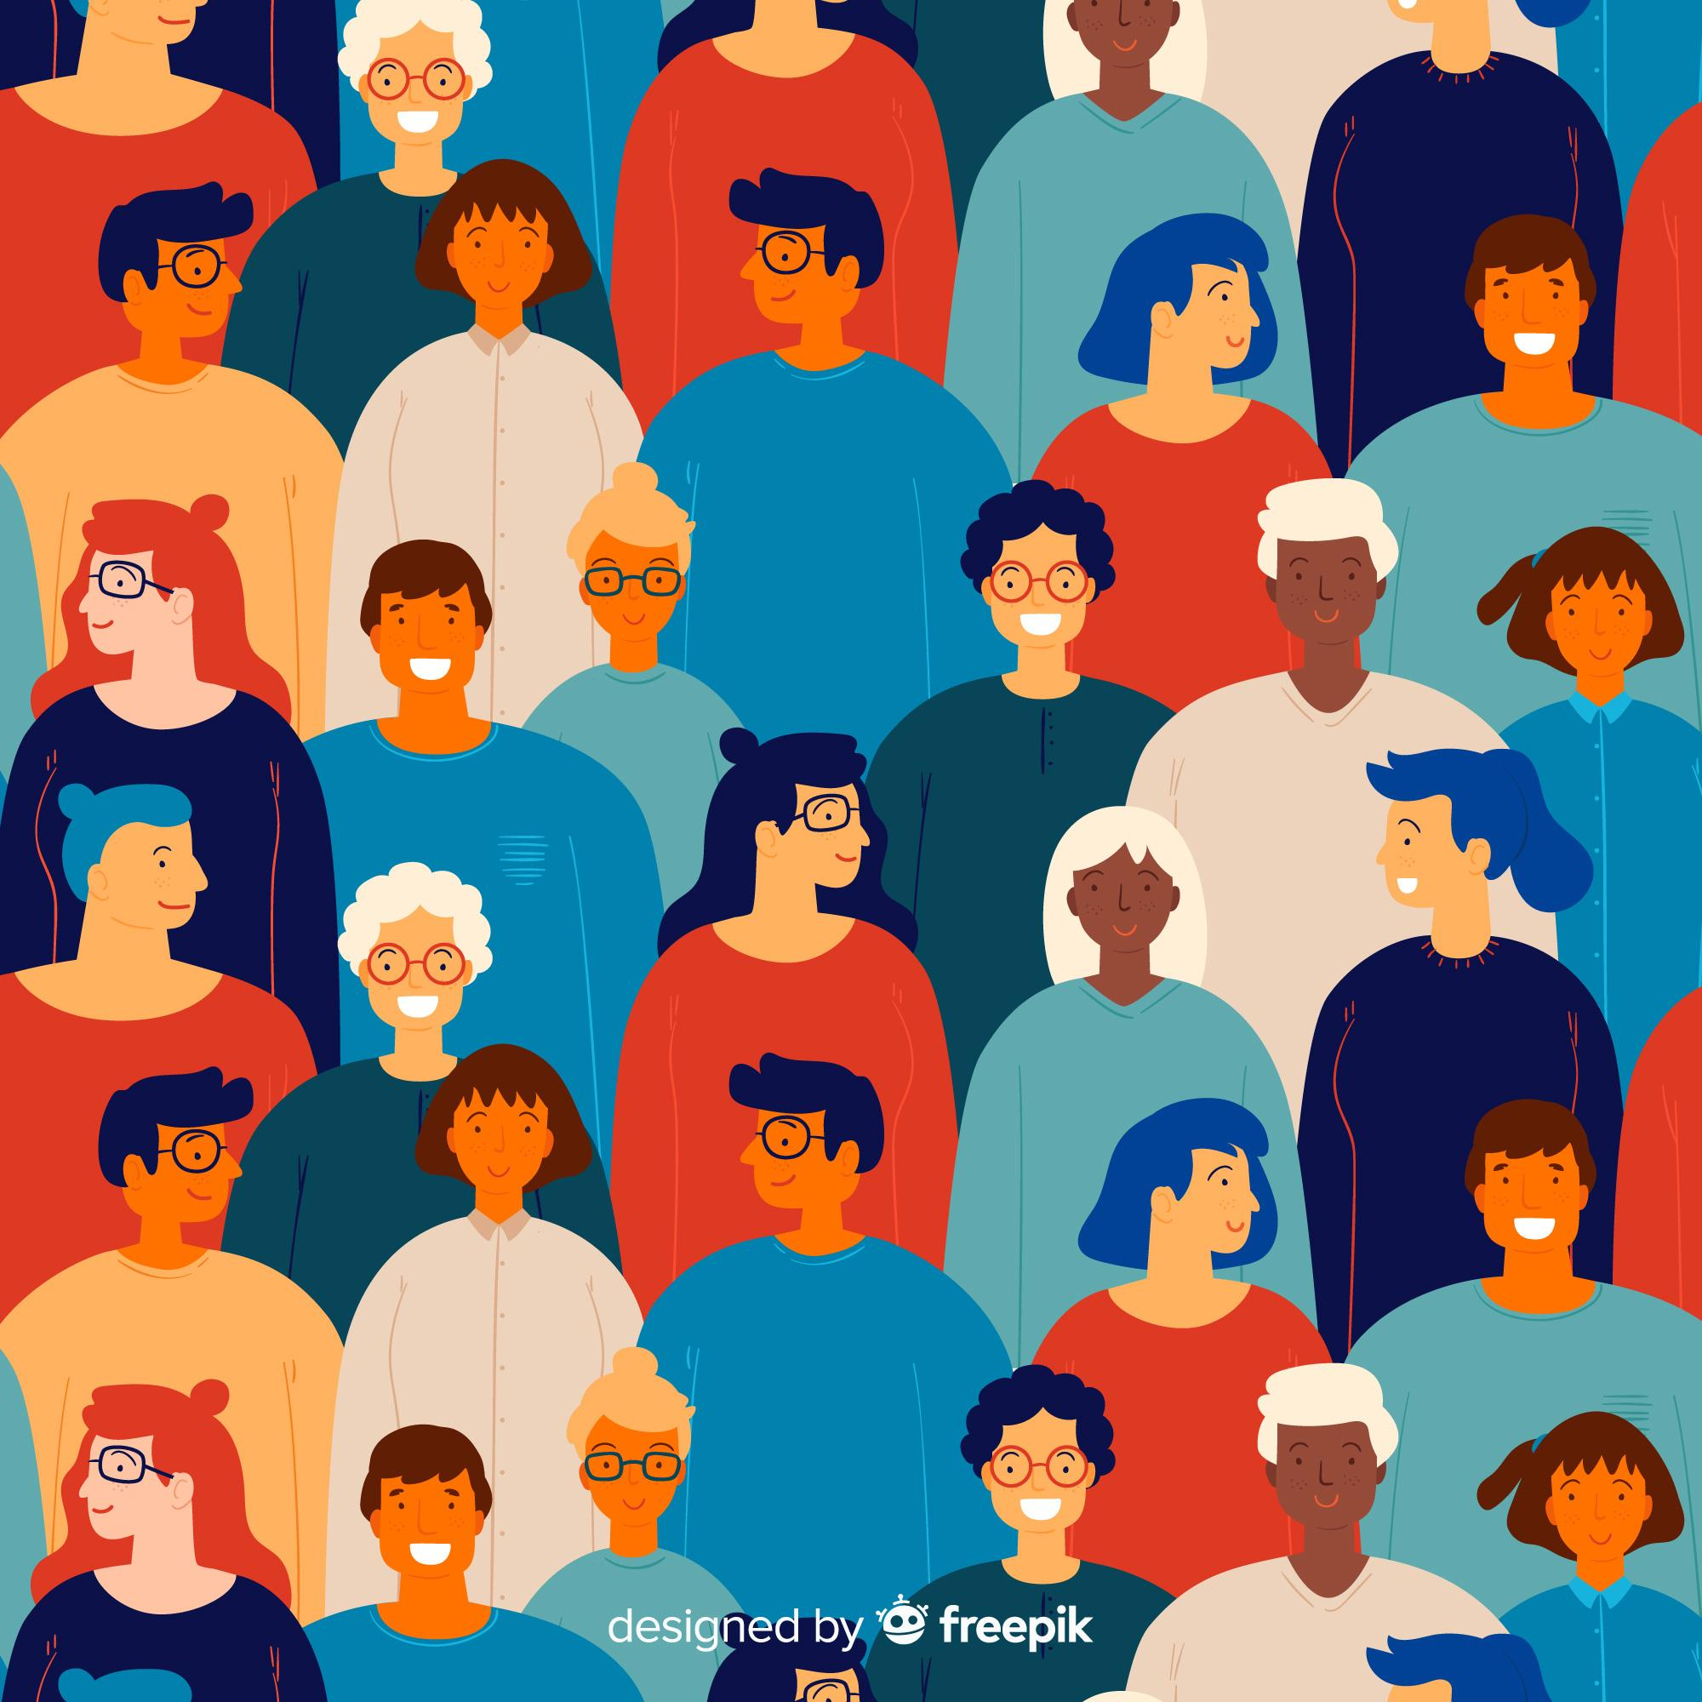
Bias Blind Spot
Everyone is biased but me!

Slide 20
Confirmation Bias
Our tendency to:
Seek out and interpret information in ways that confirm what we already believe, and
Ignore information that challenges our beliefs

Slide 22
Difficult discussions
I’m right
Important discussions are more difficult if we have different information
We are more likely to seek out those we already agree with, and avoid those who disagree with us
Political messaging is typically one-sided

Slide 23
How to fight confirmation bias
Slow down and think
Consider alternative viewpoints
Talk to others

Slide 24
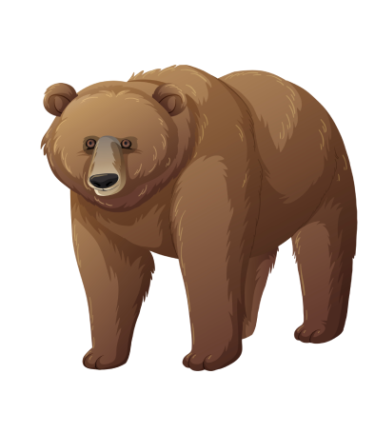

Slide 25
Take the quiz and find out if you’re a shark or a bear
Find your animal companions at your table
Decide together: 3 words to describe sharks and 3 words to describe bears

Slide 26
Do not edit
How to change the design
If you were a shark 🦈 what words did you choose to describe your fellow sharks 🦈?
If you were a bear 🐻 what words did you choose to describe your fellow bears 🐻?
Presenting with animations, GIFs or speaker notes? Enable our Chrome extension

Slide 27
Do not edit
How to change the design
If you were a shark 🦈 what words did you choose to describe bears 🐻?
If you were a bear 🐻 what words did you choose to describe sharks 🦈?
Presenting with animations, GIFs or speaker notes? Enable our Chrome extension

Slide 28
In-Group Bias
In-group: a group we are a member of
Out-group: a group we are not a member of
In-Group Bias: Our tendency to treat and evaluate in-group members more positively than out-group members

Slide 29
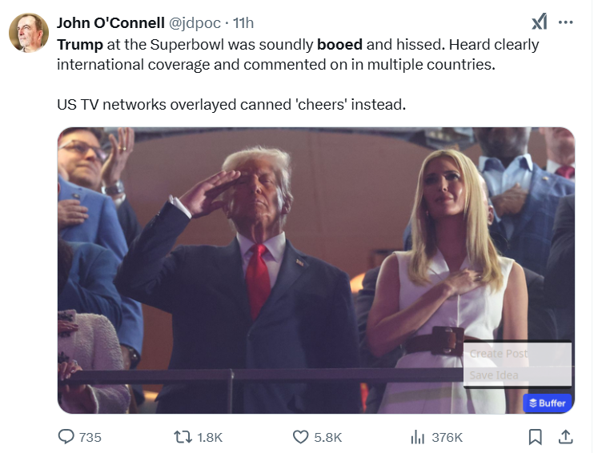
In-Group Bias

Slide 30
Difficult discussions
When someone disagrees with you, you think of them as being outside your group
You’re going to be less receptive and less kind to them
Politics puts us into groups!
Created using DALL-E 3

Slide 31
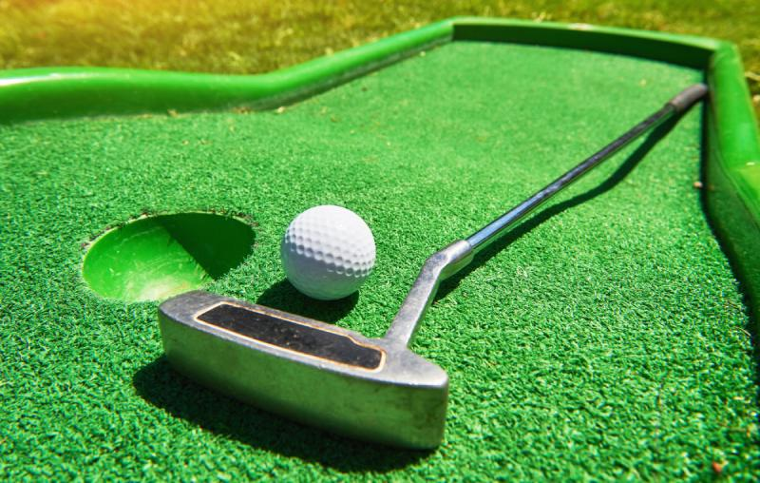
How to fight in-group bias
Think Big
Focus on commonalities, not differences
Focus on the person, not the group

Slide 32
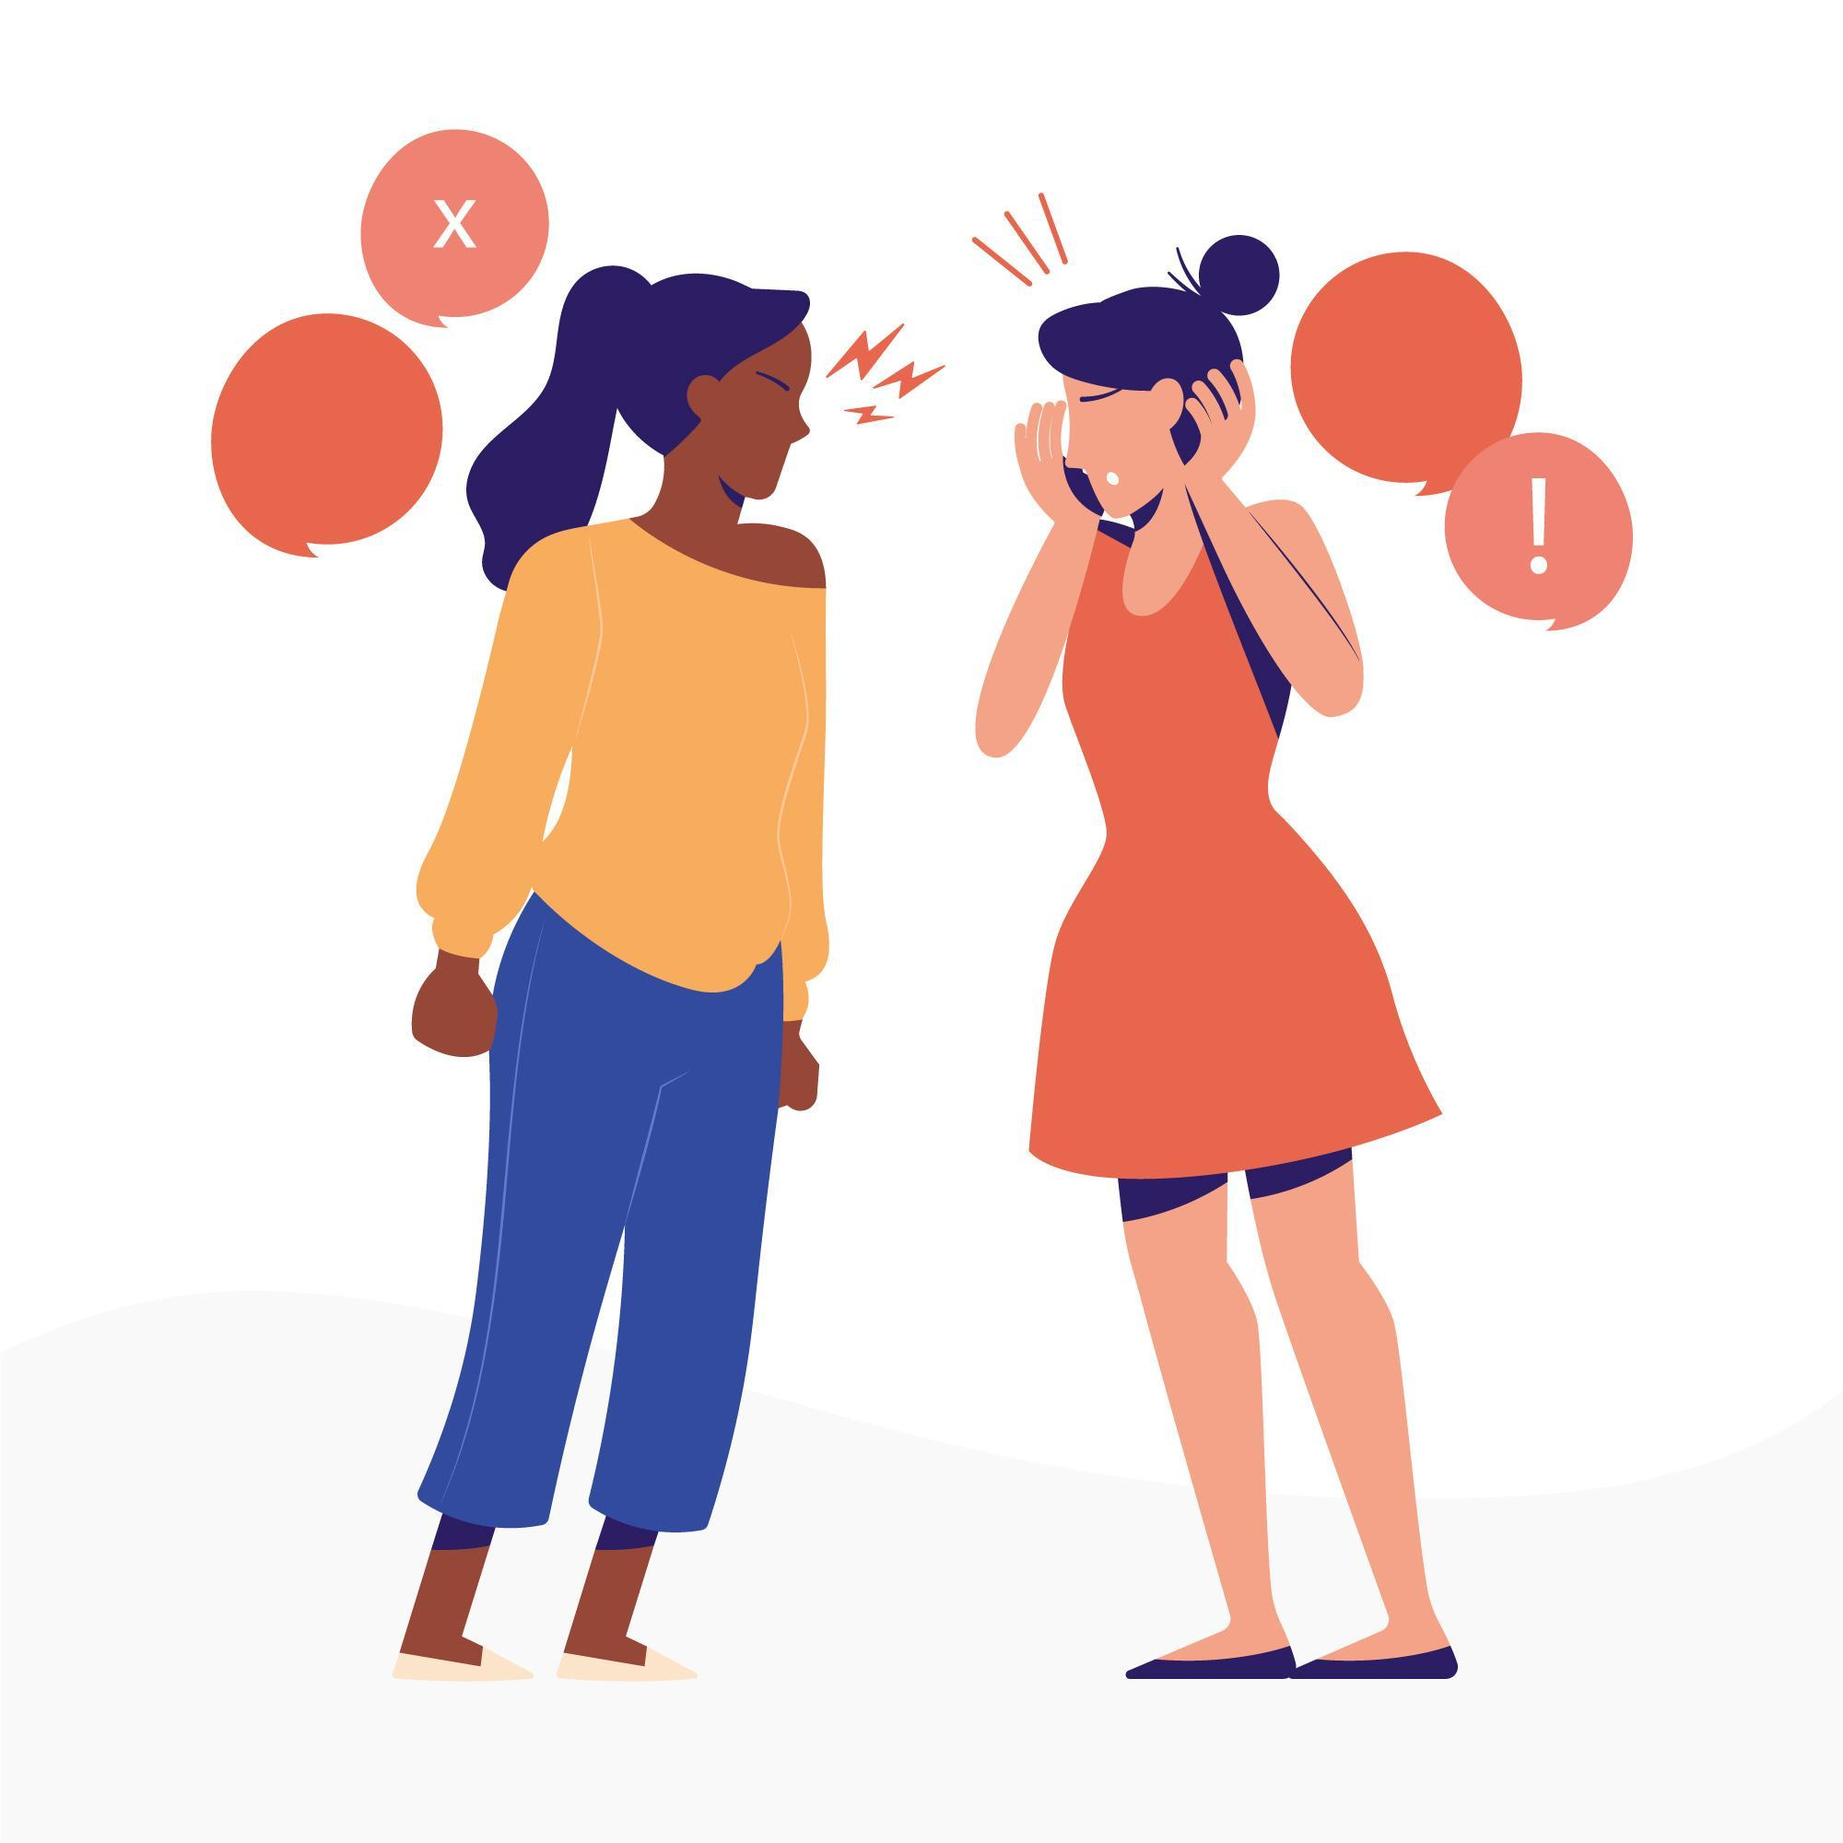
Cognitive Biases and Difficult Discussions
Discussions about political and social issues are difficult because they are about beliefs that are important to us
An abundance of information makes it difficult to pay attention to everything
Challenges to our beliefs can feel like personal attacks

Slide 33
C. Constructive Discussions
Students address a social or political issue in detail through a structured academic controversy protocol
Backgrounders with summaries and links so students can do additional research
Initially students are assigned a position, but are free to change their minds
New topics added throughout the school year

Slide 35
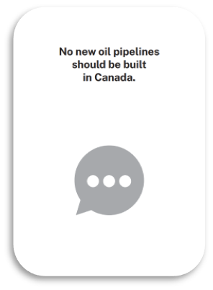
Value Cards
Take on the perspective of someone who prioritizes those values
“How would someone, who thought these values were most important, respond to this prompt?”
Reshuffle and redeal to take on a new perspective

Slide 36
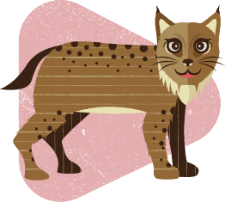
Animal Cards
Ideal for younger students and those new to discussions
Take on different animal personalities to experience how people approach discussions differently
Develop empathy and get students out of their shells

Slide 37
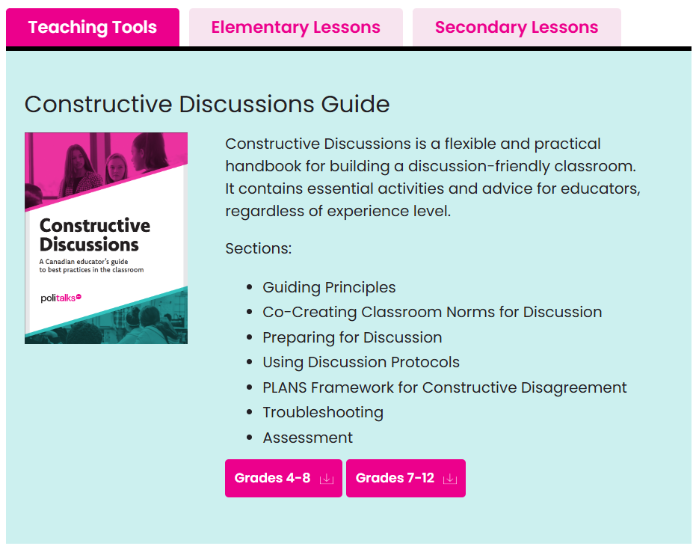
Register at politalks.ca for free English classroom resources
Register at parlonspoli.ca for free French classroom resources

