Slide 1
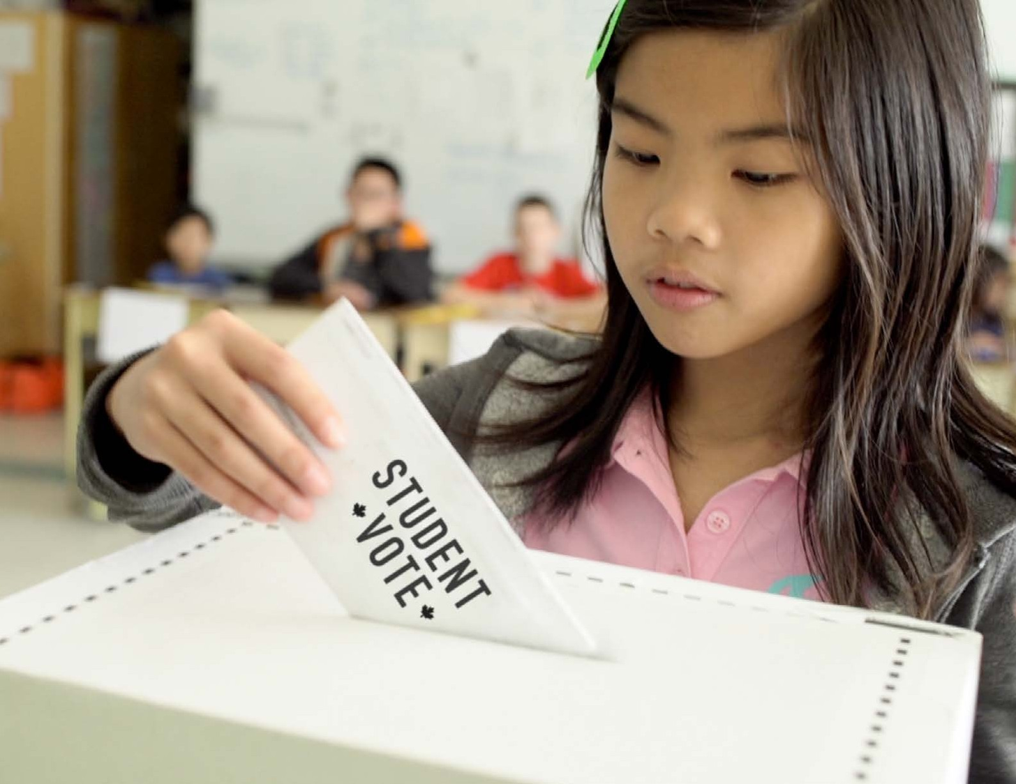

Slide 2
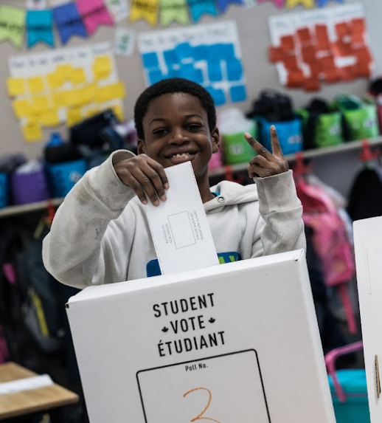
Student Vote
Designed to cultivate the habits of active and informed citizenship
Students cast ballots for the official candidates in a parallel election
Makes civic education compelling

Slide 3
Student Vote: Case for support
Low voter turnout, particularly among youth

Slide 4
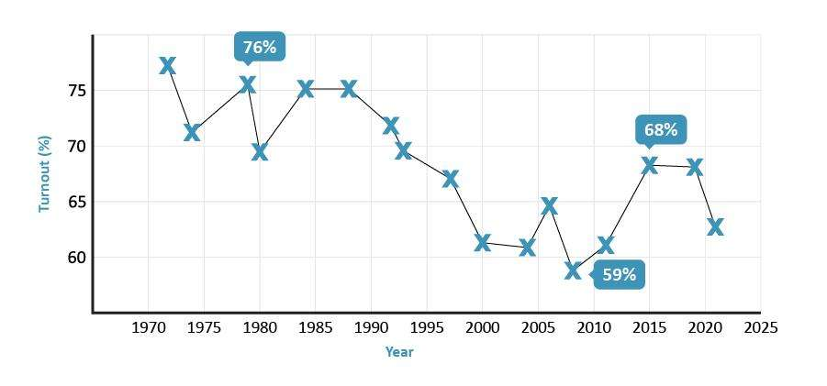
Voter turnout - Federal elections

Slide 5
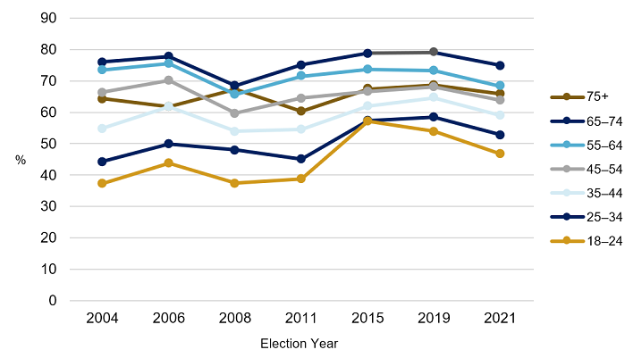
Voter turnout by age group

Slide 6
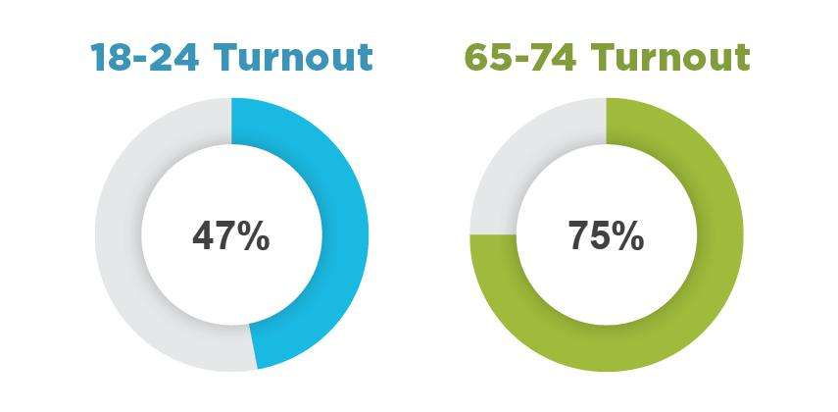
Gap in turnout by age group
Source: Elections Canada, 2021 Federal Election

Slide 7
Student Vote: Case for support
Declining voter turnout, particularly among youth
Voting is habitual

Slide 8
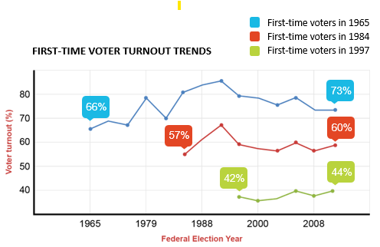
Voting is a habit

Slide 9
Student Vote: Case for support
Declining voter turnout, particularly among youth
Voting is habitual
Addresses barriers to voting

Slide 10
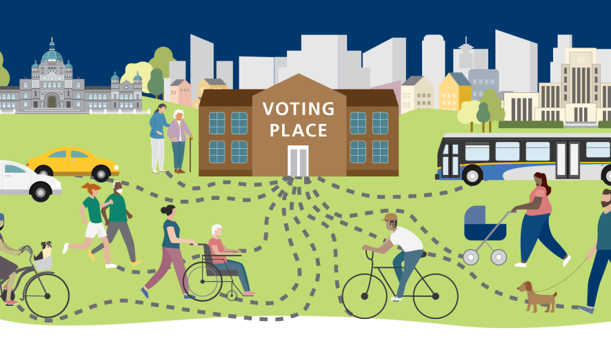
Barriers to voting

Slide 11
Motivational vs Access Barriers

Slide 12
Motivational barriers
a belief that voting is a choice rather than a duty

Slide 13
Access barriers

Slide 14
Student Vote: Case for support
Declining voter turnout, particularly among youth
Voting is habitual
Addresses barriers to voting
Less political engagement at home
Early exposure is important

Slide 15
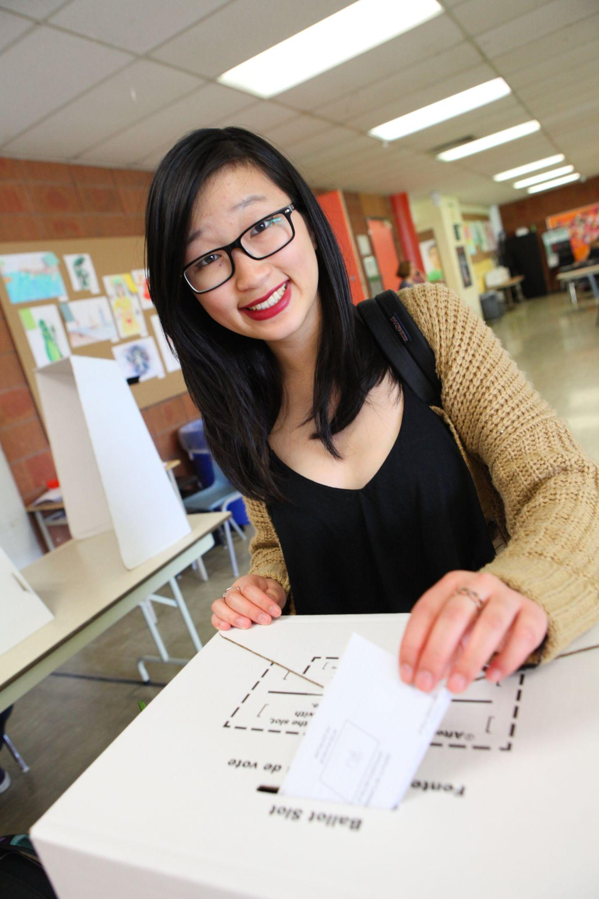
Student Vote objectives
Introduce the concepts of democracy and elections
Develop an interest in politics
Foster a sense of community
Strengthen attitudes towards voting
Spark political discussion
Demystify the voting process
Build a habit of electoral participation

Slide 16
The scope
Designed for grades 4 to 12
Offered at all levels of elections in most jurisdictions across Canada
68 elections in Canada since 2003
Since 2018, we have also organized six Student Vote projects in Latin America

Slide 17
Student outcomes

Slide 18
Outcomes among families
90% felt the program increased their families’ opportunities to learn more about elections and politics
50% stated that they knew more about politics because of their child’s involvement
58% felt that the program increased their own interest in politics
28% reported that their child’s participation positively influenced their decision to vote

Slide 20
2025 Federal Election

Slide 21
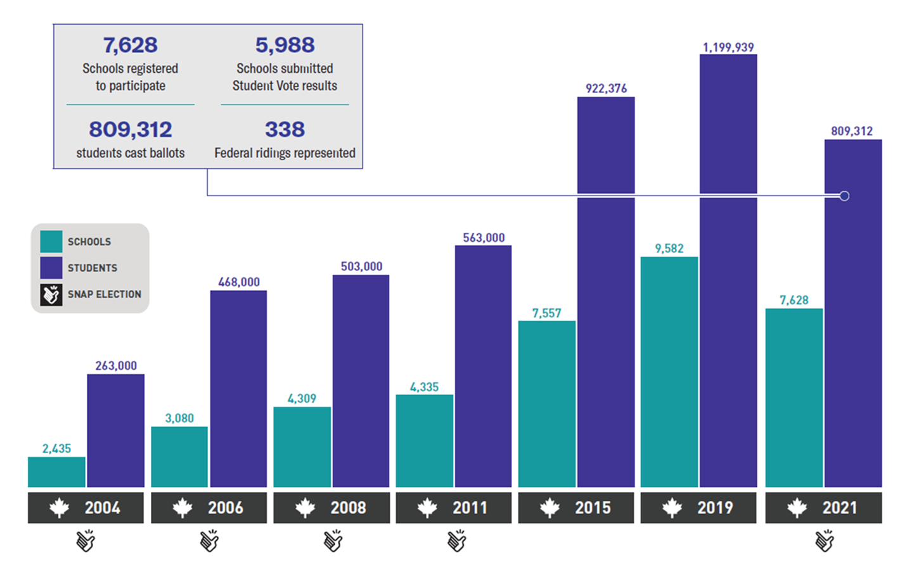
Federal election participation

Slide 22
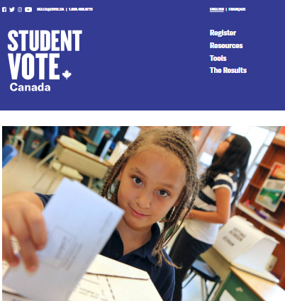
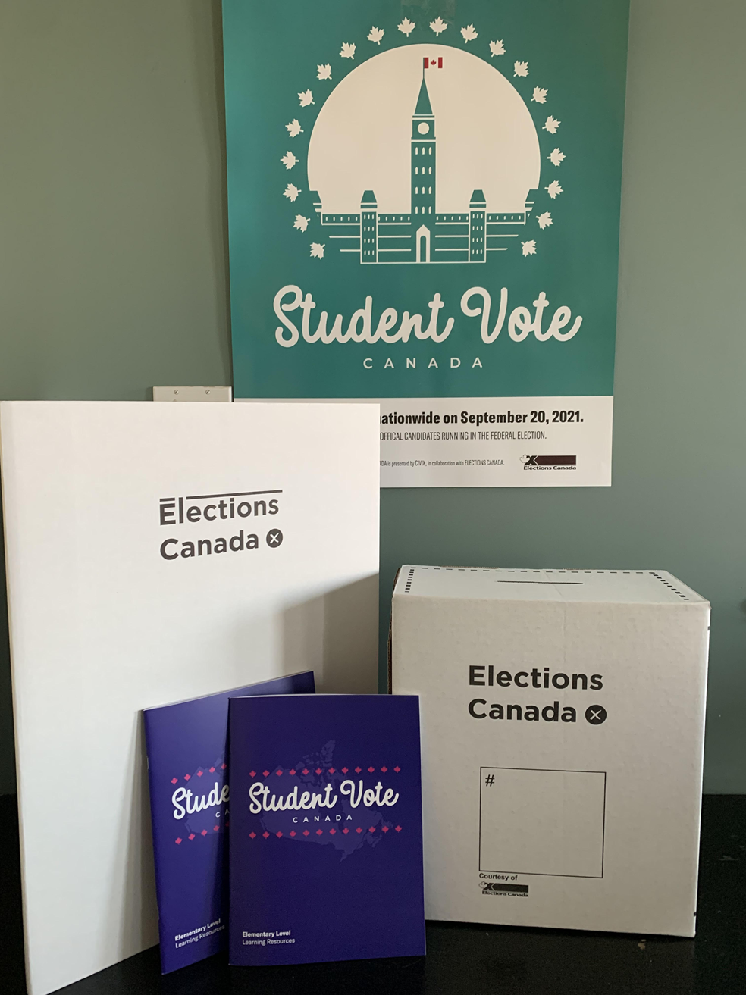
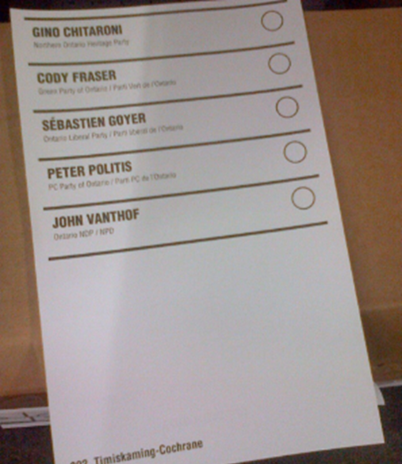
Program materials
SV election website
Resource package
Ballot kits
Lesson plans, digital files
Slide decks
Videos
Online interactives
Lesson plans
Campaign guide
Student Vote posters
Electoral district maps
Ballot boxes, screens
Ballot kit
Statement of the poll form
Election manual

Slide 23
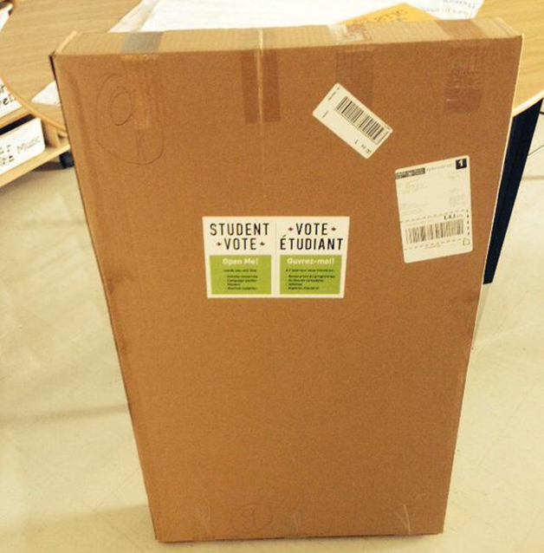
Package readiness
Look for a notification from Canada Post to track your package.
Alert your admin about the expected package.
Open the package and check the contents for accuracy.

Slide 24
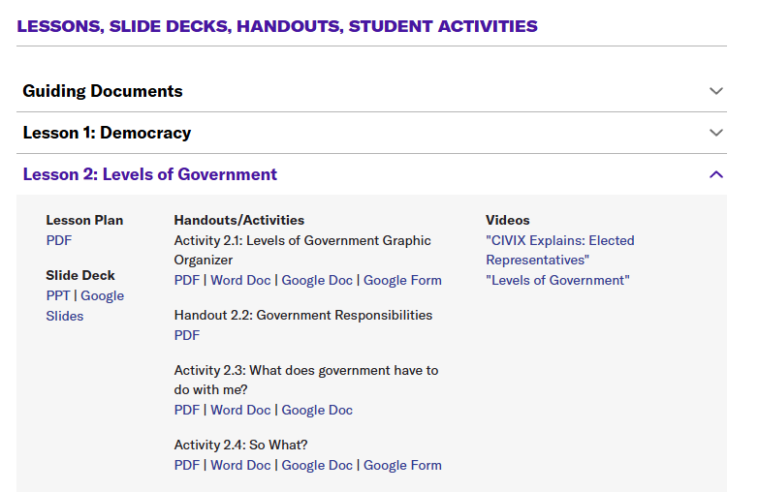
www.studentvote.ca/canada

Slide 25
Learning Resources
Elementary Resource
Grades 4-8
Secondary Resource
Grades 7-12

Slide 26
Focus Area: Constructive Discussion Skills
Best practices for classroom discussion
Classroom Norms
Discussion protocols (Think-Pair-Share, Dilemma Dialogue, Rank Order)

Slide 27
Lessons
Fundamental Themes
Democracy
Rights & Responsibilities
Levels of Government
Federal Elections

Slide 28
Elementary Lesson: Democracy
Surviving Jumanji Activity
How will you organize yourselves?
What is your plan for finding food and shelter?
Who will be responsible for decision-making?
Will you establish any rules or code of conduct?

Slide 29
Secondary Lesson: Democracy

Slide 30
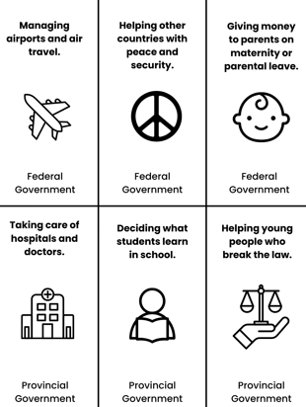
Lesson: Levels of Government
Government Scavenger Hunt
Clue: “Look at today’s headlines. Who’s making decisions that affect your life?”
Task: Find a news article related to government decisions at each level. Summarize the key issue and how it impacts people.

Slide 31
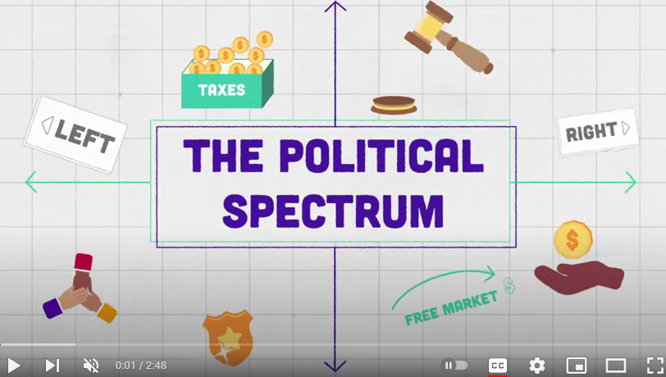
Secondary Lesson: Political Spectrum
How are people’s beliefs and values connected to their political views?
Why should we respect others’ opinions and perspectives?

Slide 32
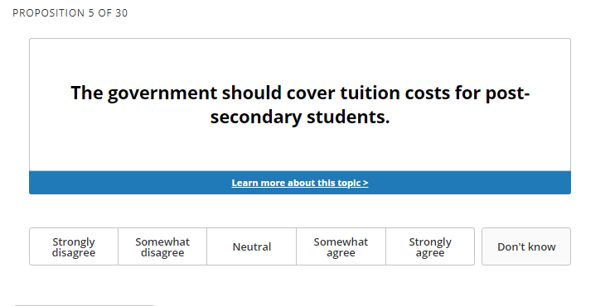
Vote Compass: Youth Edition

Slide 33
Vote Compass: Youth Edition

Slide 34
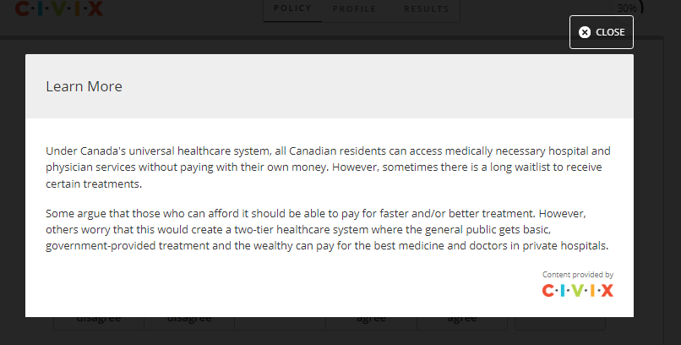
Vote Compass: Youth Edition

Slide 35
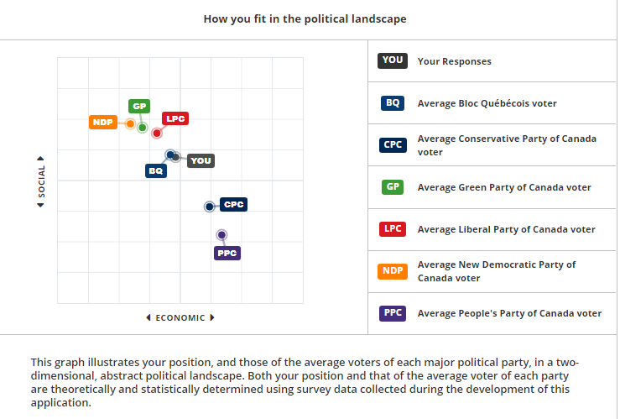

Slide 36
Lesson: Evaluating Election Information
Who made this and why?
Basic persuasive techniques:
emotional strategies, repetition, and appeals to authority.
Advanced persuasion techniques:
Fearmongering
Simplification of information
Us vs. Them framing
Presenting policy ideas as natural/settled/”common sense”
Appeals to a “better” past

Slide 37
Lessons
Election-related lessons
Researching the parties and candidates
The Leaders’ Debate
The Voting Process
Post-Election Analysis

Slide 38
Learning about parties and candidates
Divide students into groups to research one party/candidate to create a presentation/profile
Invite the candidates to your school or email them questions
Consult with news websites - Party platform summaries/district profiles
Track social media announcements from each party during the campaign
Analyze campaign advertisements
Watch clips of the leaders debate in class

Slide 39
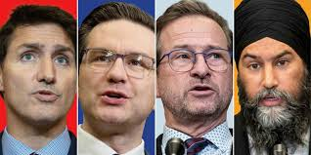
Party leader Q & A Videos

Slide 40
Pollenize
10-12 topics / Party platform summaries

Slide 41
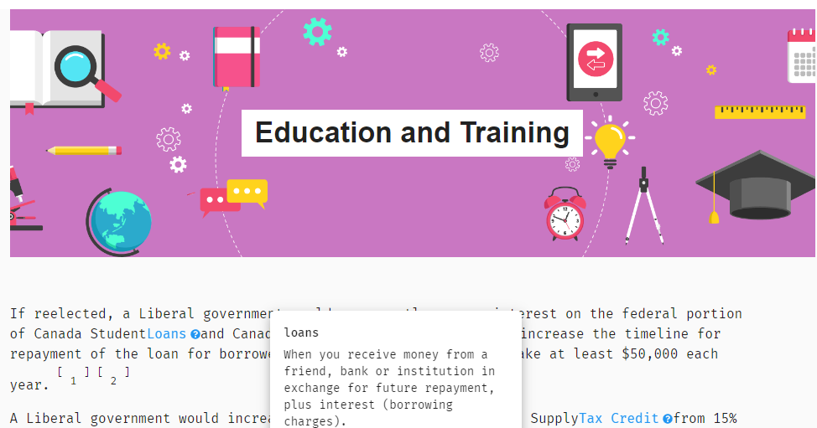
Pollenize

Slide 42
Other Tools

Slide 43
Election Manual: Voting Methods
VOTE BY CLASSROOM - Classes arrange to vote at the voting location at pre-set times throughout the day.
HOMEROOM VOTING - Ballots distributed to each participating class and students vote in their home classroom.
MOBILE VOTING STATION - Designated election officials take mobile voting booths from classroom to classroom.

Slide 44
Tips for Student Vote Day
Assign students to take on the roles of election officials
Use the templates to create Voter IDs and use a voters list
Create ‘I am a Voter’ stickers using mailing labels

Slide 45
Student Vote Results
Please keep your results confidential until the after the polls close
Share any news coverage
Look at the breakdown on the Student Vote election results and analyze the results
How did schools vote in your constituency?
How does Student Vote compare to the general election results?

Slide 46
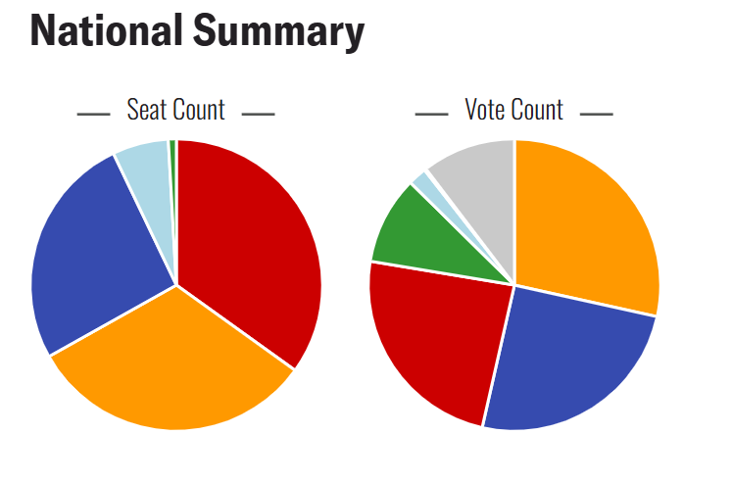
Student Vote Results

Slide 47
Results: Federal 2021
PARTY | Student Vote |  | General Election
 | Seats | Vote % | Seats | Vote %
 | 118 | 24.1% | 160 | 32.6%
 | 88 | 25.1% | 119 | 33.7%
 | 21 | 2.1% | 32 | 7.6%
 | 108 | 28.5% | 25 | 17.8%
 | 3 | 9.8% | 2 | 2.3%

Slide 48
Table Discussion
How do you organize Student Vote at your school? What has worked well?
What are some tips for engaging more colleagues or classes in the program?

Slide 49
Best Practices for Student Vote

Slide 50
Best Practices
#1 – Use CIVIX explainer videos to teach the basics

Slide 51
Best Practices
#2 – Emphasize the impact of government

Slide 52
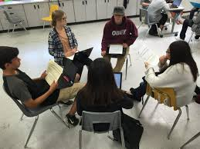
Best Practices
#3 – Build a discussion-friendly classroom

Slide 53
Best Practices
#4 – Incorporate traditional news coverage

Slide 54
Best Practices
#5 – Explore issues that matter to your students

Slide 55
Best Practices
#6 – Engage with the candidates
Candidates forum
One-on-one visits
“Political party” lunch
Email them student questions
Engage with them through social media

Slide 56
Best Practices
#7 – Involve your colleagues
Announce the program early on
Send links to relevant lessons or videos
Suggest subject-related activities (i.e. “Get out the Vote Posters”)

Slide 57
Best Practices
#8 – Encourage family engagement

Slide 58
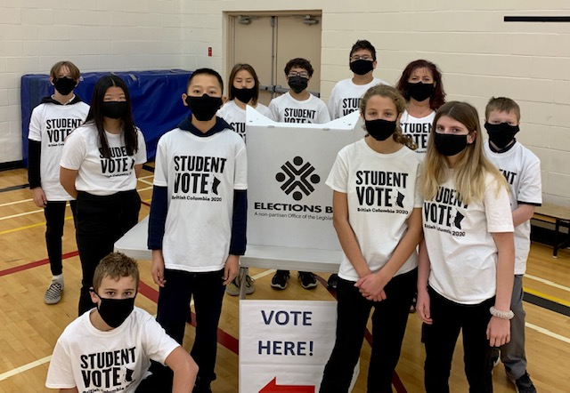
Best Practices
#9 – Empower students with responsibilities
Communications Team
Education Team
Events Team
Student Vote Day Team
Media and Community Relations

Slide 59
Best Practices
#10 – Make Student Vote Day a celebration

