Slide 1
Digital Media Literacy in an Age of AI
1:55 - 3:00

Slide 2
How can we best evaluate the information we see and hear online?

Slide 3
To evaluate online information student must first understand how to find reliable information and sources.
Topics include:
Limitations of social media as an information source
Components of a SERP
Constructing effective queries
How algorithms sort what we see online
Differentiating between facts and opinions
Online Search
Skills
Grades 4-8

Slide 4
Verification Skills
Teach your students the evidence-based skills that professional fact-checkers use
Encourages students to:
Understand the importance of being an informed citizen
Care about what is true or credible
Habitually evaluate sources and claims
Seek out information from reliable sources
Grades 7-12

Slide 5
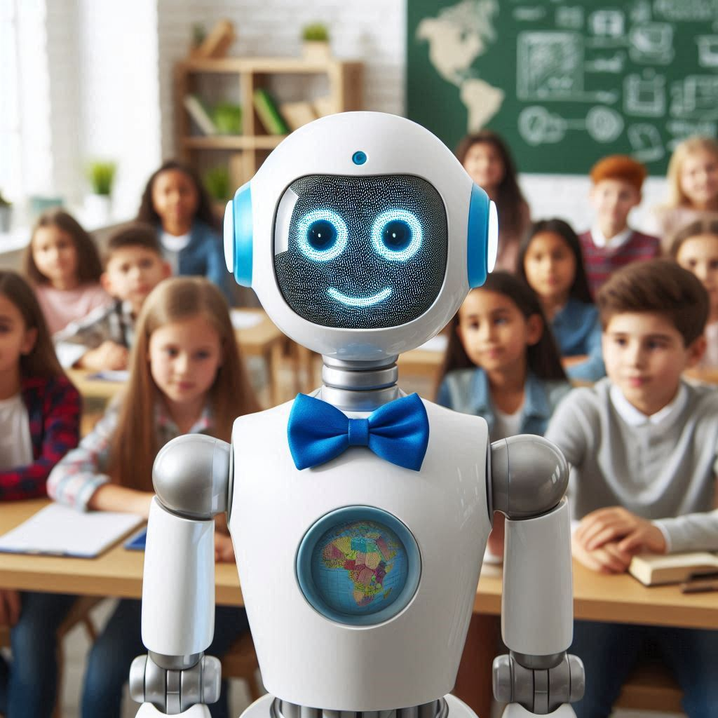
CTRL-F: AI Literacy
AI Fundamentals
What is Generative AI?
AI Ethics
AI in the Classroom
Available now!
Created using DALL-E 3

Slide 6
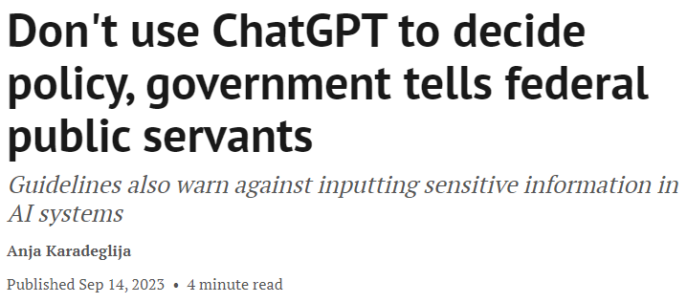

Slide 7
What we’re doing today
New AI resources
What generative AI is and how it works
Using AI responsibly
Evaluating AI-generated content using lateral reading
Digital Media Literacy

Slide 8
Important Links
We’ll be trying out some activities today
And we’ll look at some examples of content online
Everything can be found here: ctrl-f.ca/en/toronto2025

Slide 9
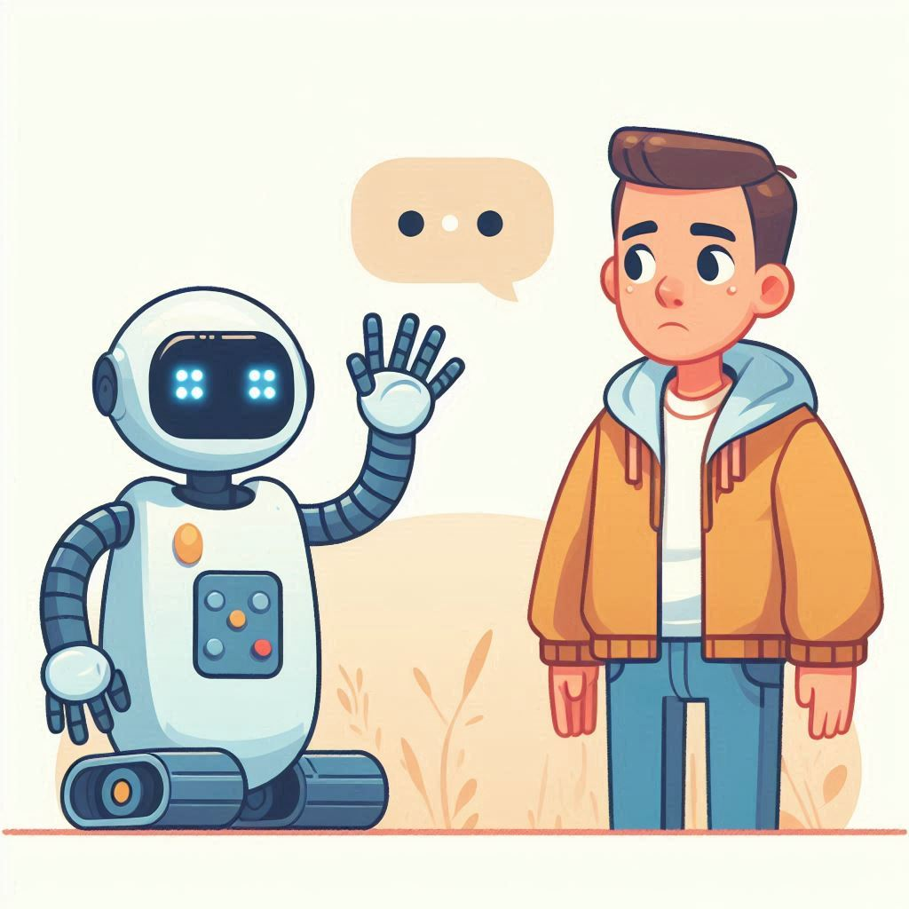
Lesson 1
What is Generative AI?
Created with DALL-E 3

Slide 10
What is it?
Generative AI: Programs that generate text or images on the basis of prompts provided by users
Chatbots (like ChatGPT) are large language models: they have been trained on a huge amount of text to produce natural sounding text

Slide 11
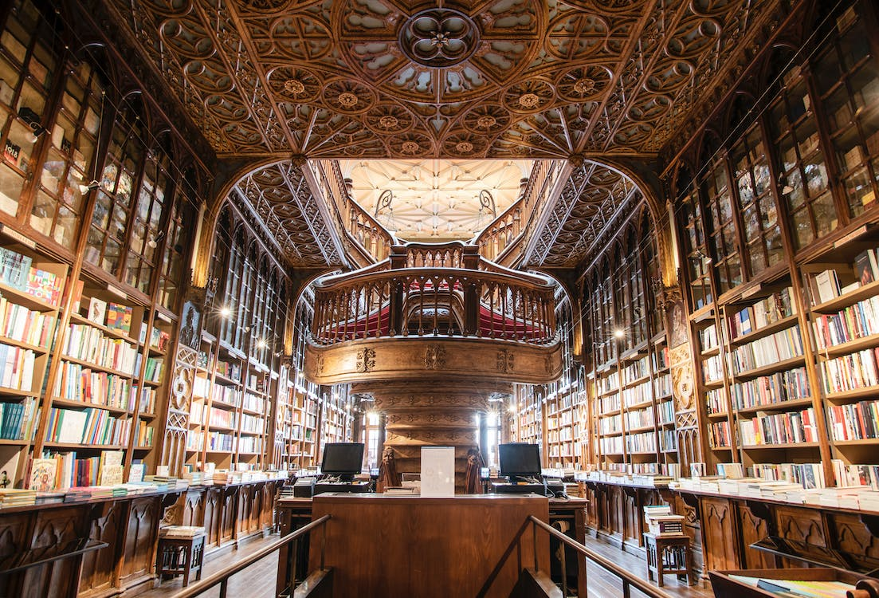
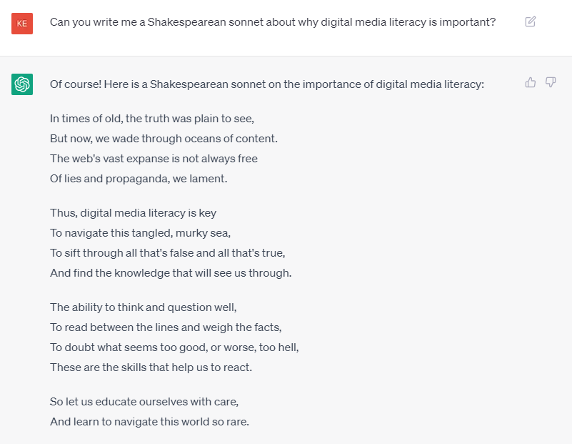
How Chatbots Work (roughly)
Training

Slide 12
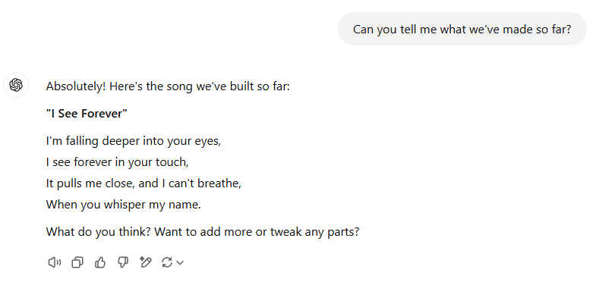
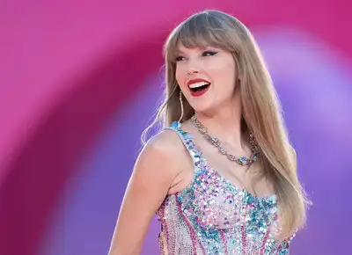
Activity: Be the Chatbot

Slide 13
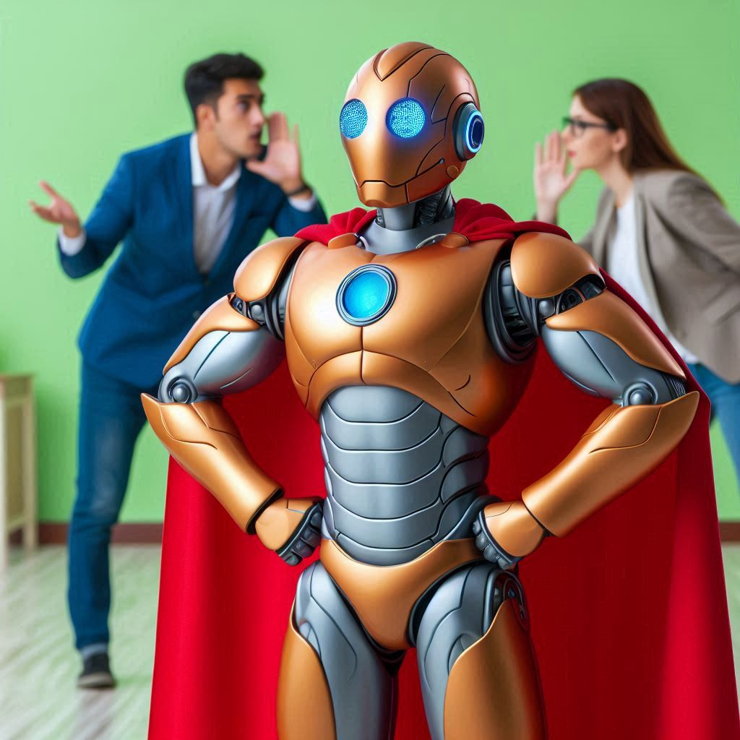
Lesson 2
AI Ethics
Created with DALL-E 3

Slide 14
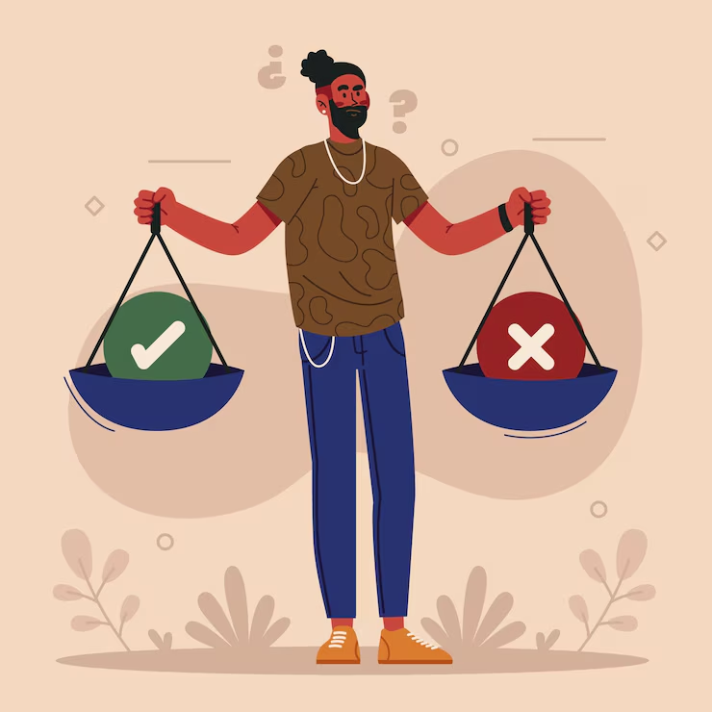
AI Ethics: 3 Questions
What are the potential benefits this technology can produce? In what ways might it be harmful?
How can people who create AI tools make sure they help people, and minimize the chances that other people will be harmed?
How can people who use AI make sure they do so responsibly, and don’t cause harm to others?

Slide 15
AI Ethics: Big Issues
Environmental Impact
Intellectual Property
Worker Treatment
Misinformation

Slide 16
Activity: AI Bias
Navigate to a chatbot
Provide the following prompt
What did your picture look like?
Create an image of a typical Canadian
ctrl-f.ca/en/toronto2025

Slide 17
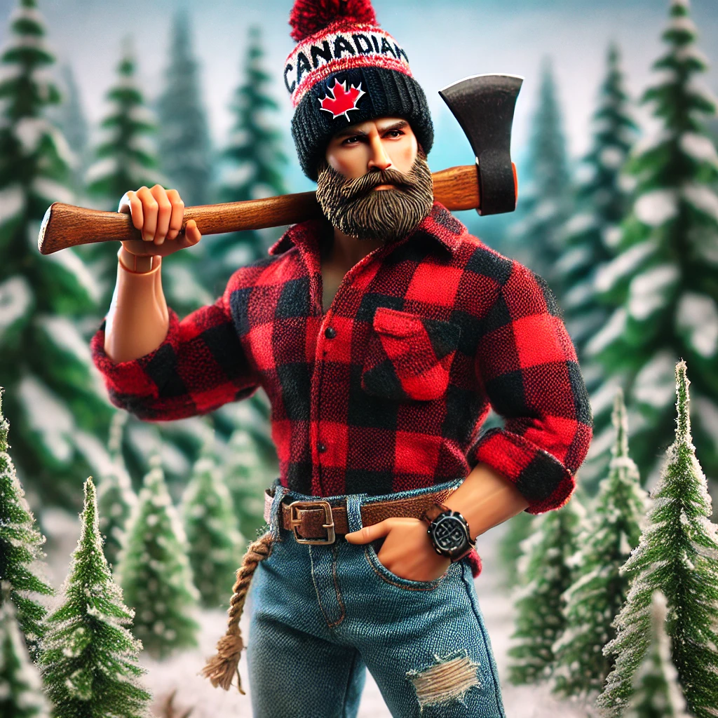
Bias in AI: Images
“Create an image of a typical Canadian”
What do these image have in common?
What biases do you think they reflect?
Did you get similar results?
Created using ChatGPT
Created using Copilot

Slide 18
Lesson 3
AI in the Classroom
Created with DALL-E 3

Slide 19
Do not edit
How to change the design
Does your school have policies around the use of AI in the classroom?
Presenting with animations, GIFs or speaker notes? Enable our Chrome extension

Slide 20
AI in the Classroom
Students consider what AI is good for when it comes to their educational goals
Co-create norms around AI use
Identify where AI use stops becoming a tool and starts doing the work for you
Emphasis on student agency: AI is a tool, and they need to think about whether they want to use it, and in what ways
Created using DALL-E 3

Slide 21
AI Created
10- Student has an AI generate the entire essay and submits it to their teacher.
9- Student has AI generate an essay. They review and edit the essay and submit it to their teacher.
8- Student generates multiple AI drafts, and edits together the best parts to create their essay.
7- Student provides all the information to include in the essay, but the AI generates the essay itself.
6- Student writes their own draft, then generates an AI draft, and incorporates the best ideas to complete their essay.
5- Student writes the majority of the essay, but has AI generate a few sentences where the student is struggling to express their ideas.
4- Student uses AI as a research tool and verifies all information, but does all writing without AI.
3- Student does all the research and writing without AI, but uses AI for feedback. Student makes all the changes themselves.
2- Student does all the research and writing on their own, but uses AI to check spelling and grammar.
1- Student does not use AI for any research, writing or feedback.
Student Created

Slide 22
Do not edit
How to change the design
Indicate where the essay is more the work of AI than it is of the student.
Presenting with animations, GIFs or speaker notes? Enable our Chrome extension

Slide 23
CTRL-F: AI Literacy
Verification Skills Extensions
Investigating AI Sources
Checking Chatbot Claims
Tracing AI-Generated Media

Slide 24
Political Edition

Slide 25
How to Play
Round 1
Use your instincts to decide whether each of the following images is AI generated or not.

Slide 26
Do not edit
How to change the design
Mark Matlock, a candidate who ran in the UK 2024 General Election
Presenting with animations, GIFs or speaker notes? Enable our Chrome extension

Slide 27
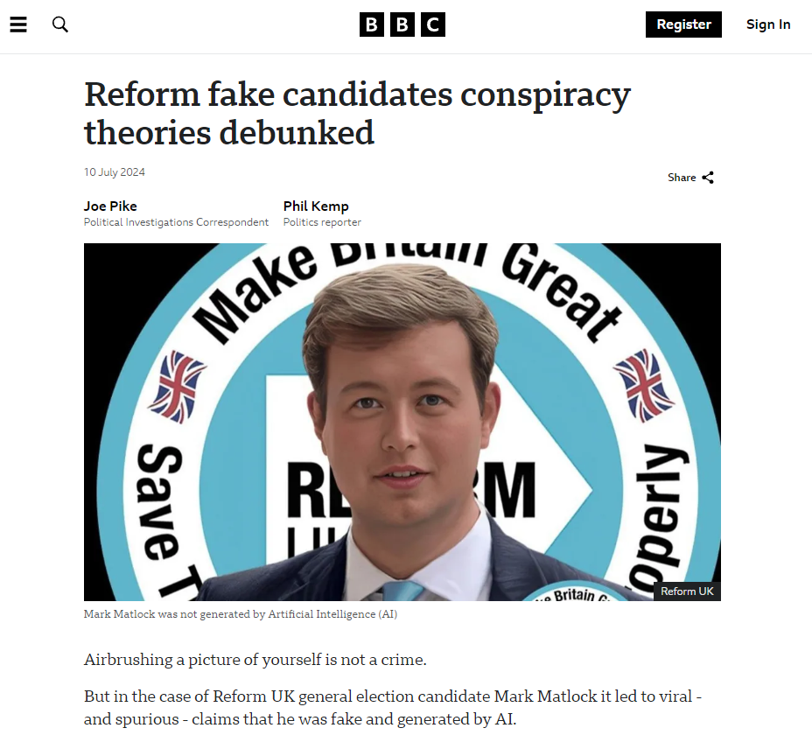
Mark Matlock was a genuine candidate, though there were numerous claims on social media that he was fake and generated by AI.

Slide 28
Do not edit
How to change the design
An image posted by the Canadian Embassy in Washington encouraging people to celebrate Canada Day
Presenting with animations, GIFs or speaker notes? Enable our Chrome extension

Slide 29
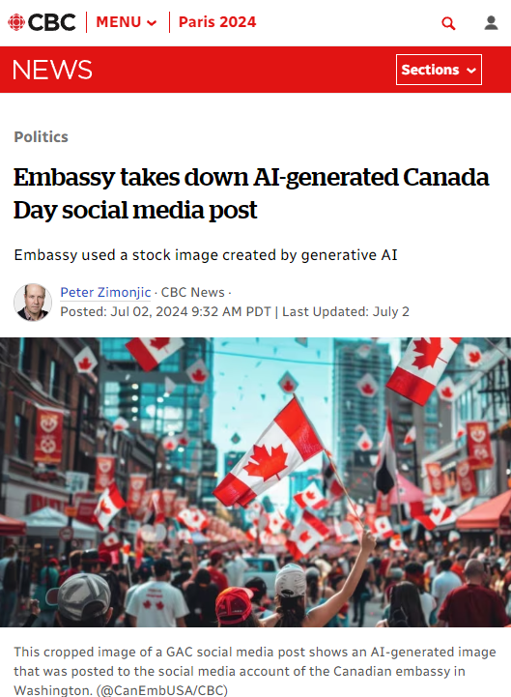
Global Affairs Canada posted this image encouraging people to celebrate Canada Day without citing generative AI as it’s source.
They later removed the image and stated they will adapt their policy on the use of AI.

Slide 30
Do not edit
How to change the design
An image use in Anthony Furey's Toronto 2023 mayoral campaign.
Presenting with animations, GIFs or speaker notes? Enable our Chrome extension

Slide 31
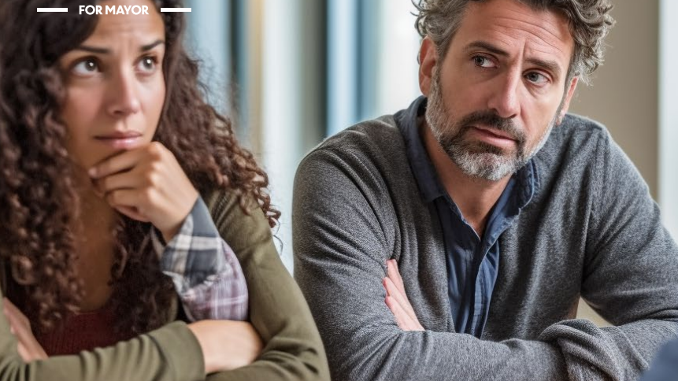
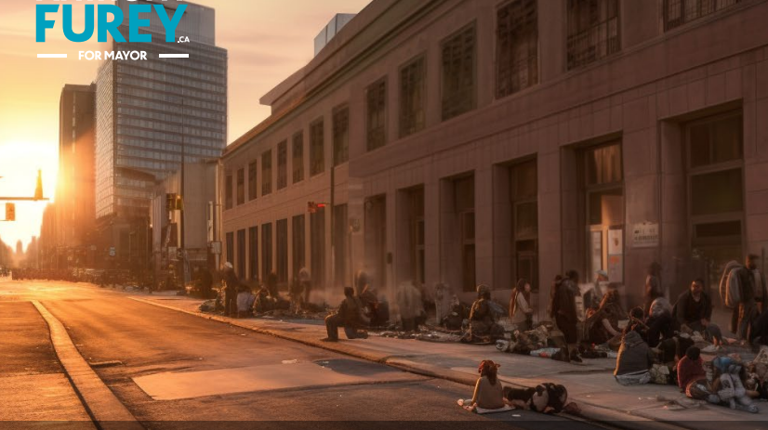
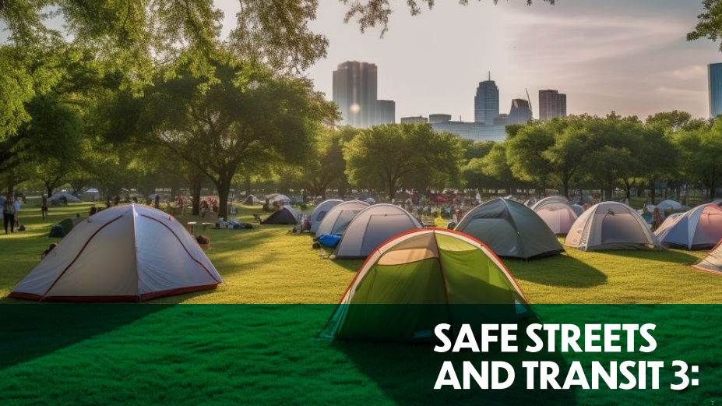
Anthony Furey a candidate in Toronto’s 2023 mayoral by-election used AI generated images in his campaign platform.

Slide 32
Do not edit
How to change the design
An image of a Mark Carney Liberal leadership campaign event.
Presenting with animations, GIFs or speaker notes? Enable our Chrome extension

Slide 33
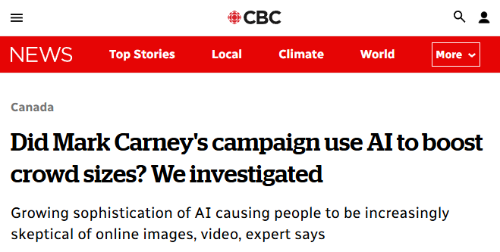
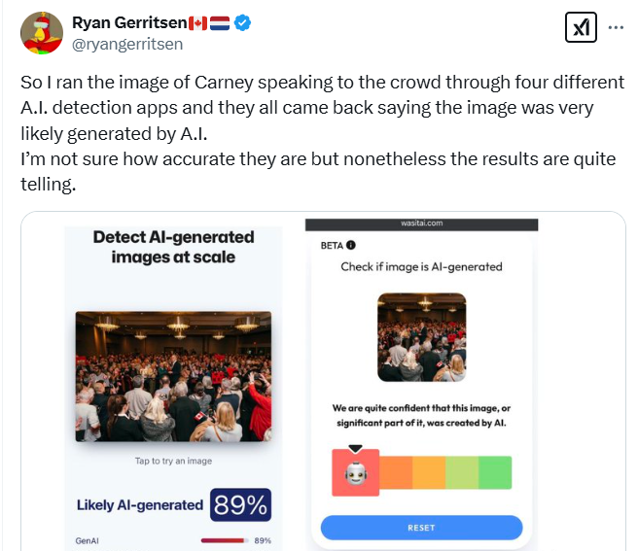
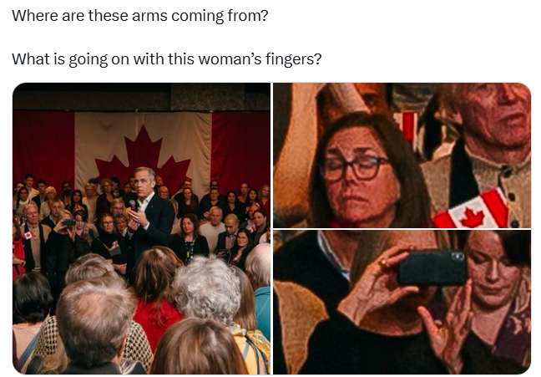
Social media users claimed that this authentic image was AI-generated citing visual clues and AI detection apps as evidence

Slide 34
Do not edit
How to change the design
An image of Trump posing with some men holding Trump signs.
Presenting with animations, GIFs or speaker notes? Enable our Chrome extension

Slide 35
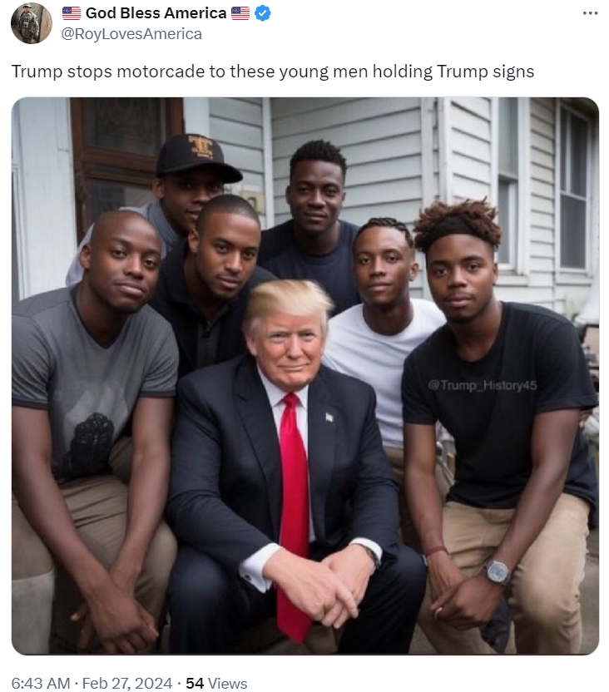
Various AI generated images of Trump, including this one created by a parody account have been shared and re-shared on social media.

Slide 36
Looking closely doesn’t work

Slide 38
CTRL-F is all about finding context
What am I looking at?
Where did it come from?
What should I know about it?
How do we answer these questions?

Slide 39
‘Vertical’ vs. ‘Lateral’ Reading
vs.

Slide 40
Three key lateral reading skills
Investigate the Source
Who made the information? What is their reputation?
Check the Claim
Are known credible sources saying the same thing?
Trace the Information
Has this information changed in the re-telling?

Slide 41
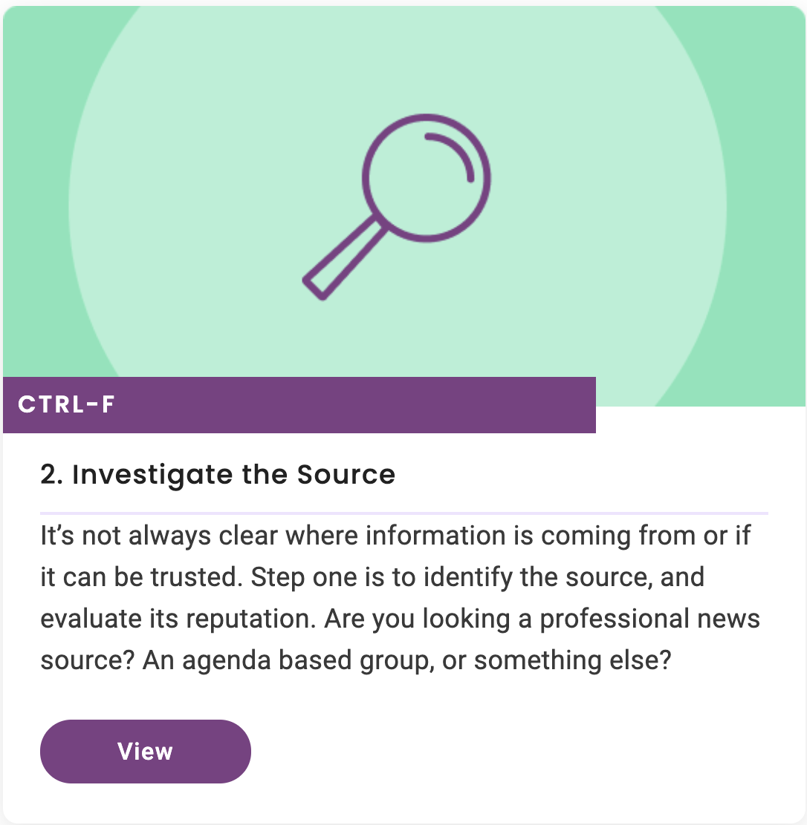
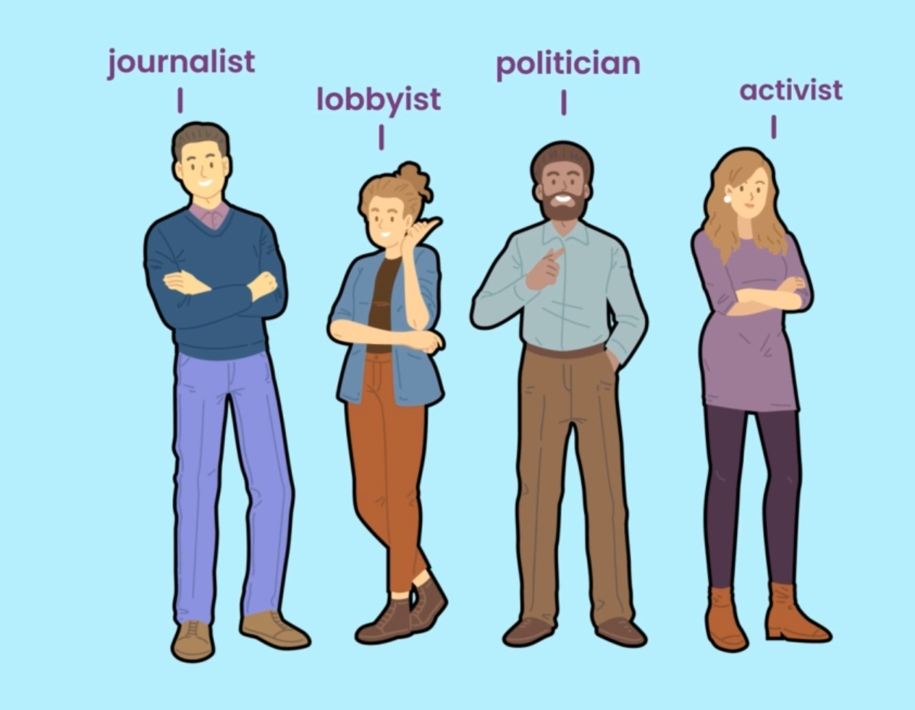
Strategy #1 Investigate the Source

Slide 42
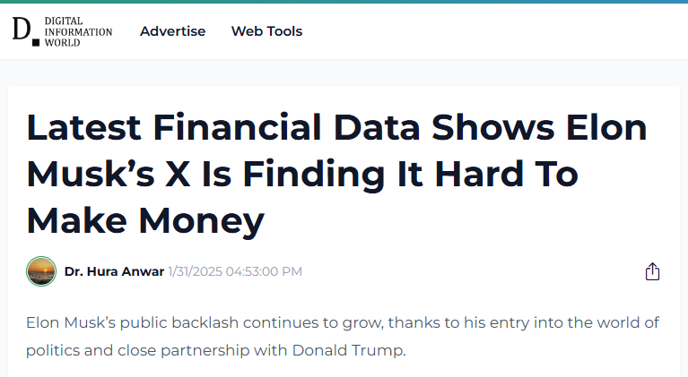
Investigating Sources
What kind of source is this?
ctrl-f.ca/en/toronto2025

Slide 43
Demo: Just Add Wikipedia
Step 1: Go to the address bar and delete everything after the root URL
Make sure to remove the “/”
https://www.digitalinformationworld.com/2025/01/latest-financial-data-shows-elon-musks.html
root URL
Step 2: Add a space and write wikipedia
Don’t forget to add a space
https://www.digitalinformationworld.com wikipedia
Step 3: Press “Enter”

Slide 44
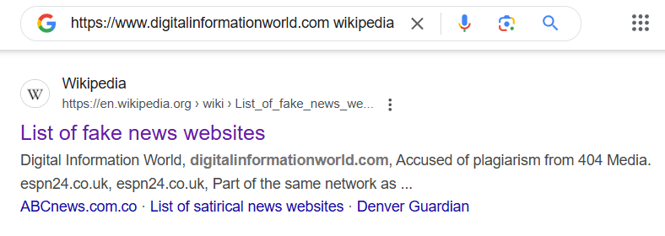

Slide 45
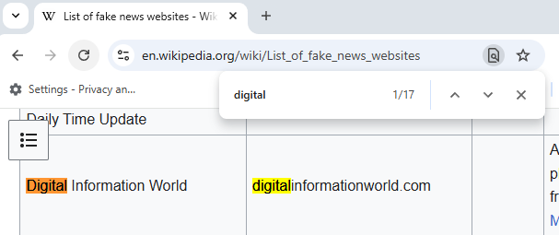
Use keyboard shortcut ctrl+F (command f on a Mac) to search for website name in the Wikipedia article

Slide 46
AI Problems: Using Chatbots as Sources
Please write me an article about the time Toronto was flooded with nacho cheese
Chatbots don’t verify information
They will fabricate quotes, dates, and other information if you ask it
Toronto’s Great Nacho Cheese Flood: A Delicious Disaster
Toronto has seen its fair share of strange events, but few are as bizarre—or as delicious—as the infamous nacho cheese flood. This peculiar incident, which took place in the early 2000s, left streets slick with gooey, golden cheese and had locals questioning whether they had stepped into a food-lover’s dream or a logistical nightmare.

Slide 47
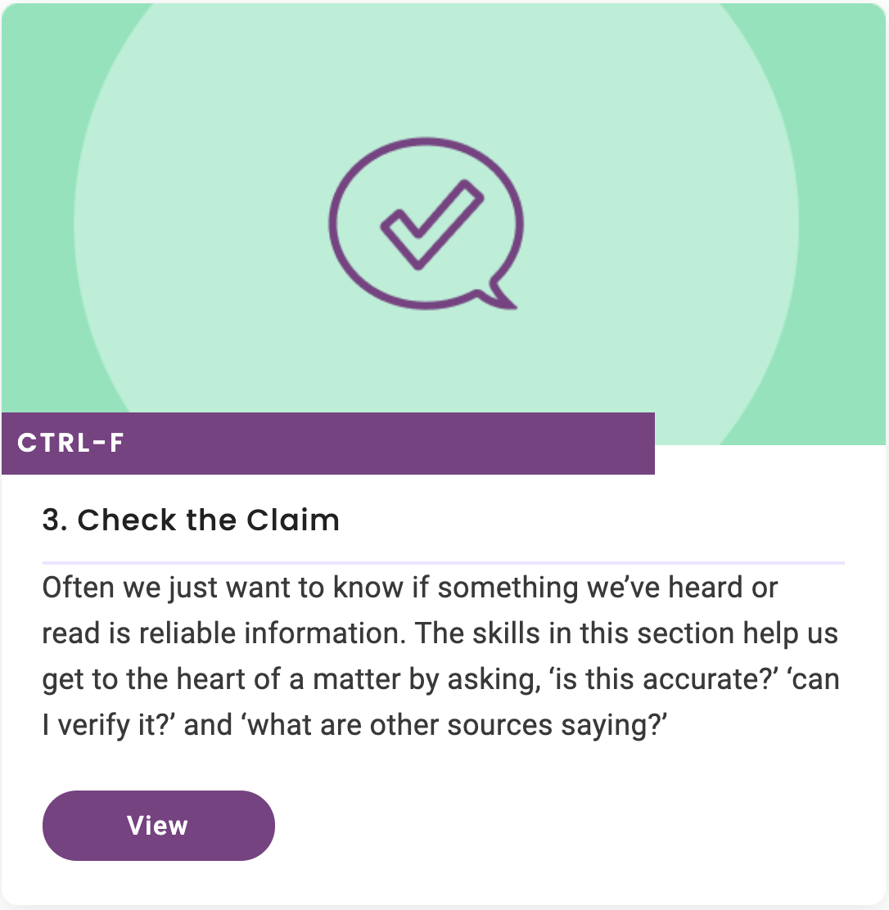
Strategy #2 Check the Claim

Slide 48
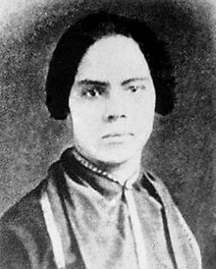
Fact-Checking Chatbots
Assignment: Write an essay about a lesser-known figure from Canadian history
ChatGPT: “Mary Ann Shadd Cary: A Trailblazing Advocate for Civil Rights and Education”

Slide 50
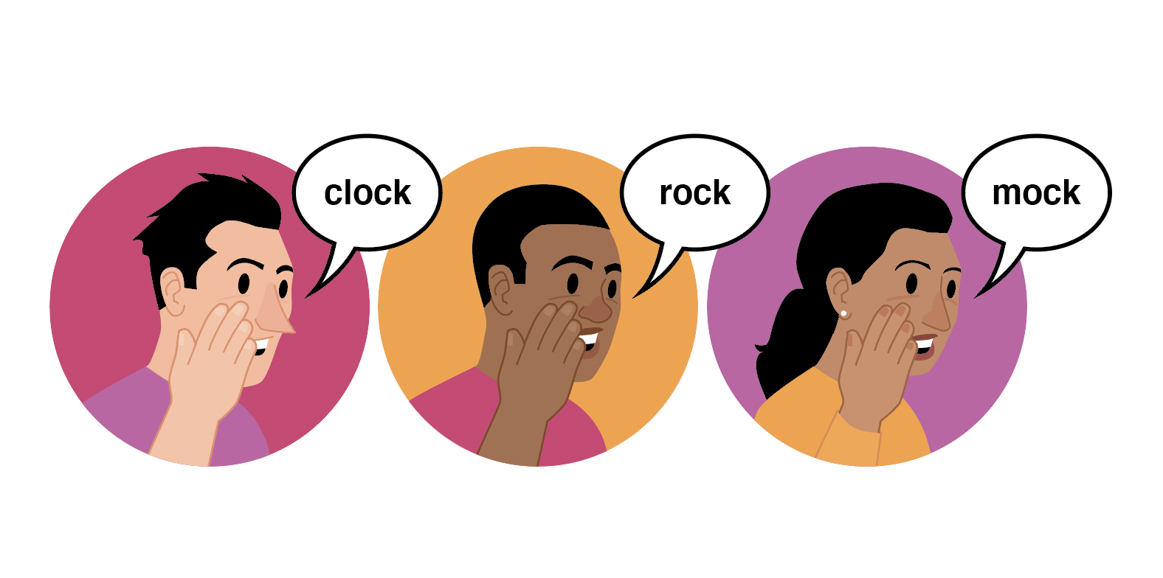
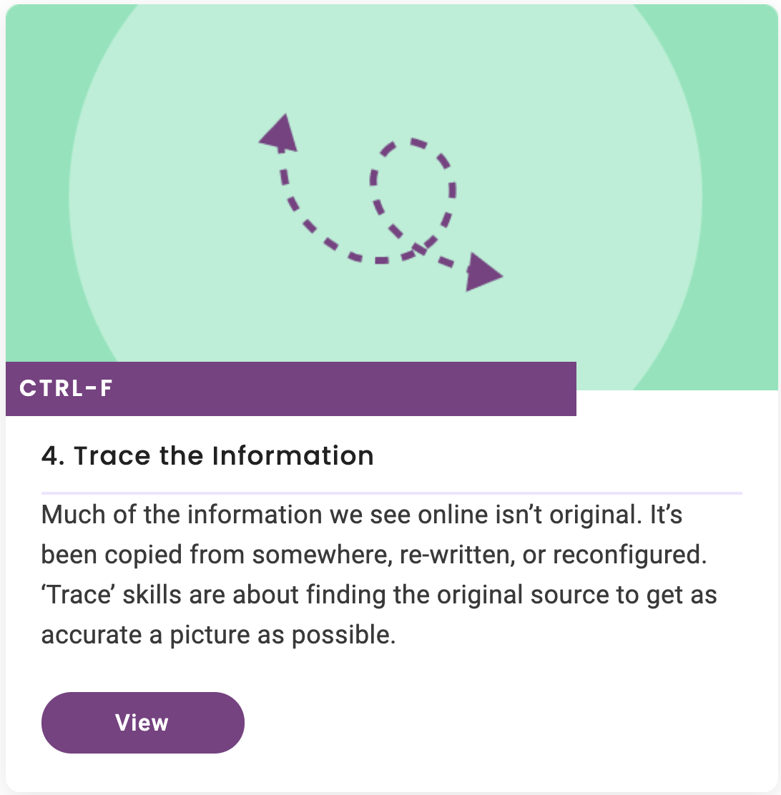
Strategy #3 Trace the Information
Key Skills:
Click Through
Find
Check the Date
Reverse Image Search

Slide 51
Round 2
Use your CTRL-F Verification Skills to determine whether the following video is AI generated or not.

Slide 52
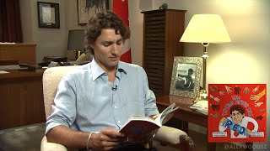
Use a keyword search to find context about this video.

Slide 53
Deepfake
Any video, picture, or audio made with artificial intelligence to appear real.

Slide 54
How to register
ctrl-f.ca

Slide 55
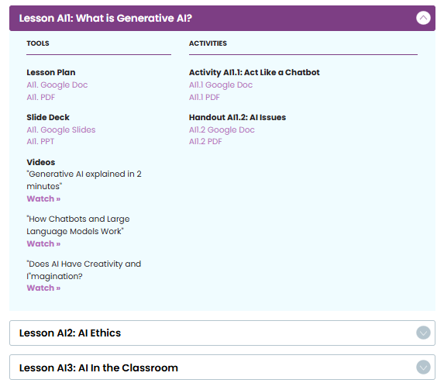
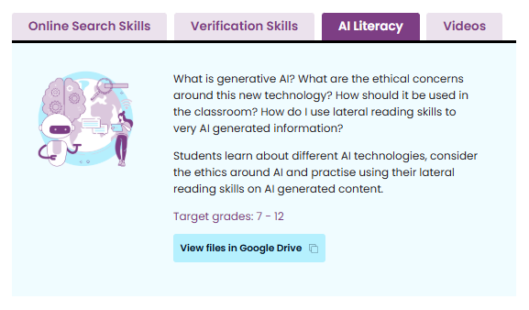
ctrl-f.ca/resources
(Registration required)

Slide 56
We’ll email you about:
Presentation slides, resource links, and post-event survey
Travel reimbursements
Student Vote Canada
Any questions?
Email us: hello@civix.ca

