Slide 1

Democracy Bootcamp
Common Ground:
A Community-Building Game
Notes:
N

Slide 2
Overview
Common Ground is an activity that engages students in a simulated community planning process to build their decision-making and problem solving skills.
It asks students to consider stakeholder interests as well as the concept of the common good.
Instructions and full lesson plan available at politalks.ca/CommonGround
Common Ground is a game originally designed by Dr. Paula Waatainen and Dr. Kirstin Funke-Robinson. It has been adapted with permission by CIVIX
Notes:
Highlight how the game introduces students to another form of civic participation (besides voting): the community consultation. This is a form of participation that requires students to use the skills they develop in the PoliTalks lessons.
Originally developed for middle school students, but it can be used from 6-12. Students will bring their own level of sophistication to it.

Slide 3
How should we live together as a society?
Notes:
What is the fundamental question at the core of civics?
But really, what’s implied when we ask this question in practical terms is something more like this...

Slide 4
How should we live together as a society [given finite resources]?
Notes:
These limitations make the question so much more difficult and interesting.
How can we build a society or community that works for us but also for other people who might have different interests or priorities

Slide 5




Premise
There’s a new development being built in your community, and four stakeholder groups have been selected by the municipal council for a consultation. As a member of one of these groups, you want to ensure that your group’s priorities are considered.
Business Improvement Association
For United Neighbours
All For One
Citizens for a Greener Community
You are also a citizen who wants the development to benefit the community as a whole
Notes:
You are the owner of a business in town and a member of your local Business Improvement Association.
You are a person who is passionate about arts, sports, and improving local culture and recreation and have recently joined For United Neighbors
You are a person who is passionate about promoting the well-being of the members of their community, so you volunteer as a member of All For One, a community association which aims to promote the welfare of all citizens.
You are someone who thinks that protecting the environment should be a top priority for everyone so you volunteer with Citizens for a Greener Community, an environmental group.

Slide 6
Objective
You will form committees made up of representatives from the four stakeholder groups to consult on the new development.
You will be presented options for what to include in the development. Your committee will be tasked with reaching a consensus about which features to include in the final proposal.
You will need to consider the priorities of all stakeholders and the needs of the community as a whole.
Notes:
The name of the game, Common Ground, represents the moment when someone might change their mind about a policy or decision because they are trying to balance between personal or group interests and what’s best for the community as a whole (common good). How do you decide when to put aside your own personal wants for the common good, and when do you decide to prioritize your wants at the expense of what might be best for others?

Slide 7
Two ways to win
“Stakeholder Interests” Victory: At the conclusion of the game, each stakeholder in every committee will receive a score. These scores will then be tallied across all groups. The stakeholder group with the most points wins the Stakeholders Interests victory.
“Common Good” Victory: At the conclusion of the game, each committee will calculate the difference between the highest and lowest stakeholder scores. The committee with the lowest number wins a Common Good victory, meaning they have done the best job balancing the interests of all stakeholders.

Slide 8
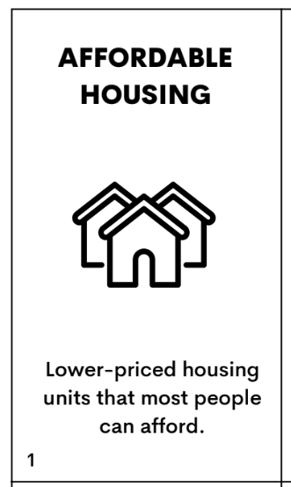

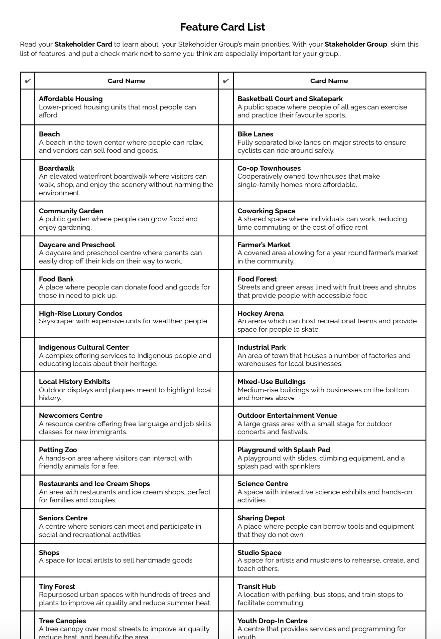
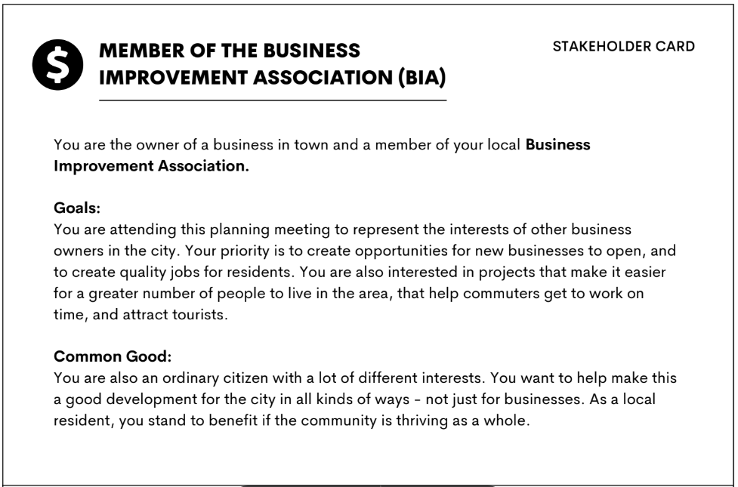
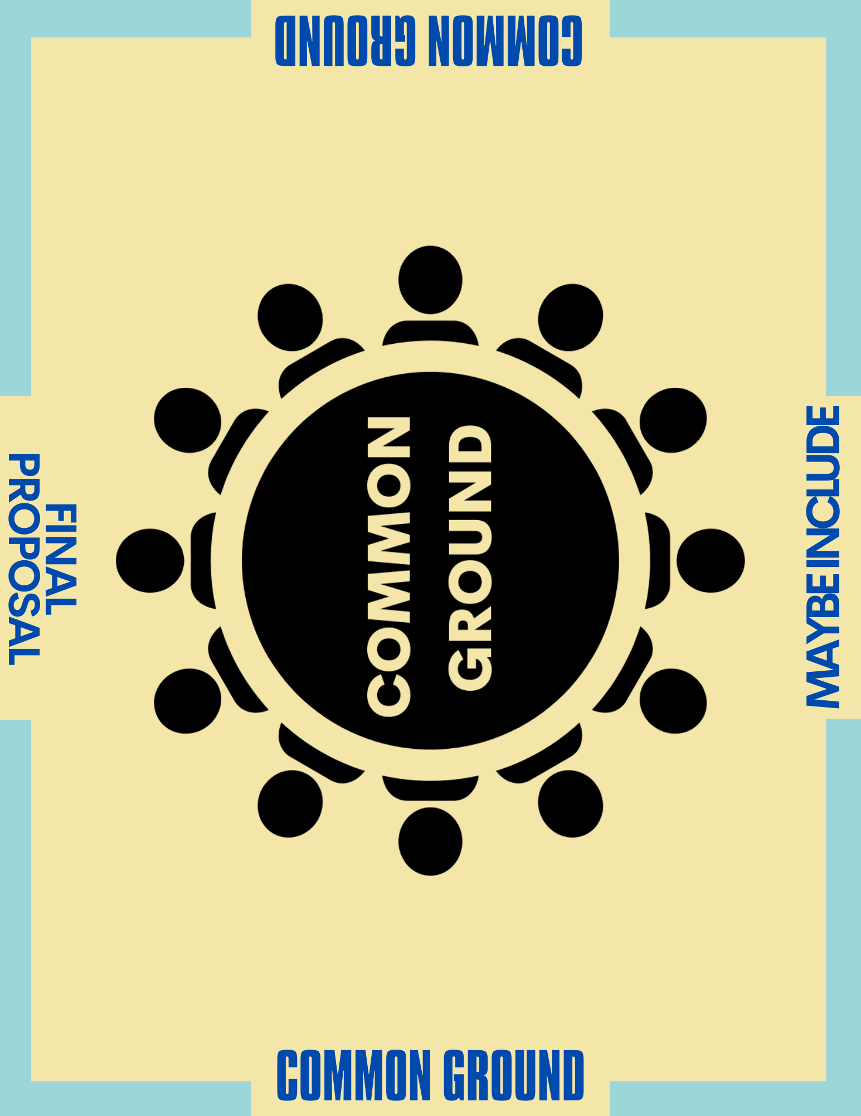
Game Materials
Feature Cards
List of Features
Stakeholder Cards
Game Board
Notes:
Ask to locate the following materials at your table

Slide 9
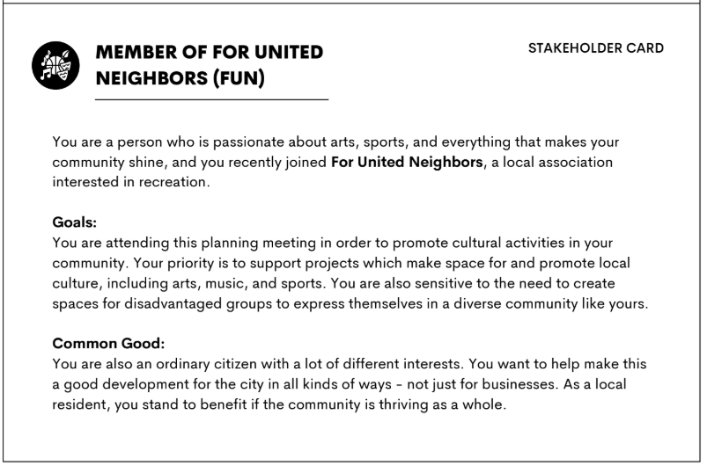
Setting up
Form committees: Your table is your committee.
Divide into 4 stakeholder groups: Pair up when possible. Each pair will play as a single stakeholder. It’s fine if there are solo stakeholders.
Assign roles: There are four Stakeholder cards. Give each stakeholder a card. This card explains the role you will play during the game. Give solo stakeholders first pick.

Slide 10

Part I: Review Your Role & Priorities
Review your Stakeholder card and the motivations, goals and priorities of your stakeholder group.
Skim the options on the Features sheet (please share with the person next to you). Identify some you think are important for your stakeholder group and ones you think are less important [3 mins]
    Your goal is to clarify your stakeholder priorities and come up with a general gameplan. You do not need to memorize any items.
Notes:
Ignore Flex cards for now

Slide 11
Part 2: Priority Setting
Distribute Feature Cards: Shuffle and distribute Feature Cards evenly among stakeholders. Each stakeholder should receive eight cards.
Private Sorting (1 min): Independently sort your eight cards into two piles based on your stakeholder priorities:
Yes: You think it must be included in the Proposal
No: You think it should not be included in the Proposal

Slide 12

Part 2: Priority Setting
Review the ‘No’ cards with your committee (5 mins): Take turns sharing your ‘No’ cards with the other members of your committee.
If another Stakeholder thinks a card is important, they take it and add it to their ‘Yes’ pile.
Cards that everyone unanimously agrees to be unimportant are discarded and set aside for the rest of the game.

Slide 13

Part 3: Deliberations
Share your ‘Yes’ cards (7 mins) : Take turns presenting the cards from your ‘Yes’ pile and making a brief case for why it’s important
  If all committee members agree that a card is important, place it in the ‘Proposal’ space on the board. Otherwise, put it in the ‘Maybe include’ space.
  If you run out of time, place all remaining ‘Yes’ cards into the ‘Maybe Include’ pile

Slide 14
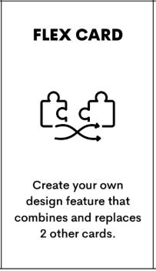
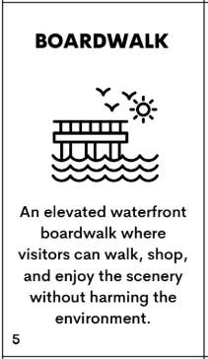
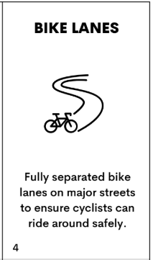
Part 3: Deliberations
Create the final proposal (5 mins): Count the number of cards in the “Proposal” pile.Your proposal must include exactly 16 cards.
  If there are fewer than 16 cards, deliberate with your committee and decide which cards from the ‘Maybe include’ pile to include.
  If there are more than 16 cards, deliberate with your committee and decide which cards to remove.
Flex Cards
Your committee can use Flex Cards to creatively combine ideas from two different cards. Cards combined with a Flex Card count as a single card
.
Ex: A Boardwalk card and a Bike Lane card can be merged into a boardwalk with a bike lane, earning points for both cards during scoring.
**YOUR IDEA MUST MAKE SENSE**
REMINDER:
Your Committee can use Flex Cards to creatively combine ideas from two different cards. Cards combined with a Flex Card count as a single card
.
Ex: A Boardwalk card and a Bike Lane card can be merged into a boardwalk with a bike lane, earning points for both cards during scoring.

Slide 15
Part 3: Deliberations
Create the final proposal (5 mins): Count the number of cards in the “Proposal” pile.Your proposal must include exactly 16 cards.
  If there are fewer than 16 cards, deliberate with your committee and decide which cards from the ‘Maybe include’ pile to include.
  If there are more than 16 cards, deliberate with your committee and decide which cards to remove.
Flex Cards
Your committee can use Flex Cards to creatively combine ideas from two different cards. Cards combined with a Flex Card count as a single card
.
Ex: A Boardwalk card and a Bike Lane card can be merged into a boardwalk with a bike lane, earning points for both cards during scoring.
**YOUR IDEA MUST MAKE SENSE**
REMINDER:
Your Committee can use Flex Cards to creatively combine ideas from two different cards. Cards combined with a Flex Card count as a single card
.
Ex: A Boardwalk card and a Bike Lane card can be merged into a boardwalk with a bike lane, earning points for both cards during scoring.

Slide 16
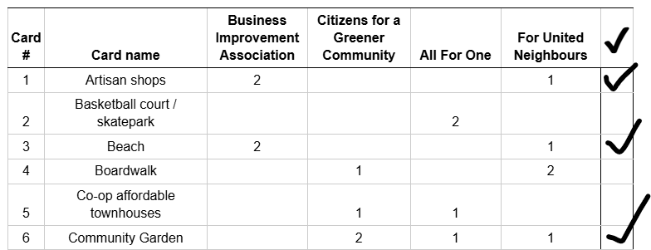
Part 4: Scoring
Tally your points (4 mins): Using the score sheet, calculate each stakeholder’s points and them on the sheet.
  Remember that cards combined using a Flex Card score points for both cards.
BIA | CGC | AFO | FUN
2 2 | 2 | 1 | 1 1 1
Total: 4 | Total: 2 | Total: 1 | Total: 3

Slide 17
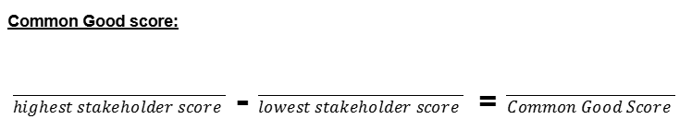
Part 4: Scoring
Calculate your Common Good Score: In the space provided, subtract the lowest and highest stakeholder scores. The result is your committee’s “common good” score
BIA | CGC | AFO | FUN
2 2 | 2 | 1 | 1 1 1
Total: 4 | Total: 2 | Total: 1 | Total: 3
4
1
3

Slide 18
Part 4: Scoring — Announce Winners
Stakeholder Interests Victory
Committee 1
Committee 2
BIA | CGC | AFO | FUN
2 2 | 2 | 1 | 1 1 1
Total: 4 | Total: 2 | Total: 1 | Total: 3
BIA | CGC | AFO | FUN
1 1 | 1 1 | 2 1 | 2
Total: 2 | Total: 2 | Total: 3 | Total: 2
 | BIA | CGC | AFO | FUN
Committee 1 + Committee 2 | 4 2 | 2 2 | 1 3 | 3 2
 | Total: 6 | Total: 4 | Total: 4 | Total: 5
The scores of Stakeholders from the same group across all Committees are added to one another. In this scenario, the Business Improvement Association wins a Stakeholder Interests Victory, as they earned the most points of all Stakeholders across all Committees.

Slide 19
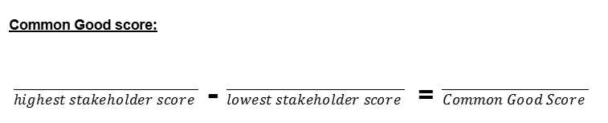
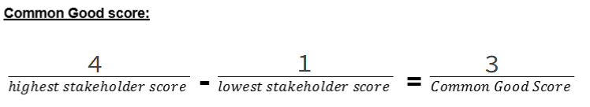
Part 4: Scoring — Announce Winners
Common Good Victory
Committee 1
Committee 2
3
2
1
In this scenario, Committee 2 wins a Common Good Victory, since they had the lowest discrepancy between their highest and lowest scoring stakeholders.

Slide 20
Debrief: Example Questions
Did you have to decide between what would be best for your stakeholder group and what would be best for the common good? How did you decide what to do?
Do you think consensus is necessary for an idea to be in the interest of the common good?
Review the proposal that obtained the “common good” victory. Do you think this proposal best reflects the common good? Why or why not?

Slide 21
Lesson Plan (starter activities, assessments), Printouts, Instructions:
politalks.ca/CommonGround
Notes:
Highlight how the game introduces students to another form of civic participation (besides voting): the community consultation. This is a form of participation that requires students to use the skills they develop in the PoliTalks lessons.
Originally developed for middle school students, but it can be used from 6-12. Students will bring their own level of sophistication to it.

Slide 22
Class set of cards available

