Slide 1
Democracy Bootcamp
Engaging in Constructive Discourse: Exploring Election Issues
10:25 - 11:00

Slide 2
Politics & Controversial Issues
A controversial issue is an authentic topic that is likely to give rise to multiple and competing answers
Political issues relate to questions about how we should live together as a public
Any issue can be controversial — and you can use less charged, lower stakes issues to build the skills and habits of constructive discussion

Slide 3
Case Studies
Overviews of divisive issues in Canada
Provides background information, and reasons people agree or disagree
politalks.ca/case-studies

Slide 4
Practice Protocol:
Structured Academic Controversy (SAC)
Consider using the SAC protocol when you want students to:
Discuss a controversial issue with two clear sides
Develop deep, nuanced understanding of a complex issue
Practice active listening
Emphasize reflection and understanding rather than debate

Slide 5
Protocol: Structured Academic Controversy
Discussion Prompt
No new oil pipelines should be built in Canada.

Slide 6
Protocol: Structured Academic Controversy
Split into 2 groups. Decide which group will agree with the prompt and which will disagree.
You don’t have to personally agree with the position you are assigned. Your goal is just to determine the best arguments or evidence for your side.
Assign a timekeeper (person who showed up the earliest today).
Identify the best 3 arguments in support of your assigned position. Prepare a short presentation to make the case for your side of the issue. (5 mins)
The “Agree” side presents their arguments while the “Disagree” side listens and takes notes. No interruption is allowed. (3 mins)

Slide 7
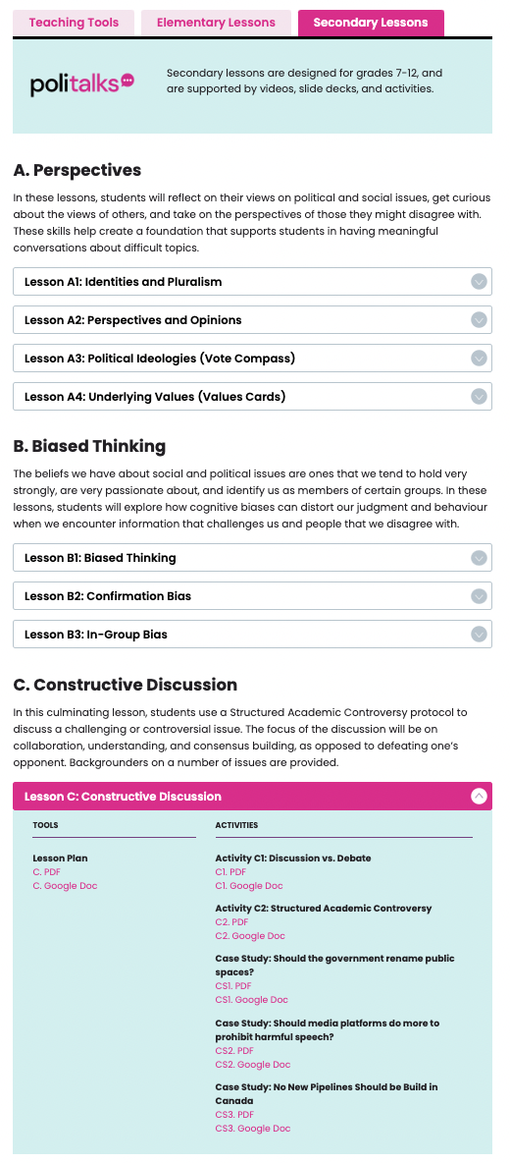
SAC & Student Vote
SAC on Student Vote, points to Case Studies on PoliTalks
Backgrounders and suggested reading on election issues
Cases Studies will be updated to cover important issues

Slide 8
Protocol: Structured Academic Controversy
The “Disagree” side restates the “Agree” side’s positions and asks clarifying questions. These questions should seek to build understanding of the position (2 min).
The “Disagree” side presents their arguments while the “Agree” side listens and takes notes. No interruption is allowed (3 mins).
The “Agree” side restates the “Disagree” side’s positions and asks clarifying questions. These questions should seek to build understanding of the position (2 min).
Come together to see if you can find common ground. You no longer have to argue the position you were assigned (5 mins).
Identify the strongest and weakest arguments of both sides. What can you agree on?
If you are unable to come to any agreement, explain the fundamental differences between the positions.

Slide 9
Group Debrief
What was the experience like at your table?
Did the SAC protocol help you see the issue in a different way?
Did anyone change their minds or update their beliefs?

