Slide 1
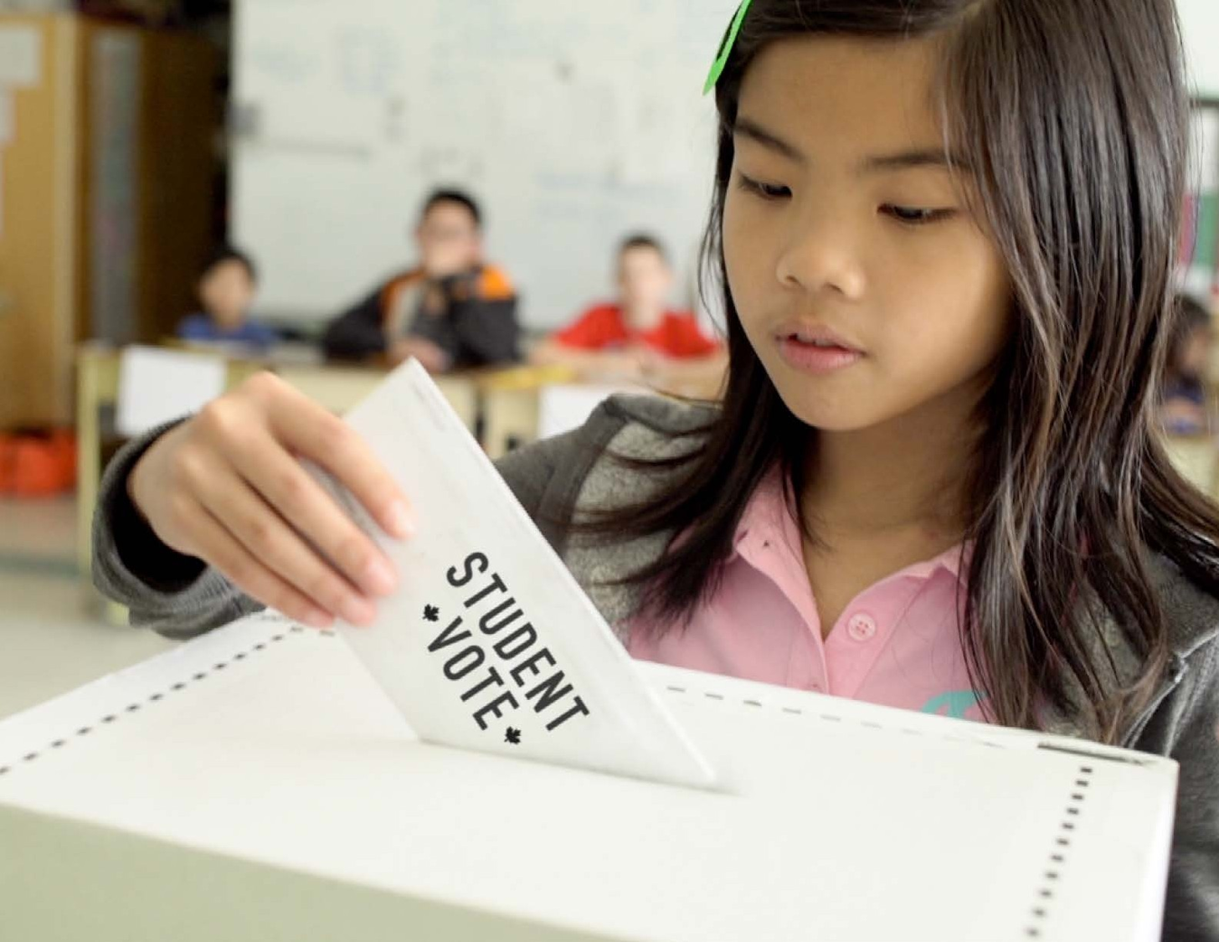

Slide 2
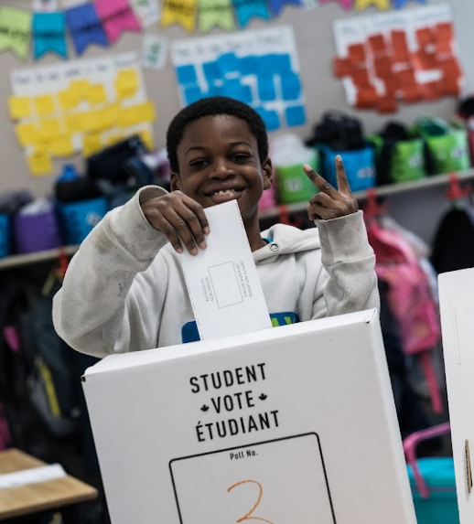
Student Vote
Designed to cultivate the habits of active and informed citizenship
Students cast ballots for the official candidates in a parallel election
Brings democracy to life

Slide 3
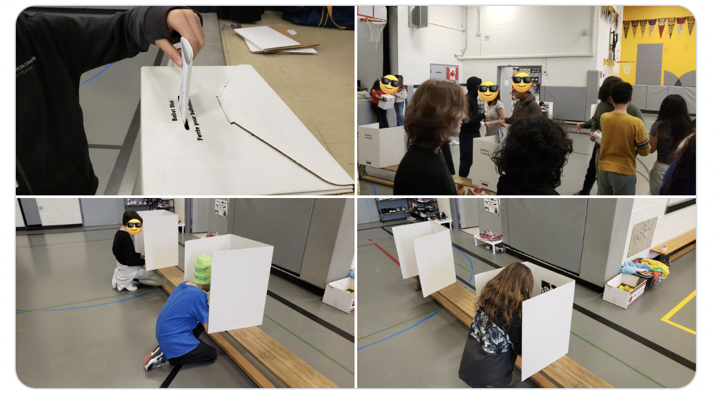
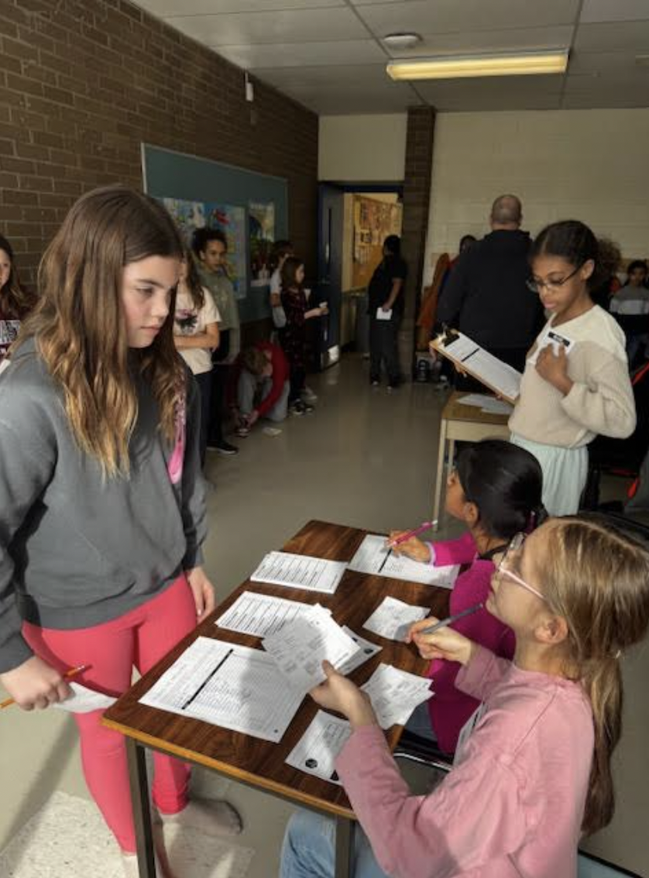
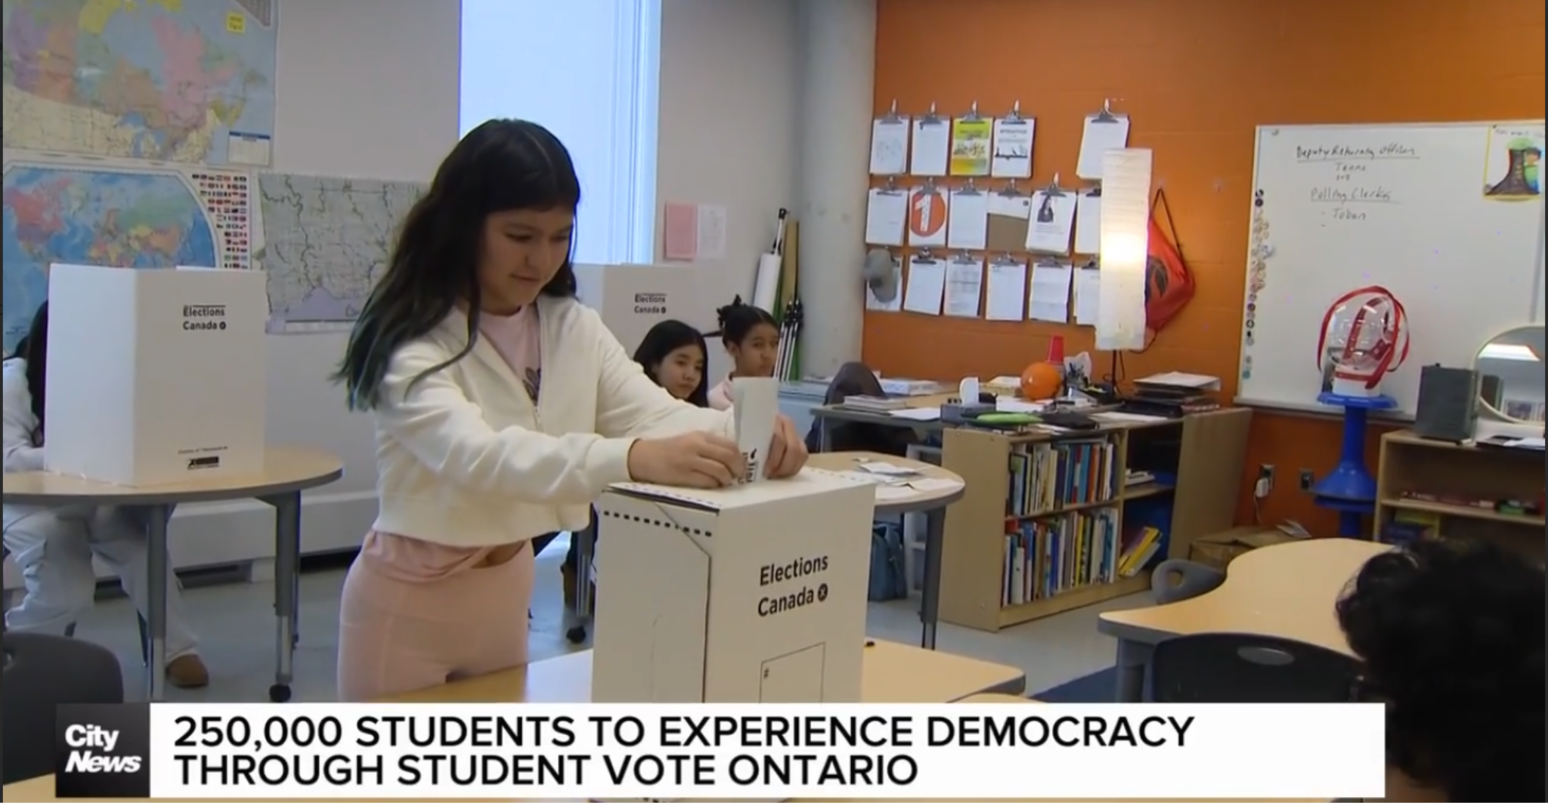

Slide 4
Questions to Consider for Table Talk
If you are new (or feel new) to Student Vote
What questions or concerns do you have?
If you are an experienced Student Vote educator?
What tips would you give to new Student Vote teachers? What do you wish you knew when you first organized Student Vote?

Slide 5
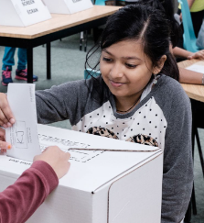
The Case for Student Vote
Low voter turnout, particularly among youth

Slide 6
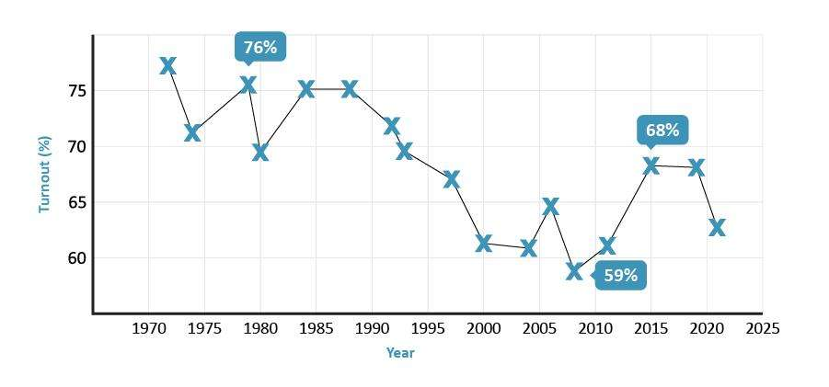
Voter turnout - Federal elections

Slide 7
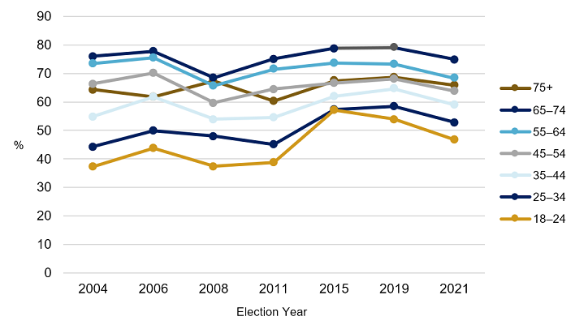
Voter turnout by age group

Slide 8
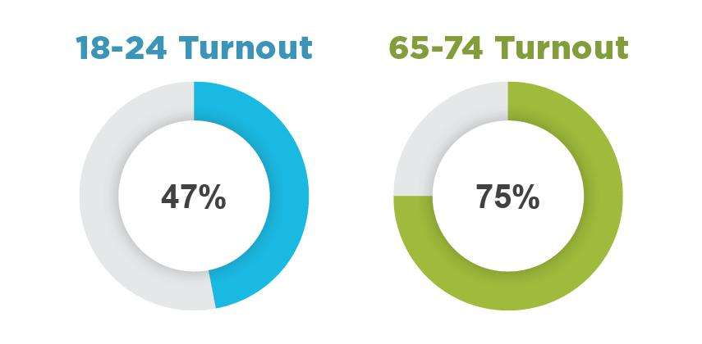
Gap in turnout by age group
Source: Elections Canada, 2021 Federal Election

Slide 9
The Case for Student Vote
Declining voter turnout, particularly among youth
Voting is habitual

Slide 10
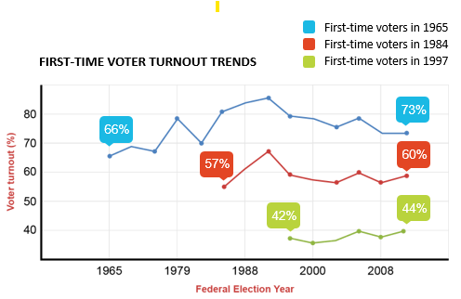
Voting is a habit

Slide 11
The Case for Student Vote
Declining voter turnout, particularly among youth
Voting is habitual
Addresses barriers to voting

Slide 12
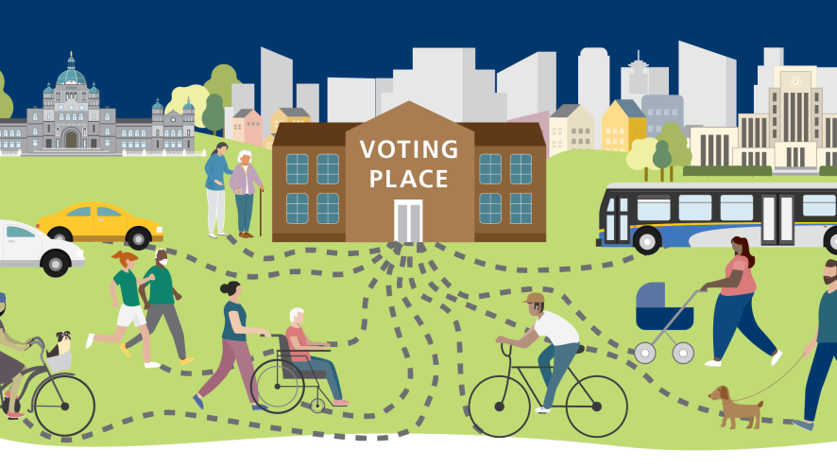
Barriers to voting

Slide 13
Motivational vs Access Barriers

Slide 14
Motivational barriers
a belief that voting is a choice rather than a duty

Slide 15
Access barriers

Slide 16
The Case for Student Vote
Declining voter turnout, particularly among youth
Voting is habitual
Addresses barriers to voting
Less political engagement at home
Early exposure is important

Slide 17
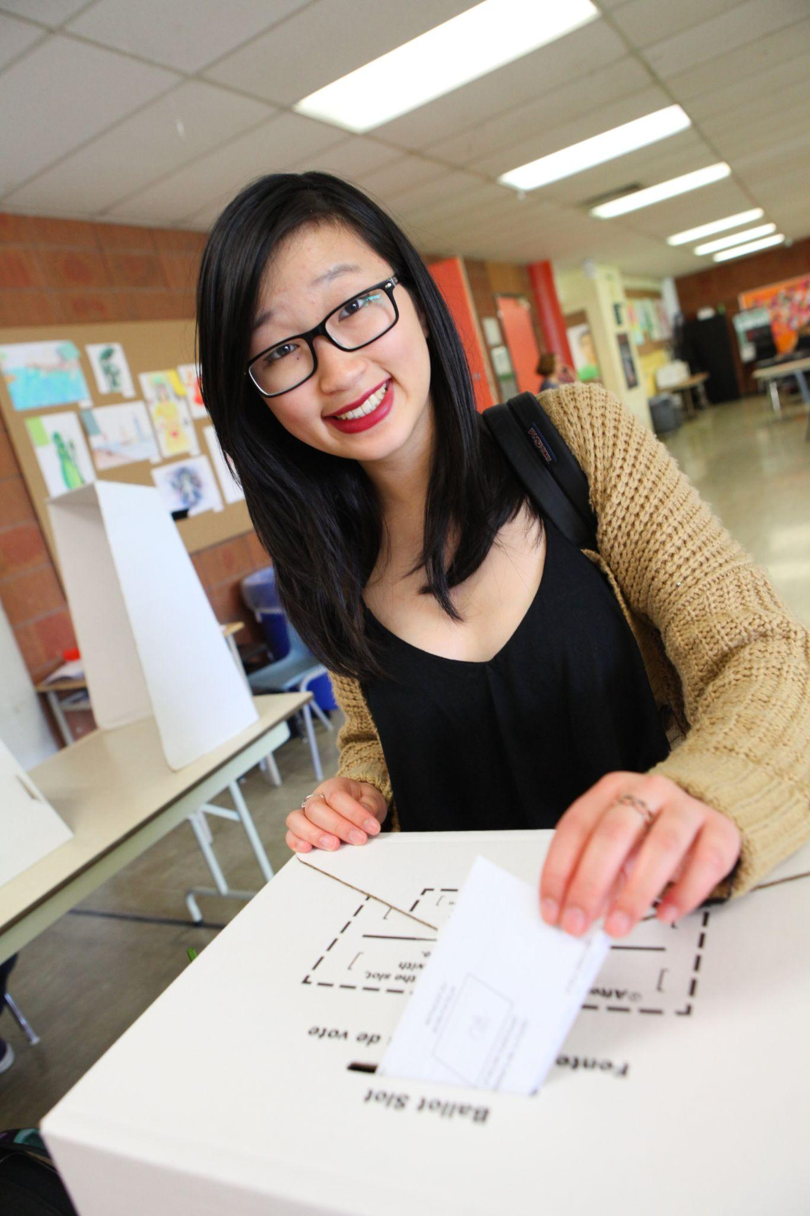
Student Vote objectives
Introduce the concepts of democracy and elections
Develop student interest in politics
Foster a sense of community
Strengthen attitudes towards voting
Spark political discussion
Demystify the voting process
Build a habit of electoral participation

Slide 18
The scope
Designed for grades 4 to 12
Offered at all levels of elections in most jurisdictions across Canada
69 elections in Canada since 2003
Since 2018, we have also organized six Student Vote projects in Latin America

Slide 19
Student outcomes

Slide 20
Outcomes among families
90% felt the program increased their families’ opportunities to learn more about elections and politics
50% stated that they knew more about politics because of their child’s involvement
58% felt that the program increased their own interest in politics
28% reported that their child’s participation positively influenced their decision to vote

Slide 22
2025 Federal Election

Slide 23
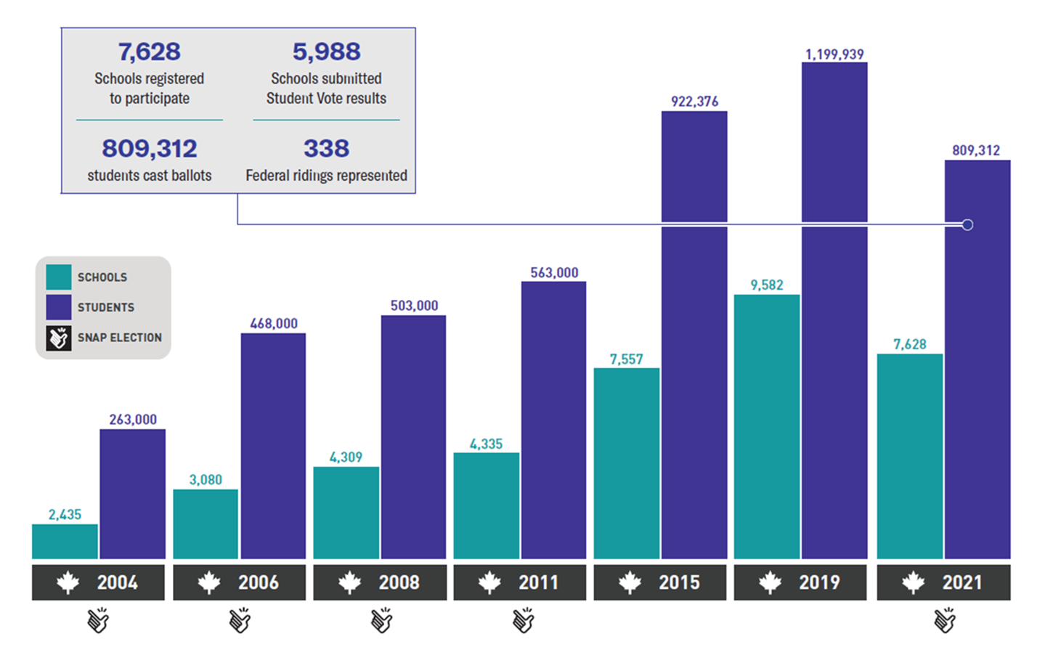
Federal election participation

Slide 24
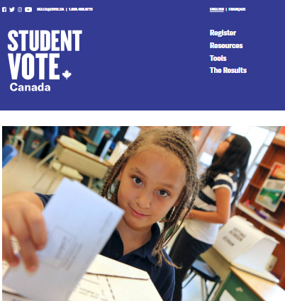
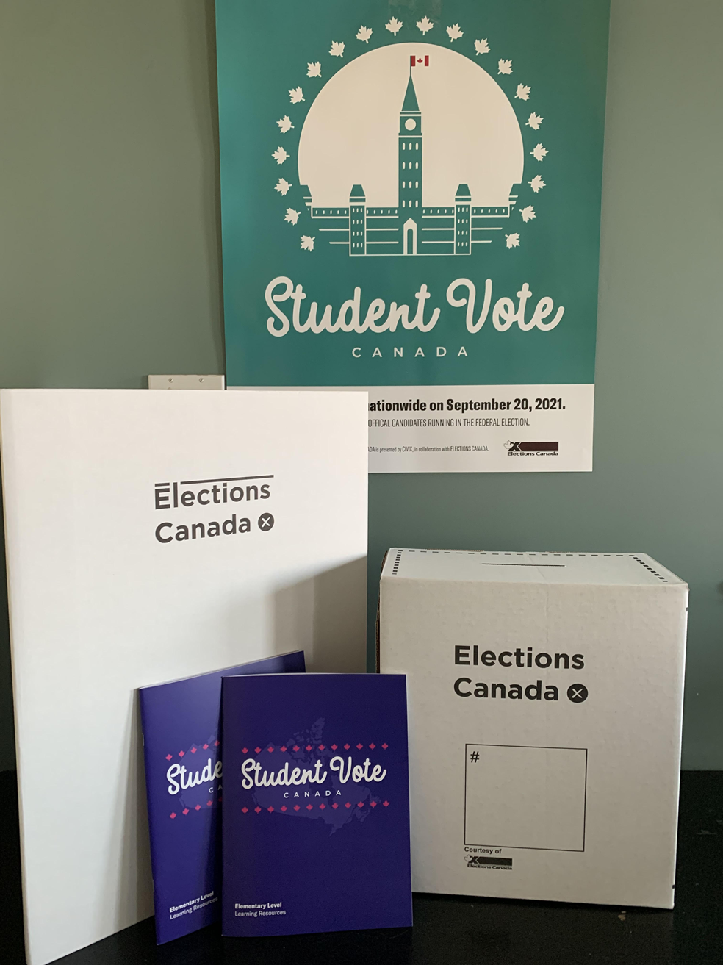
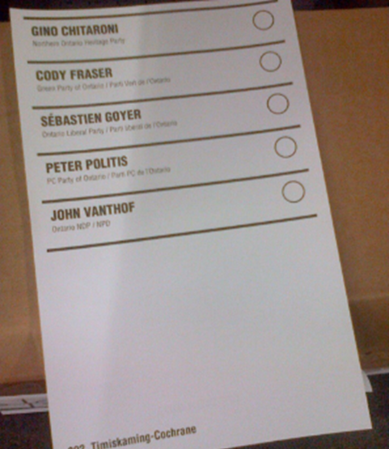
Program materials
SV election website
Resource package
Ballot kits
Lesson plans, digital files
Slide decks
Videos
Online interactives
Lesson plans
Campaign guide
Student Vote posters
Electoral district maps
Ballot boxes, screens
Ballot kit
Statement of the poll form
Election manual

Slide 25
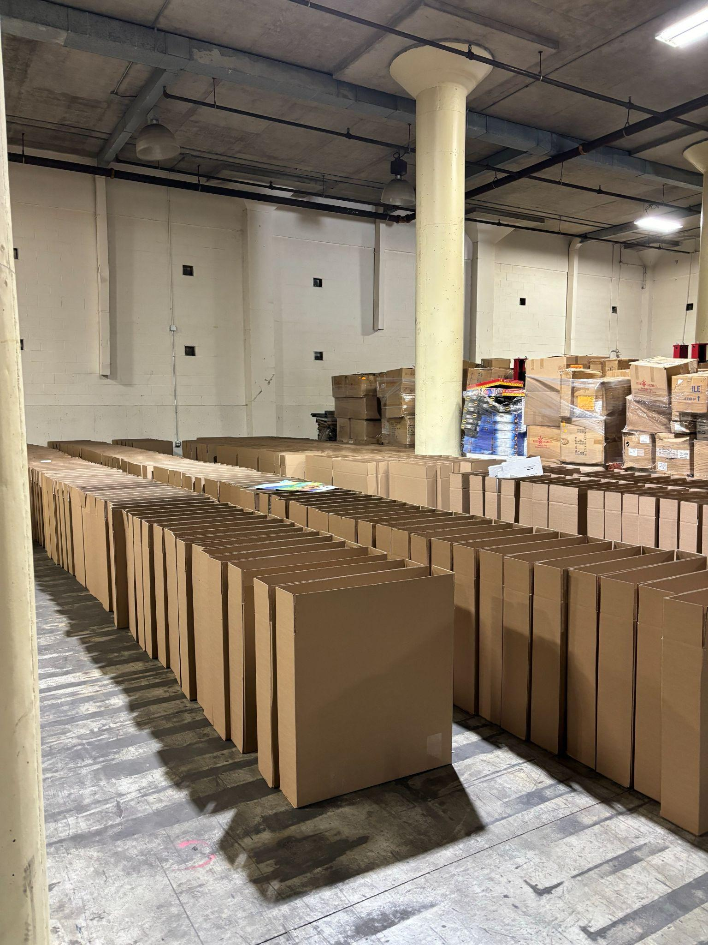
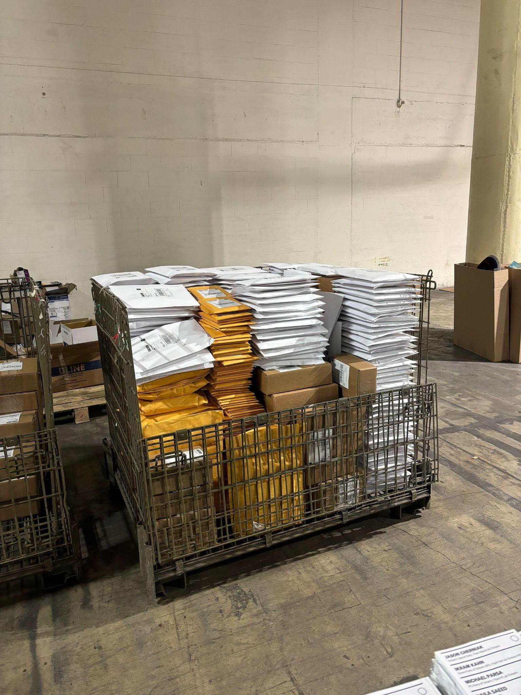
Two packages
BALLOTS
Resource package
Ballot kit

Slide 26
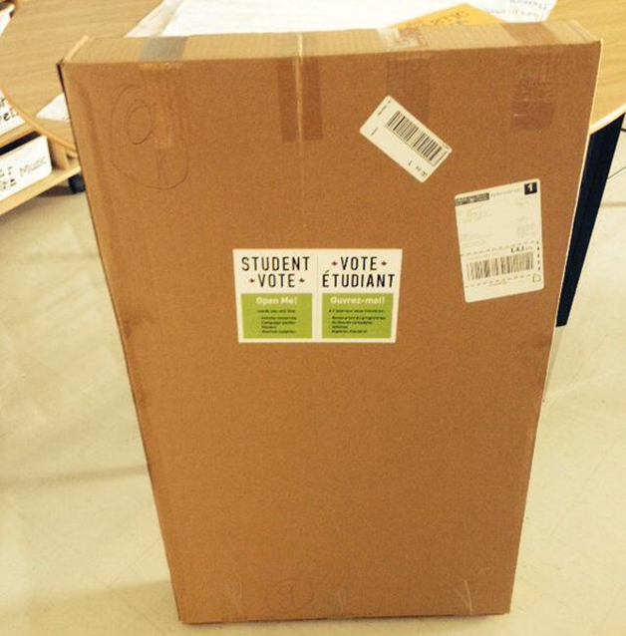
Package readiness
Look for a notification from Canada Post to track your package.
Alert your admin about the expected package.
Open the package and check the contents for accuracy.

Slide 27
Learning Resources
Elementary Resource
Grades 4-8
Secondary Resource
Grades 7-12

Slide 28
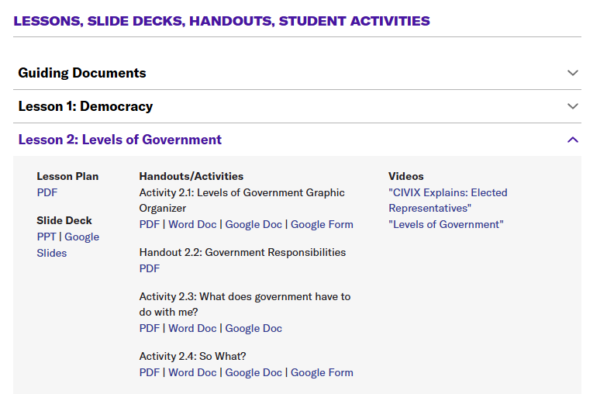
www.studentvote.ca/canada

Slide 29
Focus Area: Constructive Discussion Skills
Best practices for classroom discussion
Classroom Norms
Discussion protocols (Think-Pair-Share, Dilemma Dialogue, Rank Order)

Slide 30
Lessons
Fundamental Themes
Democracy
Rights & Responsibilities
Levels of Government
Federal Elections

Slide 31
Elementary Lesson: Democracy
Surviving Jumanji Activity
How will you organize yourselves?
What is your plan for finding food and shelter?
Who will be responsible for decision-making?
Will you establish any rules or code of conduct?

Slide 32
Secondary Lesson: Democracy

Slide 33
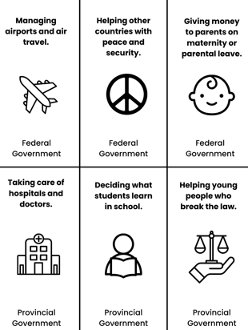
Lesson: Levels of Government
Government Scavenger Hunt
Clue: “Look at today’s headlines. Who’s making decisions that affect your life?”
Task: Find a news article related to government decisions at each level. Summarize the key issue and how it impacts people.

Slide 34
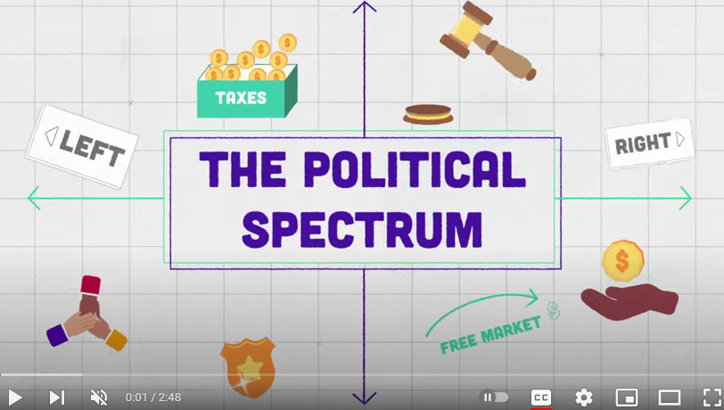
Secondary Lesson: Political Spectrum
How are people’s beliefs and values connected to their political views?
Why should we respect others’ opinions and perspectives?

Slide 35
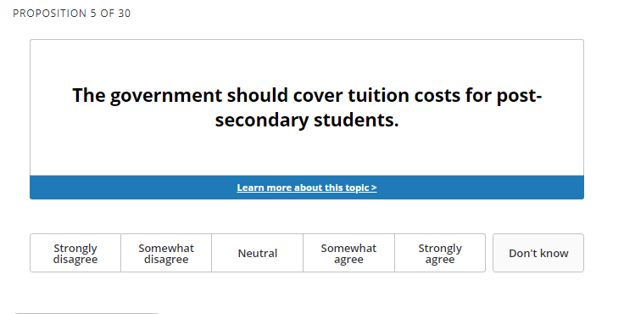
Vote Compass: Youth Edition

Slide 36
Vote Compass: Youth Edition

Slide 37
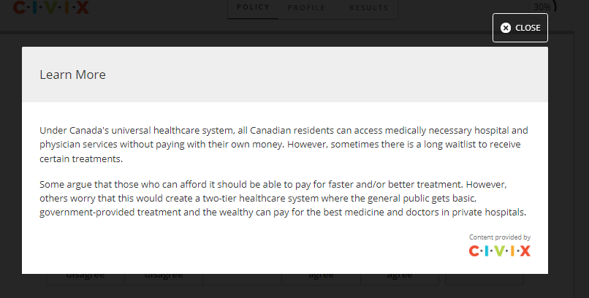
Vote Compass: Youth Edition

Slide 38
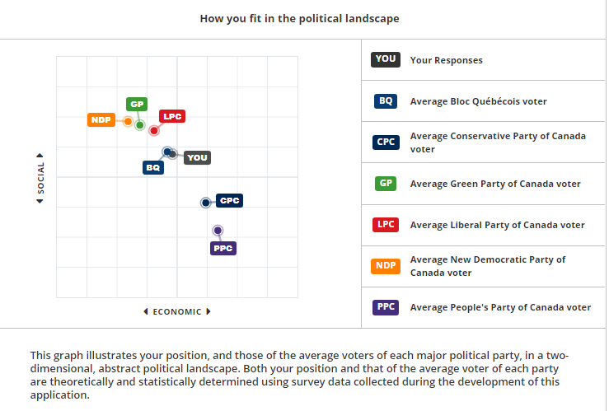

Slide 39
Lesson: Evaluating Election Information
Who made this and why?
Basic persuasive techniques:
emotional strategies, repetition, and appeals to authority.
Advanced persuasion techniques:
Fearmongering
Simplification of information/presenting policy ideas as natural
Us vs. Them framing
Appeals to a “better” past
Appeals to a better future

Slide 40
Lessons
Election-related lessons
Researching the parties and candidates
The Leaders’ Debate
The Voting Process
Post-Election Analysis

Slide 41
Learning about parties and candidates
Divide students into groups to research one party/candidate to create a presentation/profile
Invite the candidates to your school or email them questions
Consult with news websites - Party platform summaries/district profiles
Track social media announcements from each party during the campaign
Analyze campaign advertisements
Watch clips of the leaders debate in class

Slide 42
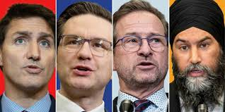
Party leader Q & A Videos

Slide 43
Pollenize
10-12 topics / Party platform summaries

Slide 44
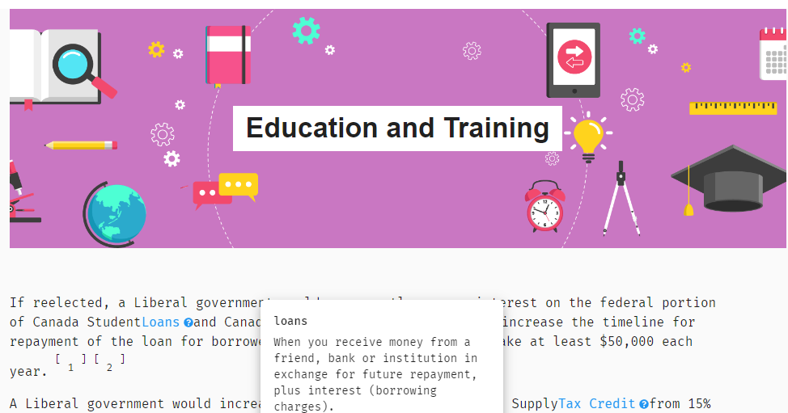
Pollenize

Slide 45
Other Tools

Slide 46
Election Manual: Voting Methods
VOTE BY CLASSROOM - Classes arrange to vote at the voting location at pre-set times throughout the day.
HOMEROOM VOTING - Ballots distributed to each participating class and students vote in their home classroom.
MOBILE VOTING STATION - Designated election officials take mobile voting booths from classroom to classroom.

Slide 47
Tips for Student Vote Day
Assign students to take on the roles of election officials
Use the templates to create Voter IDs and use a voters list
Create ‘I am a Voter’ stickers using mailing labels

Slide 48
Student Vote Results
Please keep your results confidential until the after the polls close
Share any news coverage
Look at the breakdown on the Student Vote election results and analyze the results
How did schools vote in your constituency?
How does Student Vote compare to the general election results?

Slide 49
Table Discussion
Those who are new (or feel new) to Student Vote: Share your questions/concerns with the group.
Those who are experienced Student Vote teachers: Share one tip for running a successful Student Vote or a piece of advice you wish you knew the first (or second) time delivered the program.

Slide 50
Best Practices for Student Vote

Slide 51
Best Practices
#1 – Use CIVIX explainer videos to teach the basics

Slide 52
Best Practices
#2 – Emphasize the impact of government

Slide 53
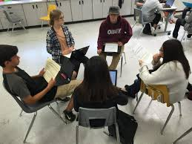
Best Practices
#3 – Build a discussion-friendly classroom

Slide 54
Best Practices
#4 – Incorporate traditional news coverage

Slide 55
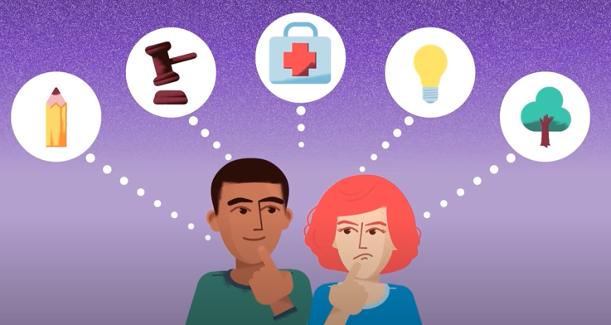
Best Practices
#5 – Explore issues that matter to your students

Slide 56
Best Practices
#6 – Engage with the candidates
Candidates forum
One-on-one visits
“Political party” lunch
Email them student questions
Engage with them through social media

Slide 57
Best Practices
#7 – Involve your colleagues
Announce the program early on
Send links to relevant lessons or videos
Suggest subject-related activities (i.e. “Get out the Vote Posters”)

Slide 58
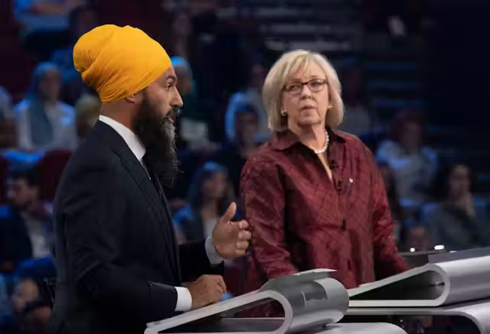
Best Practices
#8 – Encourage family engagement

Slide 59
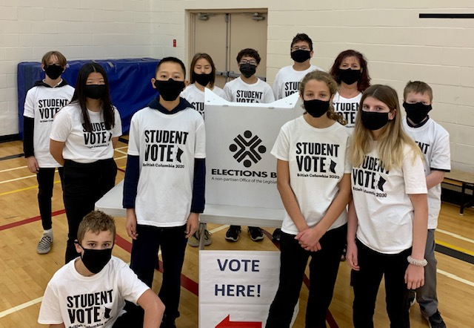
Best Practices
#9 – Empower students with responsibilities
Communications Team
Education Team
Events Team
Student Vote Day Team
Media and Community Relations

Slide 60
Best Practices
#10 – Make Student Vote Day a celebration

