Slide 1
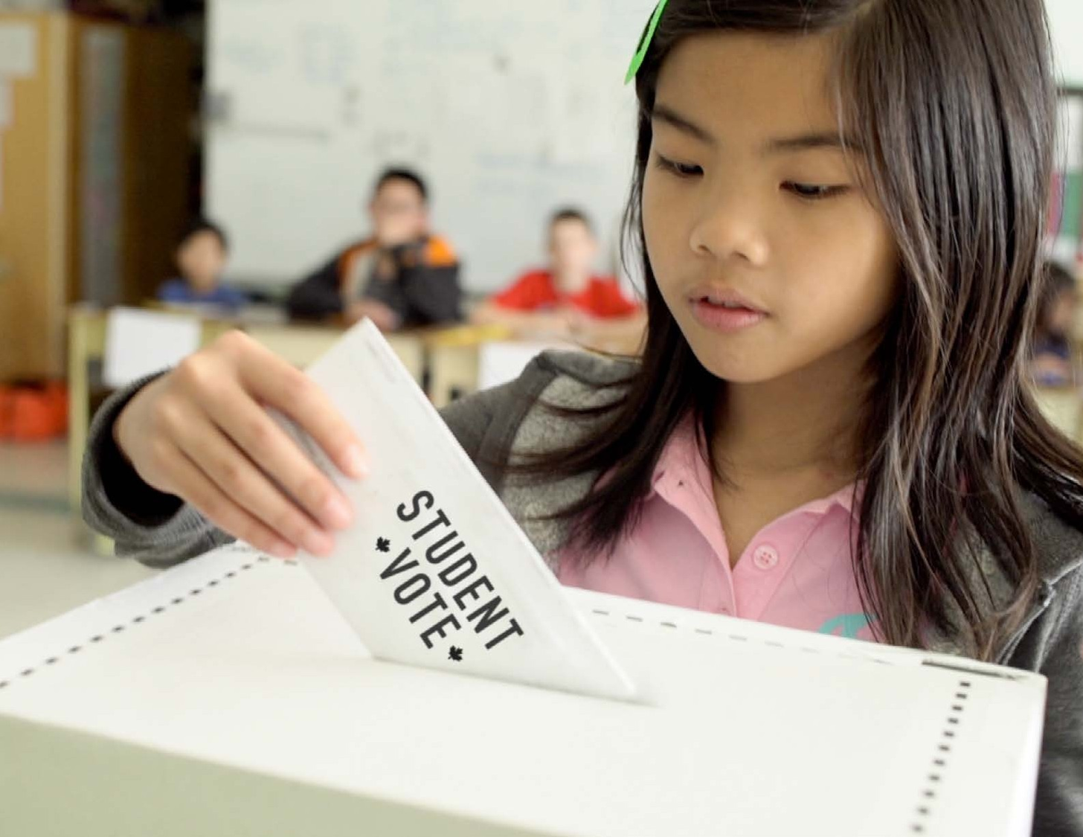

Slide 2
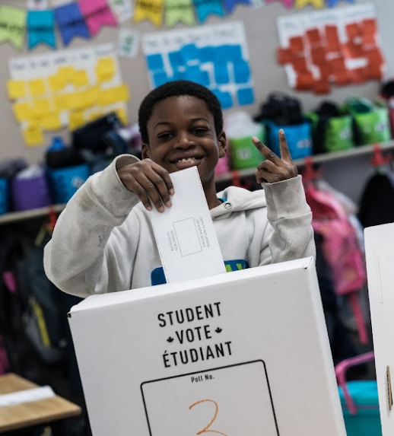
Student Vote
Designed to cultivate the habits of active and informed citizenship
Students cast ballots for the official candidates in a parallel election
Makes civic education compelling

Slide 3
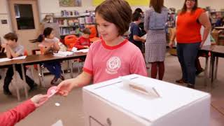

Slide 4
Do not edit
How to change the design
What was voter turnout in the 2021 federal election?
Presenting with animations, GIFs or speaker notes? Enable our Chrome extension

Slide 5
What do we know about voter turnout?

Slide 6
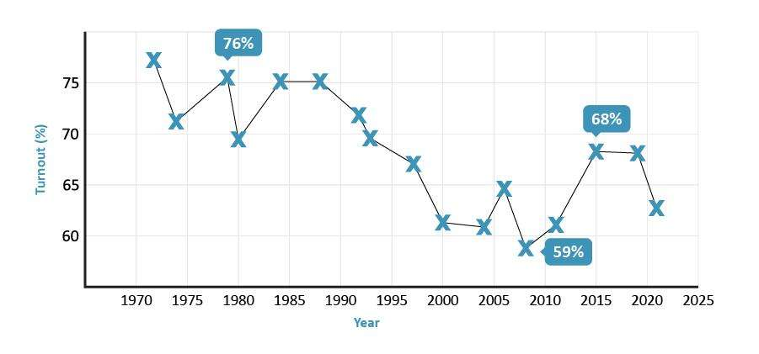
Decline in voter turnout

Slide 7
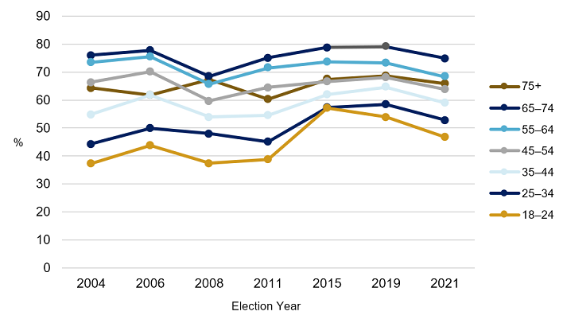
Turnout is lowest among youth

Slide 8
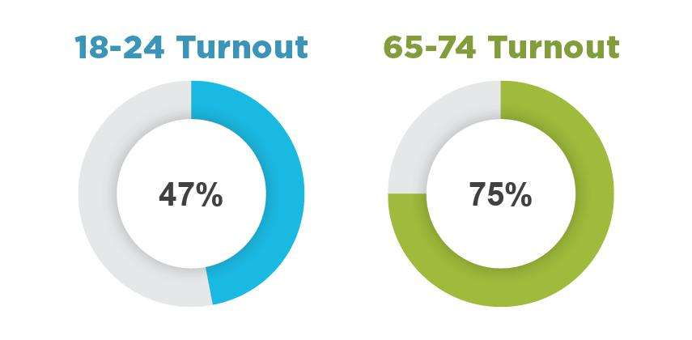
Gap between age groups remains
Source: Elections Canada, 2021 Federal Election

Slide 9
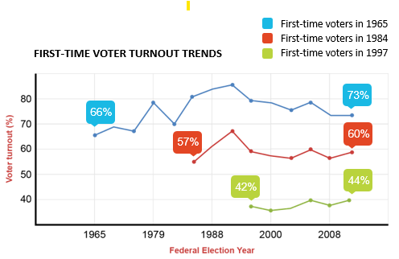
Voting is a habit

Slide 10
Barriers to Youth Participation

Slide 11
Motivational barriers
a belief that voting is a choice rather than a duty

Slide 12
Access barriers

Slide 13
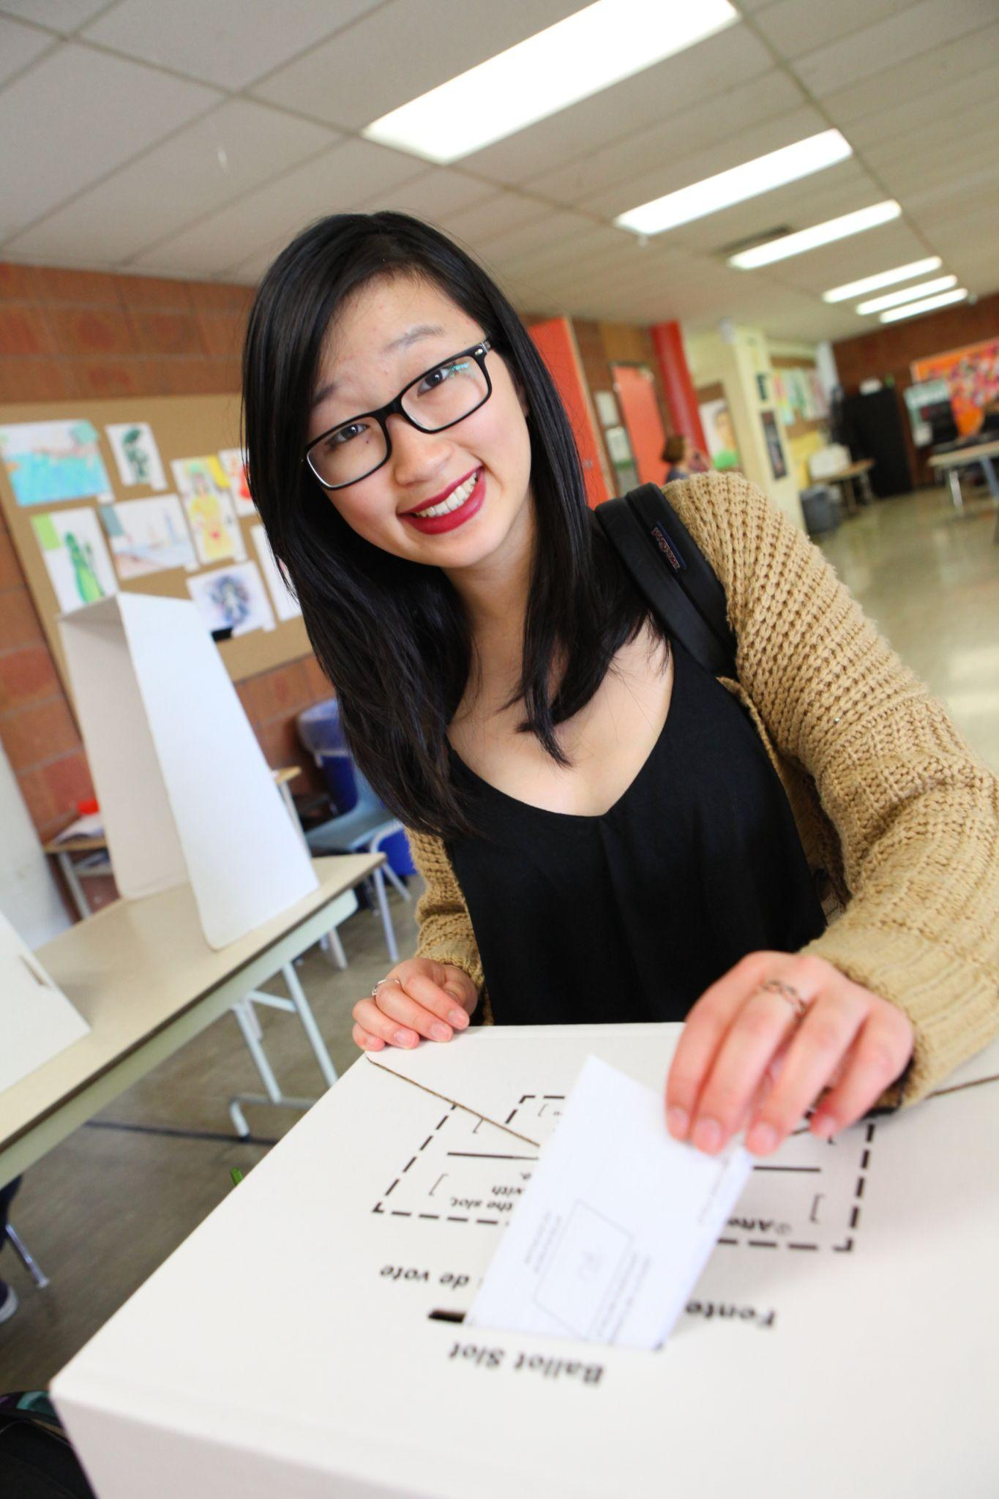
Early exposure is important
Young people who voted were much more likely to say…
They learned about government and politics in high school (65% voters vs 46% of non-voters)
Participated in a mock election, such as Student Vote (49% voters vs 39% non-voters)

Slide 14
2025 Federal Election
April 28 or May 5
?

Slide 15
Questions to Consider for Table Talk
If you are new (or feel new) to Student Vote
What questions or concerns do you have?
If you are an experienced Student Vote educator?
What tips would you give to new Student Vote teachers? What do you wish you knew when you first organized Student Vote?

Slide 16
Do not edit
How to change the design
Which item is not included in your first package?
Presenting with animations, GIFs or speaker notes? Enable our Chrome extension

Slide 17
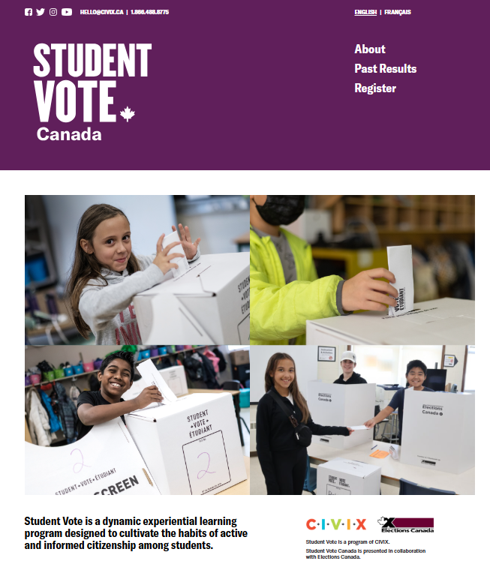
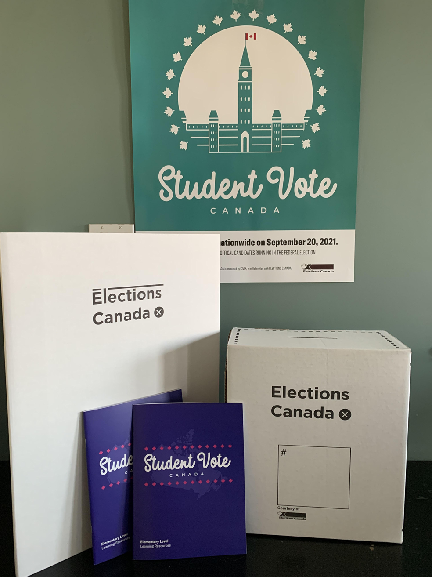
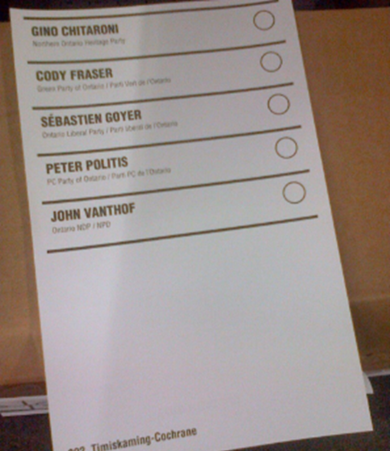
Program materials
SV election website
Resource package
Ballot kits
Lesson plans, digital files
Slide decks
Videos
Online interactives
Lesson plans
Campaign guide
Student Vote posters
Electoral district maps
Ballot boxes, screens
Ballot kit
Statement of the poll form
Election manual

Slide 18
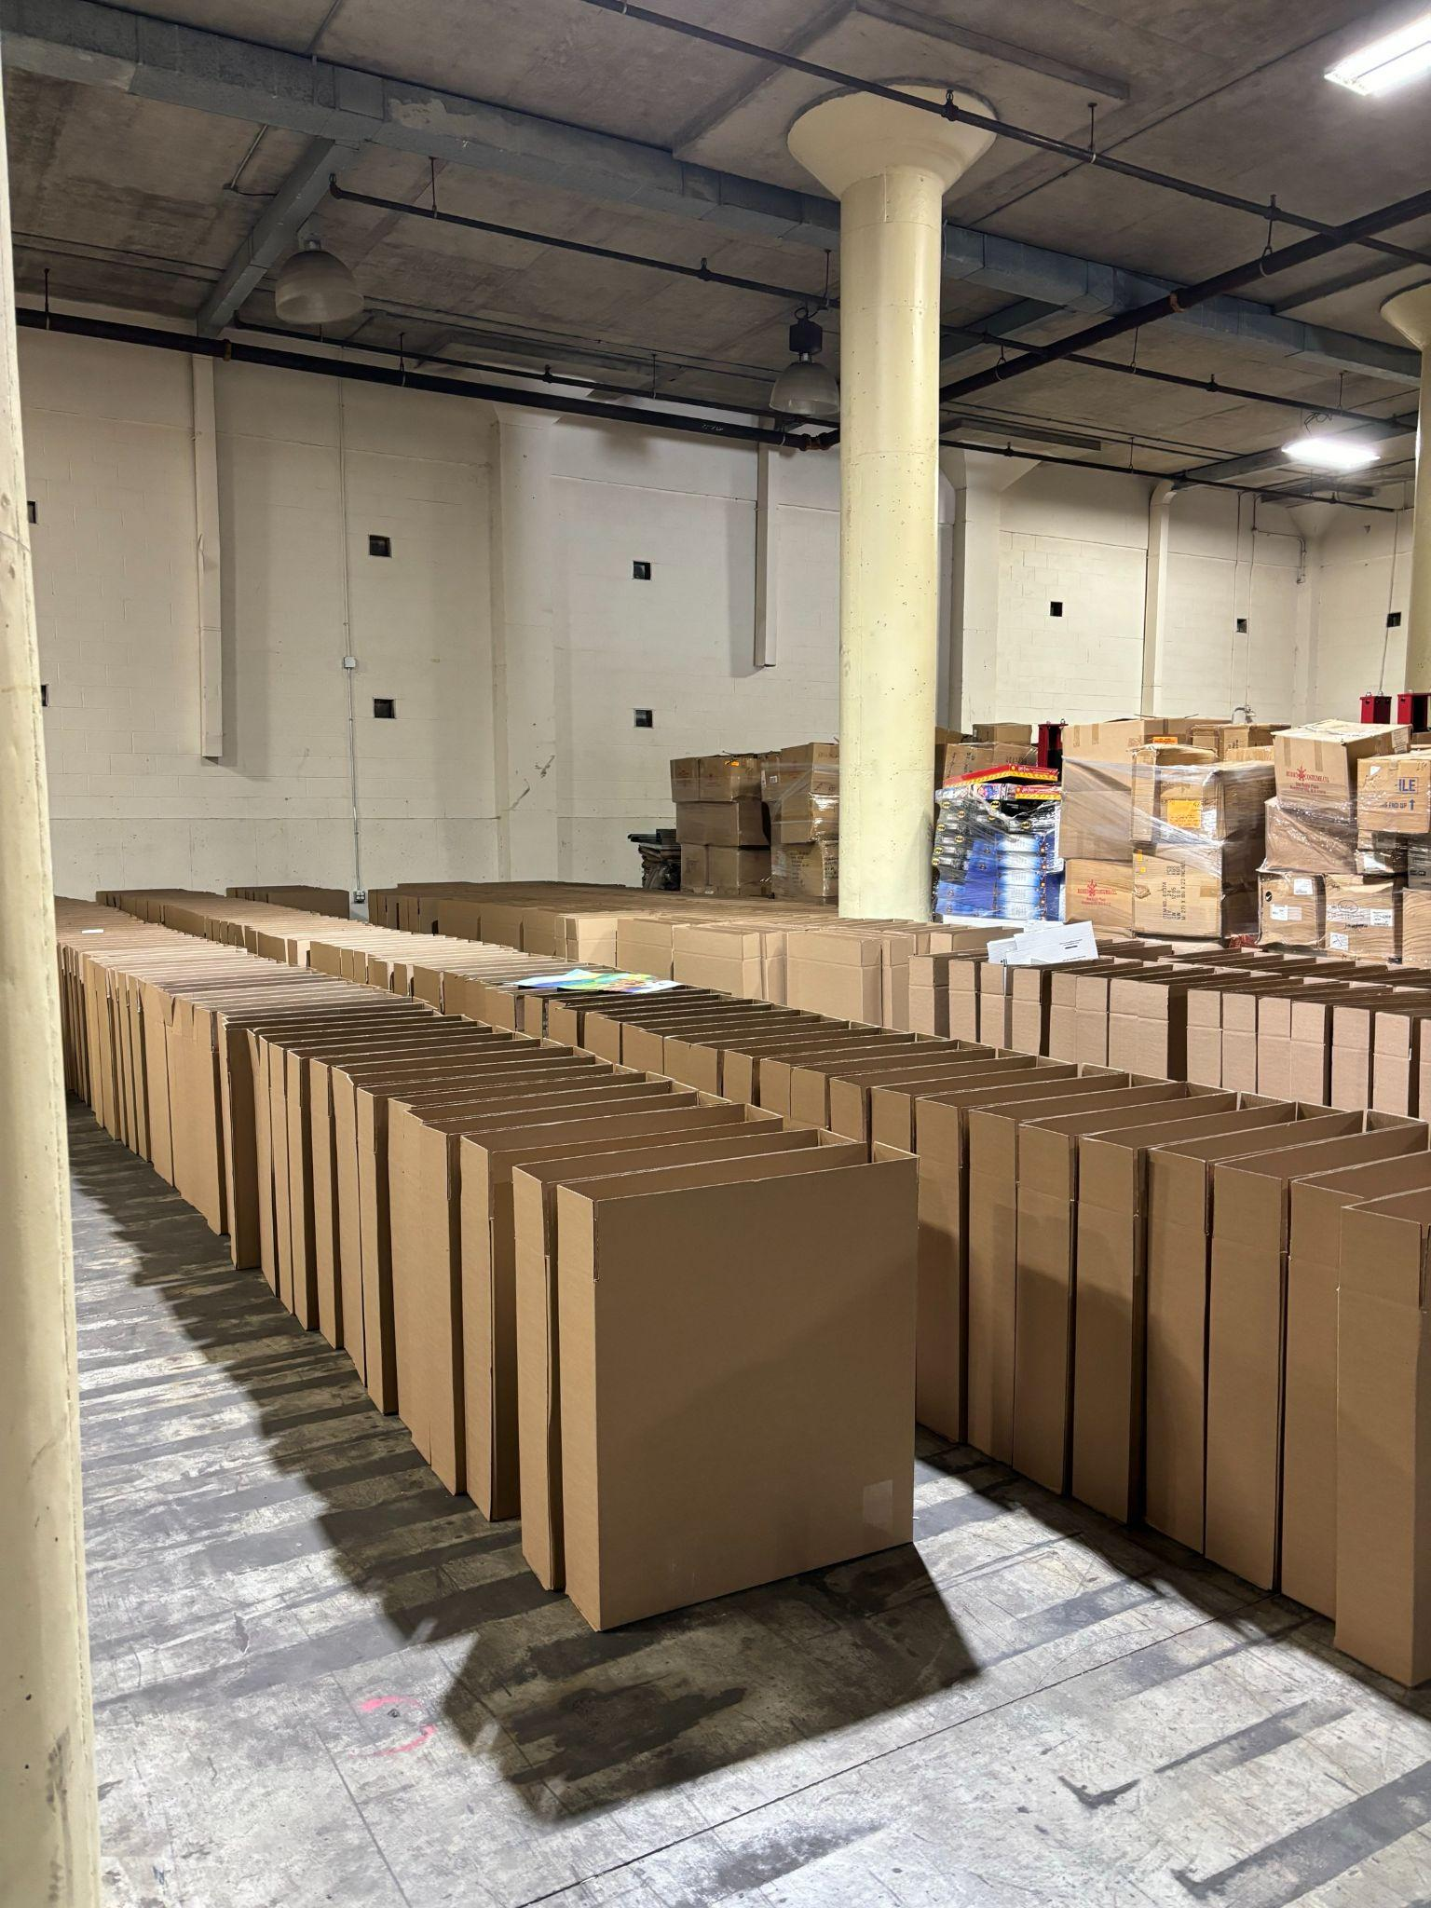
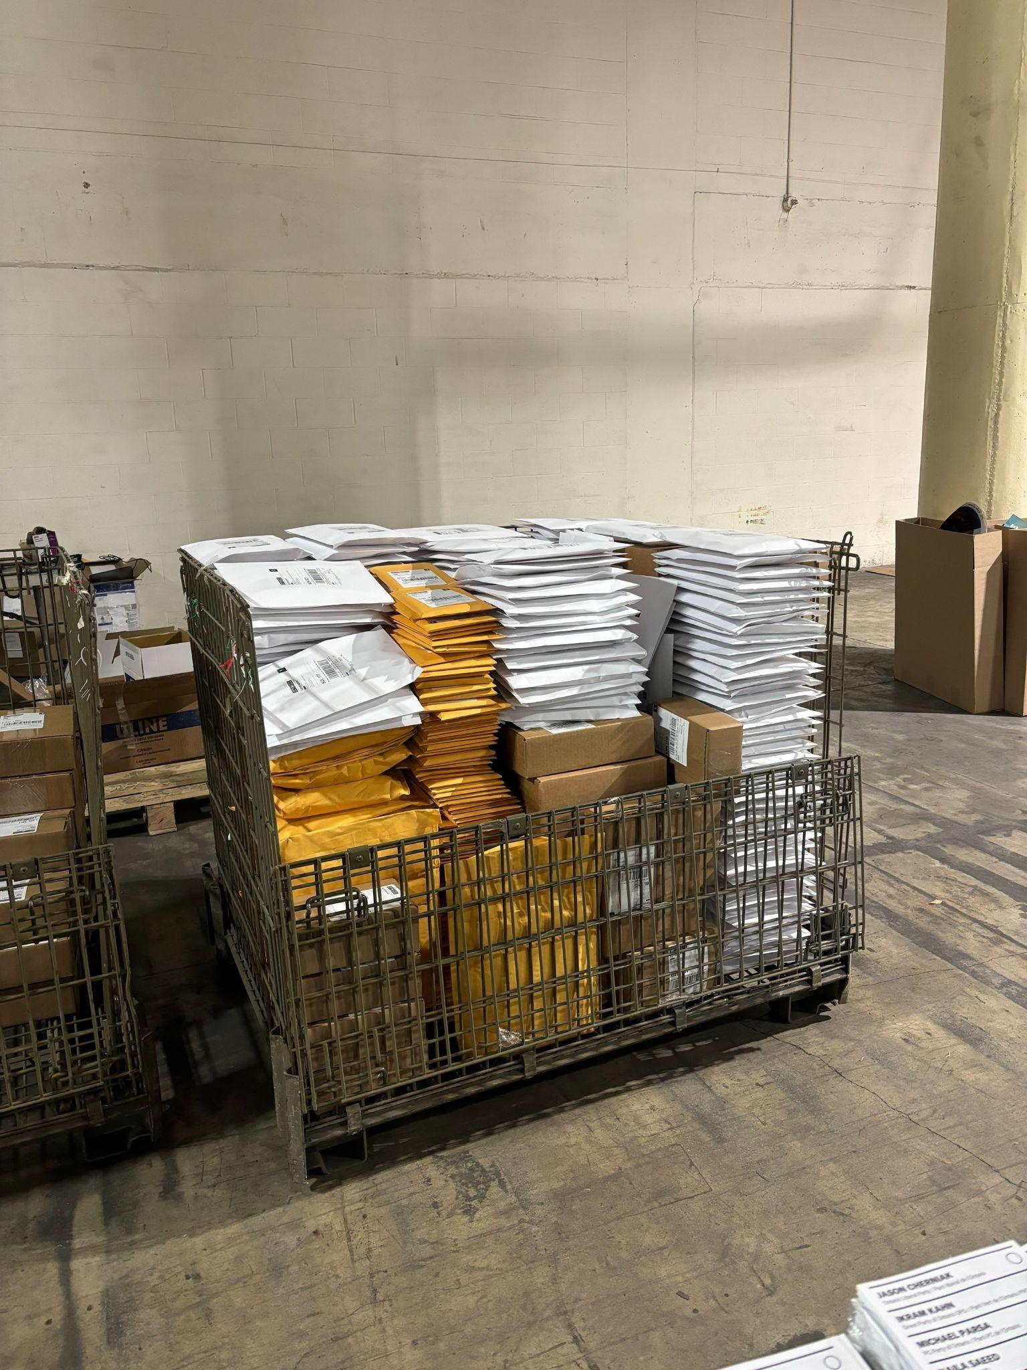
Warehouse Operations
Resource packages
Ballot kits

Slide 19
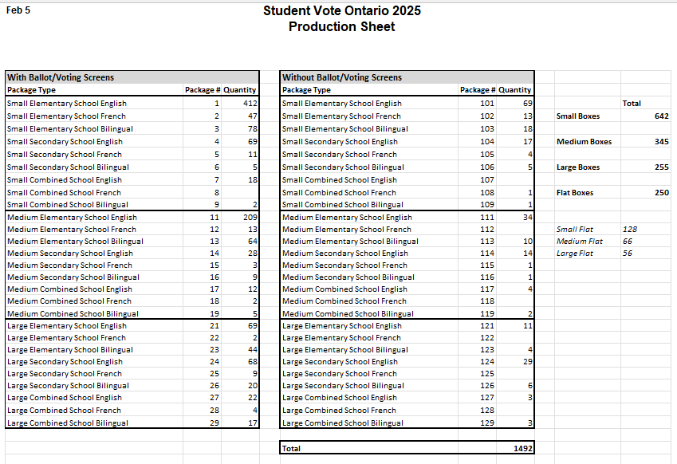
58 Package Types

Slide 20
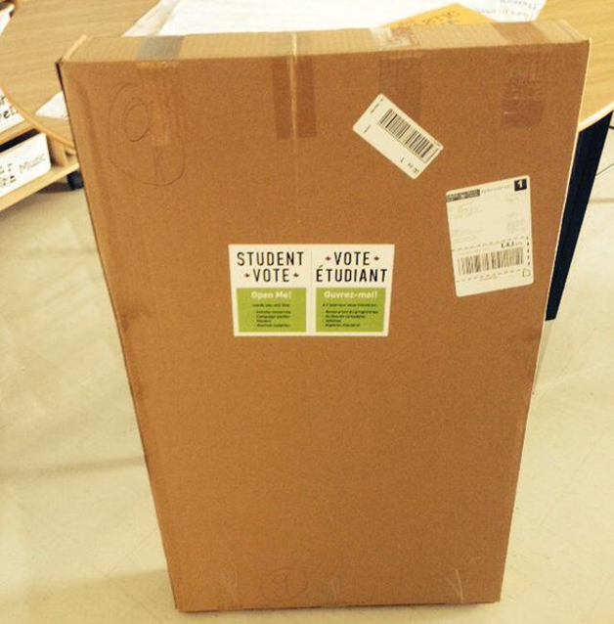
Package readiness
Look for a notification from Canada Post to track your package.
Alert your admin about the expected package.
Open the package and check the contents for accuracy.

Slide 21
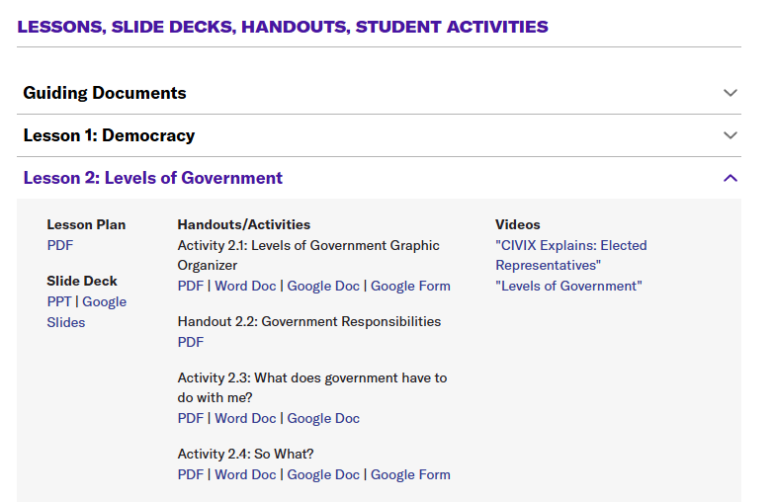
www.studentvote.ca/canada

Slide 22
Learning Resources
Elementary Resource
Grades 4-8
Secondary Resource
Grades 7-12

Slide 23
Secondary Lessons
1: Democracy
2: Levels of Government
3: Political Ideologies
4: Political Persuasion
5: Federal Elections
6: The Leaders’ Debate
7: The Voting Process
8: Post-Election Analysis

Slide 24
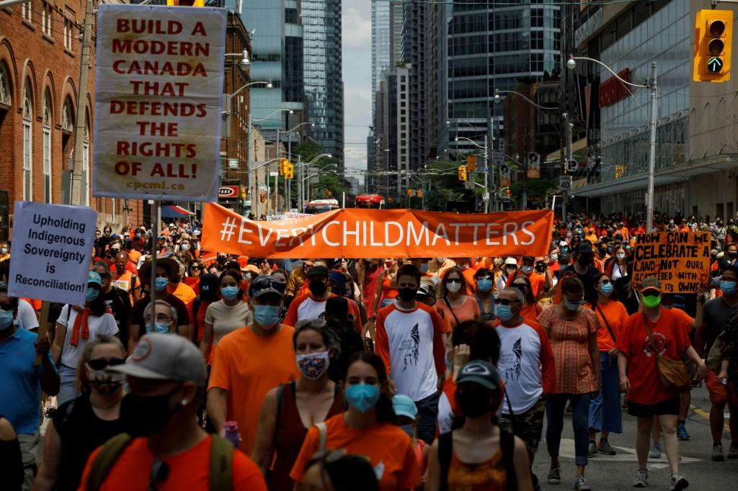
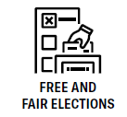
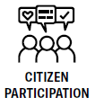
Lesson 1: Democracy
Scenario 1: Fundamental Freedoms
A high school has a policy that allows students to wear shirts with slogans, as long as they are respectful. A student wears a shirt with a political message that some disagree with. Some teachers demand the student be forced to remove it.

Slide 25
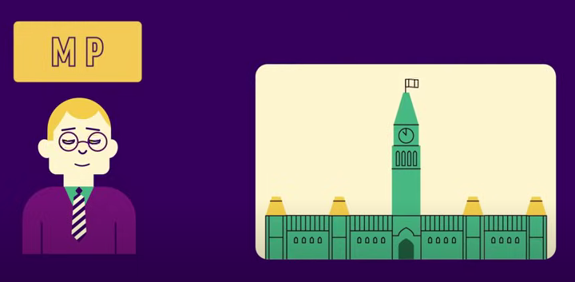
Lesson 2: Levels of Government
How is government structured in Canada?
How does government affect me?
ONLINE SCAVENGER HUNT
1. Representation: How many Members of Parliament are there in Canada?
2. Government Actions: Choose one department/agency. Write down two recent actions or announcements it has made.
3. Laws: Find a bill from the 44th Parliament that interests you. Summarize what the bill is and its current status.
4. Government Support: Find and describe one benefits program available to Canadians.
“Levels of Government” video

Slide 26
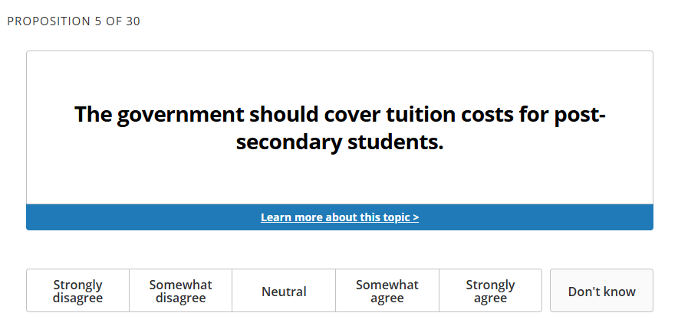
Lesson 3: Political Ideologies
How do personal beliefs and values influence political perspectives and opinions on issues?

Slide 27
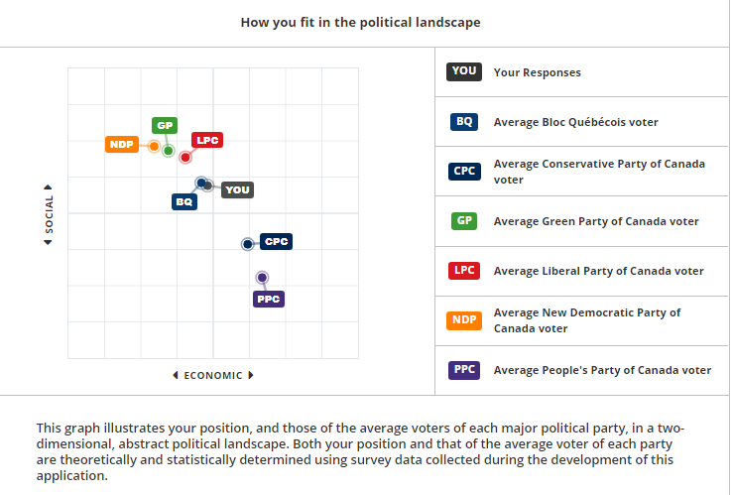
Vote Compass: Youth Edition

Slide 28
Lesson 4: Political Persuasion
What are some common techniques used in political advertising to try to persuade voters?
Persuasive techniques
Using slogans or catchphrases
Inciting fear
Instilling a sense of hope
‘Us vs. Them’ framing
Presenting ideas as obvious/beyond debate
Appeals to nostalgia

Slide 29
Historical Example

Slide 30
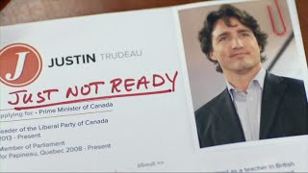
Historical Example

Slide 31
Lesson 5: Federal Elections
How are candidates elected to the House of Commons?
Which party or candidate will best address my priorities and concerns?
RANK ORDER
Cost of living and affordability
Healthcare funding
Economic recovery and job creation
Housing crisis
Climate change and energy policy
National debt and government spending
Immigration
Public safety and crime prevention
Foreign relations and trade
Indigenous reconciliation
Digital regulation and online safety
Democratic institutions
“Federal Elections” video

Slide 32
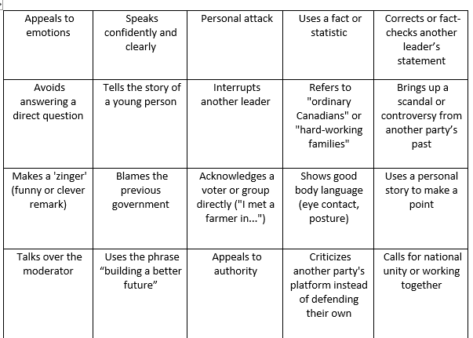
Lesson 6: The Leaders’ Debate
What makes a leader’s argument effective and persuasive during a debate?
Leaders’ Debate “Bingo”
“Logical Fallacies” video

Slide 33
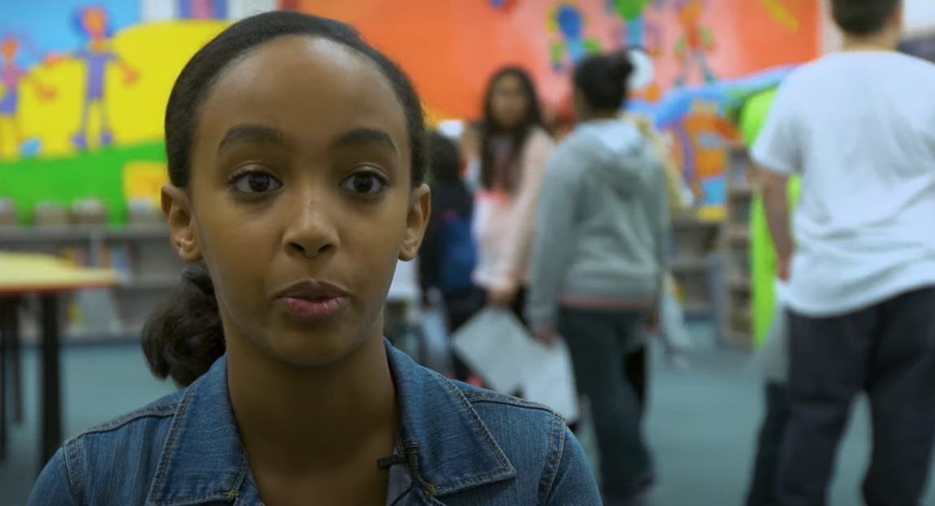
Lesson 7: The Voting Process
When, where and how do people vote in federal elections?
How do safeguards protect the integrity and security of federal elections?

Slide 34
Election Escape Room
CHALLENGE 1: VOTING SAFEGUARDS
Some people claim that anyone can vote, even if they’re not eligible. What safeguards are in place to prevent this?
CHALLENGE 2: SECURING THE VOTE
Some say people can vote twice or someone else can vote in their name. How is our voting process secure?
CHALLENGE 3: ELECTION MISINFORMATION
False information is spreading about election security. Can you identify the misinformation?
CHALLENGE 4: COUNTING THE VOTES
Some believe ballots can be tampered with. How can you prove Canada’s ballot counting process is secure?

Slide 35
Party leader Q & A Videos

Slide 36
Pollenize
10-12 topics / Party platform summaries

Slide 37
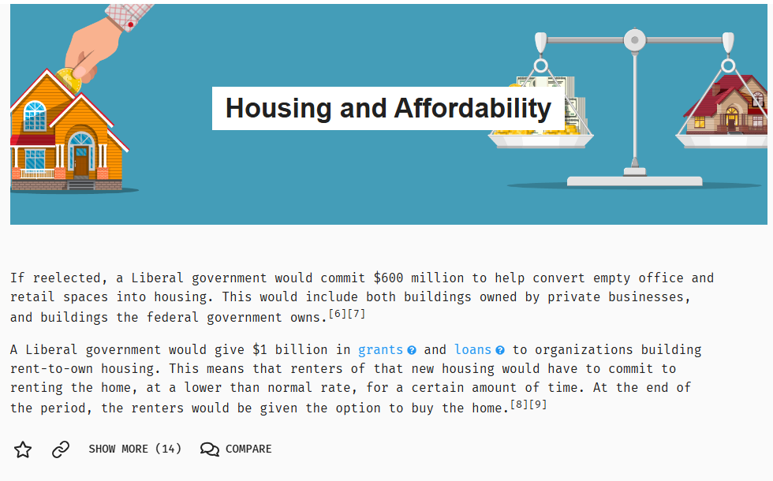
Pollenize

Slide 38
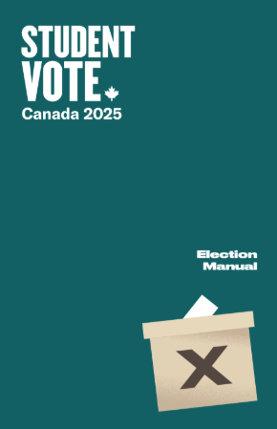
Other Tools

Slide 39
Election Manual: Voting Methods
VOTE BY CLASSROOM - Classes arrange to vote at the voting location at pre-set times throughout the day.
HOMEROOM VOTING - Ballots distributed to each participating class and students vote in their home classroom.
MOBILE VOTING STATION - Designated election officials take mobile voting booths from classroom to classroom.

Slide 40
Do not edit
How to change the design
How do you organize your vote?
Presenting with animations, GIFs or speaker notes? Enable our Chrome extension

Slide 41
Student Vote Results
Please keep your results confidential until the after the polls close
Share any news coverage
Look at the breakdown on the Student Vote election results and analyze the results
How did schools vote in your constituency?
How does Student Vote compare to the general election results?

Slide 42
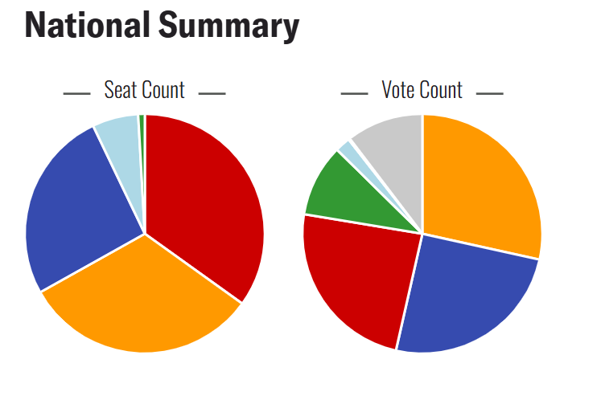
Student Vote Results

Slide 43
Results: Federal 2021
PARTY | Student Vote |  | General Election
 | Seats | Vote % | Seats | Vote %
 | 118 | 24.1% | 160 | 32.6%
 | 88 | 25.1% | 119 | 33.7%
 | 21 | 2.1% | 32 | 7.6%
 | 108 | 28.5% | 25 | 17.8%
 | 3 | 9.8% | 2 | 2.3%

Slide 44
Table Talk and Challenge
Those who are new (or feel new) to Student Vote: Share your questions/concerns with the group.
Those who are experienced Student Vote teachers: Share one tip for running a successful Student Vote or a piece of advice you wish you knew the first (or second) time delivered the program.
Share your best three tips with us. Email to dan@civix.ca

Slide 45
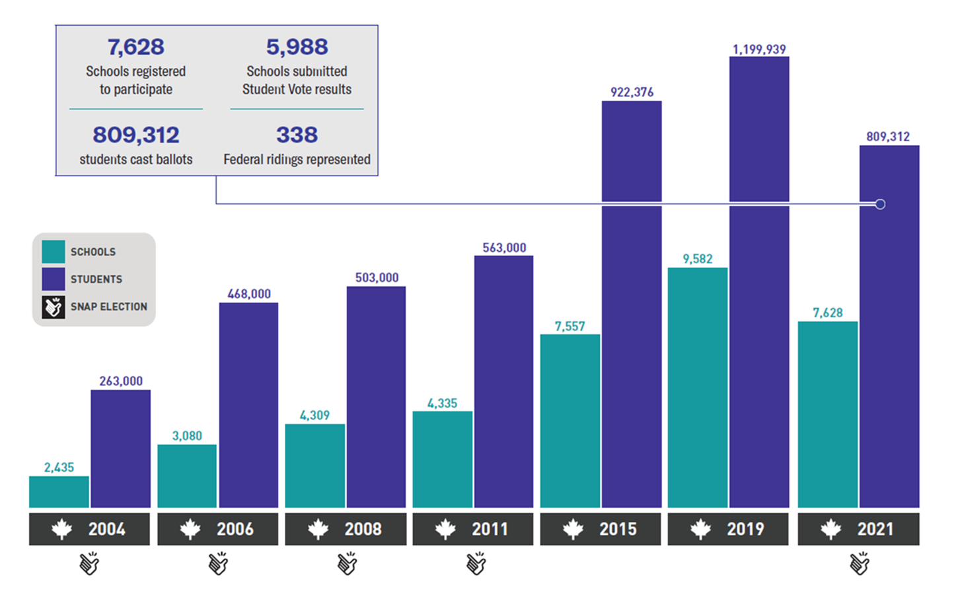
Federal election participation

Slide 46
How do you engage your entire school in the program?

Slide 47
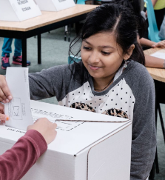
Best Practices for Student Vote

Slide 48
Best Practices
#1 – Use CIVIX explainer videos to teach the basics

Slide 49
Best Practices
#2 – Emphasize the impact of government

Slide 50
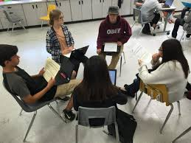
Best Practices
#3 – Build a discussion-friendly classroom

Slide 51
Best Practices
#4 – Incorporate traditional news coverage

Slide 52
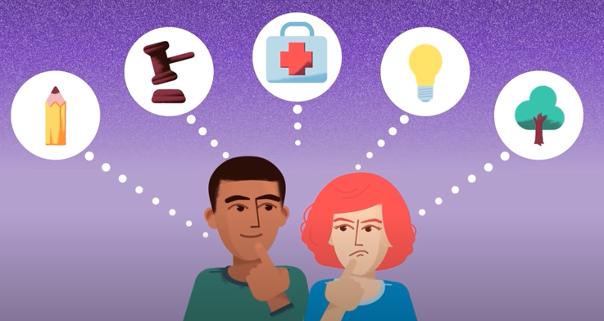
Best Practices
#5 – Explore issues that matter to your students

Slide 53
Best Practices
#6 – Engage with the candidates
Candidates forum
One-on-one visits
“Political party” lunch
Email them student questions
Engage with them through social media

Slide 54
Best Practices
#7 – Involve your colleagues
Announce the program early on
Send links to relevant lessons or videos
Suggest subject-related activities (i.e. “Get out the Vote Posters”)

Slide 55
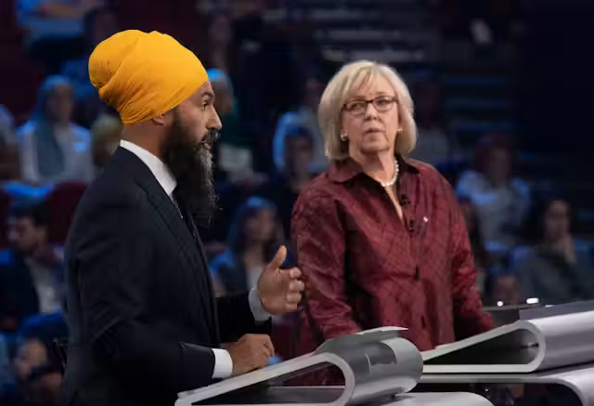
Best Practices
#8 – Encourage family engagement

Slide 56
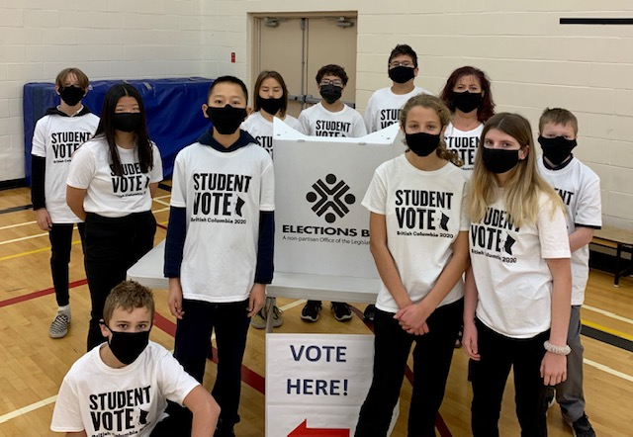
Best Practices
#9 – Empower students with responsibilities
Communications Team
Education Team
Events Team
Student Vote Day Team
Media and Community Relations

Slide 57
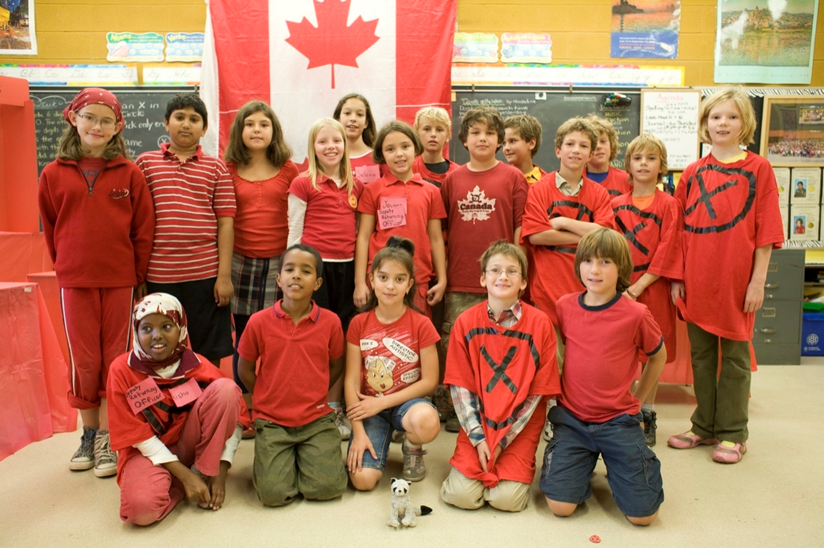
Best Practices
#10 – Make Student Vote Day a celebration

