Slide 1
Democracy Bootcamp
Tipping Point: an experiential civic deliberation game

Slide 2
Overview
Tipping Point is an activity that engages students in a simulated community planning process to build their decision-making and problem solving skills.
Working in committees, students assume stakeholder roles and practice cooperation and consensus building in order to create a balanced proposal that meets diverse interests.
Instructions and full lesson plan available at politalks.ca/tippingpoint
Tipping Point is a game originally designed by Dr. Paula Waatainen and Dr. Kirstin Funke-Robinson. It has been adapted with permission by CIVIX

Slide 3
How should we live together as a society?

Slide 4
How should we live together as a society [given finite resources]?

Slide 5
Premise
There’s a new development being built in your community, and four stakeholder groups have been selected by the municipal council for a consultation. As a member of one of these groups, you want to ensure that your group’s priorities are considered.
Business Improvement Association
For United Neighbours
All For One
Citizens for a Greener Community
You are also a citizen who wants the development to benefit the community as a whole

Slide 6
Objective
You will form committees made up of representatives from the four stakeholder groups to consult on the new development.
You will be presented options for what to include in the development. Your committee will be tasked with reaching a consensus about which features to include in the final proposal.
You will need to consider the priorities of all stakeholders and the needs of the community as a whole.

Slide 7
Two ways to win
“Stakeholder Interests” Victory: At the conclusion of the game, each stakeholder in every committee will receive a score. These scores will then be tallied across all groups. The stakeholder group with the most points wins the Stakeholders Interests victory.
“Common Good” Victory: At the conclusion of the game, each committee will calculate the difference between the highest and lowest stakeholder scores. The committee with the lowest number wins a Common Good victory, meaning they have done the best job balancing the interests of all stakeholders.

Slide 8
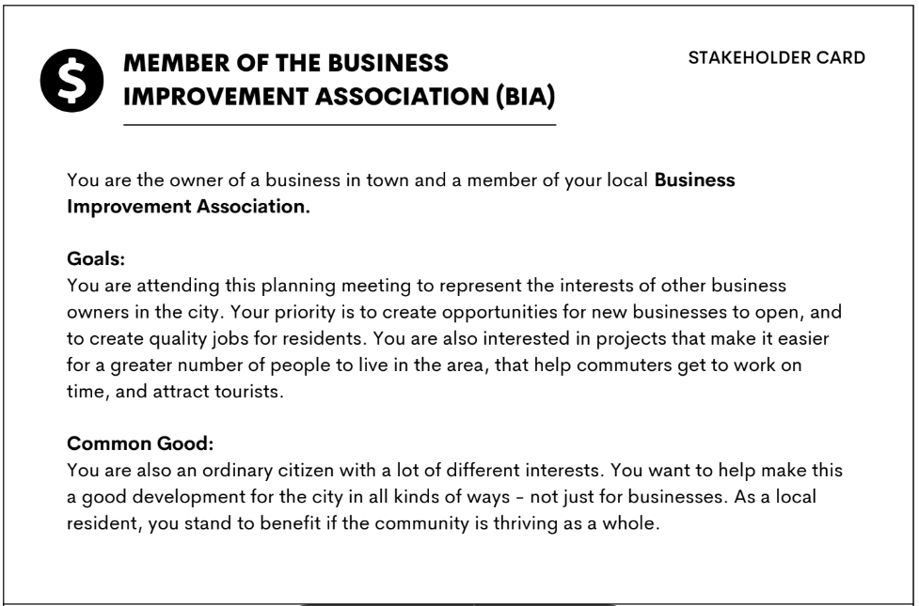
Setting up
Form committees: Get into groups of 4. Each group is a committee.
Collect your materials at the back of the room
Assign roles: There are four Stakeholder cards. Give each member of the committee a different card. This card explains the role you will play during the game.

Slide 9
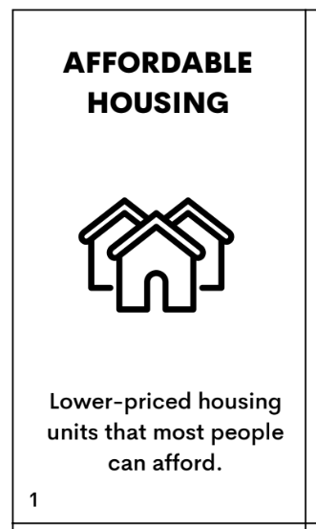
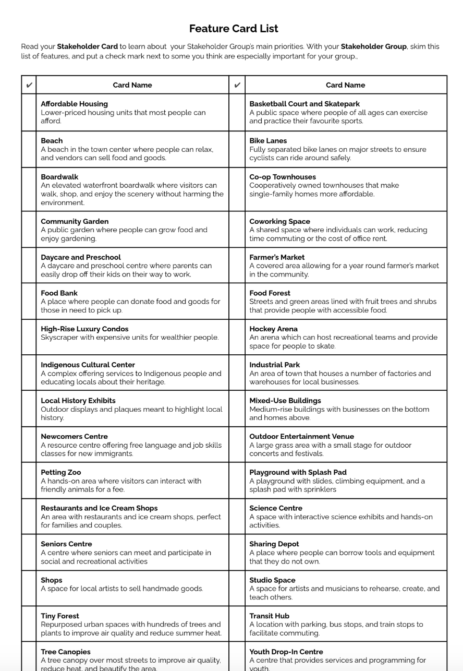
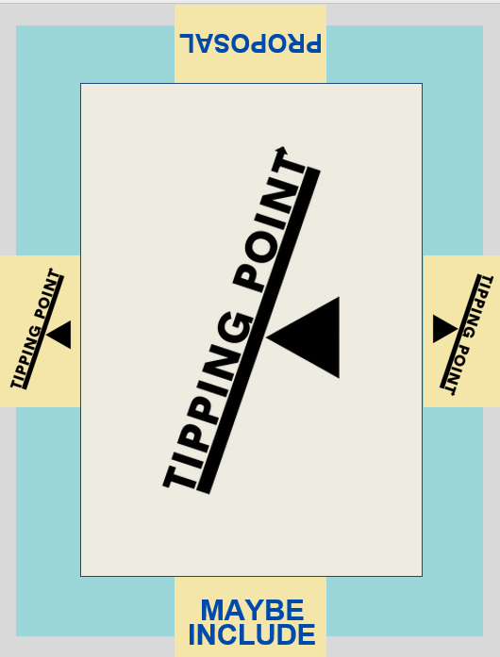
Game Materials
Feature Cards
List of Features
Stakeholder Cards
Game Board

Slide 10
Part I: Review Your Role & Priorities
Review your Stakeholder card and the motivations, goals and priorities of your stakeholder group.
Skim the options on the Features sheet (please share with the person next to you). Identify some you think are important for your stakeholder group and ones you think are less important [3 mins]
Your goal is to clarify your stakeholder priorities and come up with a general gameplan. You do not need to memorize any items.

Slide 11
Part 2: Priority Setting
Distribute Feature Cards: Shuffle and distribute Feature Cards evenly among Stakeholders. Each stakeholder should receive eight cards.
Private Sorting (1 min): Independently sort your eight cards into two piles based on your stakeholder priorities:
Yes: You think it must be included in the Proposal
No: You think it should not be included in the Proposal

Slide 12
Part 2: Priority Setting
Review the ‘No’ cards with your committee (5 mins): Take turns sharing your ‘No’ cards with the other members of your committee.
If another Stakeholder thinks a card is important, they take it and add it to their ‘Yes’ pile.
Cards that everyone unanimously agrees to be unimportant are discarded and set aside for the rest of the game.

Slide 13
Part 3: Deliberations
Share your ‘Yes’ cards (7 mins) : Take turns presenting the cards from your ‘Yes’ pile and making a brief case for why it’s important
If all committee members agree that a card is important, place it in the ‘Proposal’ space on the board. Otherwise, put it in the ‘Maybe include’ space.
Review the proposal: Once all committee members have shared their “Yes” cards, count the number of cards in the “Proposal” container.

Slide 14
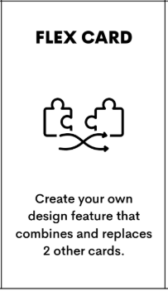
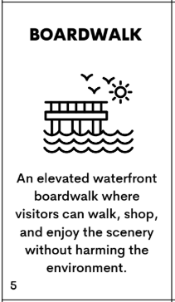
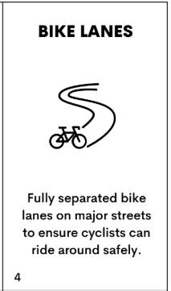
Part 3: Deliberations
Creating the final proposal (5 mins): Your proposal must include exactly 16 cards.
If there are fewer than 16 cards, deliberate with your committee and decide which cards from the ‘Maybe include’ pile to include.
If there are more than 16 cards, deliberate with your committee and decide which cards to remove.
Flex Cards
Your committee can use Flex Cards to creatively combine ideas from two different cards. Cards combined with a Flex Card count as a single card .
Ex: A Boardwalk card and a Bike Lane card can be merged into a boardwalk with a bike lane, earning points for both cards during scoring.
**YOUR IDEA MUST MAKE SENSE**
REMINDER:
Your Committee can use Flex Cards to creatively combine ideas from two different cards. Cards combined with a Flex Card count as a single card .
Ex: A Boardwalk card and a Bike Lane card can be merged into a boardwalk with a bike lane, earning points for both cards during scoring.

Slide 15
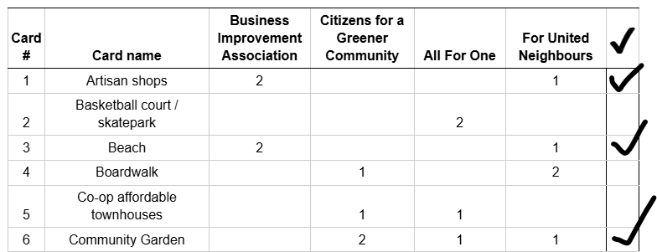
Part 4: Scoring
Tally your points (4 mins): Using the score sheet, calculate each stakeholder’s points and them on the sheet.
Remember that cards combined using a Flex Card score points for both cards.
BIA | CGC | AFO | FUN
2 2 | 2 | 1 | 1 1 1
Total: 4 | Total: 2 | Total: 1 | Total: 3

Slide 16
Part 4: Scoring
Calculate your Common Good Score: In the space provided, subtract the lowest and highest stakeholder scores. The result is your committee’s “common good” score
BIA | CGC | AFO | FUN
2 2 | 2 | 1 | 1 1 1
Total: 4 | Total: 2 | Total: 1 | Total: 3
4
1
3

Slide 17
Debrief: Example Questions
Did you have to decide between what would be best for your stakeholder group and what would be best for the common good? How did you decide what to do?
Do you think consensus is necessary for an idea to be in the interest of the common good?
Review the proposal that obtained the “common good” victory. Do you think this proposal best reflects the common good? Why or why not?

Slide 18
Lesson Plan (starter activities, assessments), Printouts, Instructions:
politalks.ca/tippingpoint

Slide 19
Class set of cards available at the back of the room

