Slide 1
Democracy Bootcamp
Understanding Values and Biases in Political Discussions
9:40 - 10:10

Slide 2
Introducing PoliTalks
PoliTalks supports educators in building discussion-friendly classrooms.
It provides resources and activities designed to build the knowledge, attitudes, and skills students need to engage in constructive discussion.
...

Slide 3
Elementary
Secondary
...
...
Primaire
Secondaire

Slide 4
Do not edit
How to change the design
What are some issues your students are talking about?
Presenting with animations, GIFs or speaker notes? Enable our Chrome extension

Slide 5
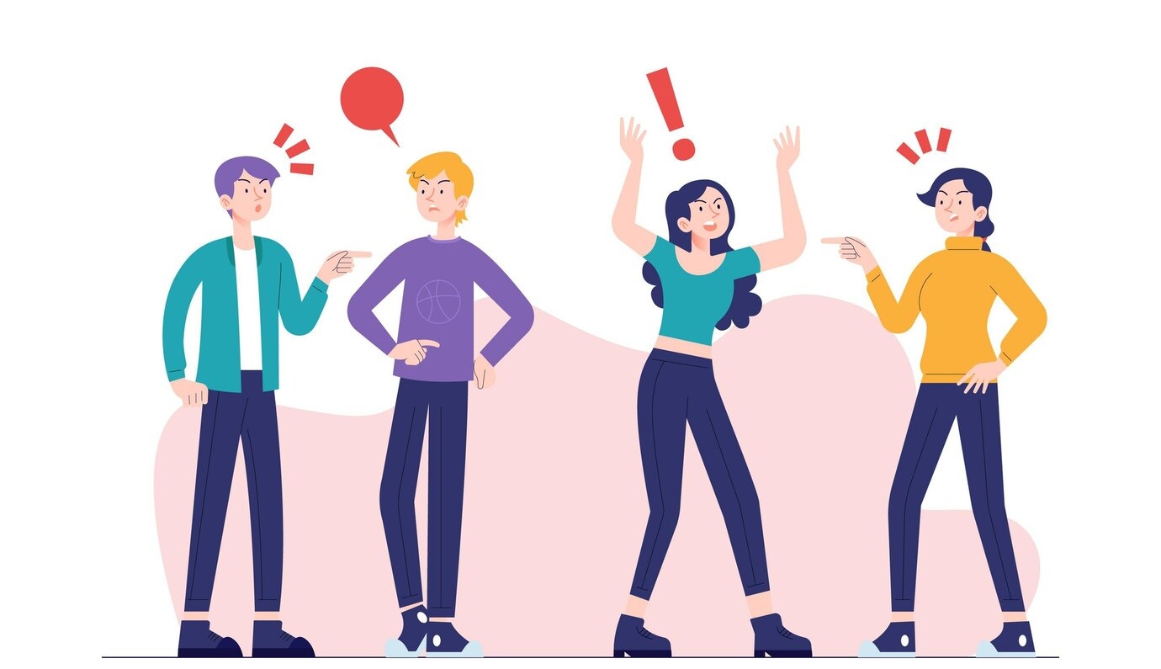
Why is it hard to talk about politics?
We often approach others with anger, frustration, and distrust instead of curiosity
There are lots of factors out in the world that make it hard to talk about politics constructively
Part of the problem has to do with how we process information and interact with others

Slide 6
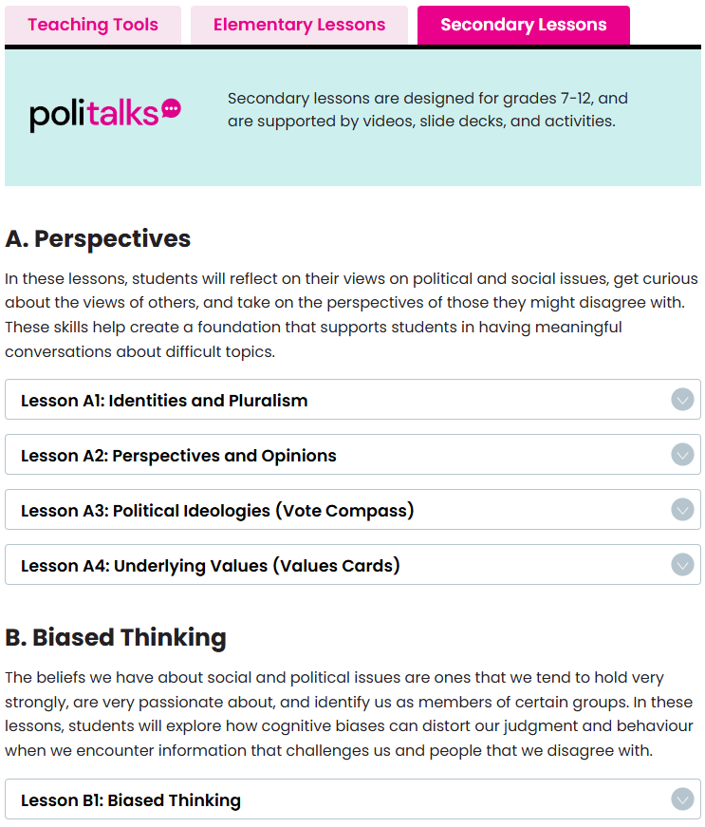
Lessons Overview
A. Perspectives
B. Biased Thinking
C. Constructive Discussions

Slide 7
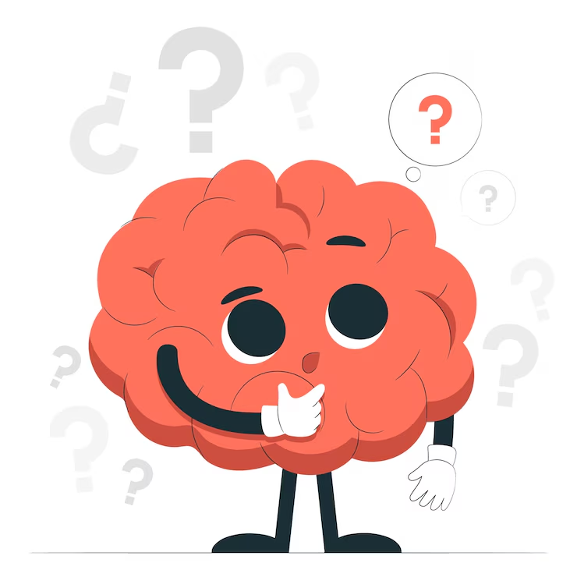
Cognitive Biases
...
Errors in reasoning that result from:
Our brains having to process a lot of information quickly
Our brains trying to protect us from perceived harms

Slide 8
There are lots of cognitive biases!
“It’s been so cold lately! So much for so-called ‘global warming,’ eh?”
Recency bias
“Sarah wears ripped jeans, has piercings and tattoos. She must like punk music.”
Representativeness bias
“My horoscope is super accurate, I’m such a Scorpio!”
Confirmation bias

Slide 9
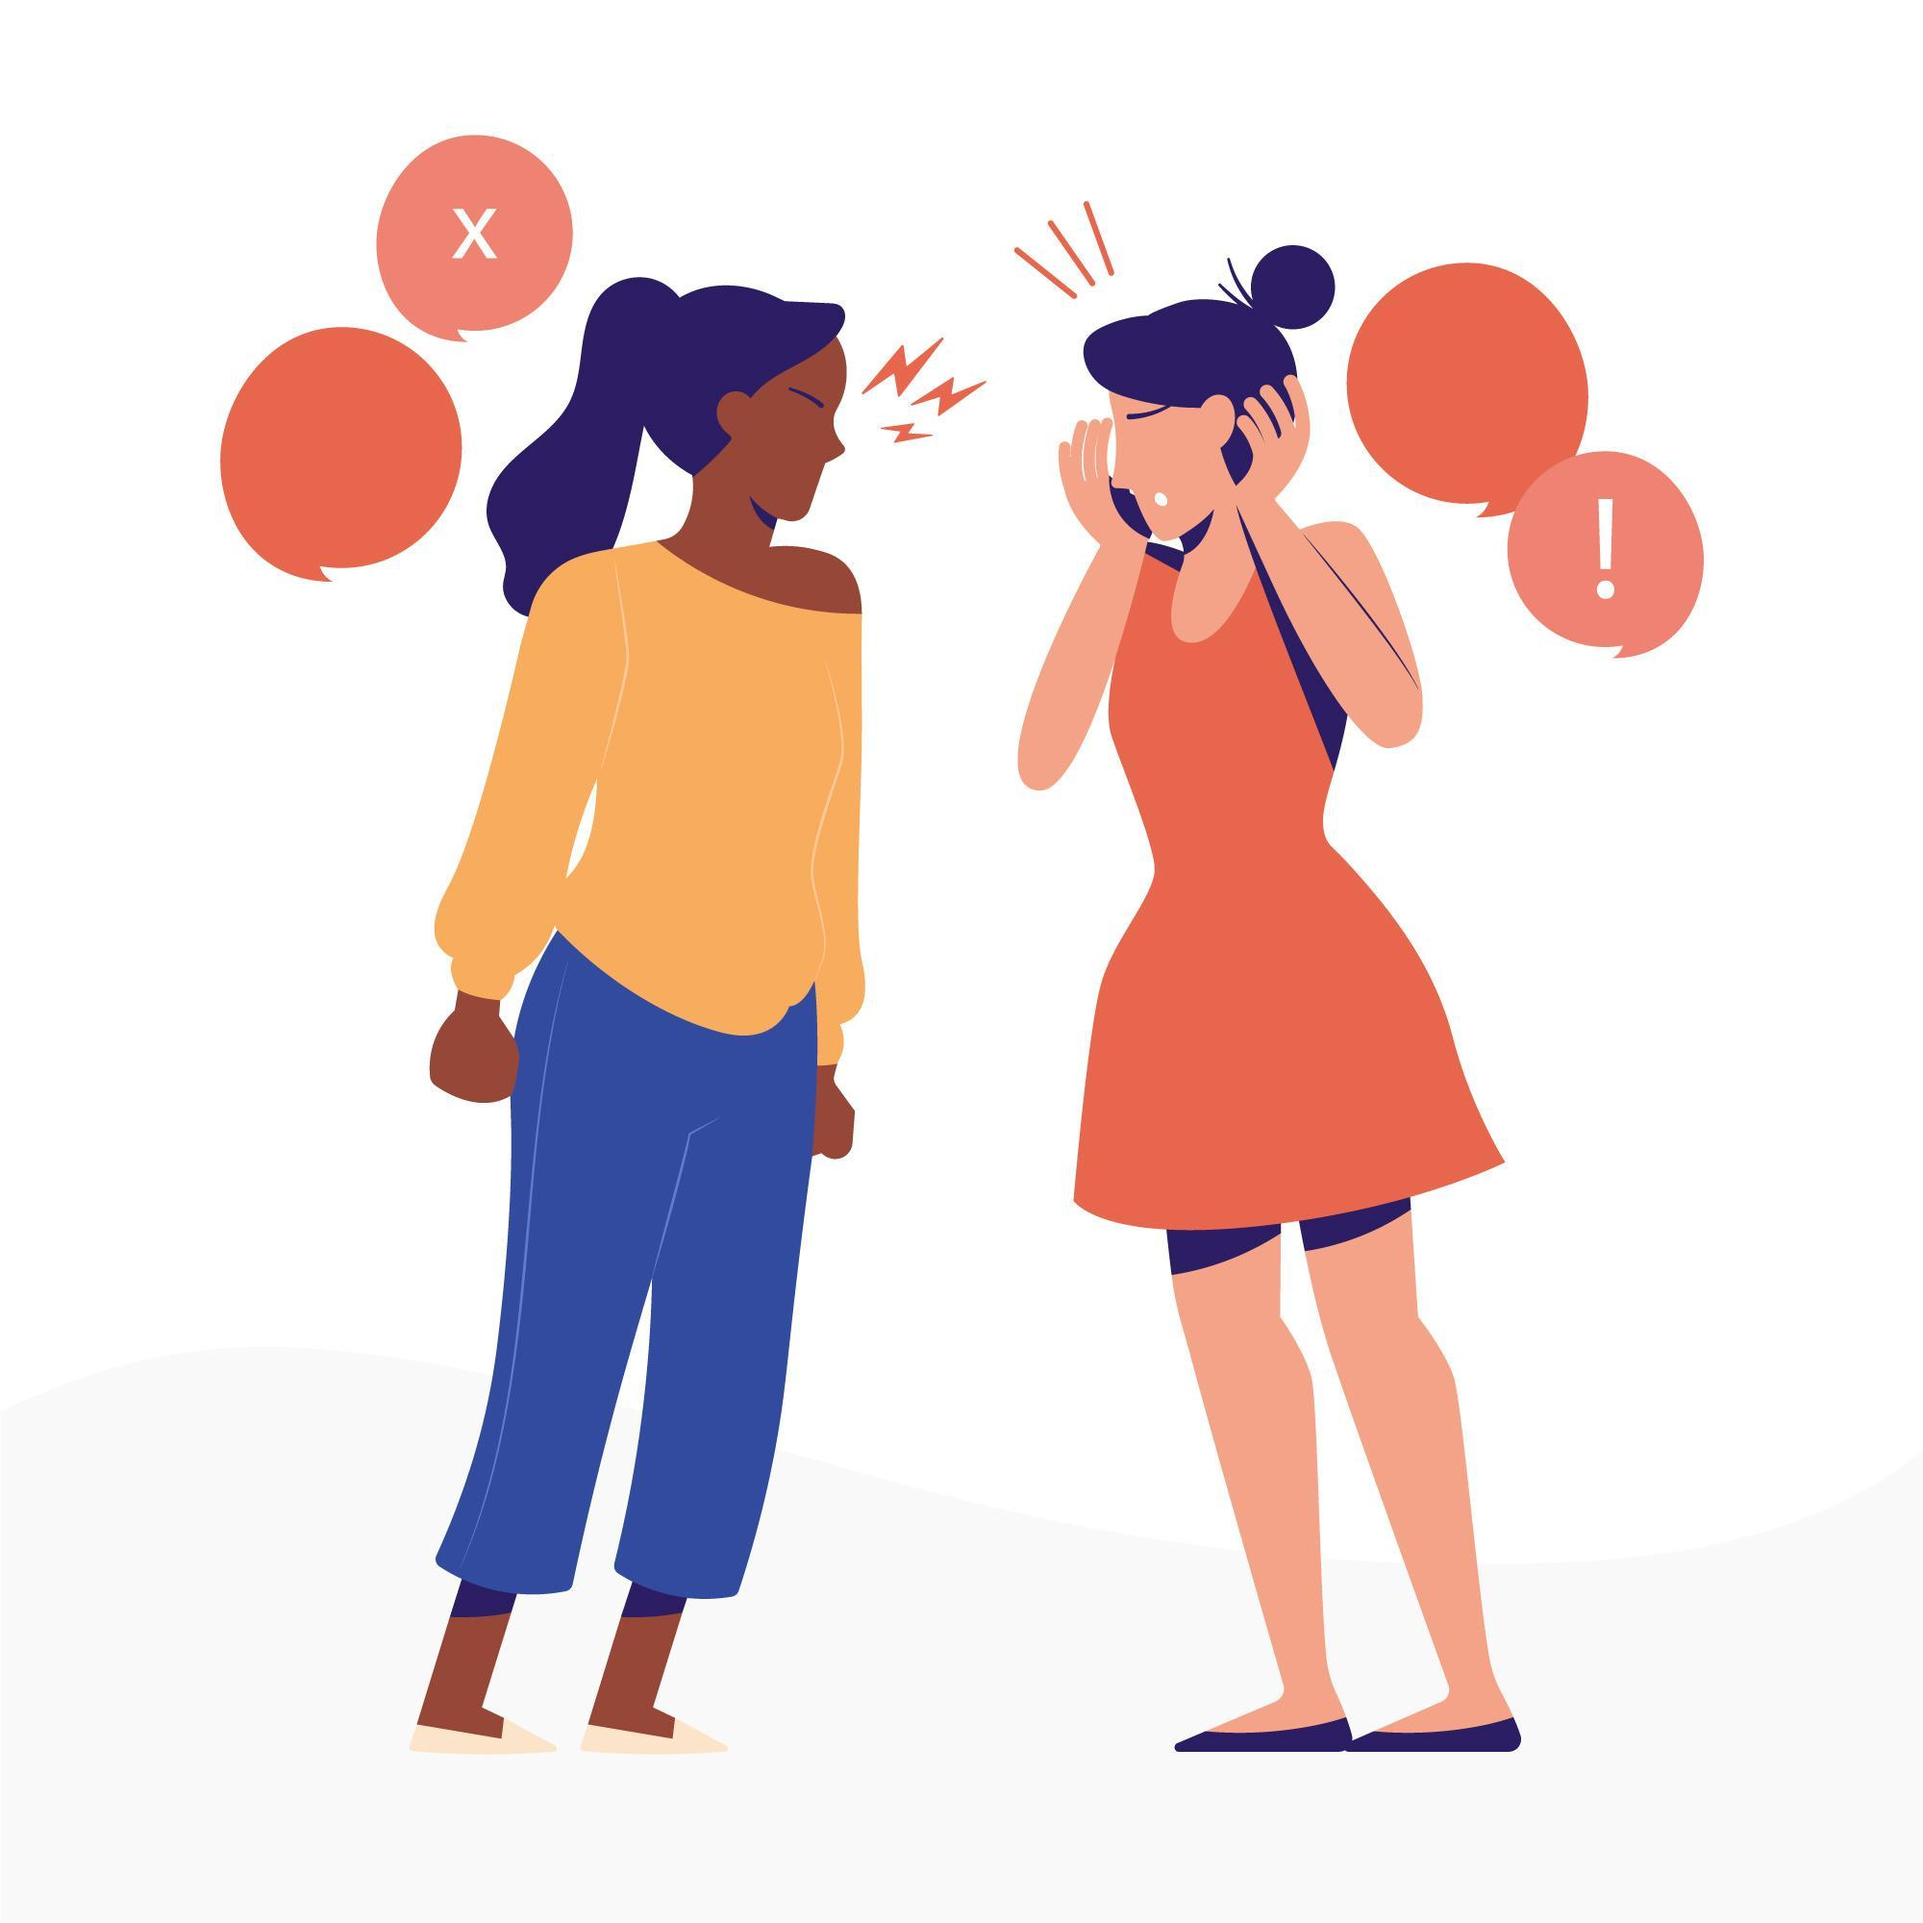
Cognitive Biases and Difficult Discussions
Discussions about political and social issues are difficult because they are important to us
An abundance of information makes it difficult to pay attention to everything, so we pick and choose
Challenges to our beliefs can feel like personal attacks

Slide 10
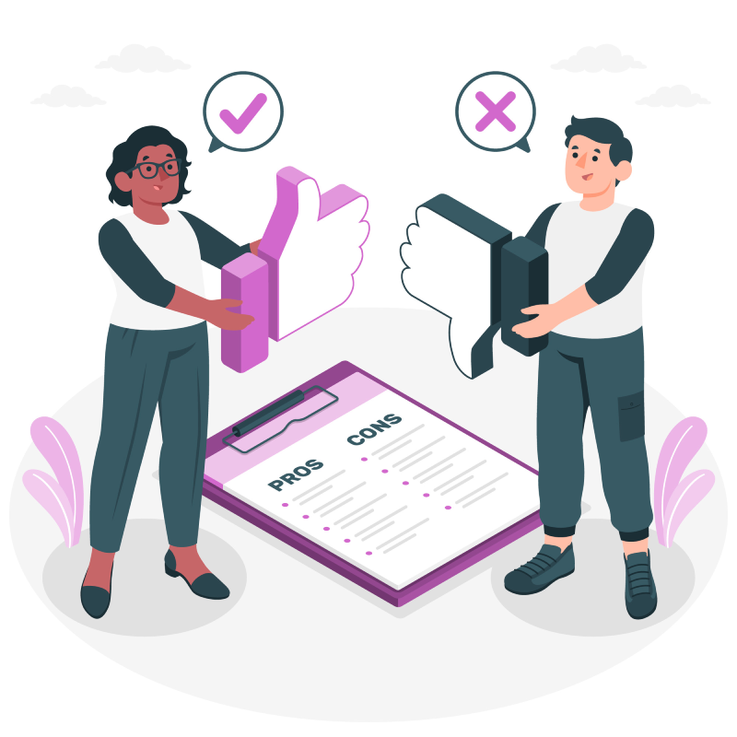
B. Biased Thinking
Biased Thinking
Confirmation Bias
In-Group Bias

Slide 11
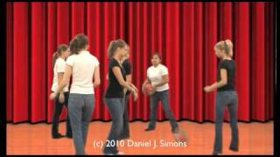

Slide 12
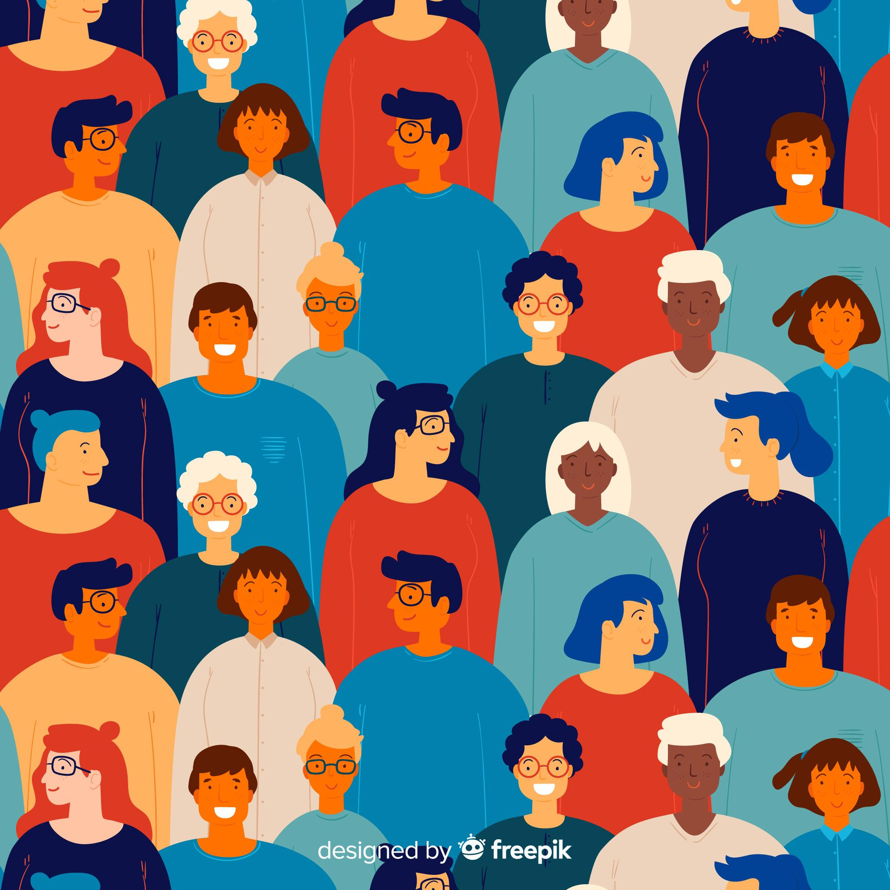
Bias Blind Spot
Everyone is biased but me!

Slide 13
Confirmation Bias
Our tendency to:
Seek out and interpret information in ways that confirm what we already believe, and
Ignore information that challenges our beliefs

Slide 15
Difficult discussions
I’m right
Important discussions are more difficult if we have different information
We are more likely to seek out those we already agree with, and avoid those who disagree with us
Political messaging is typically one-sided

Slide 16
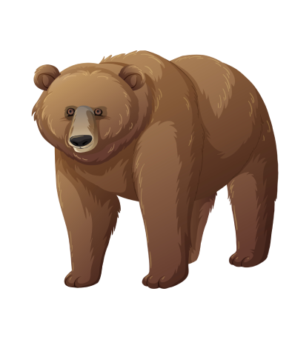

Slide 17
Do not edit
How to change the design
Are you a shark or a bear?
Presenting with animations, GIFs or speaker notes? Enable our Chrome extension

Slide 18
Do not edit
How to change the design
If you are a shark 🦈: what is one word you would use to describe your fellow sharks 🦈?If you are a bear 🐻: what is one word you would use to describe your fellow bears 🐻?
Presenting with animations, GIFs or speaker notes? Enable our Chrome extension

Slide 19
Do not edit
How to change the design
If you are a shark 🦈: what is one word you would use to describe bears🐻?If you are a bear 🐻: what is one word you would use to describe sharks 🦈?
Presenting with animations, GIFs or speaker notes? Enable our Chrome extension

Slide 20
In-Group Bias
In-group: a group we are a member of
Out-group: a group we are not a member of
In-Group Bias: Our tendency to treat and evaluate in-group members more positively than out-group members

Slide 21
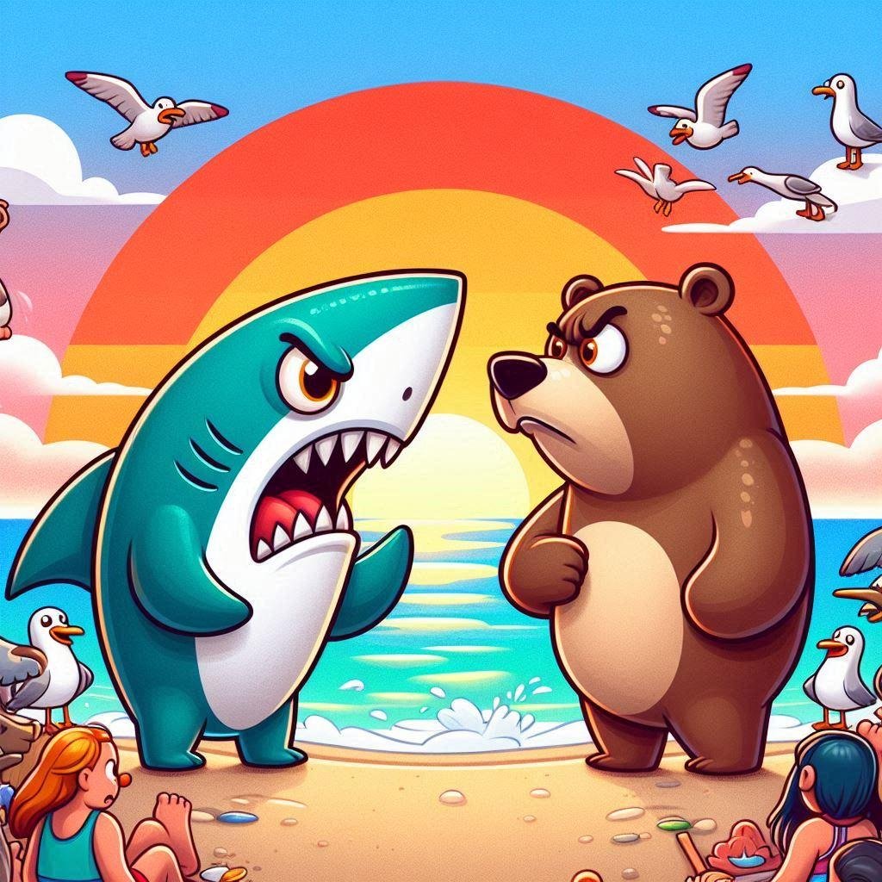
Difficult discussions
When someone disagrees with you, you think of them as being outside your group
You’re going to be less receptive and less kind to them
Politics puts us into groups!
Created using DALL-E 3

Slide 22
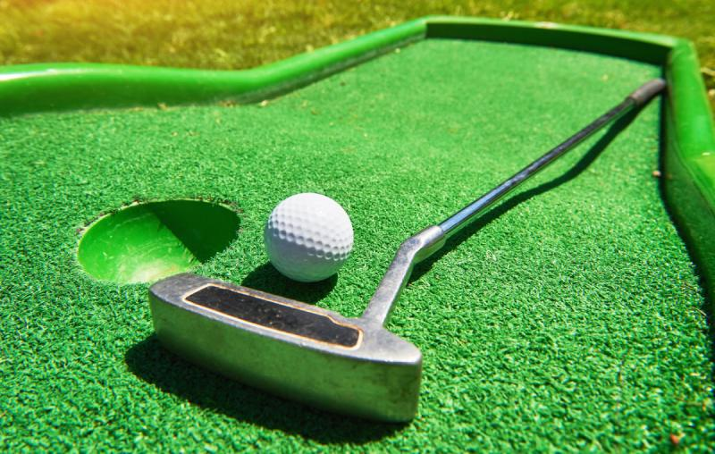
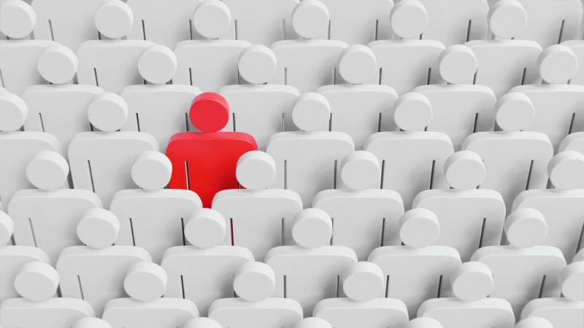
How to fight in-group bias
Think Big
Focus on commonalities, not differences
Focus on the person, not the group

Slide 23
Discussion Guide
Guiding Principles
Creating a Discussion-Friendly Classroom: Norms of Agreement
Preparing for Discussion
Framework for Constructive Disagreement (PLANS)
Troubleshooting
Appendix: Activities and Handouts
Table of Contents image here
Cover image TK

Slide 24
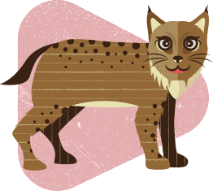
Animal Cards
Ideal for younger students and those new to discussions
Take on different animal personalities to experience how people approach discussions differently
Develop empathy and get students out of their shells

Slide 25
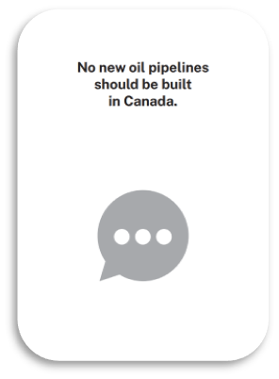
Value Cards
Take on the perspective of someone who prioritizes those values
“How would someone, who thought these values were most important, respond to this prompt?”
Reshuffle and redeal to take on a new perspective

Slide 26
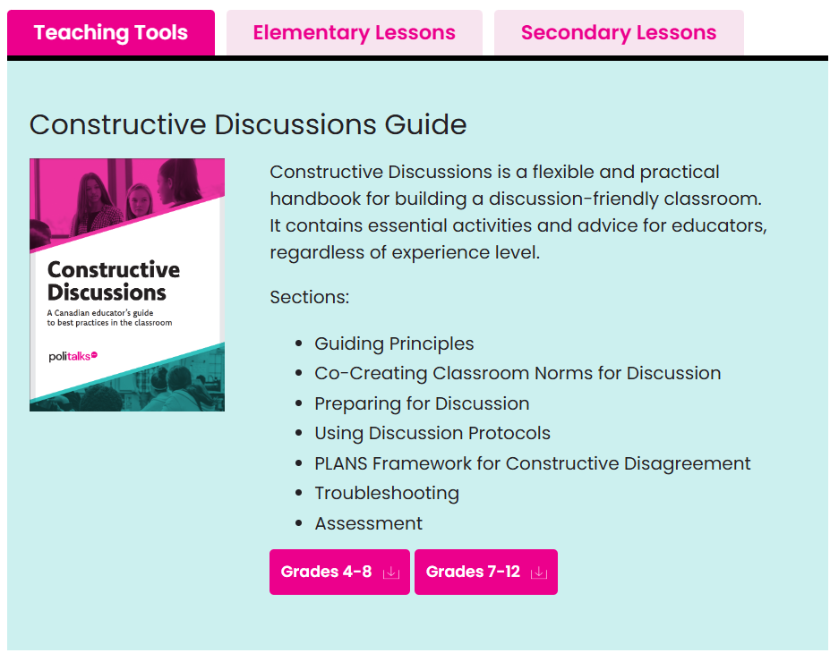
Register at politalks.ca for free English classroom resources
Register at parlonspoli.ca for free French classroom resources

